Slide 1

《外借及使用小型無人機須知》
Notes on Borrowing and
Using a Small Unmanned Aircraft

Slide 2

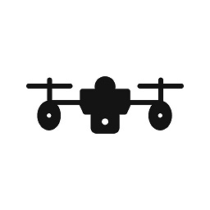
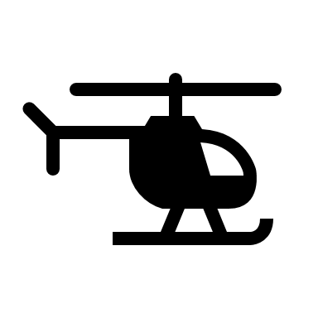
政府制訂的《小型無人機令》（香港法例第448G 章）已於2022年6月1日生效。
任何人如干犯《小型無人機令》所訂的罪行，一經循公訴程序定罪，可處罰款10萬元及監禁兩年
小型無人機令
Small Unmanned Aircraft Order
Small Unmanned Aircraft Order (Laws of Hong Kong Cap. 448G ) commences on 1 June 2022.
If a person commits an offence under the SUA Order, the person is liable on conviction on indictment to a fine of $100,000, and imprisonment for two years.
https://www.cad.gov.hk/english/sua.html
*A six-month grace period will be given法例設立了6個月的寬限期。

Slide 3
小型無人機的分類
Categorisation of SUA
分類Category
甲1類 A1 | 重量不超過250 克 weight not more than 250g
甲2類 A2 | 重量在250 克以上但不超過7 公斤 weight more than 250g but not more than 7kg
乙類 B | 重量在7公斤以上但不超過25 公斤 weight more than 7kg but not more than 25kg

Slide 4

操作規定 Operation Requirements
操作規定 Operation Requirements | 甲一類操作 Cat. A1 (重量 ≤ 250 克 weight ≤ 250g) | 甲二類操作 Cat A2 (250克<重量≤7公斤 250g < weight ≤ 7kg)
操作時間 Time of operations | 只限日間 Daylight hours only #
將無人機保持在視線內 Maintain visual line of sight
在同一時間最多可操作的小型無人機數量 Maximum number of SUA to be operated by a remote pilot at the same time | 1
小型無人機的最大尺寸 Maximum dimensions of SUA | 1米，但旋翼任何兩端之間的最遠距離可達1.2米 1 m, except that the longest distance between any two rotor blade tips can be up to 1.2 m
運載任何人或動物 Carriage of person or animal | 不許可 No
小型無人機掉下任何東西 Dropping from SUA | 不許可 None
#日間時間指日出前半小時至日落後半小時的一段時間 （不包括兩者在內）half an hour before sunrise until half an hour after sunset (both points of time exclusive)

Slide 5
操作規定 Operation Requirements
操作規定 Operation Requirements | 甲一類操作 Cat. A1 | 甲二類操作 Cat. A2
最高飛行高度 （地面以上） Maximum flying altitude Above Ground Level (AGL) | 100呎 ft | 300呎 ft
與沒有參與該次飛行的人或和不受遙控駕駛員控制的構築物／車輛／ 船隻的最低橫向間距 Minimum lateral separation from uninvolved people / structures / vehicles / vessels | 10米 m | 10米 m | 30米 m
最高速度 Maximum speed | 每小時20公里 20 km/hr | 每小時20公里 20 km/hr | 每小時50公里 50 km/hr

Slide 6
規管要求
操作類別 | 標準操作 |  | 進階操作
準則 | 甲一類小型無人機 (重量≤ 250克) 及 (甲一類操作規定 的限制之內) | 甲二類小型無人機 (250克<重量 ≤7公斤)* 及 (甲二類操作規定 的限制之內) | (i) 甲一類或甲二類小型無人機，但超 出適用操作規定； (ii) 乙類無人機(7公斤<重量≤25公斤)； (iii) 涉及運載危險品的操作；或 (iv) 在限制飛行區內的操作
註冊和標籤規定 (見第3章)
小型無人機須註冊和展示標籤 | 🗴 | P | P
小型無人機負責人的最低年齡 | 🗴 | 18 | 18
遙控駕駛員的註冊 (見第4章)
遙控駕駛員須註冊 | 🗴 | P | P
遙控駕駛員的最低年齡 | 🗴 | 14 | 14
進階等級訓練和評核規定 (第5章)
遙控駕駛員須接受 進階等級的訓練和評核 | 🗴 | 🗴 | P
設備規定 (見第6章)
安全系統(飛行記錄和 適飛空域辨識功能) | 🗴 | P | P
操作規定 (見第7和第8章)
操作規定 | P (甲一類小型無人機操作規定) | P (甲二類小型無人機操作規定) | P (如許可訂明)
須事先取得民航處的操作許可 | 🗴 | 🗴 | P
保險規定 (見第9章)
購買小型無人機第三者責任保險 (身體受傷及／或死亡) | 🗴 | 於稍後階段適用 (1) | P
最低保額 | 🗴 | 500 萬港元 (1) | 1 000 萬港元
*亦適用於獲豁免的甲一類小型無人機（憲報公告第2303號）

Slide 7
Regulatory
Category of Operations | Standard Operations |  | Advanced Operations
Criteria | Cat A1 SUA (weight≤ 250 g) and (Within Cat A1 SUA operating requirements) | Cat A2 SUA (250 g < weight ≤7 kg)* and (Within Cat A2 SUA operating requirements) | (i) Cat A1 or A2 SUA but exceeding the applicable operating requirements;
 |  |  | (ii) Cat B SUA (7 kg < weight ≤ 25kg);
 |  |  | (iii) Operations involving carriage of dangerous goods; or
 |  |  | (iv) Operations in restricted flying zone
Registration and Labelling Requirements (see Chapter 3)
Registration & labelling of SUA | x | √ | √
Min. age of SUA responsible person | x | 18 | 18
Registration of Remote Pilots (see Chapter 4)
Registration of remote pilot | x | √ | √
Min. age of remote pilot | x | 14 | 14
Advanced Rating Training and Assessment Requirements (see Chapter 5)
Training & assessment of remote pilots with Advanced Rating | x | x | √
Equipment Requirements (see Chapter 6)
Safety System (flight log & geo-awareness) | x | √ | √
Operating Requirements (see Chapter 7 and Chapter 8)
Operating requirements | √ (Cat A1 SUA operating requirements) | √ (Cat A2 SUA operating requirements) | √ (As specified in Permission)
Permission from the CAD prior to operations | x | x | √
Insurance Requirements (see Chapter 9)
SUA insurance for third-party liability (bodily injury and/or death) | x | To be applicable at a later time ⁽¹⁾ | √
Min. coverage | x | HKD 5 million ⁽¹⁾ | HKD 10 million
*Also applicable to Category A1 SUA under exemption (G.N. 2303)
Note (1): The mandatory insurance requirement for Standard Category A2 Operations will commence at a later date to be specified by the Director-General of Civil Aviation (“DGCA”) by notice published in the Gazette.

Slide 8
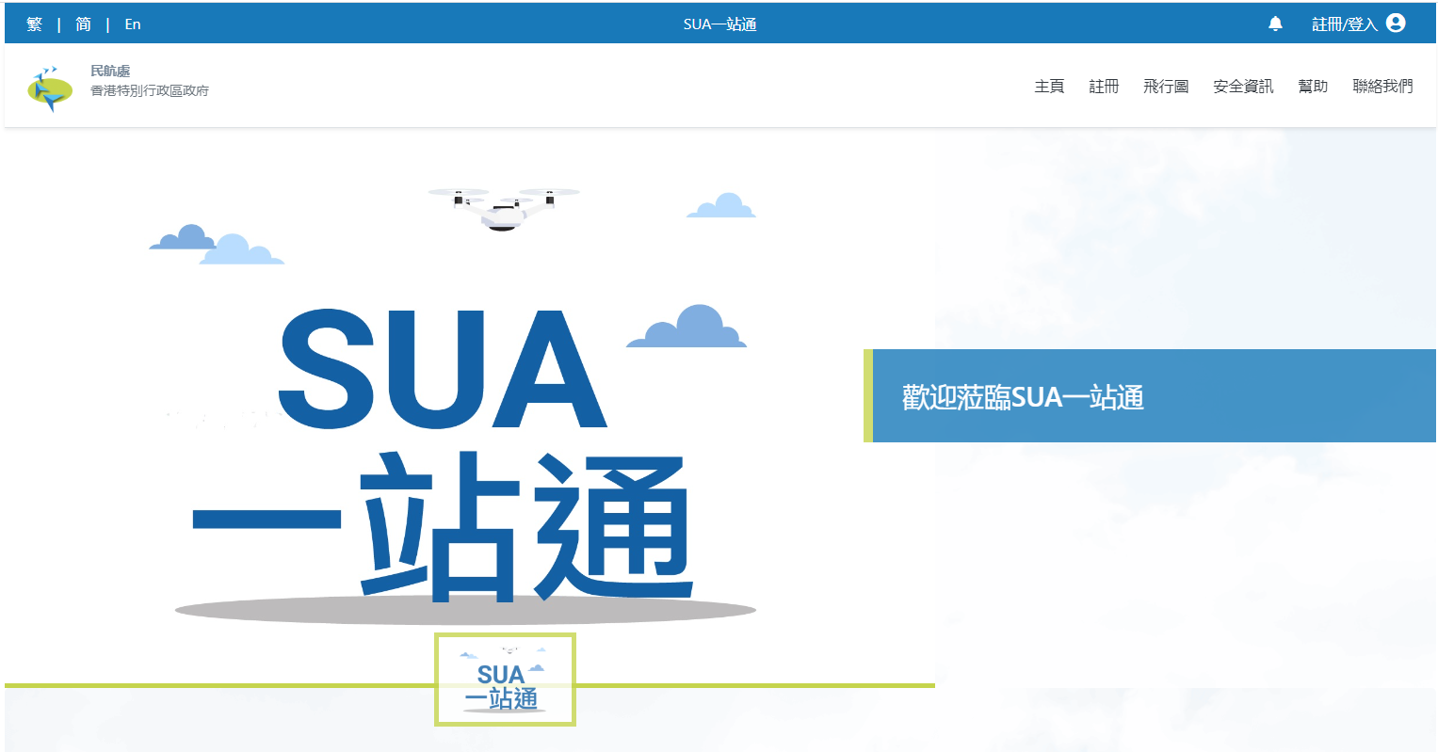

註冊 Registration https://esua.cad.gov.hk/web/account/signup/
Remote Pilot
https://esua.cad.gov.hk/

Slide 9
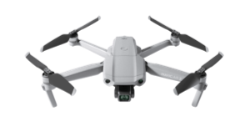

外借航拍機
Borrow a Small Unmanned Aircraft ( Drone)
預先以電郵聯絡圖書館預約借機日期、時間及型號 Contact the library by email in advance to reserve the date, time and model of the machine
必須要在SUA一站通註冊成為遙控駕駛員Must register as a remote pilot at SUA website https://esua.cad.gov.hk/
在借用航拍機當天，你須完成一份《小型無人機借用測試》已確保你清楚明白規定要求Complete a ‘Small Unmanned Aircraft (Drone) Test” when check out a drone
你亦需要簽署一張《外借及操作小型無人機承諾書》已確保你遵守相關要求 Borrower must a sign an “Undertaking for Borrowing and Operating of Small Unmanned Aircraft”
未能符合所需要求者， 恕圖書館未能提供外借服務 Those who fail to meet the requirements, the library will not be able to provide drone loan

Slide 10
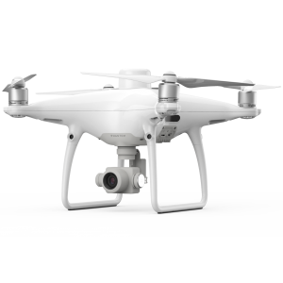
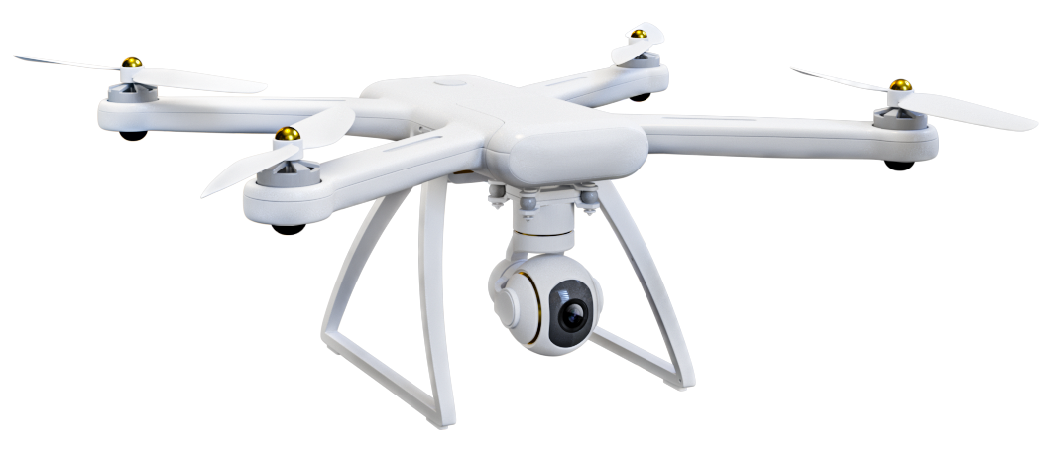
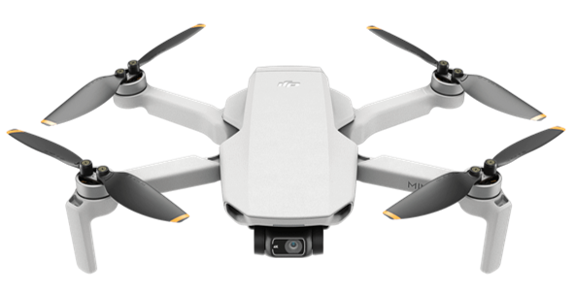
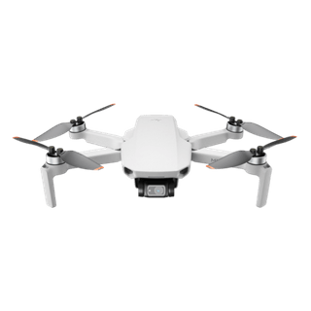
基本操作
Basic Operation
Demonstration , Q&A
Dji Mini 2 x 2 (New)
Dji Mini 3 Pro x 1 (New)
Dji Phantom 4 Pro x1
Mi Drone x 1

Slide 11
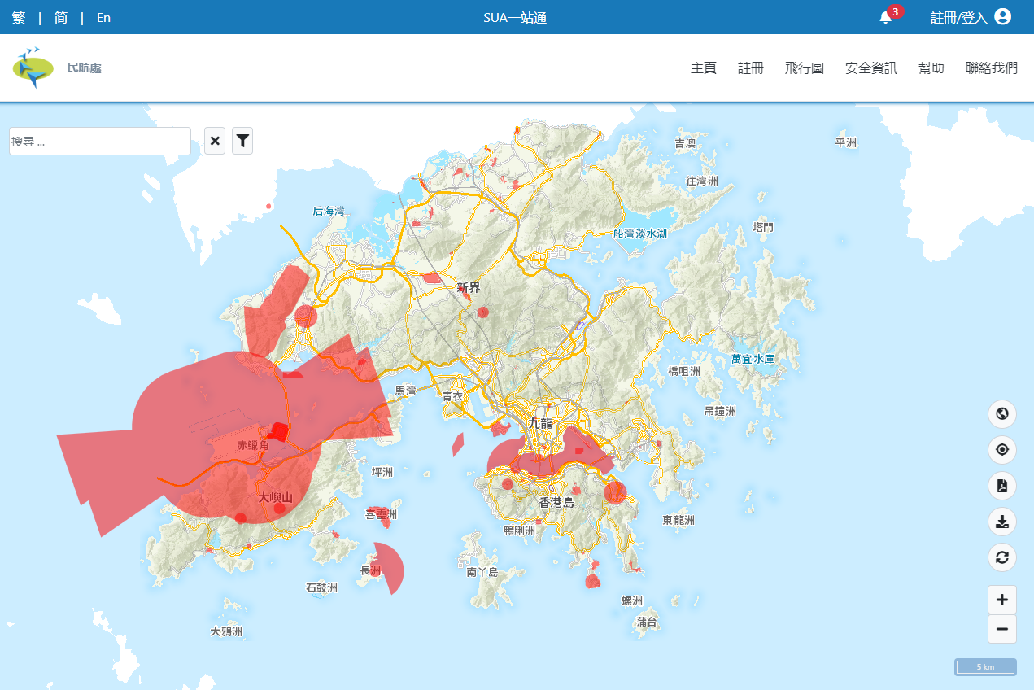
禁飛區
Restricted Flying Zone
https://esua.cad.gov.hk/web/droneMap

Slide 12





天氣
Weather
Beaufort Wind Scale 5: 17-21 mean wind speed in knots

Slide 13
相關資訊
Related information
小型無人機令 （第448G章) Small Unmanned Aircraft Order (Cap. 448G )
https://www.cad.gov.hk/chinese/sua.html
SUA一站通
https://esua.cad.gov.hk/web/
小型無人機安全規定文件Safety Requirements Document https://www.cad.gov.hk/documents/Safety_Requirements_Document.pdf
圖書館航拍機 Library Drones for loan
https://www.lib.eduhk.hk/facilities-equipment/vr-ar-media-equipment-for-loan
查詢 Enquiry :
媒體製作組 Media Production Team | 2948 6661 | libtech@eduhk.hk
流通服務台 Circulation Counter | 2948 6658 | libcir@eduhk.hk
諮詢服務台 Information Counter | 2948 6653 | libinfo@eduhk.hk
©EdUHK Library 2022

