Slide 1
Introduction to 3D Drawing and Printing

Slide 2
Outline
3D Printing Technologies
3D Printing Materials
3D Printing @ EdUHK Library
  Printer Model & Materials
  Submit A Print Job & Price
  From stl to gcode (Printer Setting)
3D Modeling
  Introduce Different Software
  Internet and Library Resources
  Create Your 3D Model by Tinkercad

Slide 3
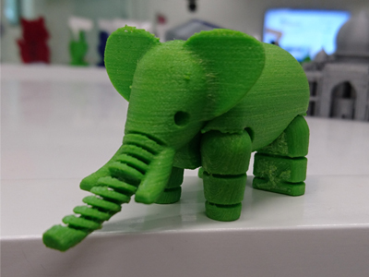
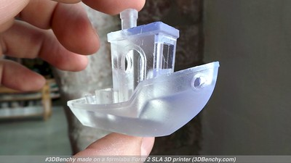
3D Printing Technologies
FFF/FDM (Fused Filament Fabrication/Fused Deposition Modeling)
（熔融沉積成型）
  Additive manufacturing process in which material is selectively dispensed through a nozzle or orifice
SLA／DLP／LCD (Stereolithography/Digital light processing/Liquid-crystal Display)
（光固化）
  Additive manufacturing process in which a liquid photopolymer in a vat is selectively cured by light-activated polymerization
SLS (Selective laser sintering)（選擇性激光燒結）
  Additive manufacturing process in which thermal energy selectively fuses regions of a powder bed

Slide 4
3D Printing Materials
FFF/FDM
  ABS/PLA/Nylon(PA)/PETG/TPU/PEI
SLA／DLP／LCD
  Vat Polymerization Resin(還原聚合樹脂)
SLS
  Polyamide (Such as Nylon 12,Alumide and PA-GF)

Slide 5
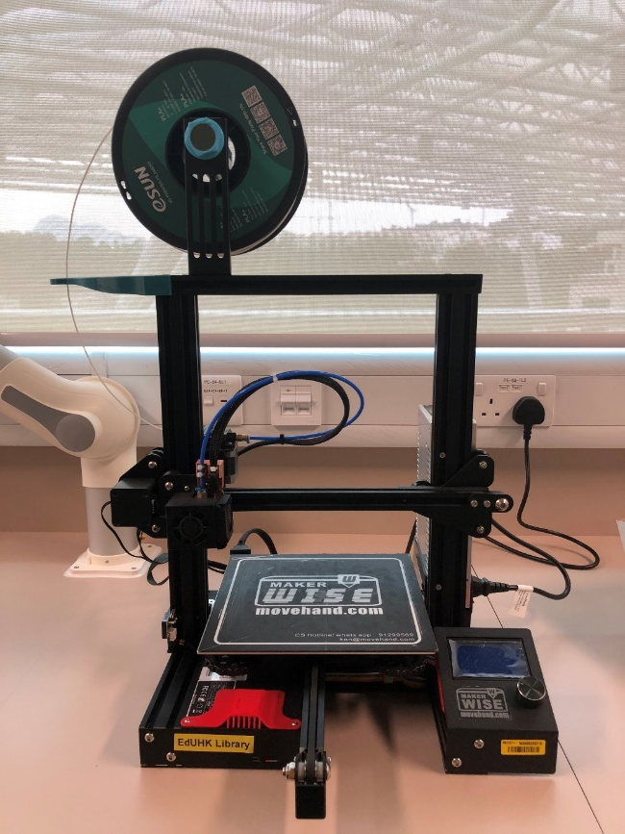

3D Printing @ EdUHK Library – Printer Model & Materials
Model: CP220 (Self operated)
  The print volume of 3D printer is 235 x 235 x 250 mm
Technology: FDM
Printing material: PLA (1.75mm diameter)
File Format: stl → gcode
Software used: Cura (to check stl and convert to gcode)
Instruction for self-operated printer (https://www.lib.eduhk.hk/wp-content/uploads/2021/12/wisemakerCP220userguide.pdf)
Notes:
Any more models?

Slide 6
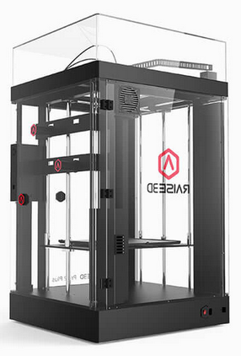
3D Printing @ EdUHK Library – Printer Model & Materials
Model: Raise Pro2 Plus (Staff operated)
  Print volume
    Single extrusion: 305 x 305 x 605 mm
    Dual extrusion: 280 x 305 x 605 mm
Technology: FDM
Printing material: PLA (1.75mm diameter)
File Format: stl → gcode
Software used: ideaMaker (to check stl and convert to gcode)

Slide 7
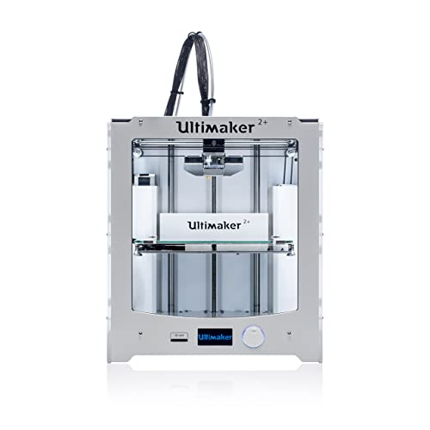
3D Printing @ EdUHK Library – Printer Model & Materials
Model: Ultimaker 2/2+/3 (Staff operated)
  Print volume
    Ultimaker 2 - 230 x 225 x 205 mm
    Ultimaker 2+ - 223 x 223 x 205 mm
    Ultimaker 3
      Single extrusion: 215 x 215 x 200 mm
      Dual extrusion: 197 x 215 x 200 mm
File Format: stl → gcode
Printing material: PLA (2.85mm diameter)
Software used: Cura (to check stl and convert to gcode)

Slide 8
3D Printing @ EdUHK Library – Submit A Print Job & Price
Eligibility of Usage: EdUHK Students and Staff only
Charges: $20 base charge plus a material charge of $1 per gram
Acceptable File Formats: STL only
Applications are processed twice a day from Monday to Friday (working days only)
For jobs submitted | Notification will be sent by | Payment should be made by | Output will be ready by
Before 10 am | 11 am on the same day | 11 am on the 2nd day | 11 am on the 3rd day
10 am – 2 pm | 3 pm on the same day | 3 pm on the 2nd day | 3 pm on the 3rd day
After 2 pm | 11 am on the 2nd day | 11 am on the 3rd day | 11 am on the 4th day

Slide 9
From stl to gcode (Printer Setting)
Free Download Ultimaker Cura: https://ultimaker.com/software/ultimaker-cura
File Checking (Cura or other Slicing Software)
File format (STL is preferable)
Object Size
Printing Quality
Infill
Support
Adhesion
Common Mistakes

Slide 10
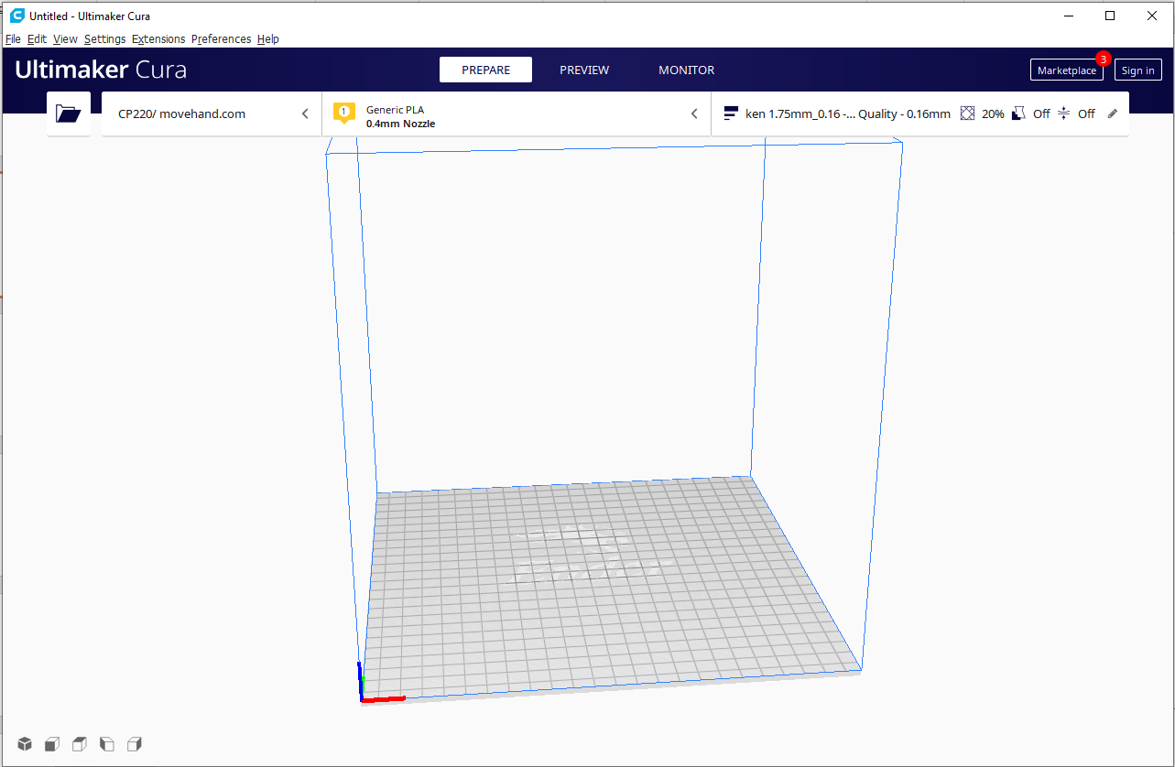
From stl to gcode - File Format
Open File
Open the STL file

Slide 11
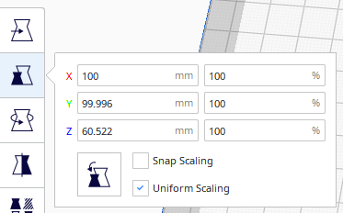
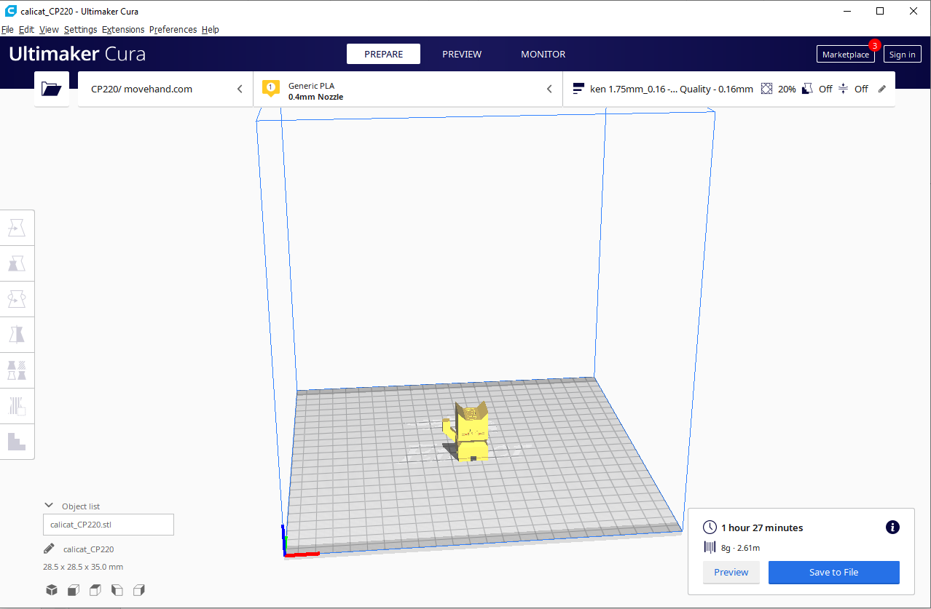
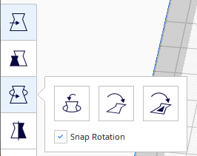
Resize and rotate
From stl to gcode - File Format
Resize the object
Rotate the object

Slide 12
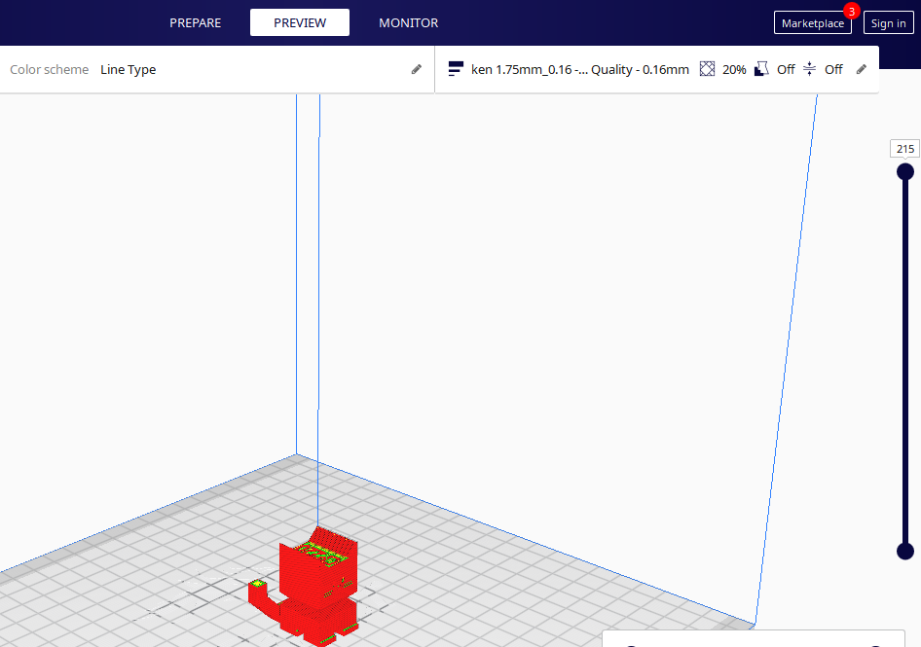
Preview
From stl to gcode - File Format
Moving this slider to preview the printing of individual layer

Slide 13
Object size
From stl to gcode – Object Size
Time and materials required will display here

Slide 14
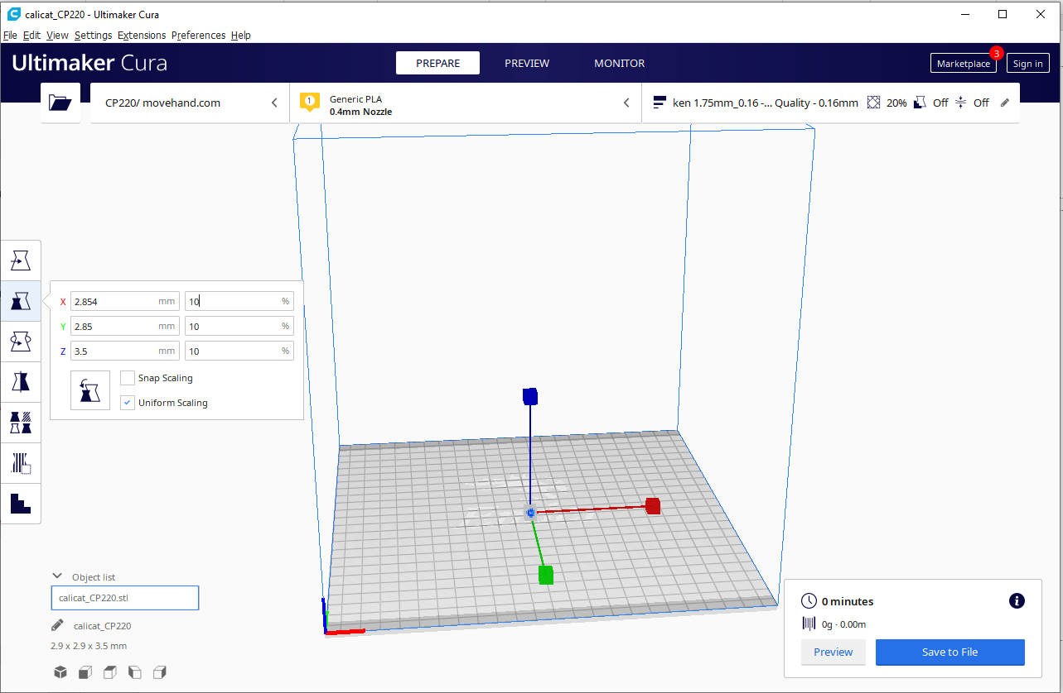
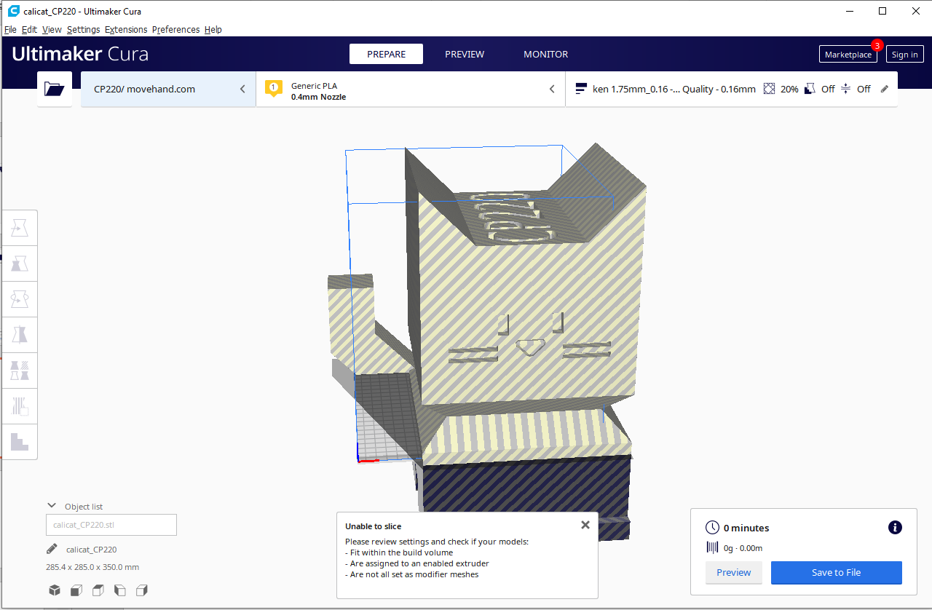
Object too small or too large
From stl to gcode - File Format

Slide 15
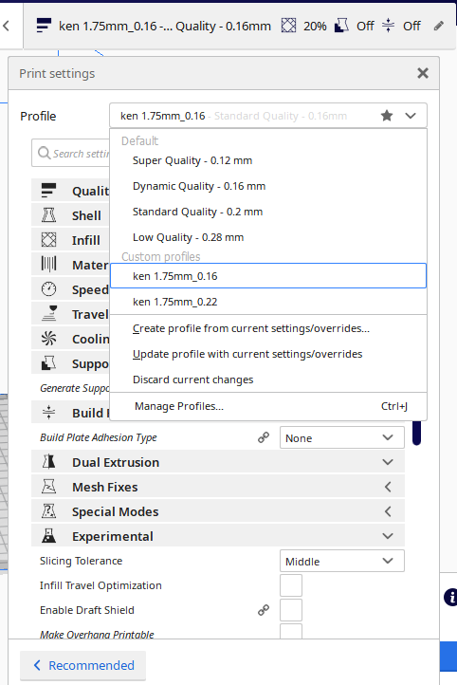
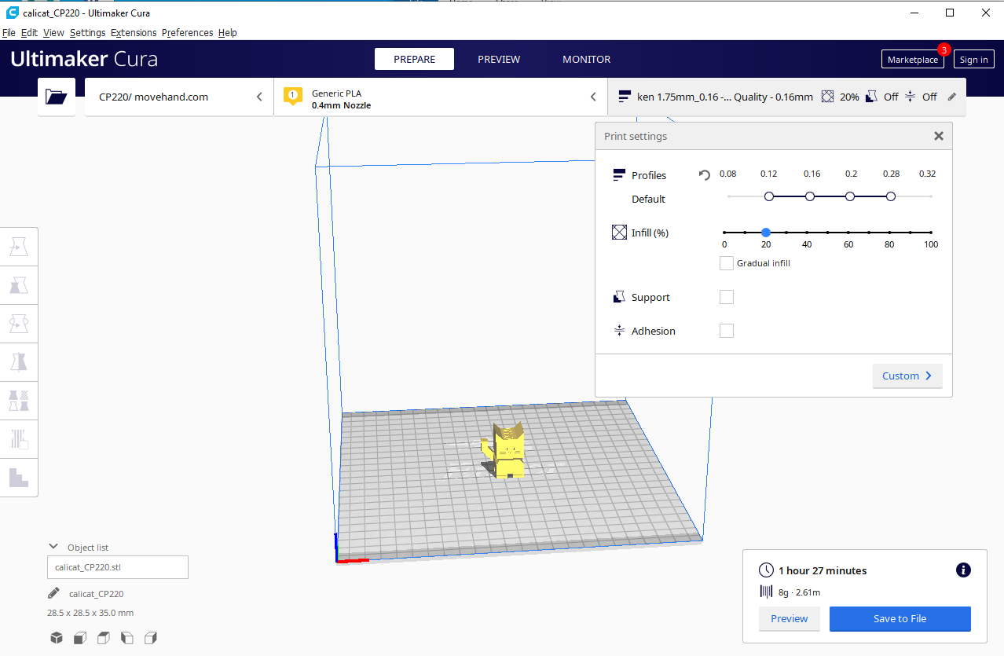
From stl to gcode –
Printing Quality
Different layer height will effect the printing quality and time required. The lower layer height, the better the printing quality, but longer the printing time.
For this object, when layer height is
0.16mm, it requires 1h 27m; when layer height is 0.22mm it requires 52m

Slide 16
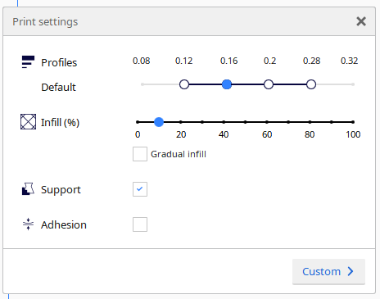
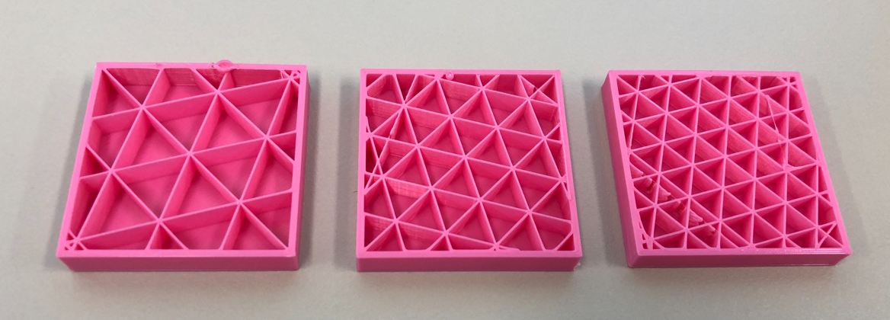
From stl to gcode - Infill
10%
15%
20%
Infill % ↑ → Time required & weight ↑

Slide 17
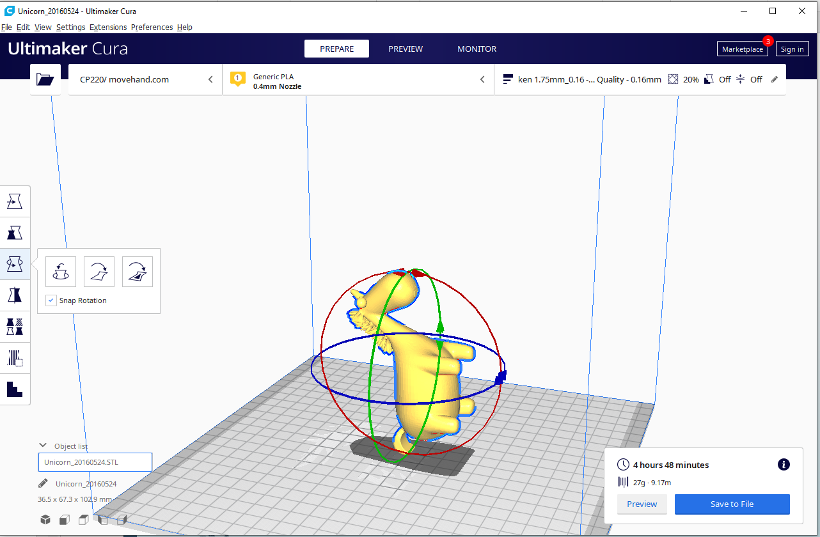
From stl to gcode - Support and Adhesion
Rotate the object to change the orientation

Slide 18
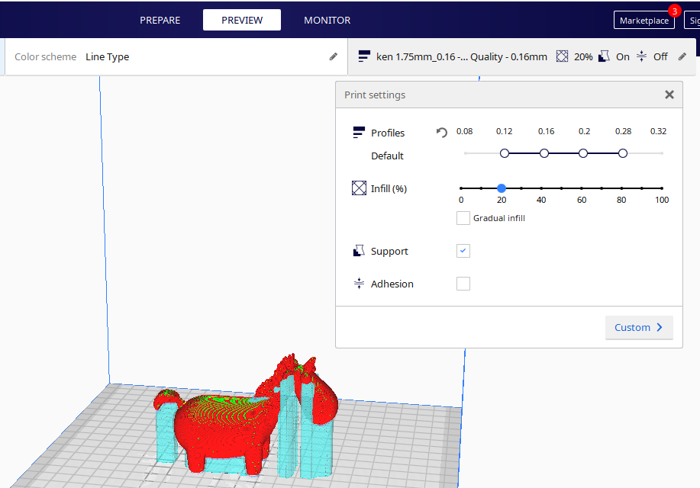
From stl to gcode - Support and Adhesion
Green part is the support added

Slide 19
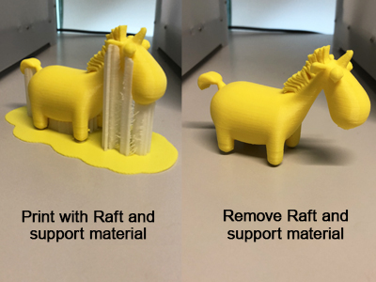
From stl to gcode - Support and Adhesion

Slide 20
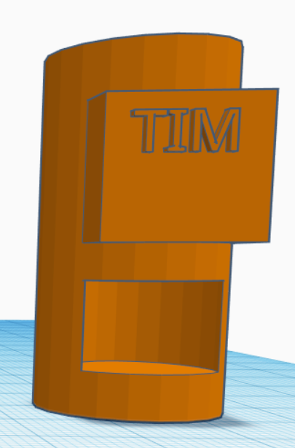
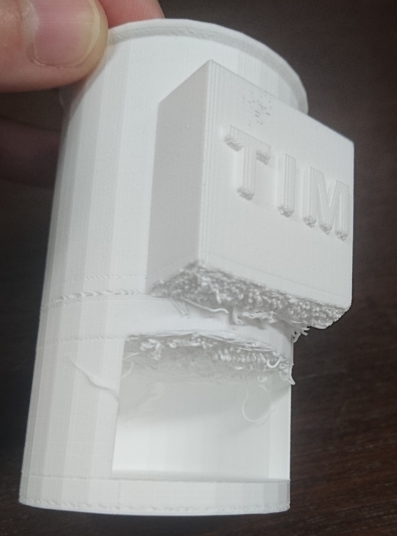
From stl to gcode - Support and Adhesion
What happen if no support is added for an overhang object?
Materials will fall down

Slide 21
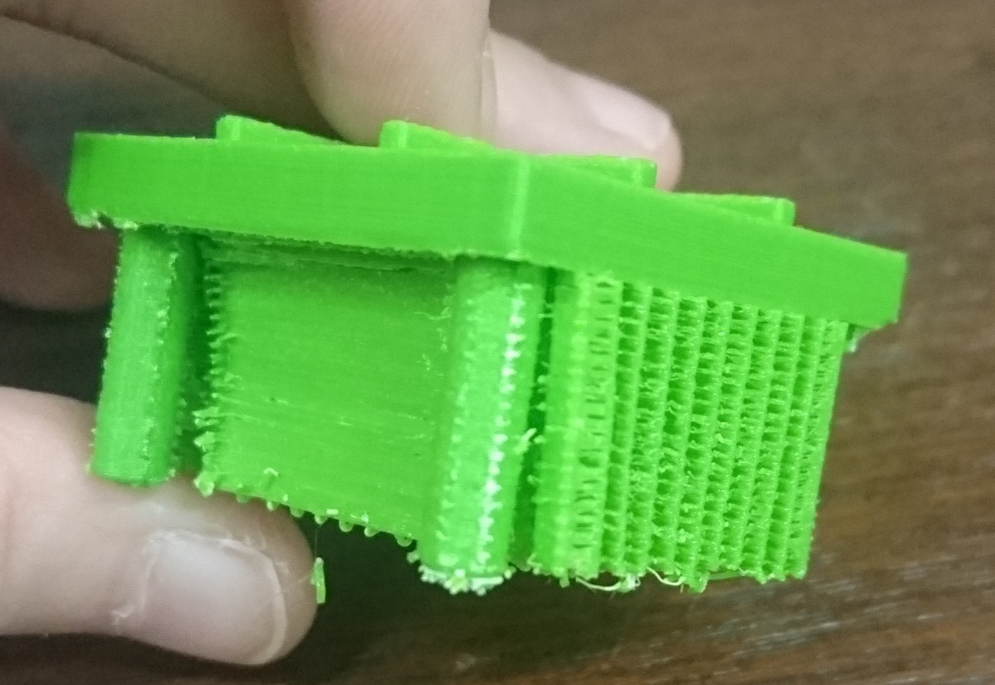
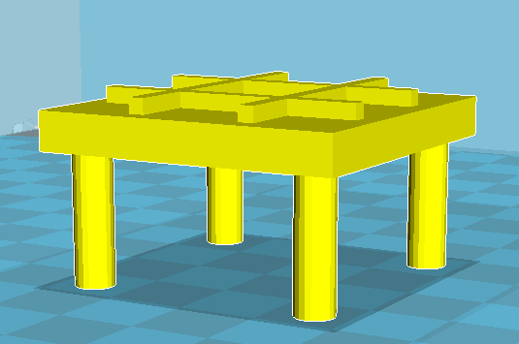
From stl to gcode - Support and Adhesion
Too much support?
It will waste time and materials
With support part
Object: 5g
Support part: 5g

Slide 22
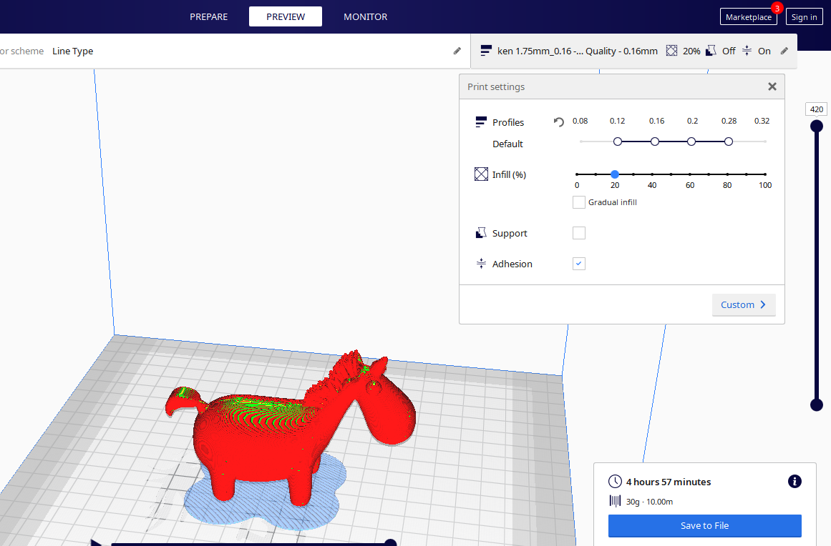
From stl to gcode - Support and Adhesion
Blue part is the adhesion added

Slide 23
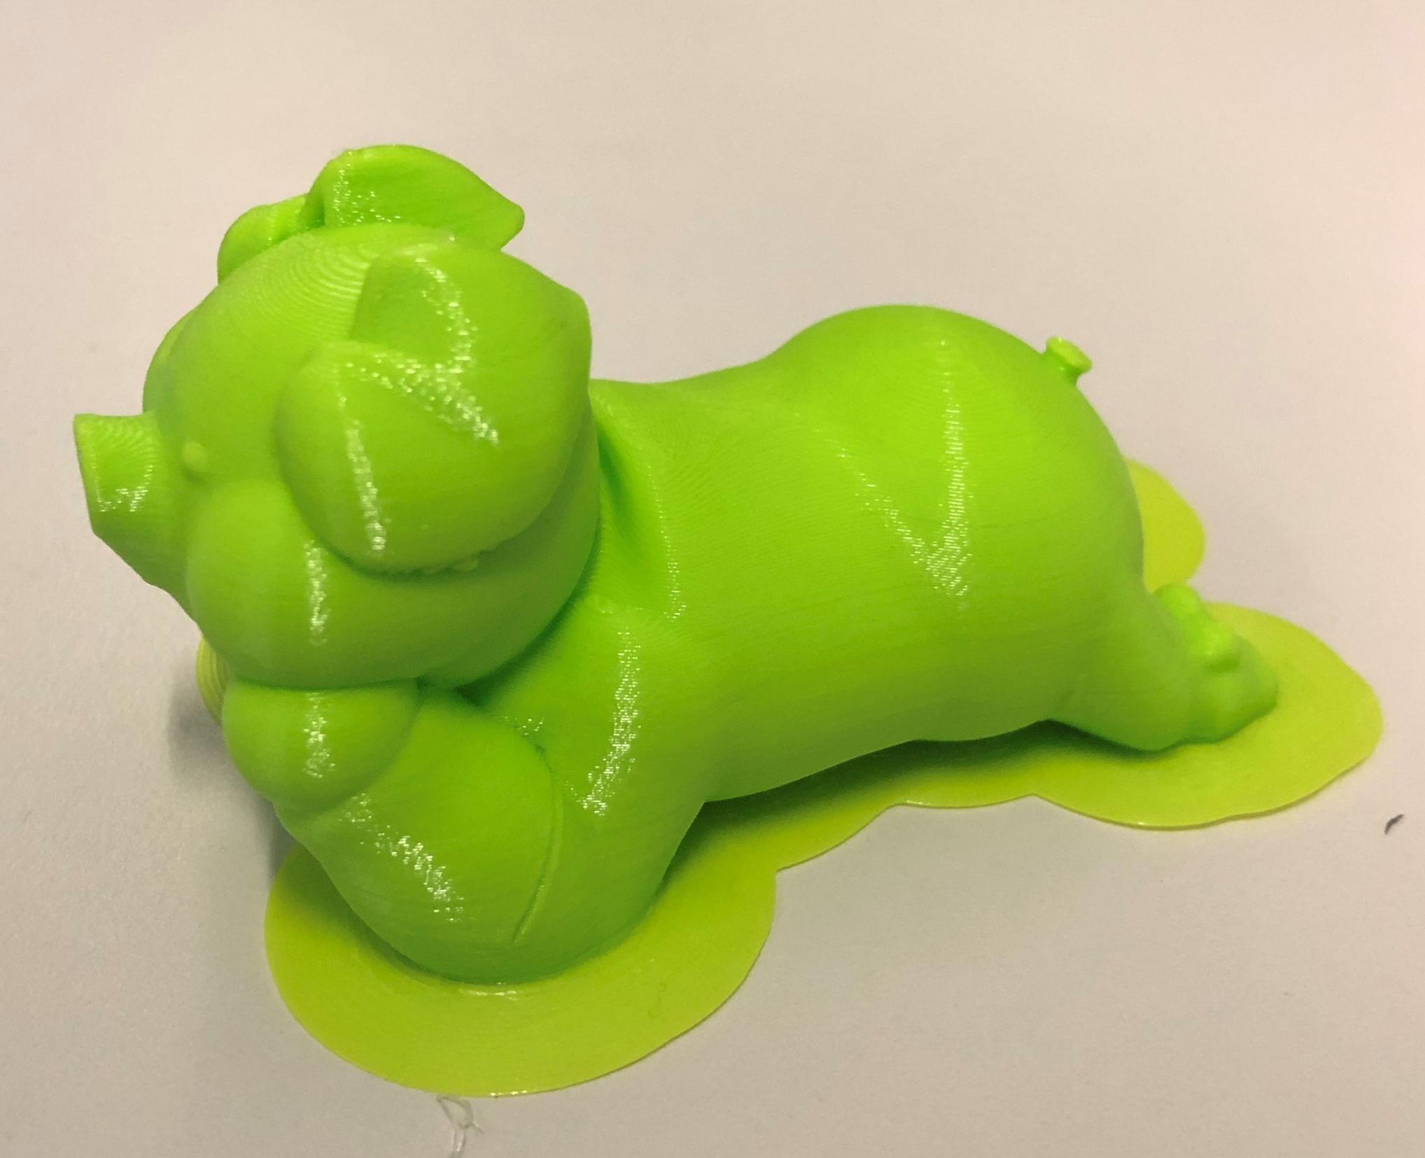
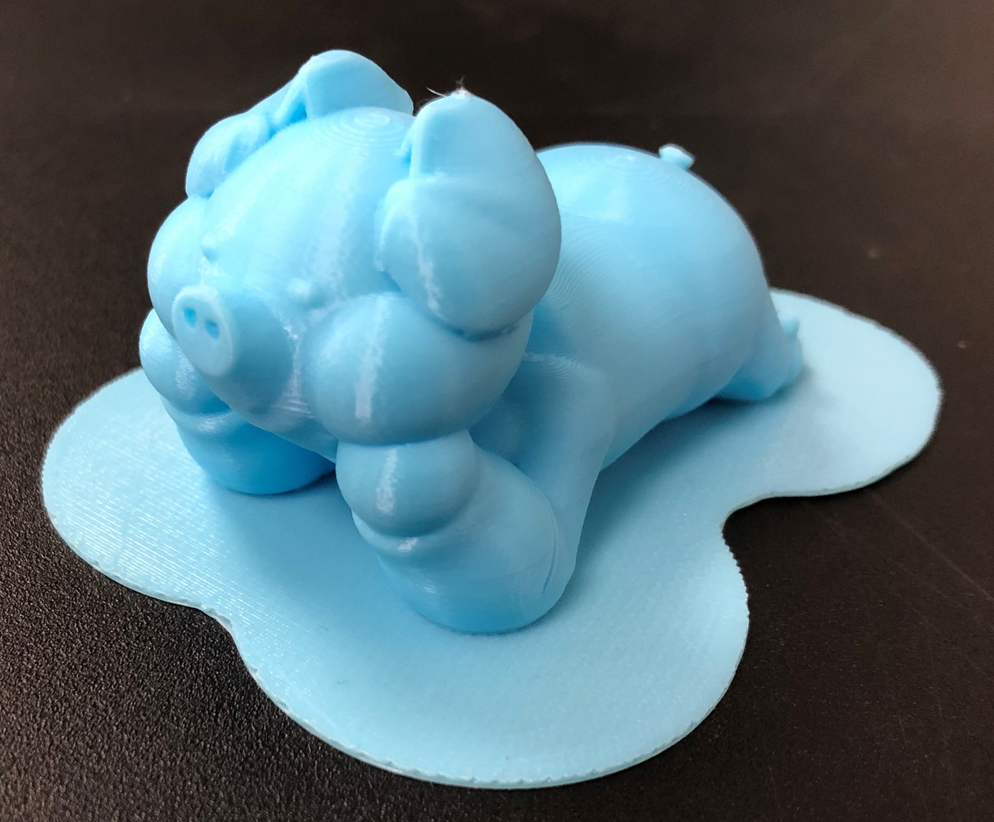
From stl to gcode - Support and Adhesion
Brim
Raft
22g; 2h 30ms
25g; 2h 44ms
Brim is extend from the bottom layer
Raft is add the new layer under bottom layer

Slide 24
From stl to gcode - Support and Adhesion
When should we add support or adhesion?
Support:
Overhang part
Please remind that user should remove the support part by themselves.
And support will effect the smoothness of the surface and increase the time and material for printing.
有懸空部份。
注意讀者需自行拆卸support part。
另外，support part會影響列印表面的光滑程度，而且也會令列印時間加長及浪費物料。
Adhesion:
The object’s first layer is made up of parts that are difficult to attach to the base.
最底層由多個部份組成，或最底層接觸底部份較少，令底層難以固定在底板上。

Slide 25
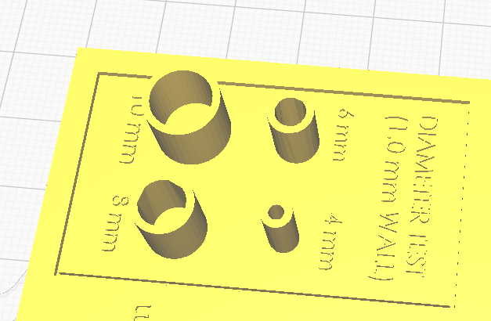
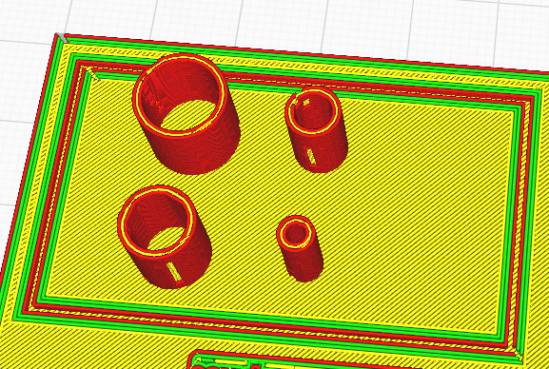
From stl to gcode – Common Mistakes
Usually occurs when the detail parts are too small or too fine
Prepare
Preview

Slide 26
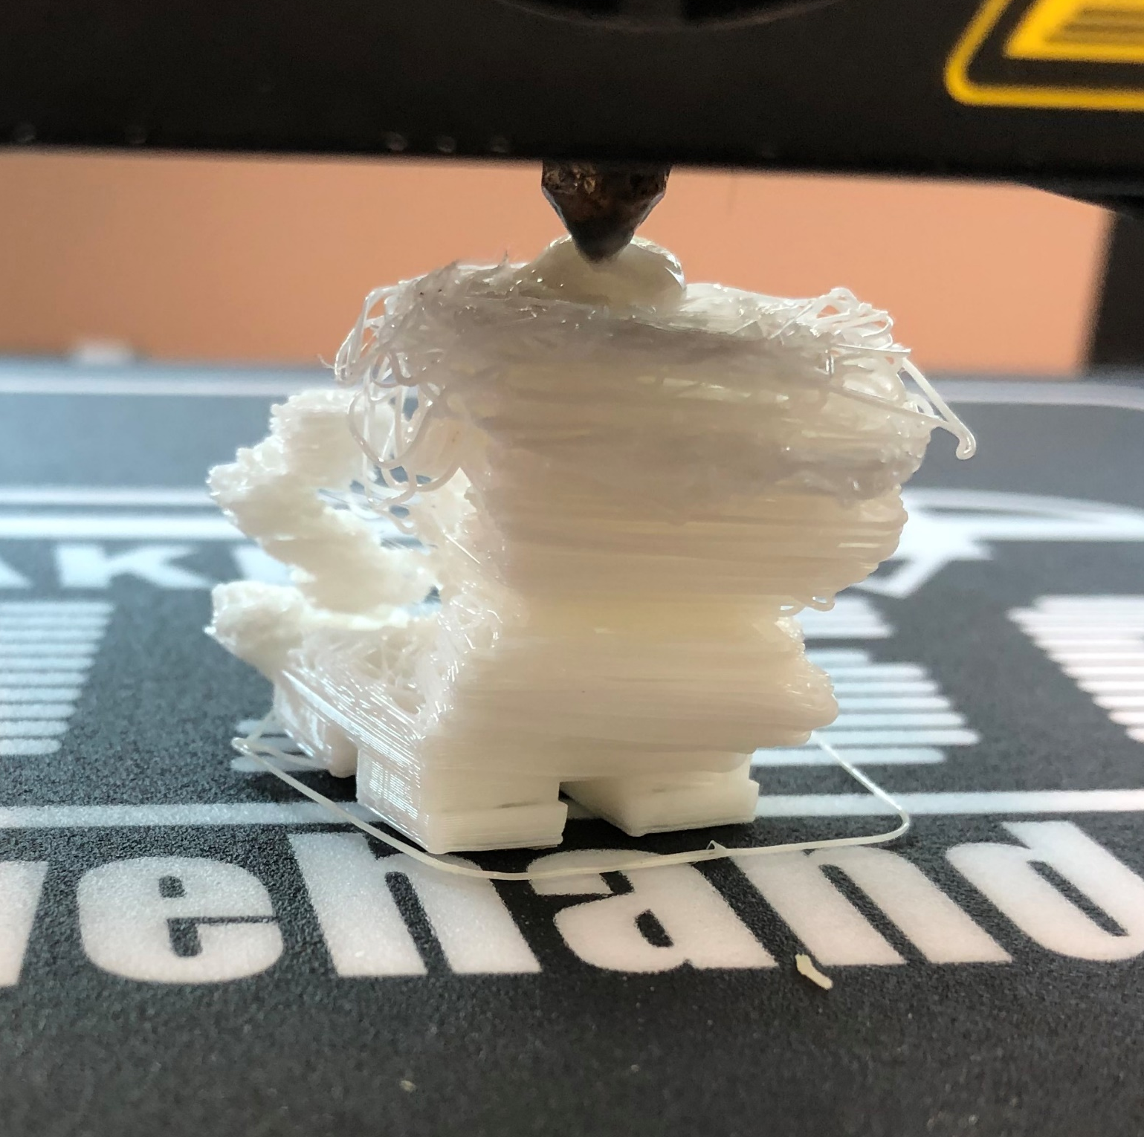
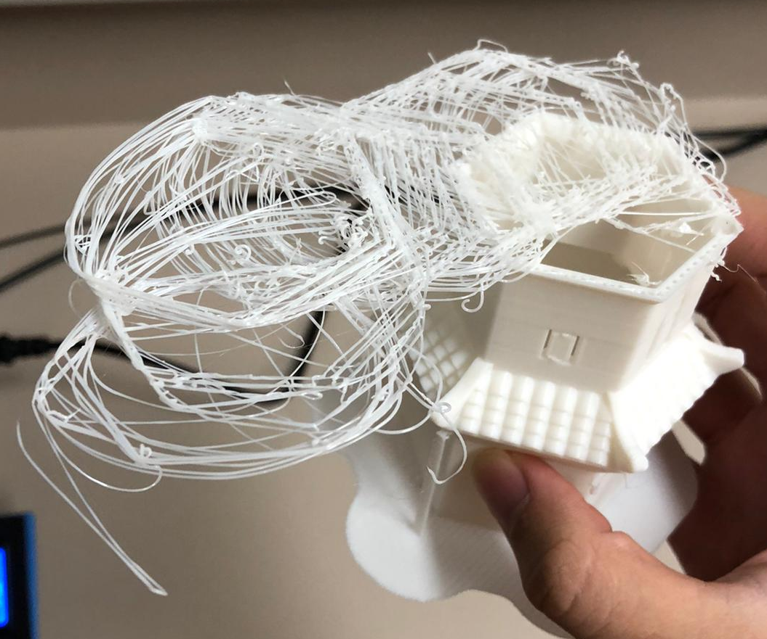
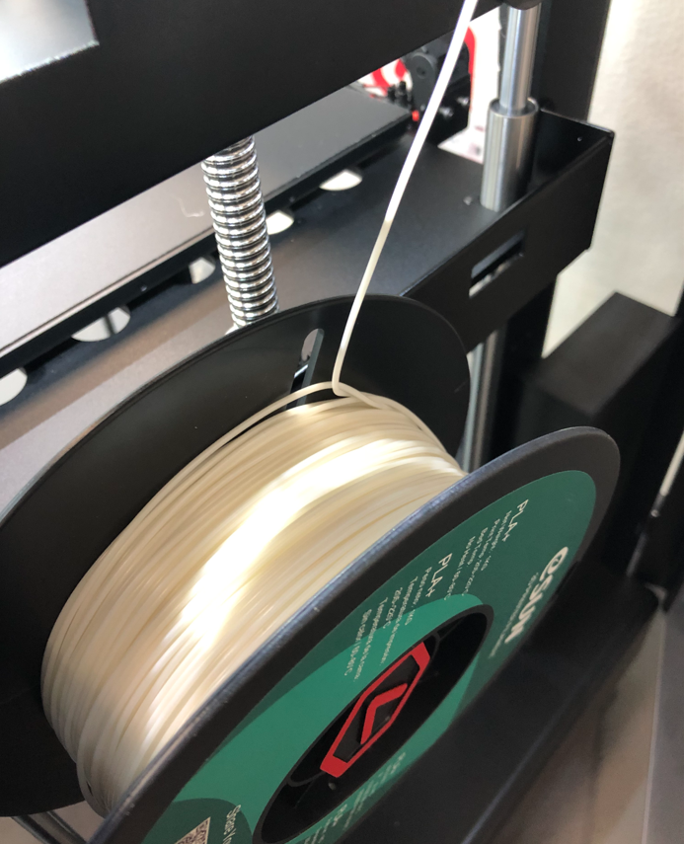
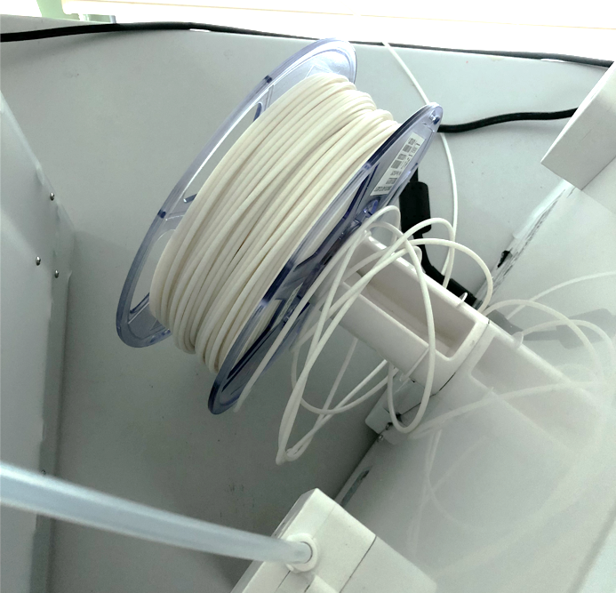
From stl to gcode – Common Mistakes
Problems | Improvement
Design Error (e.g. Details cannot be printed ) | Re-design and layer-by-layer check in Cura preview
Bottom layer cannot be fixed (shifted) | Print with Brim/Raft help
Print without support Easy to fail when printing large objects Object exceeds printable range | Separate print (disassemble) e.g. 615 mm Eiffel Tower (https://www.thingiverse.com/thing:254133)
Shifted
Filament cannot load

Slide 27
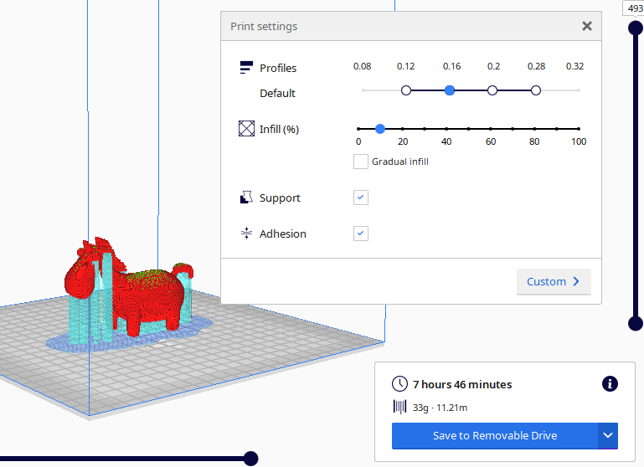
3D Printing Example
Cute Unicorn
https://www.thingiverse.com/thing:2222300
  Size: 36.5 x 102.9 x 67.3mm
  Time required: 7h 26ms
  Weight: 33 grams (included support & adhesion)
  Charges: $53 ($33 + $20)

Slide 28
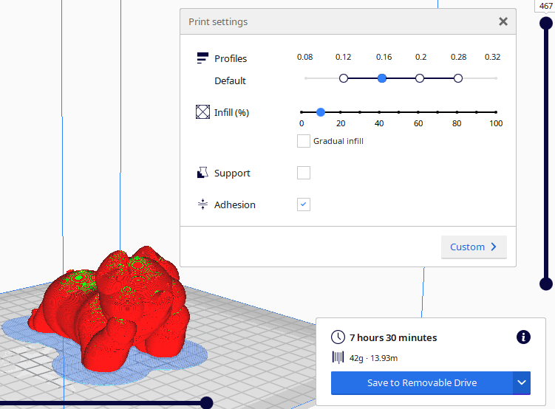
3D Printing Example
Cute Pig
https://www.thingiverse.com/thing:2077170
  Size: 107.5 x 58.9 x 58.4mm
  Time required: 7hrs 30ms
  Weight: 42 grams (included adhesion)
  Charges: $62 ($42 + $20)

Slide 29
3D Modeling – Introduce Different Software
Create 3D model by yourself
  https://www.tinkercad.com/ (Free/ Web-based)
  https://www.sketchup.com/plans-and-pricing/sketchup-free (Free with limited features only/ Web-based)
  https://www.blender.org/ (Free forever/ Non-web-based)

Slide 30
3D Modeling – Internet and Library Resources
Online tutorials
  Tinkercad
  https://www.tinkercad.com/learn/designs?collectionId=OSZ5W2BL1W5N51F
  SketchUp
  https://www.youtube.com/user/SketchUpVideo
  Blender
  https://www.blender.org/support/tutorials/
Download 3D model from the internet (* pay attention to copyright)
  https://www.thingiverse.com/
  https://www.printables.com/

Slide 31
3D Modeling – Internet and Library Resources
The 3D printing handbook : technologies, design and applications
Design for 3D printing
An introduction to 3D printing
Beginning Google Sketchup for 3D Printing
3D printing handbook : 使用並認識用於自我表現的新工具

Slide 32
Contact Us
Library 3D Printing Service
https://www.lib.eduhk.hk/facilities-equipment/3d-a1-printing-and-laser-cutting-engraving-service
Enquiry about 3D Printing
Email: libsys@eduhk.hk
Tel: 2948 6661

