Slide 1
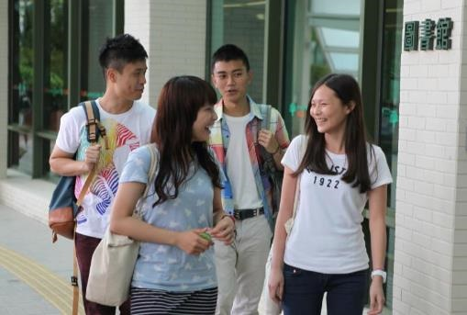
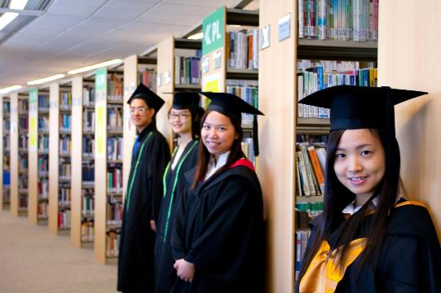


2023/24 Library Orientation

Slide 2

Contents
(Click to go)
Location | P.3-5
Facilities and Booking System | P.6-12
Borrowing Privileges and Responsibilities | P.13-25
iSearch | P.26-27
Inter-campus Delivery | P.28-29
Resources Sharing: | P.30-34
Joint University Librarians Advisory Committee (JULAC) Cards Interlibrary Loan (ILL)
Electronic Resources | P.35-45
Other Resources | P.46-47
Other Information | P.48

Slide 3
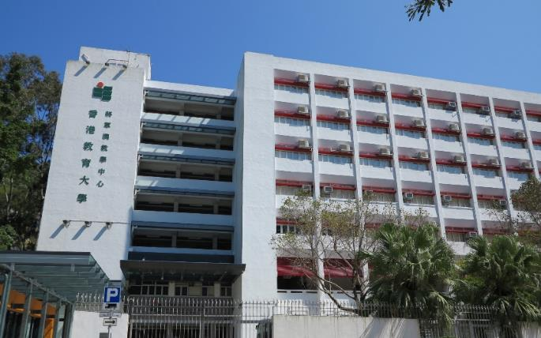
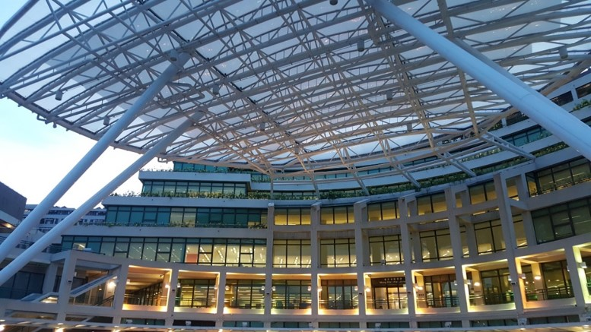

Our Locations
Mong Man Wai Library
(Block C, Tai Po Campus)
Tseung Kwan O Study Centre Library
(1 King Yin Lane, Tseung Kwan O)
Different Opening Hours

Slide 4
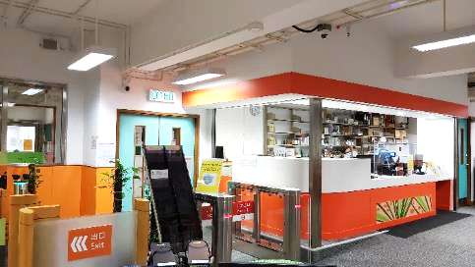
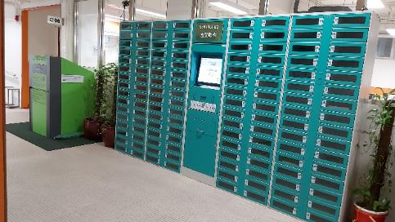
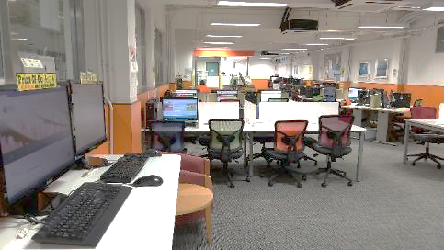
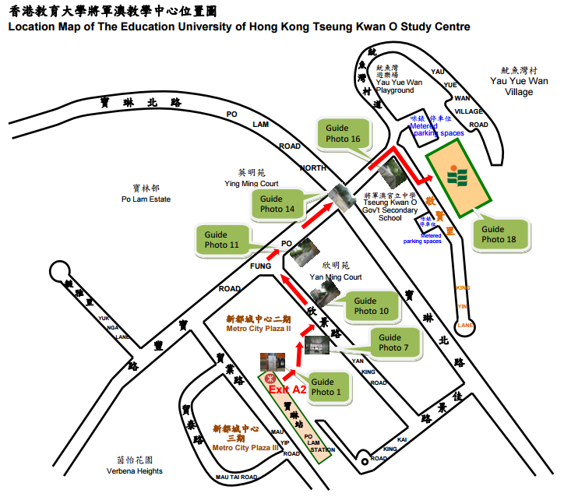
Tseung Kwan O Study Centre Library
The Tseung Kwan O Study Centre Library (TKOSC Library) is located on the ground floor of the EdUHK Tseung Kwan O Study Centre.
It serves primarily as a resource centre for students enrolled in programmes at the Tseung Kwan O Study Centre.
In addition, students and staff of TKOSC also enjoy access to the resources, facilities and services of the MMW Library on Tai Po Campus.
地址：新界將軍澳敬賢里1號
Address: No. 1, King Yin Lane, Tseung Kwan O, New Territories
Tel : 2190 8521
Notes:
Use gif for the map
More tko image

Slide 5
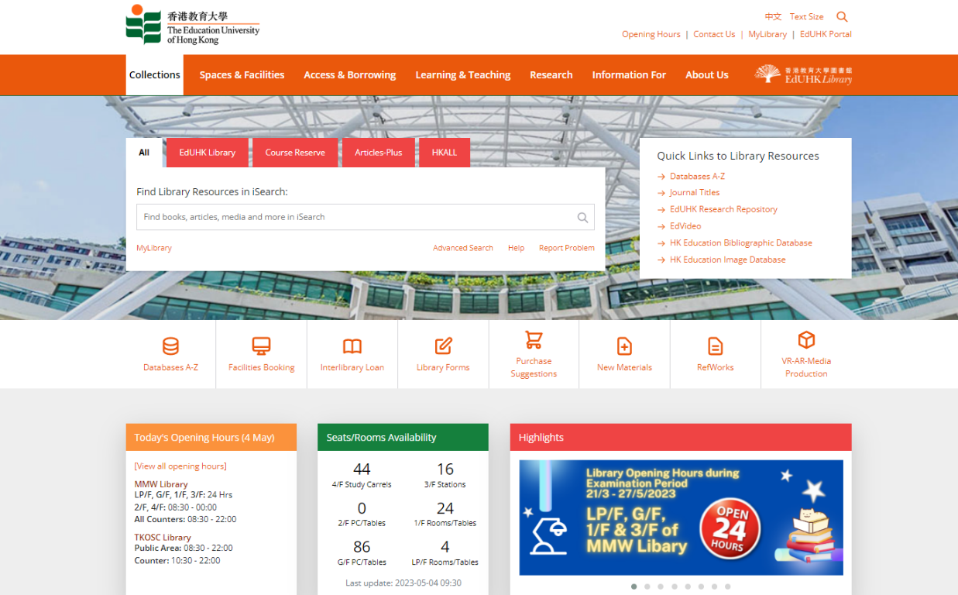
Current Opening Hours of MMW Library & TKOSC Library

Slide 6
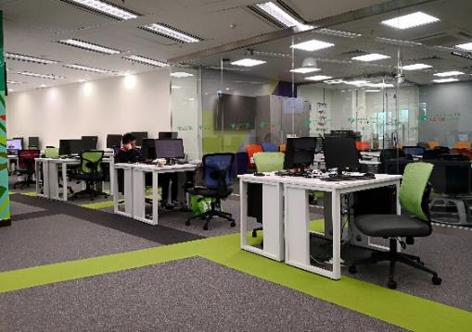

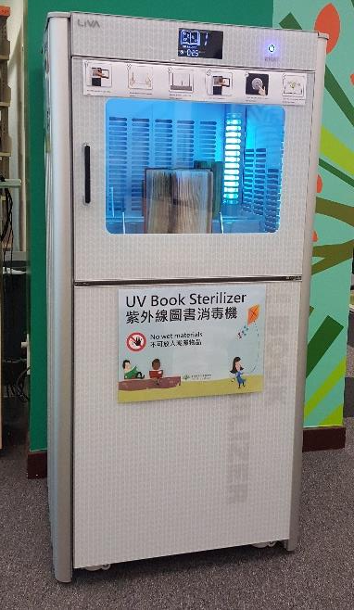
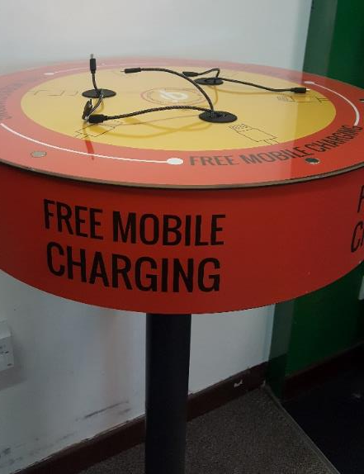
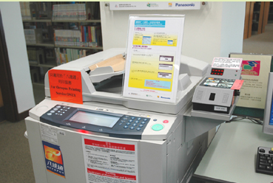
Facilities Highlight @MMW Library
PC Workstations
Wireless Network
UV Book Sterilizers
Printing, Photocopying and Scanning Facilities
Mobile Device Charging Stations

Slide 7
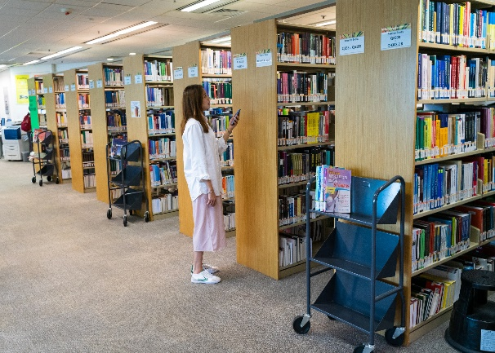
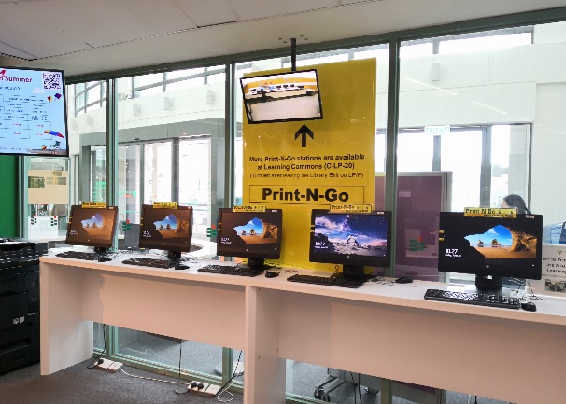
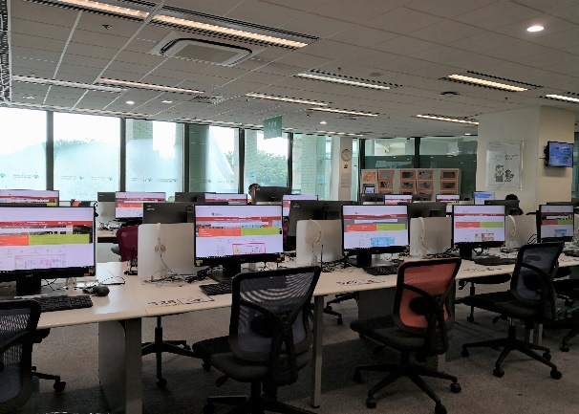
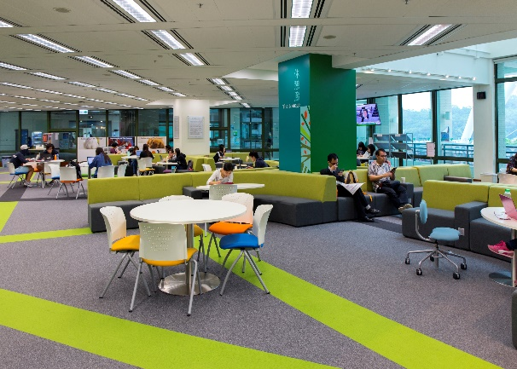
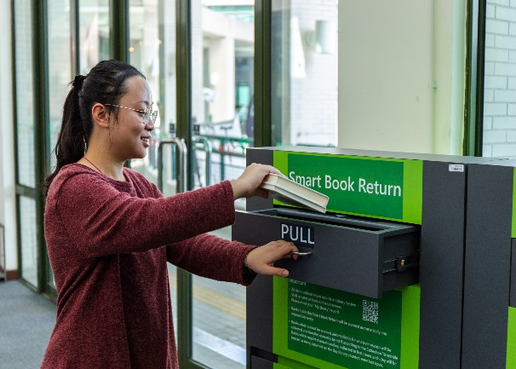
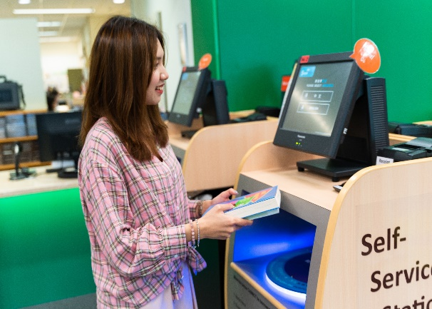
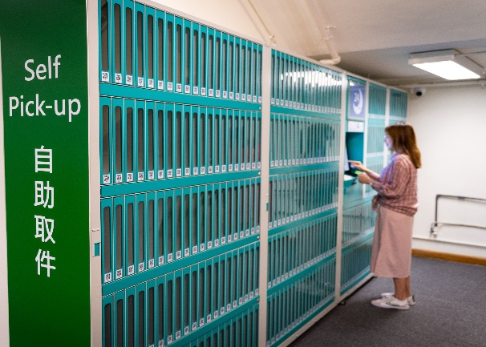
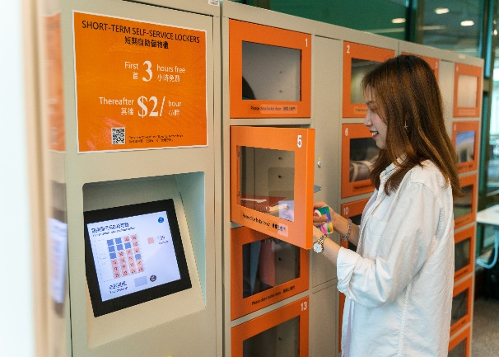
Facilities Highlight G/F (Open 24 hours)
Reserve Collection
reading materials for specific programmes and modules
Print-N-Go Stations
OCIO Print Quota System
Quiet Zone & PC Area
60 networked PCs
The Lounge
perfect place for chatting and relaxation
24-hour Smart Book Return
Self-Service Stations
RFID self-service
Self Pick-up Station
Short-Term
Self-Service Lockers

Slide 8

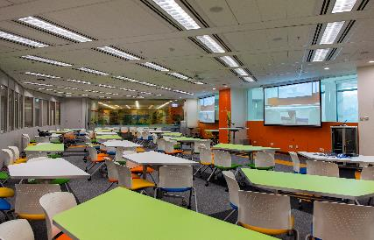
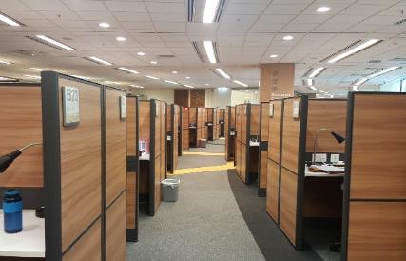
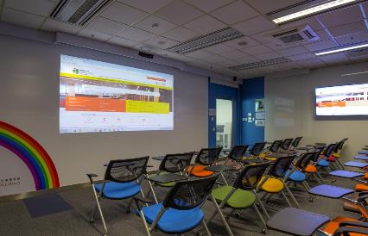
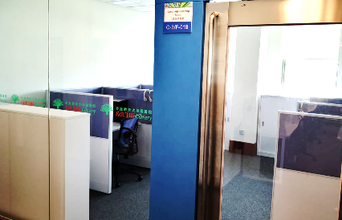
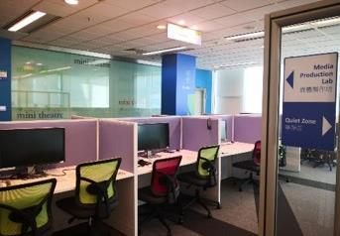
Facilities Highlight
1/F - 4/F
Discussion Zone
5 group discussion rooms
24 group discussion tables on 1/F
Flexi Zone
Two sets of 4K projectors and PCs
Two sets of Handheld Wireless Microphone
Research Commons
62 individual study carrels on 4/F
Mini Theatre
40 seats for classes on 3/F
Language Learning Room
4 workstations on 3/F
Media Production Lab
16 media workstations on 3/F

Slide 9
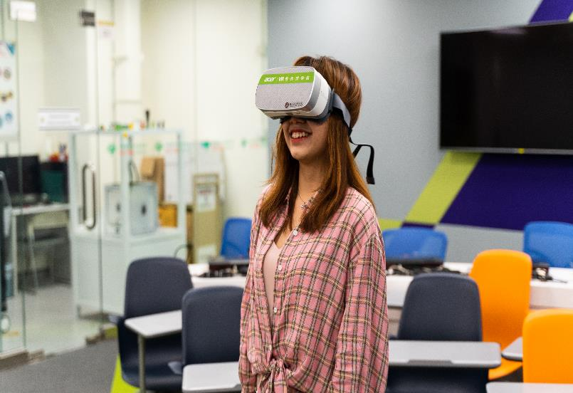
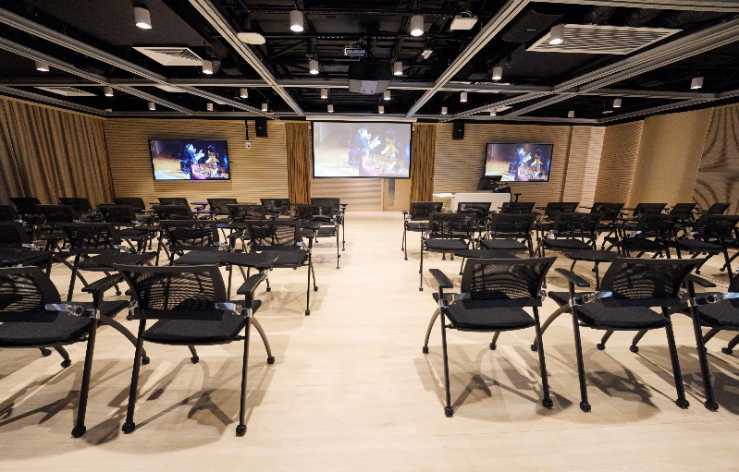
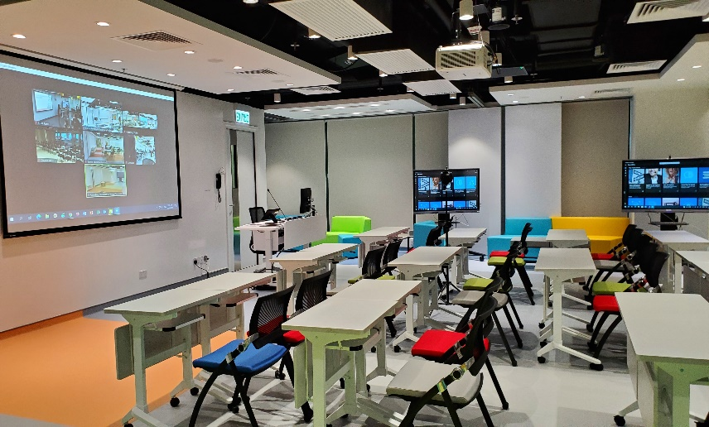
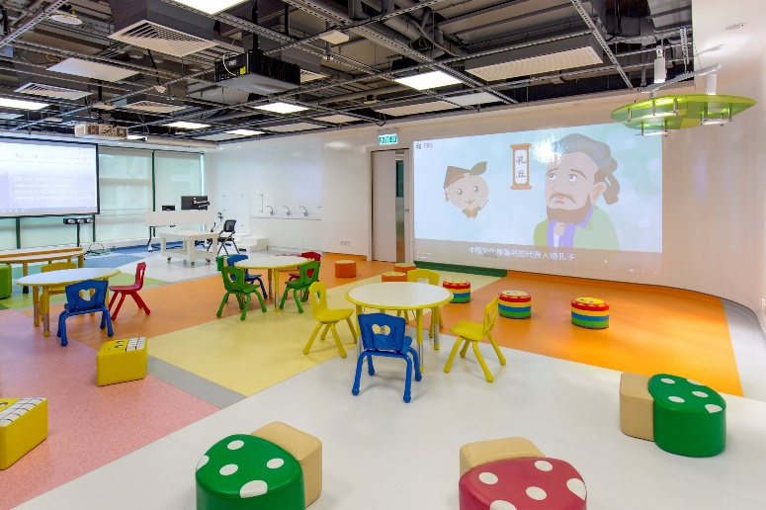
Creative Arts Room (1/F)
Specially designed for creative arts
Professional audio-visual facilities for performance and recording
Moveable partition boards for zoning and artworks display, etc.
Creative Lab (G/F)
VR-AR Media Equipment and Software
Video-conferencing and Recording Equipment, etc.
Future
Classrooms
Future Primary & Secondary Classroom (1/F)
Designed for students at senior primary to junior secondary levels
Moveable and flappable 4K interactive touch-screen displays, etc.
Future Early Childhood & Primary Classroom (1/F)
Designed for school children at kindergarten to junior primary levels with custom-made furniture for young children
Different lighting effects, 4K projectors, opaque projectors, projection screen and projection wall, etc.

Slide 10
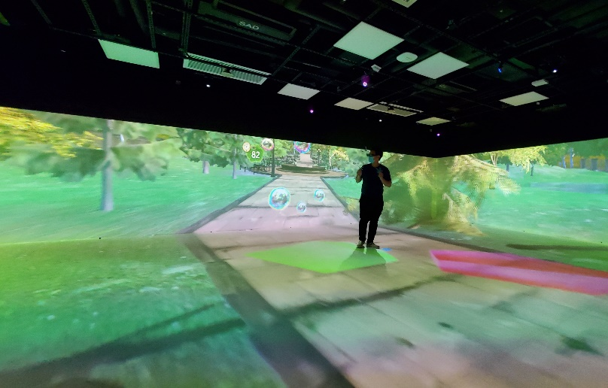
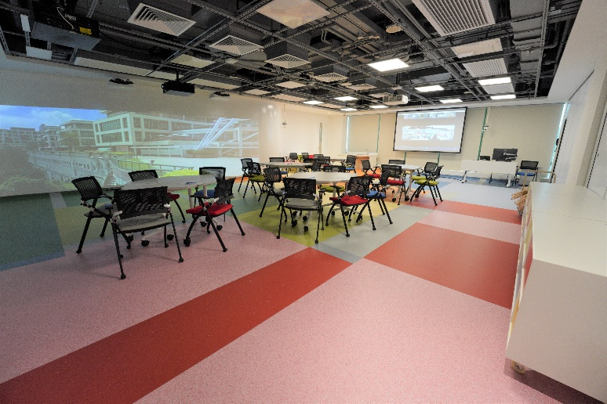
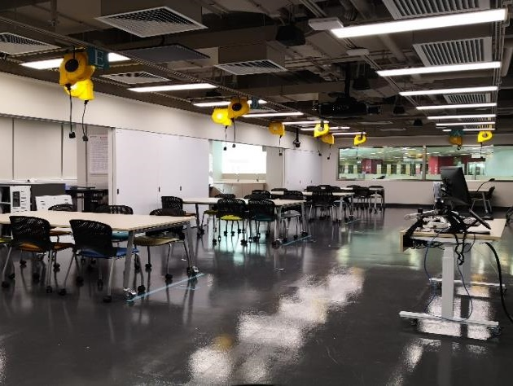
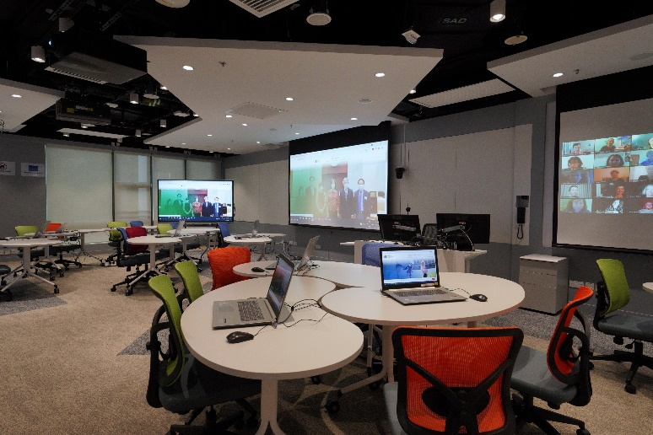
Extended Reality Room (2/F)
One of the largest VR CAVEs in Hong Kong supporting 360-degree interactive 4-side and floor projection as well as surround sound system
Includes a VR Experience Area with VR treadmill and extra wide gaming station
Special Education Room (1/F)
Specially designed for students with special education needs
Induction loop system for hearing aids
32:10 extra-wide video projection wall for visual stimulations, etc.
Future
Classrooms
STEM Room (2/F)
Designed for STEM and Makerspace classes
One 4K projector & Two 4K 86” interactive LCD panels, etc.
e-Learning Studio (2/F)
Designed for classes by Library and other academic units
42 notebook computers
PTZ cameras and ceiling mic arrays for 2-way video communications and online/hybrid teaching, etc.

Slide 11
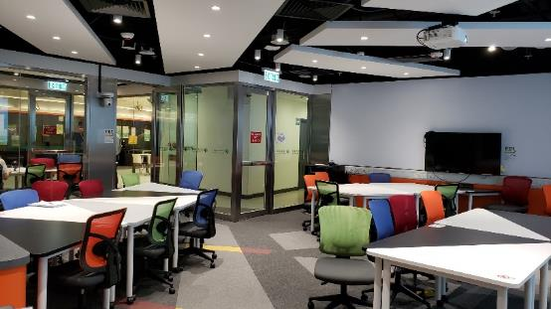
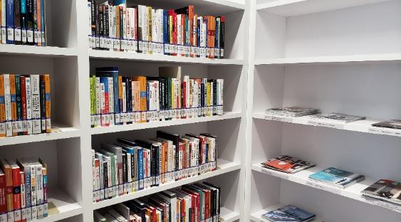
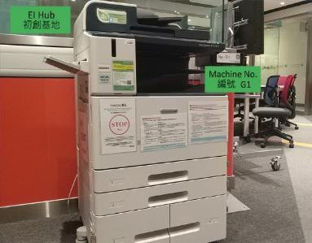
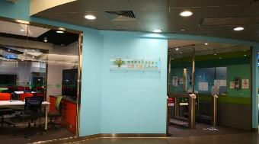
EI Hub
(LP/F – Open 24 Hours)
Located on LP/F of MMW Library, EI Hub provides a co-working space for students who are carrying out projects or starting their own businesses. EI Hub opens 24 hours and is available for advance online booking by EdUHK students.
EIH Collection includes over 400 books and magazines (14-day loan)
3-in-1 Octopus-operated machine for photocopying, scanning and Wi-Fi printing
Direct access between the Learning Commons and all floors of the Library

Slide 12


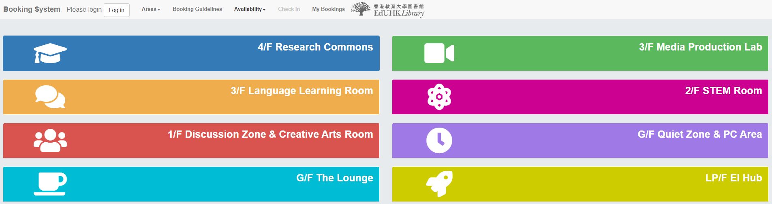
Login to the Booking System, select the desired facilities and time slots
Check in within 15 minutes after the start of each booking session
Check out before you leave
Library Booking System

Slide 13
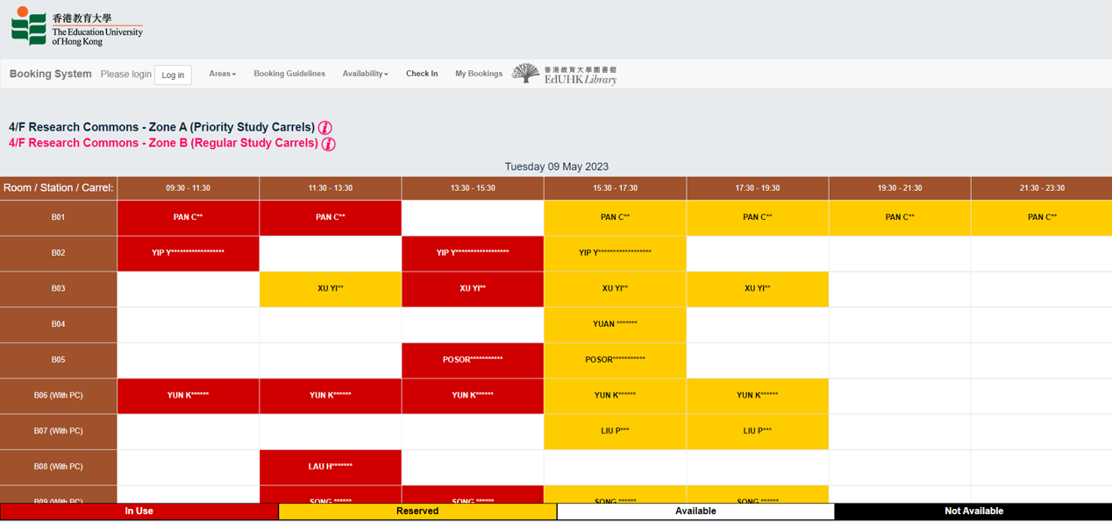
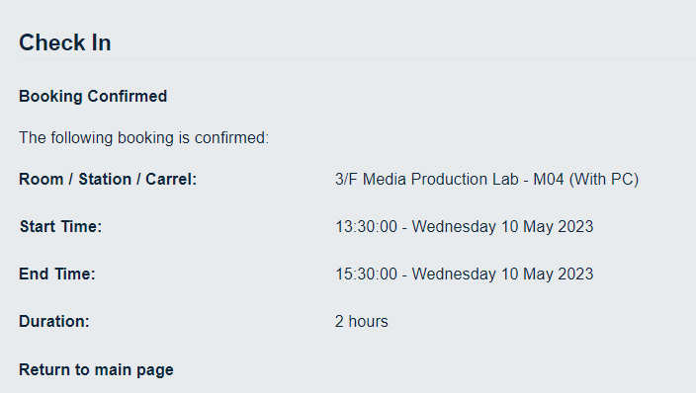
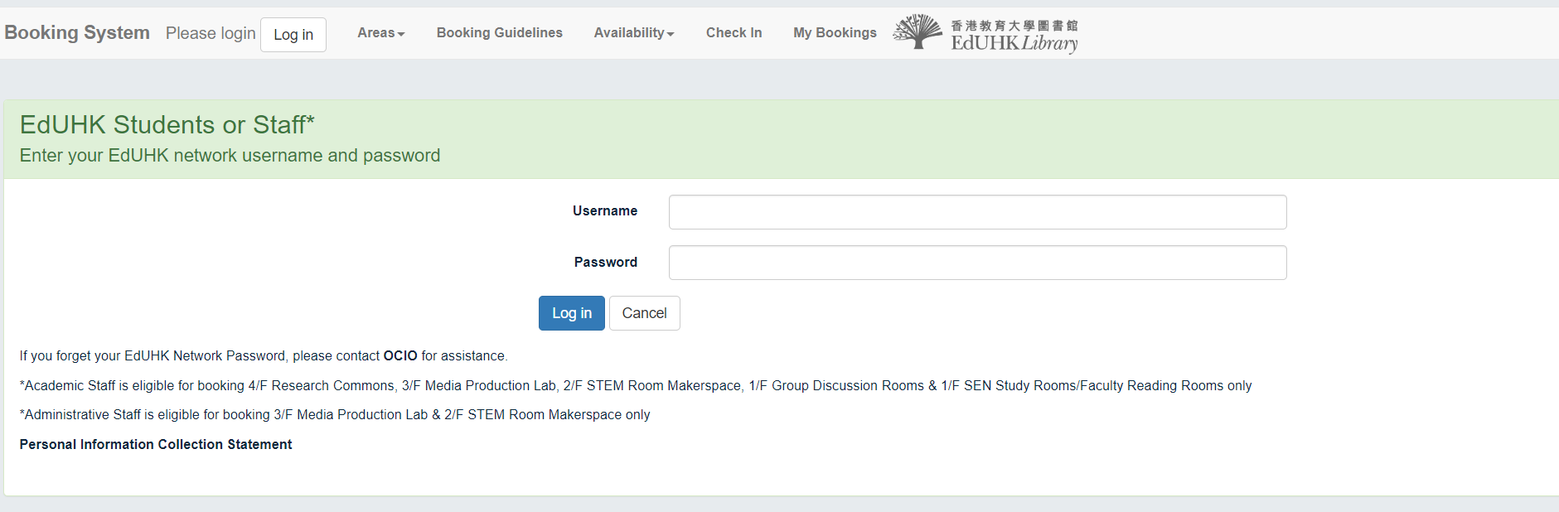
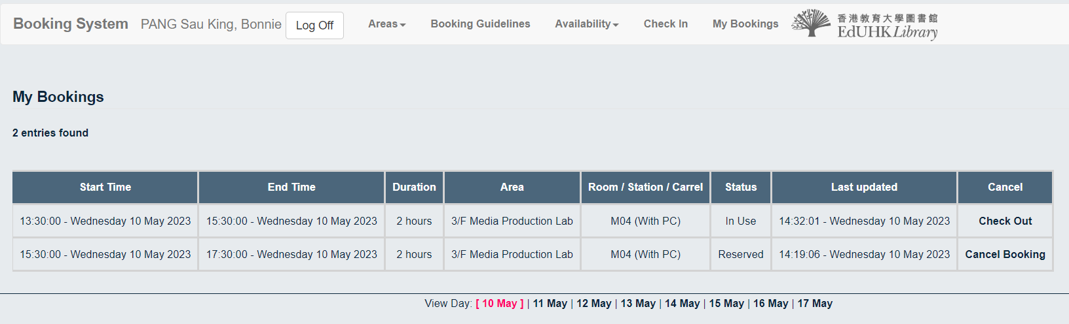
CHEN Tai Man

Slide 14

Your Borrowing Privileges
Postgraduate Degrees (Master’s & Doctoral Degrees) click
Bachelor Degrees
Elder Academy
Higher Diploma click
Postgraduate Diploma
Professional Development Programmes
Please select your status:

Slide 15

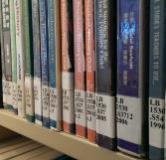
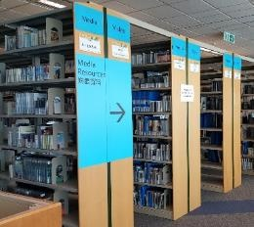






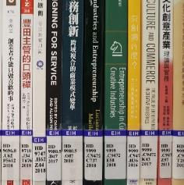
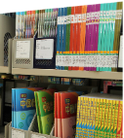


Your Borrowing Privileges
https://www.lib.eduhk.hk/about/policies-regulations/regulations#4
For
Postgraduate Degrees
Loan Quota: 80 items (for any combinations)
Hold Quota: 20 items
PressReader
HyRead
iRead
Browzine
Scribd
Circulation Books: 90 days
Media and e-book reader: 14 days
Teaching Resources, School Textbooks and EIH Collection: 14 days
Reserve Collection:
7 days or Library Use Only
The initial loan periods of 14-day, 30-day and 90-day loan items will be reduced to 7 days, 15 days and 30 days respectively if the items have been held by other users when the items are being checked out.
Notes:
如要更改頁面內容，請先點擊頁面，將已選取的透明方塊移走以進行修改，修改完成後再把方塊移回原位。

Slide 16
Your Borrowing Privileges
https://www.lib.eduhk.hk/about/policies-regulations/regulations#4
For:
Bachelor Degrees,
Elder Academy,
Higher Diploma,
Postgraduate Diploma,
Professional Development Programmes
Loan Quota: 50 items (for any combinations)
Hold Quota: 20 items
PressReader
HyRead
iRead
Browzine
Scribd
Circulation Books: 30 days
Media and e-book reader: 14 days
Teaching Resources, School Textbooks and EIH Collection: 14 days
Reserve Collection:
7 days or Library Use Only
The initial loan periods of 14-day, 30-day and 90-day loan items will be reduced to 7 days, 15 days and 30 days respectively if the items have been held by other users when the items are being checked out.
Notes:
如要更改頁面內容，請先點擊頁面，將已選取的透明方塊移走以進行修改，修改完成後再把方塊移回原位。

Slide 17
For
Postgraduate Degrees
Hong Kong Academic Library Link
(香港高校圖書聯網)
Postgraduate Degree students can borrow 15 books from other UGC libraries via HKALL for 30 days
HKALL loan quota (15 books) included in EdUHK Library loan quota
Request books with available status only
Pick up books at MMW Library or Tseung Kwan O Study Centre Library
You will be notified by email when the item is ready for pickup
Require to pick up books within 5 days from the date of notification
All loans may be renewed up to 90 days unless a hold or recall has been placed by a local user of the lending library
Notes:
如要更改頁面內容，請先點擊頁面，將已選取的透明方塊移走以進行修改，修改完成後再把方塊移回原位。
New add: All loans may be renewed up to 90 days unless a hold or recall has been placed by a local user of the lending library

Slide 18
Hong Kong Academic Library Link
(香港高校圖書聯網)
For:
Bachelor Degrees,
Elder Academy,
Higher Diploma,
Postgraduate Diploma,
Professional Development Programmes
Students can borrow 15 books from other UGC libraries via HKALL for 15 days
HKALL loan quota (15 books) included in EdUHK Library loan quota
Request books with available status only
Pick up books at MMW Library or Tseung Kwan O Study Centre Library
You will be notified by email when the item is ready for pickup
Require to pick up books within 5 days from the date of notification
All loans may be renewed up to 45 days unless a hold or recall has been placed by a local user of the lending library
Notes:
如要更改頁面內容，請先點擊頁面，將已選取的透明方塊移走以進行修改，修改完成後再把方塊移回原位。
New add: All loans may be renewed up to 45 days unless a hold or recall has been placed by a local user of the lending library

Slide 19
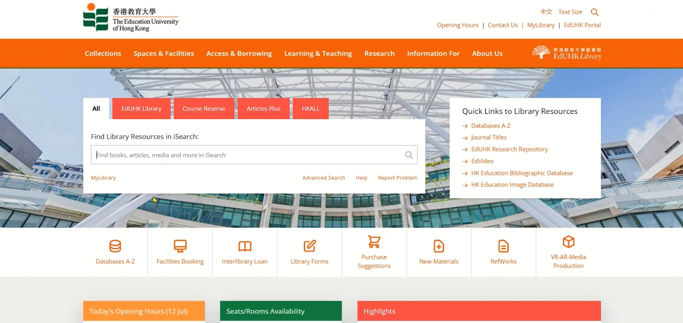
Request for HKALL

Slide 20












Overdue Fines 逾期罰款
Overdue fines are calculated according to the loan period of items
When an overdue fine reaches the Maximum Fine, all borrowing privileges of the borrower will be suspended until payment is made.
14-day, 7-day,
3-day and 1-day loans
$2 per day
30-day and 90-day loans
$1 per day
3-hour loans
$2 per hour
HKALL items
$2 per day
Notes:
New add: HKALL items

Slide 21


Renewal 續借 (EdUHK Library Items)
All loans with a loan period of 14 days or more may be renewed up to the maximum loan period specified below unless a hold or a recall has been placed.
* EdUHK Students (excluding students of self-funded non-credit bearing programmes)
Borrowers can renew their loans in person or online via the Library System anytime before the due date.
The new due date is calculated from the date of renewal.
Overdue items are not renewable.
Automatic renewal of EdUHK Library items (HKALL items excluded) three days before the due date.
Initial Loan Period | Maximum Loan Period after Renewals
14 days | 56 days
30 days | Unlimited *
90 days | Unlimited

Slide 22
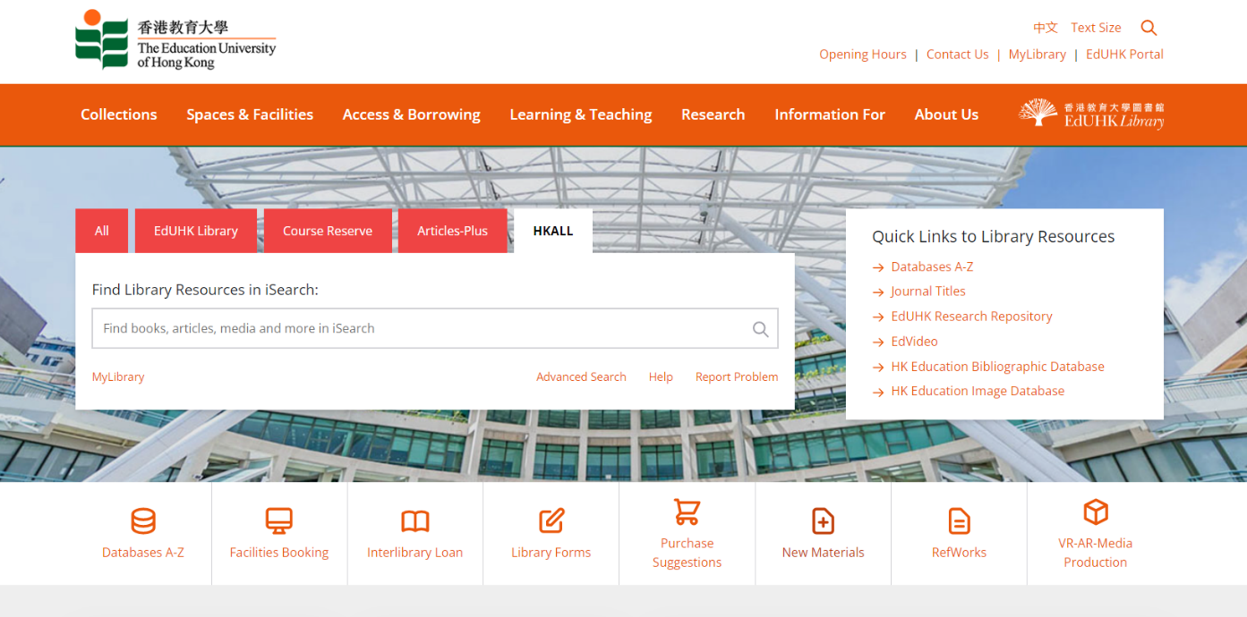
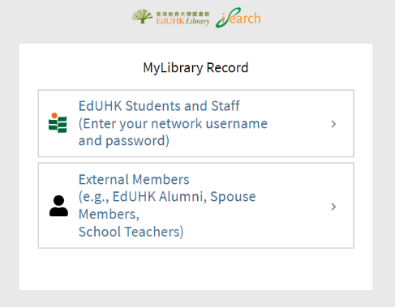
MyLibrary Record
Sign in to MyLibrary Record to view your loan record, renew your loan items, check your loan history, view request status, save searches and search results, etc.

Slide 23


View Loan Record and Renewal
Click to renew

Slide 24



Hold 預約
All loaned items with a loan period of 14 days or more are subject to hold requests (original loan period will not be shortened) placed on them by another user.
Your “hold” quotas: 20 items
Email notice will be sent to you when the hold item is ready for pickup.

Slide 25


Recall 催還
All loaned items with a loan period of 30 days or more are also subject to recall (original loan period will be shortened) if requested by another user.
Email will be sent to you notifying the revised due date.
HKALL items may be recalled by users of the lending library.
Late return of recalled or held items will be treated as overdue and liable to a fine.

Slide 26

Library Notice
All library notices will be sent to you by email
(EdUHK email account, e.g. s0765432@s.eduhk.hk)
  Due date alert notice (3 days before the due date and on the due date)
  Overdue notice
  Item recalled notice (due date shortened)
  Pickup notice
  Weekly report of loan activities

Slide 27

iSearch
One-stop search for multiple information sources, e.g. books, videos, journals & articles or more
Gives you Google-like searching experience

Slide 28


More Tips on Using iSearch
iSearch User Guide

Slide 29

Inter-campus Delivery 校內圖書運送服務
Students and staff can request loanable materials housed in Tai Po MMW Library to be sent to the Tseung Kwan O Study Centre Library for borrowing, or vice versa.
Only available for loan materials can be requested for delivery. For items on loan, they can be delivered at different libraries.
Items cannot be requested for delivery within the same library. Otherwise, items will be delivered to the another library automatically.

Slide 30

How to Request Items
(Inter-campus Delivery)

Slide 31
Resources Sharing
Please select your status:
Postgraduate Degrees (Master’s & Doctoral Degrees)
UGC-funded PGDE Programmes click
UGC-funded Undergraduate Degree Programmes click
Professional Development Programmes
Higher Diploma click
Elder Academy

Slide 32






Joint University Librarians Advisory Committee (JULAC) Cards
UGC-Funded Postgraduate Diploma (PGDE) and Postgraduate Degree students are eligible to apply for JULAC Cards
Visit and borrow items of other 7 UGC libraries
Borrowing privileges may vary among libraries
Admission to some libraries may be restricted during “black-out” periods of peak seasons
Application can be made online at https://www.lib.eduhk.hk/access-borrowing/julac-library-cards
* Postgraduate Degrees (Master’s & Doctoral Degrees) / UGC-funded PGDE Programmes
Notes:
如要更改頁面內容，請先點擊頁面，將已選取的透明方塊移走以進行修改，修改完成後再把方塊移回原位。

Slide 33




Book Return Service for JULAC Card Holders
You can return books borrowed with your JULAC cards at MMW Library or Tseung Kwan O Study Centre Library
No overdue items
Must return books in person with your JULAC card at the Circulation Counter
At least 3 working days before the due date
* Postgraduate Degrees (Master’s & Doctoral Degrees) / UGC-funded PGDE Programmes
Notes:
如要更改頁面內容，請先點擊頁面，將已選取的透明方塊移走以進行修改，修改完成後再把方塊移回原位。

Slide 34
Joint University Librarians Advisory Committee (JULAC) Cards
UGC-funded Undergraduate Degree students are eligible to apply for JULAC Library Reader Cards
Visit and use the collections of other UGC libraries in-house
Annual registration fee $50 charged by each host library (1 Aug - 31 Jul)
Admission to some libraries may be restricted during “black-out” periods of peak seasons
Application can be made online at https://www.lib.eduhk.hk/access-borrowing/julac-library-cards
* UGC-funded Undergraduate Degree Programmes
Notes:
如要更改頁面內容，請先點擊頁面，將已選取的透明方塊移走以進行修改，修改完成後再把方塊移回原位。

Slide 35



Interlibrary Loan
If a journal article required is not found in the Library, use the interlibrary loan service to get an electronic copy.
Fill in the online form

Slide 36
Electronic Resources
The Library has a rich collection of electronic resources and research tools

Slide 37



E-Databases & E-Books Collections
Refine the databases by Subject or Resource Type

Slide 38



Recommended E-Databases
The Library has more than 300 e-databases of different subject areas:
Academic Search Ultimate
ERIC
Factiva
ProQuest Databases
Scopus
Social Sciences Citation Index
ACI 學術引用文獻資料庫
CEPS 中文電子期刊服務
CNKI 中國知網
中國學位論文全文數據庫
漢籍電子文獻資料庫
… and more
Join our workshops to discover how the databases can help your research

Slide 39



E-Journals
The Library has subscribed over 134,000 English and Chinese e-journals
Login with EdUHK account

Slide 40


EdVideo (Local TV Programmes)
Video-on-demand service which features education related and current affairs programmes from RTHK, TVB, ATV, ETV and ViuTV

Slide 41


EdUHK Research Repository
The EdUHK Research Repository collects, manages, preserves and showcases the research output of EdUHK staff in one digital location. The Research Repository also provides access to an electronic copy of the material when available.

Slide 42

Remote Access to E-Resources 遠程登錄圖書館電子資源
Remote access to library electronic resources is available via Non-EdUHK network
Use your EdUHK Network Username and Password for authentication purpose

Slide 43






Library Mobile Apps
Lib MAP
EdU Library
Smart Learning
https://edulib.me/map
https://edulib.me/app
https://edulib.me/smart-learning-app

Slide 44


Library SMS Alert Service 圖書館短訊提示服務
SMS Alert service (https://sms.lib.eduhk.hk/) is available to all EdUHK staff and students for free
Register your HK phone number before using this service
Receive SMS alert when a borrowed item is due within 3 days, overdue, recalled or ready to pick up

Slide 45


Library Workshops
Supports students to develop essential information and research skills
Provides hands-on training on different library resources

Slide 46





Download This PowerPoint

Slide 47


Library Regulations
Important
Admission to the EdUHK Library is conditional upon the presentation of a valid EdUHK Staff/Student Card or EdUHK Library Borrower/Reader Card.
Don’t lend/borrow Library Card to/from others users.
Food must not be brought into or consumed in the Library, except in area(s) designated by the Librarian from time to time.
Except in designated discussion areas, library users must keep silent inside the Library, and must not cause disturbance to other library users and library staff.
No seats may be reserved by placing materials on the desks or chairs.
Personal belongings should not be left unattended anywhere in the Library.
Don’t leave the library exit with uncharged library material(s).
Cases & Actions can be found in Library Regulations section 6.

Slide 48


Library Handbook
Library VR Tour
2023/2024

Slide 49

Ask your Librarian @
Information Counter
Tel: 2948 6653
WhatsApp: 9514 9655 (Mon-Fri, 9am-5pm)
Email: libinfo@eduhk.hk
Library Zoom: https://app.lib.eduhk.hk/zoom

