Slide 1
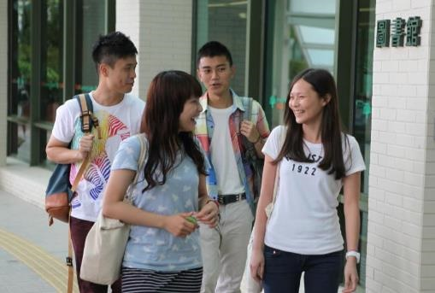
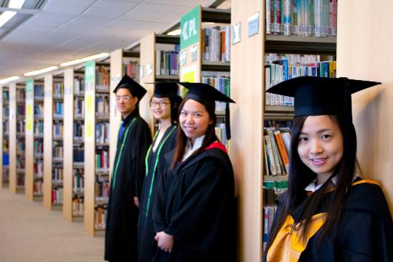


2024/25 Library Orientation

Slide 2

Contents
(Click to go)
Location | P.3-5
Facilities and Booking System | P.6-14
Borrowing Privileges | P.15-26
iSearch | P.27-28
Inter-campus Delivery | P.29-30
Electronic Resources | P.31-37
Other Information | P.38-45

Slide 3
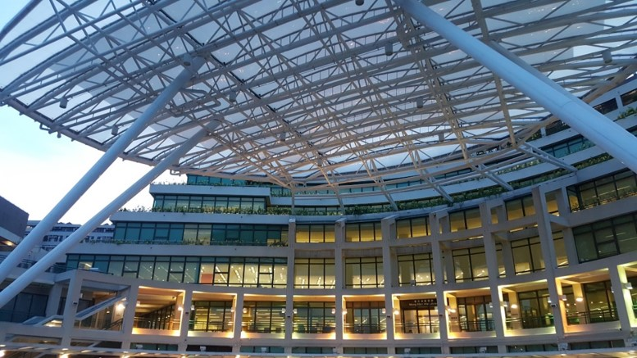
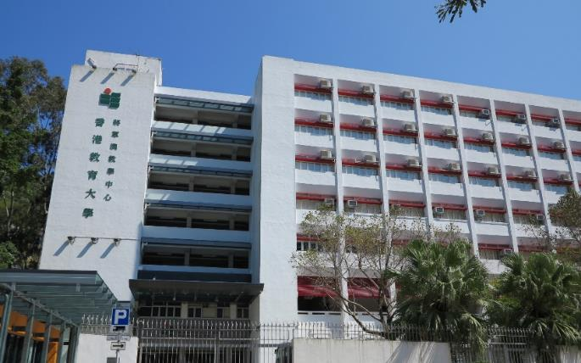
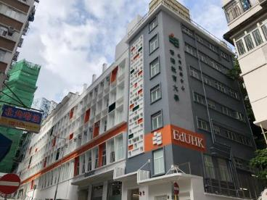
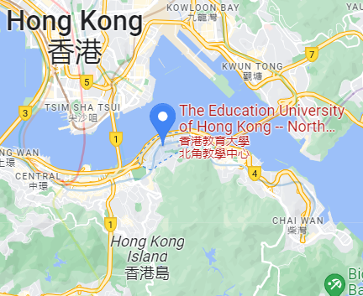

Our Service Locations
Mong Man Wai Library
(Block C, Tai Po Campus)
Tseung Kwan O Study Centre Library
(1 King Yin Lane, Tseung Kwan O)
North Point Study Centre
(Self Pick-up Station and Book Return only)
Different Opening Hours

Slide 4
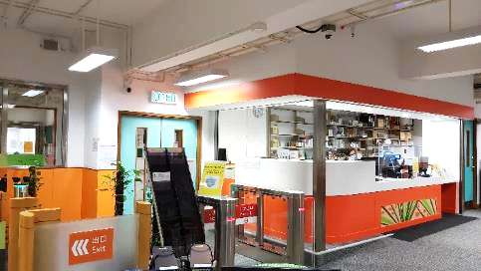
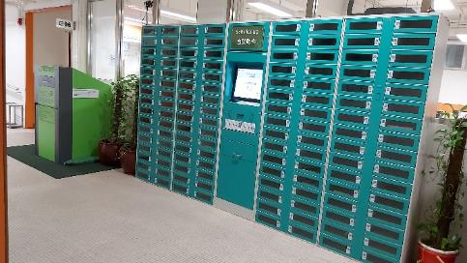
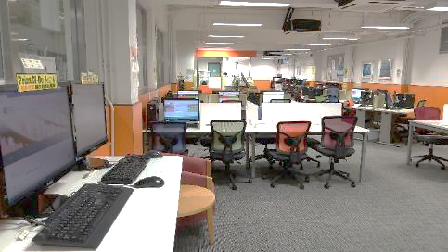
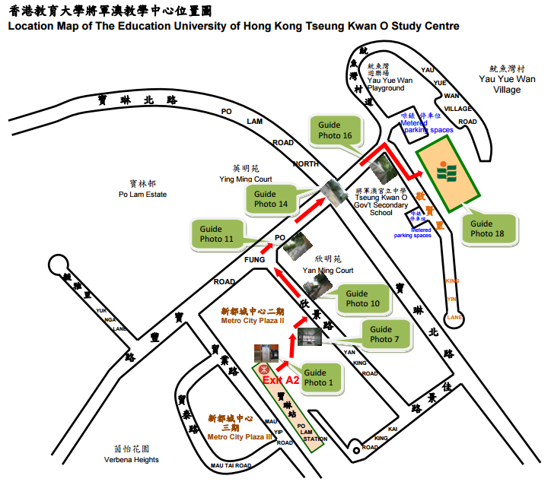
Tseung Kwan O Study Centre Library
The Tseung Kwan O Study Centre Library (TKOSC Library) is located on the ground floor of the EdUHK Tseung Kwan O Study Centre.
It serves primarily as a resource centre for students enrolled in programmes at the Tseung Kwan O Study Centre.
In addition, students and staff of TKOSC also enjoy access to the resources, facilities and services of the MMW Library on Tai Po Campus.
地址：新界將軍澳敬賢里1號
Address: No. 1, King Yin Lane, Tseung Kwan O, New Territories
Tel : 2190 8521
Notes:
Use gif for the map
More tko image

Slide 5
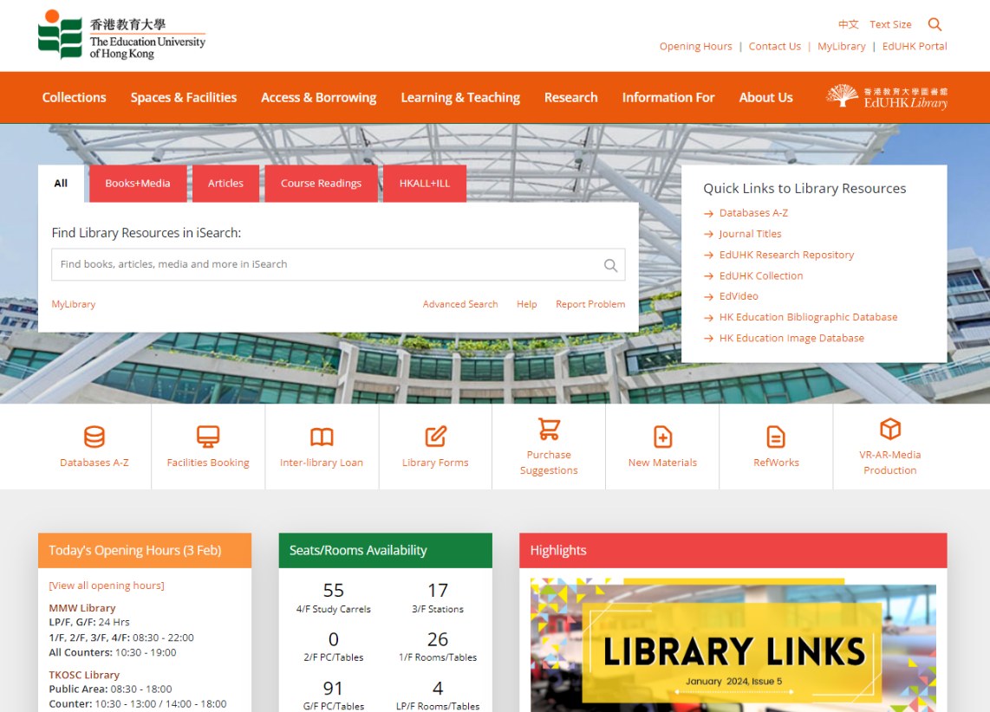
Current Opening Hours of MMW Library & TKOSC Library

Slide 6
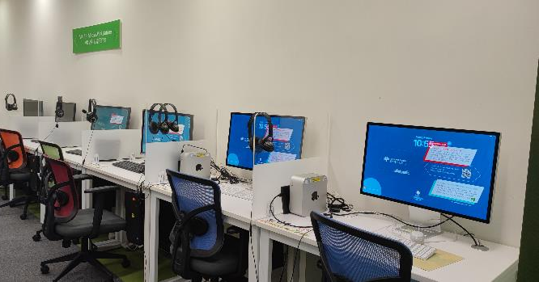
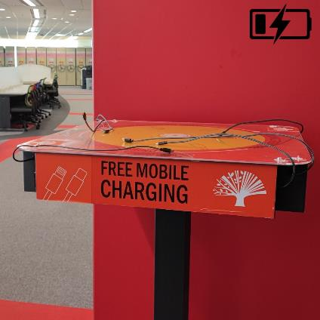
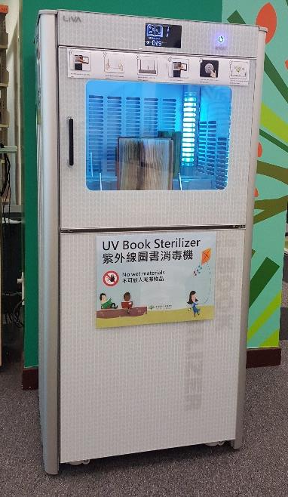
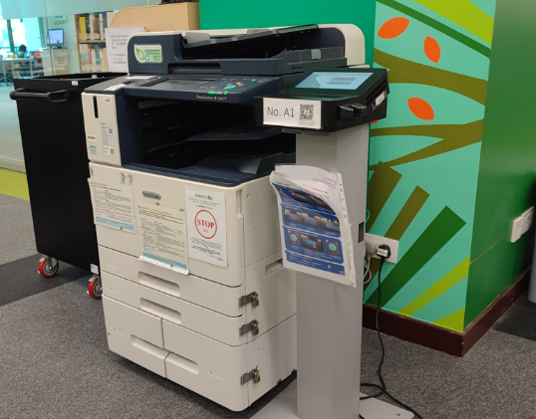
Facilities Highlight @MMW Library
PC Workstations
Mobile Device Charging Stations
UV Book Sterilizers
Printing, Photocopying and Scanning Facilities

Slide 7
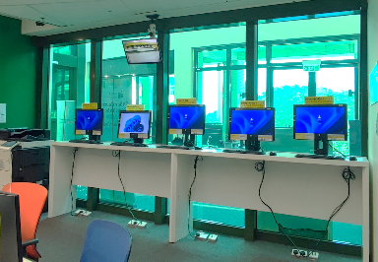
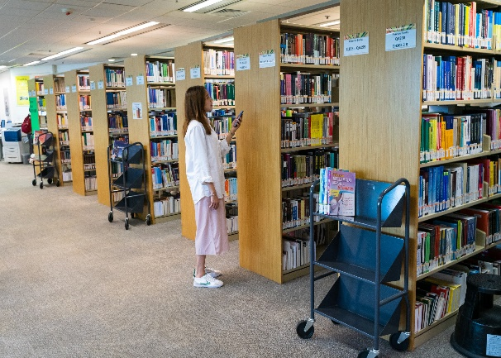
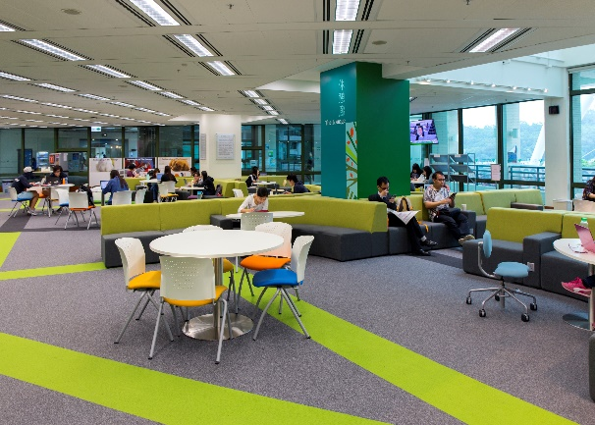
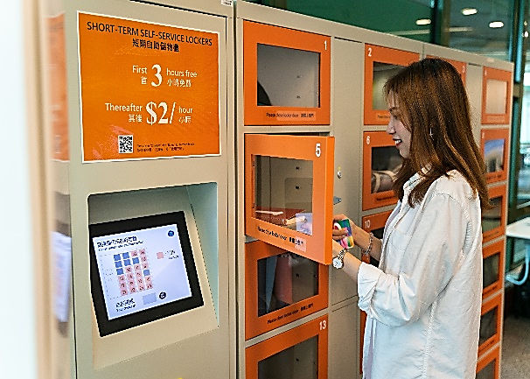
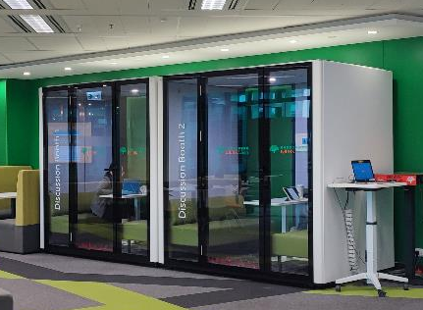
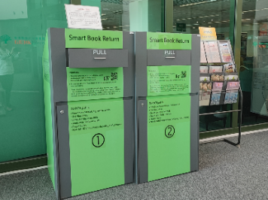
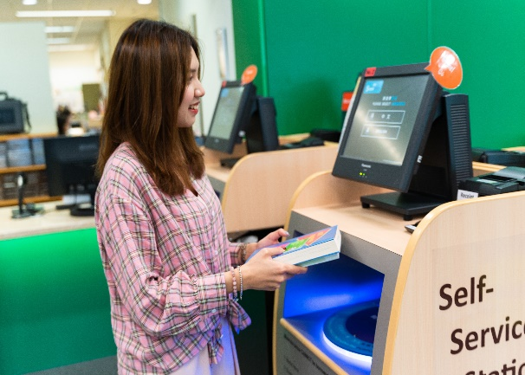
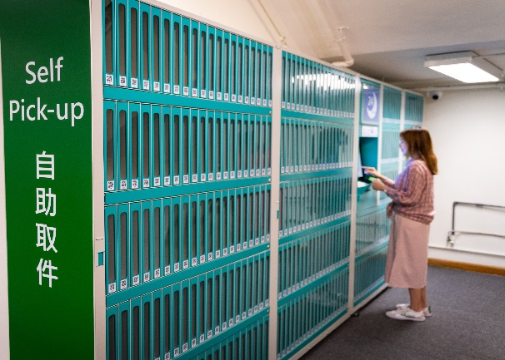
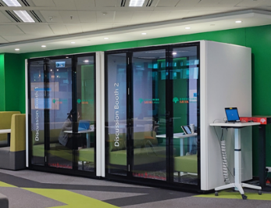
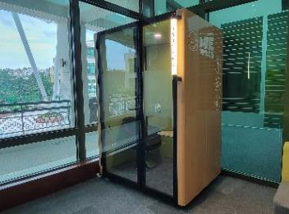
Facilities Highlight G/F (Open 24 hours)
Print-N-Go Stations
OCIO Print Quota System
Reserve Collection
reading materials for specific programmes and modules
The Lounge
perfect place for chatting and relaxation
Short-Term
Self-Service Lockers
24-hour Smart Book Return
Self-Service Stations
RFID self-service
Self Pick-up Station
Discussion Booths
5 on G/F
Me Space

Slide 8
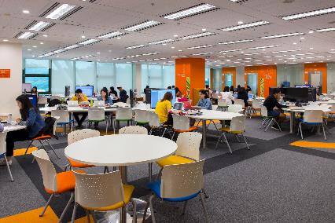
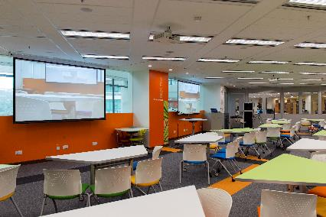
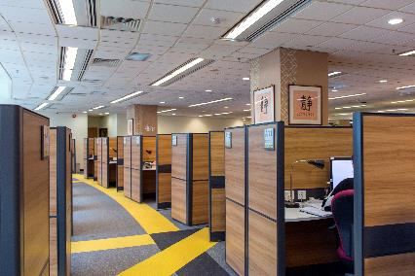
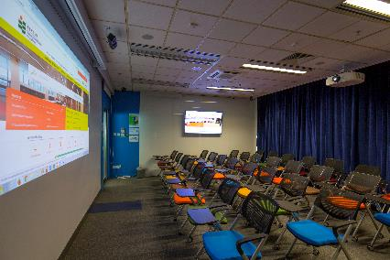
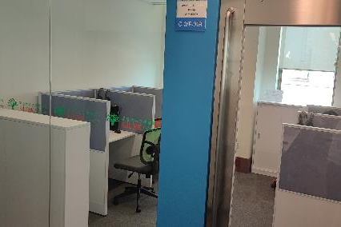
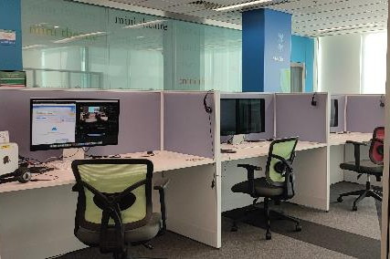
Facilities Highlight
1/F - 4/F
Discussion Zone (1/F)
5 group discussion rooms
23 group discussion tables
4 discussion booths
4 study booths
Flexi Zone (1/F)
Two sets of 4K projectors and PCs
Two sets of Handheld Wireless Microphone
Research Commons (4/F)
62 individual study carrels on 4/F
Mini Theatre (3/F)
40 seats for classes
Language Learning Room (3/F)
4 workstations
Media Production Lab (3/F)
16 media workstations

Slide 9
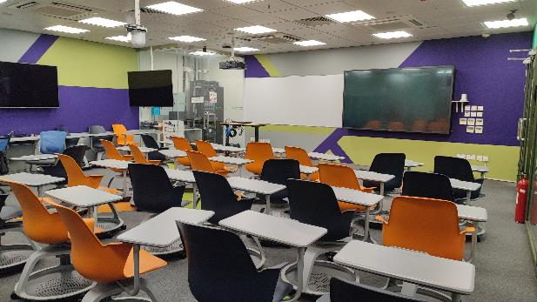
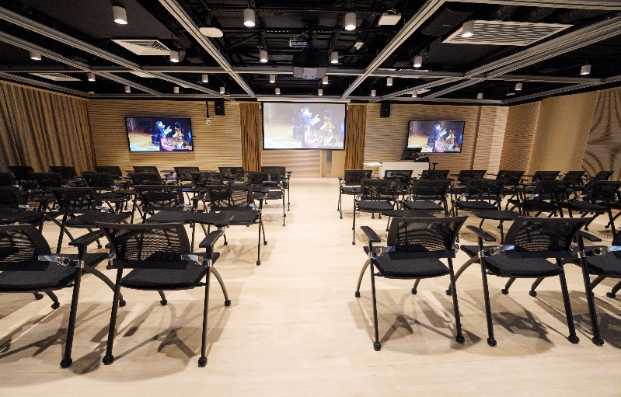
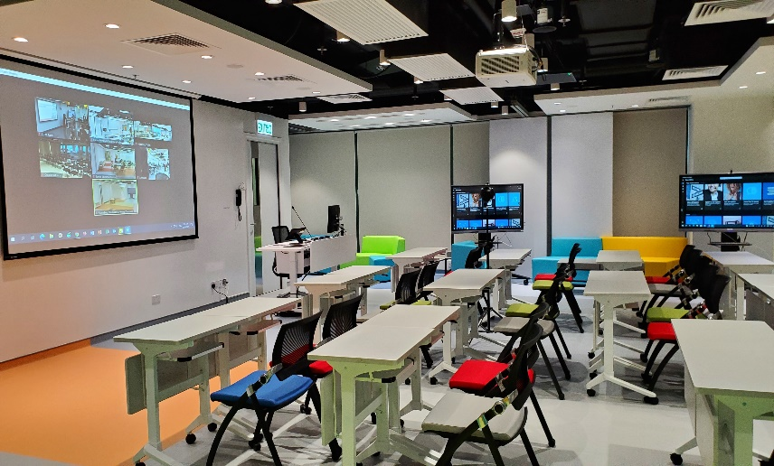
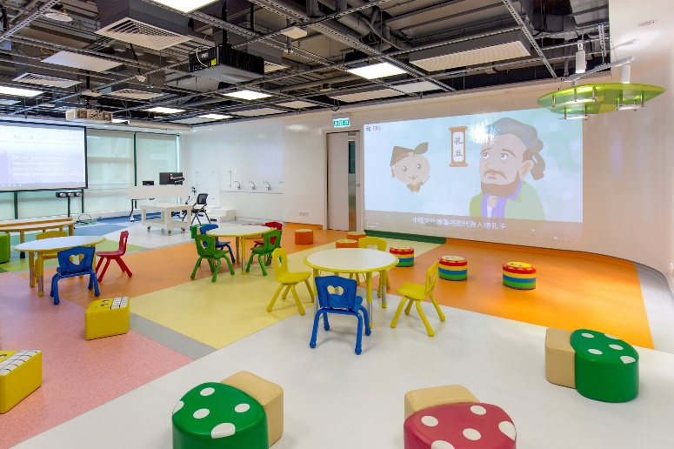
Creative Arts Room (1/F)
Specially designed for creative arts
Professional audio-visual facilities for performance and recording
Moveable partition boards for zoning and artworks display, etc.
Creative Lab (G/F)
VR-AR Media Equipment and Software
Video-conferencing and Recording Equipment, etc.
Future
Classrooms
Future Primary & Secondary Classroom (1/F)
Designed for students at senior primary to junior secondary levels
Moveable and flappable 4K interactive touch-screen displays, etc.
Future Early Childhood & Primary Classroom (1/F)
Designed for school children at kindergarten to junior primary levels with custom-made furniture for young children
Different lighting effects, 4K projectors, opaque projectors, projection screen and projection wall, etc.

Slide 10
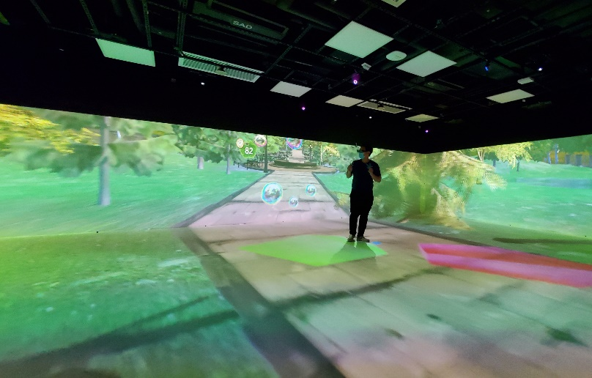
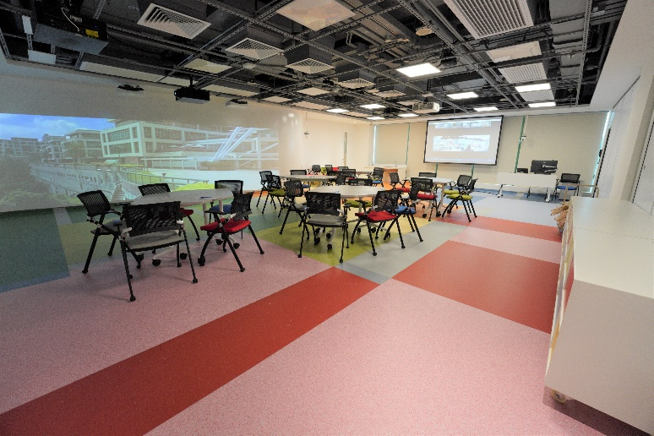
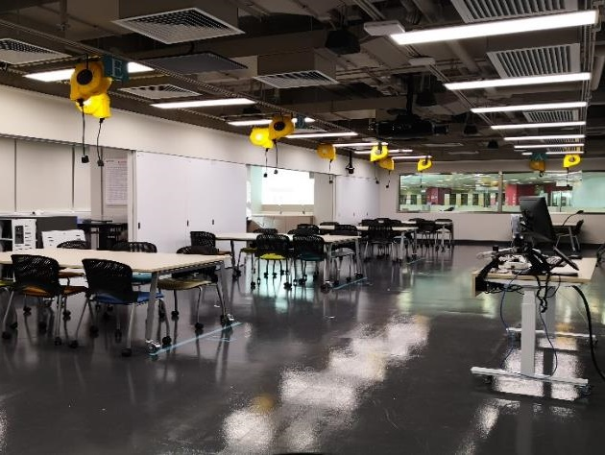
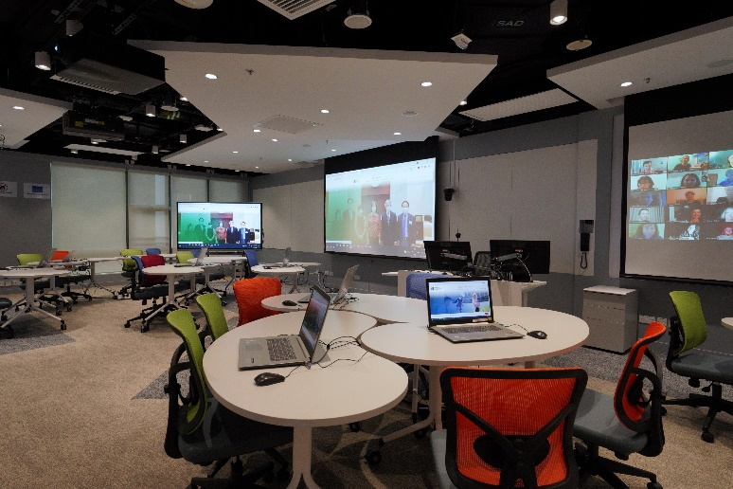
Extended Reality Room (2/F)
One of the largest VR CAVEs in Hong Kong supporting 360-degree interactive 4-side and floor projection as well as surround sound system
Includes a VR Experience Area with VR treadmill and extra wide gaming station
Special Education Room (1/F)
Specially designed for students with special education needs
Induction loop system for hearing aids
32:10 extra-wide video projection wall for visual stimulations, etc.
Future
Classrooms
STEM Room (2/F)
Designed for STEM and Makerspace classes
One 4K projector & Two 4K 86” interactive LCD panels, etc.
e-Learning Studio (2/F)
Designed for classes by Library and other academic units
42 notebook computers
PTZ cameras and ceiling mic arrays for 2-way video communications and online/hybrid teaching, etc.

Slide 11
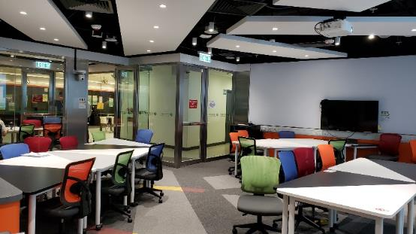
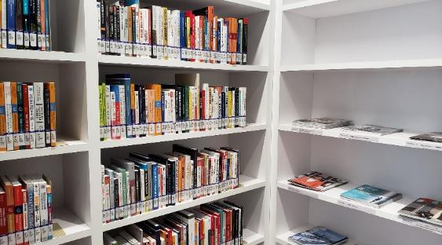
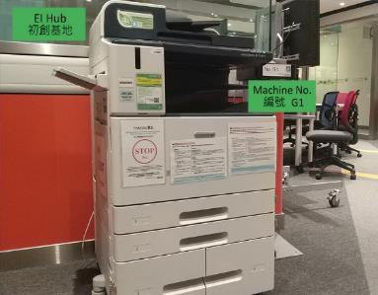
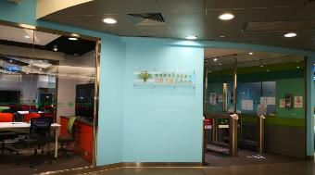
EI Hub
(LP/F – Open 24 Hours)
Located on LP/F of MMW Library, EI Hub provides a co-working space for students who are carrying out projects or starting their own businesses. EI Hub opens 24 hours and is available for advance online booking by EdUHK students.
EIH Collection includes over 400 books and magazines (14-day loan)
3-in-1 Octopus-operated machine for photocopying, scanning and Wi-Fi printing
Direct access between the Learning Commons and all floors of the Library

Slide 12


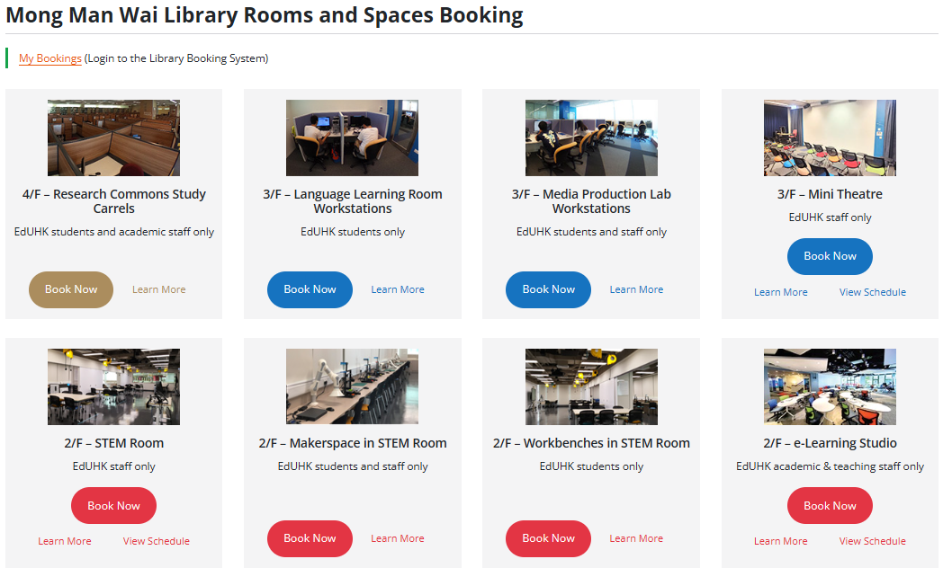


Login to the Booking System, select the desired facilities and time slots
Check in within 15 minutes after the start of each booking session
Check out before you leave
Library Booking System

Slide 13
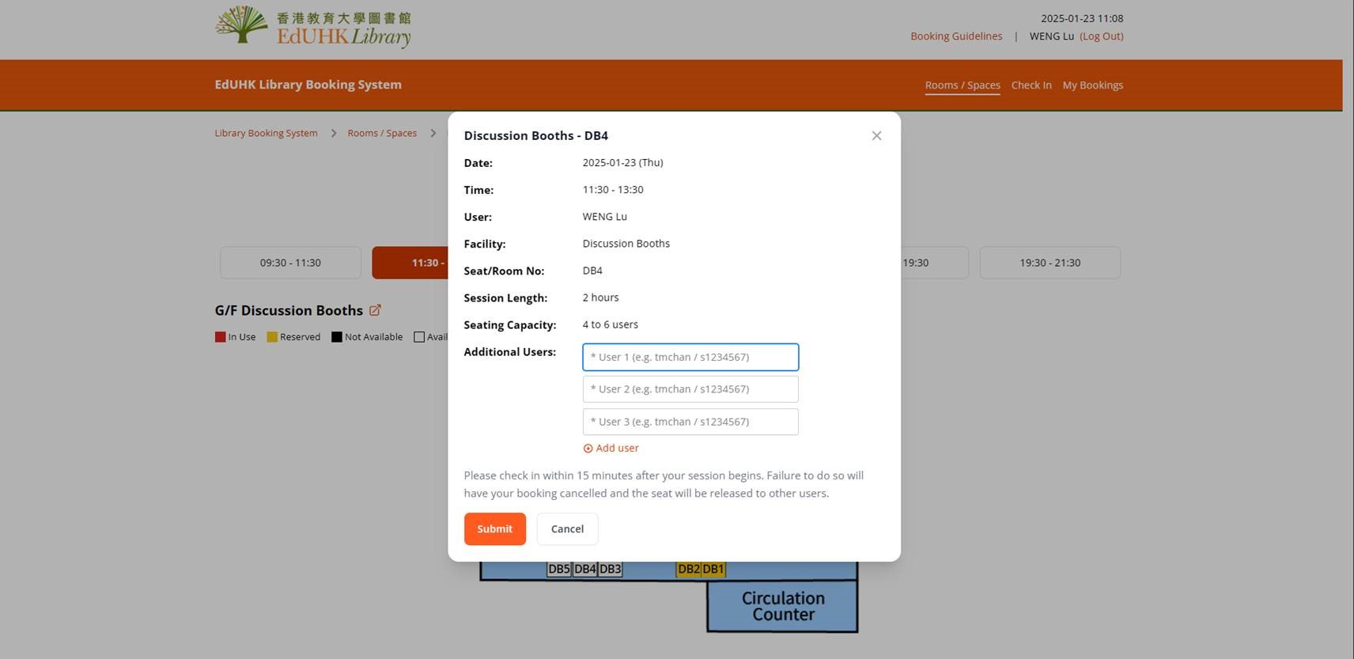
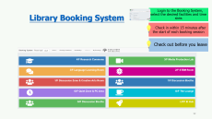
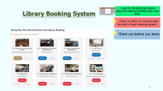
WANG LE

Slide 14
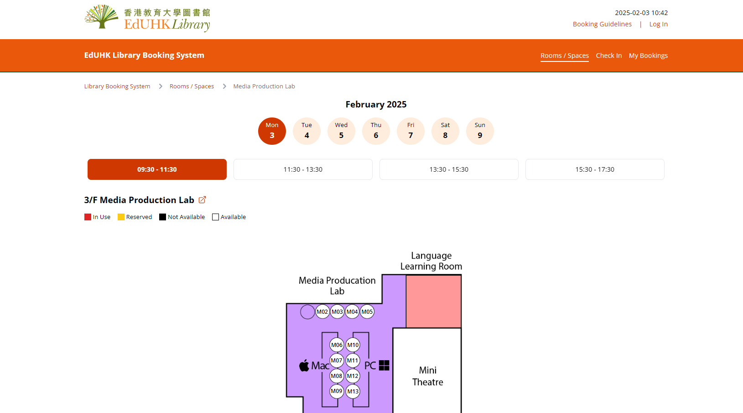
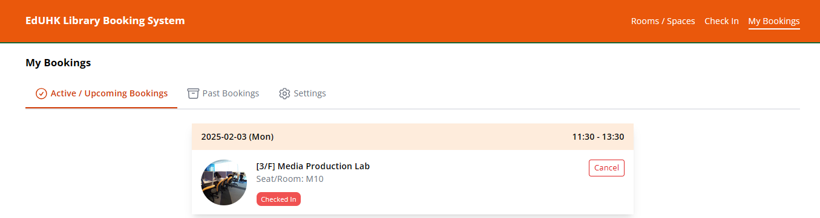

Slide 15

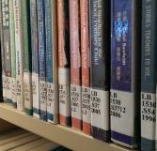












Your Borrowing Privileges
https://www.lib.eduhk.hk/about/policies-regulations/regulations#4
For:
Professional Development Programmes
Loan Quota: 50 items (for any combinations)
Hold Quota: 20 items
Airiti Reader
Browzine
Everand
HyRead 3
Scribd
PressReader
Circulation Books: 30 days
Media and e-book reader: 14 days
Teaching Resources, School Textbooks and EIH Collection: 14 days
Reserve Collection:
7 days or Library Use Only
The initial loan periods of 14-day, 30-day and 90-day loan items will be reduced to 7 days, 15 days and 30 days respectively if the items have been held by other users when the items are being checked out.
Notes:
如要更改頁面內容，請先點擊頁面，將已選取的透明方塊移走以進行修改，修改完成後再把方塊移回原位。

Slide 16
For:
Professional Development Programmes
Hong Kong Academic Library Link
(香港高校圖書聯網)
Students can borrow 15 books from other UGC libraries via HKALL for 15 days
HKALL loan quota (15 books) included in EdUHK Library loan quota
Request books with available status only
Pick up books at MMW Library, Tseung Kwan O Study Centre Library or North Point Study Centre
You will be notified by email when the item is ready for pickup
Require to pick up books within 5 days from the date of notification
All loans may be renewed up to 45 days unless a hold or recall has been placed by a local user of the lending library
Notes:
如要更改頁面內容，請先點擊頁面，將已選取的透明方塊移走以進行修改，修改完成後再把方塊移回原位。
New add: All loans may be renewed up to 45 days unless a hold or recall has been placed by a local user of the lending library

Slide 17
For:
Professional Development Programmes
Inter-library Loan and Document Delivery Service
You can request book chapters or journal articles that are not available in EdUHK Library from other libraries worldwide.
You will be notified by email to download the requested electronic items from MyLibrary. There is a maximum download limit of 5 times. PDFs that have expired cannot be retrieved.

Slide 18



How to Request HKALL, ILL & DDS
Step 1: Sign in
Use DDS service to get a digital copy of one chapter
Use HKALL service to get a physical copy from other 7 UGC university libraries
Step 2: Check for Available Services

Slide 19












Overdue Fines 逾期罰款
Overdue fines are calculated according to the loan period of items
When an overdue fine reaches the Maximum Fine, all borrowing privileges of the borrower will be suspended until payment is made.
14-day, 7-day,
3-day and 1-day loans
$2 per day
30-day and 90-day loans
$1 per day
3-hour loans
$2 per hour
HKALL items
$2 per day
Notes:
New add: HKALL items

Slide 20


Renewal 續借 (EdUHK Library Items)
All loans with a loan period of 14 days or more may be renewed up to the maximum loan period specified below unless a hold or a recall has been placed.
* EdUHK Students (excluding students of self-funded non-credit bearing programmes)
Borrowers can renew their loans in person or online via the Library System anytime before the due date.
The new due date is calculated from the date of renewal.
Overdue items are not renewable.
Automatic renewal of EdUHK Library items (HKALL items excluded) three days before the due date.
Initial Loan Period | Maximum Loan Period after Renewals
14 days | 56 days
30 days | Unlimited *
90 days | Unlimited

Slide 21


MyLibrary Record
Sign in to MyLibrary Record to view your loan record, renew your loan items, check your loan history, view request status, save searches and search results, etc.

Slide 22


View Loan Record and Renewal
Click to renew

Slide 23




Hold 預約
All loaned items with a loan period of 14 days or more are subject to hold requests (original loan period will not be shortened) placed on them by another user.
Your “hold” quotas: 20 items
Email notice will be sent to you when the hold item is ready for pickup.

Slide 24


Recall 催還
All loaned items with a loan period of 30 days or more are also subject to recall (original loan period will be shortened) if requested by another user.
Email will be sent to you notifying the revised due date.
HKALL items may be recalled by users of the lending library.
Late return of recalled or held items will be treated as overdue and liable to a fine.

Slide 25

Library Notice
All library notices will be sent to you by email
(EdUHK email account, e.g. s0765432@s.eduhk.hk)
  Due date alert notice (3 days before the due date and on the due date)
  Overdue notice
  Item recalled notice (due date shortened)
  Pickup notice
  Weekly report of loan activities

Slide 26

iSearch
One-stop search for multiple information sources, e.g. books, videos, journals & articles or more
Gives you Google-like searching experience

Slide 27


More Tips on Using iSearch
iSearch User Guide

Slide 28

Inter-campus Delivery 校內圖書運送服務
Students and staff can request loanable materials housed in Tai Po MMW Library to be sent to the Tseung Kwan O Study Centre Library for borrowing, or vice versa. Loanable materials from above libraries can be sent to North Point Study Centre for borrowing.
Only available for loan materials can be requested for delivery. For items on loan, they can be delivered at different libraries.
Items cannot be requested for delivery within the same library. Otherwise, items will be delivered to the another library automatically.

Slide 29





How to Request Items
(Inter-campus Delivery)
Select Pickup Location
TKO book
Click Request

Slide 30

Electronic Resources
The Library has a rich collection of electronic resources and research tools

Slide 31



E-Databases & E-Books Collections
Refine the databases by Subject or Resource Type

Slide 32



Recommended E-Databases
The Library has more than 300 e-databases of different subject areas:
Academic Search Ultimate
ERIC
Factiva
ProQuest Databases
Scopus
Social Sciences Citation Index
ACI 學術引用文獻資料庫
CEPS 中文電子期刊服務
CNKI 中國知網
中國學位論文全文數據庫
漢籍全文資料庫
… and more
Join our workshops to discover how the databases can help your research

Slide 33


E-Journals
The Library has subscribed over 137,000 English and Chinese e-journals
Login with EdUHK account

Slide 34


EdVideo (Local TV Programmes)
Video-on-demand service which features education related and current affairs programmes from RTHK, TVB, former ATV, former ETV and ViuTV

Slide 35


EdUHK Research Repository
The EdUHK Research Repository collects, manages, preserves and showcases the research output of EdUHK staff in one digital location. The Research Repository also provides access to an electronic copy of the material when available.

Slide 36

Remote Access to E-Resources 遠程登錄圖書館電子資源
Remote access to library electronic resources is available via Non-EdUHK network
Use your EdUHK Network Username and Password for authentication purpose

Slide 37






Library Mobile Apps
Lib MAP
EdU Library
Smart Learning
https://edulib.me/map
https://edulib.me/app
https://edulib.me/smart-learning-app

Slide 38






Mobile Borrowing Service
First mobile application among all local university libraries
Allow EdUHK Library users to borrow library books instantly by themselves anywhere inside the Library.
Not all library materials can be borrowed by phones, please check them out at Circulation Counter if needed
Remember to scan EdUHK Library Barcode (starting with 31995…) instead of ISBN Barcode

Slide 39


Library SMS Alert Service 圖書館短訊提示服務
SMS Alert service (https://sms.lib.eduhk.hk/) is available to all EdUHK staff and students for free
Register your HK phone number before using this service
Receive SMS alert when a borrowed item is due within 3 days, overdue, recalled or ready to pick up

Slide 40


Library Workshops
Supports students to develop essential information and research skills
Provides hands-on training on different library resources

Slide 41





Download This PowerPoint

Slide 42


Library Regulations
Important
Admission to the EdUHK Library is conditional upon the presentation of a valid EdUHK Staff/Student Card or EdUHK Library Borrower/Reader Card.
Don’t lend/borrow Library Card to/from others users.
Food must not be brought into or consumed in the Library, except in area(s) designated by the Librarian from time to time.
Except in designated discussion areas, library users must keep silent inside the Library, and must not cause disturbance to other library users and library staff.
No seats may be reserved by placing materials on the desks or chairs.
Personal belongings should not be left unattended anywhere in the Library.
Don’t leave the library exit with uncharged library material(s).
Cases & Actions can be found in Library Regulations section 6.

Slide 43


Library Handbook
Library VR Tour
2024/2025

Slide 44

Ask your Librarian @
Information Counter
Tel: 2948 6653
WhatsApp: 9514 9655 (Mon-Fri, 9am-5pm)
Email: libinfo@eduhk.hk
Library Zoom: https://app.lib.eduhk.hk/zoom

