Slide 1

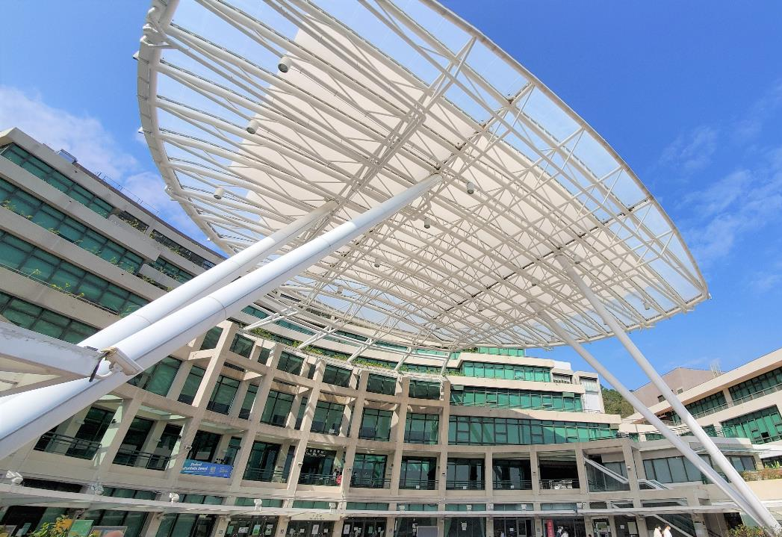

2025/26
NEW STAFF
ORIENTATION

Slide 2


Outline
The Basics
Tips and Services Highlights
  Borrowing
  Using other local university library resources
  Your purchase recommendation
  Teaching support from Library
  Research support from Library
Other Facilities and Services

Slide 3
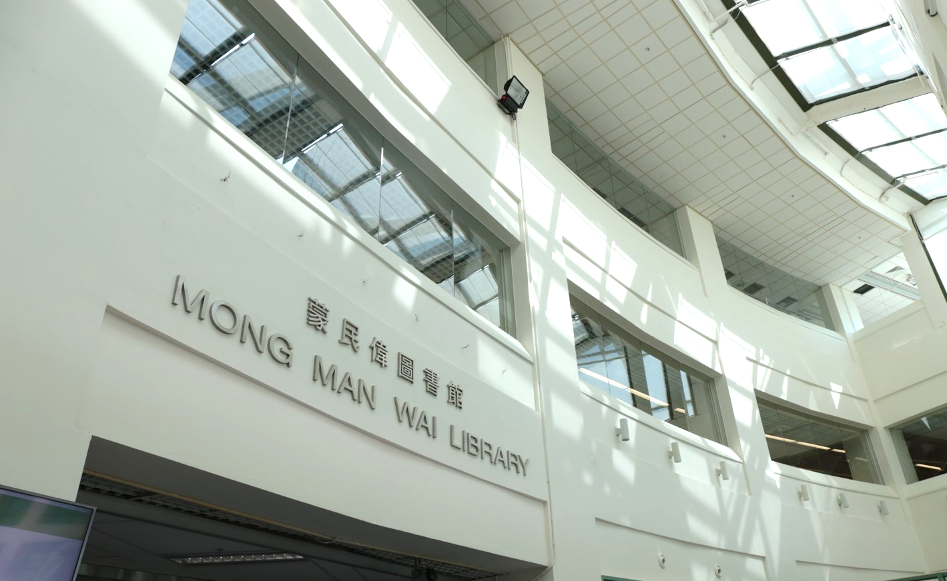
THE
BASICS

Slide 4

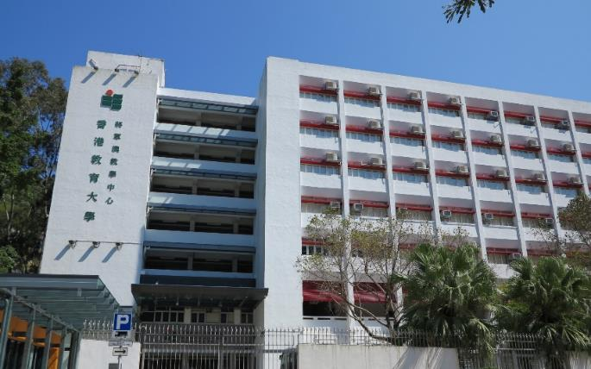
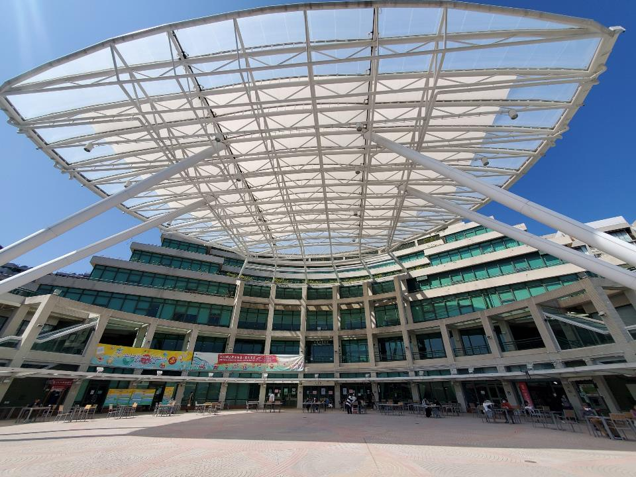
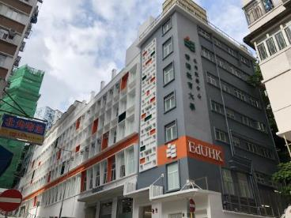
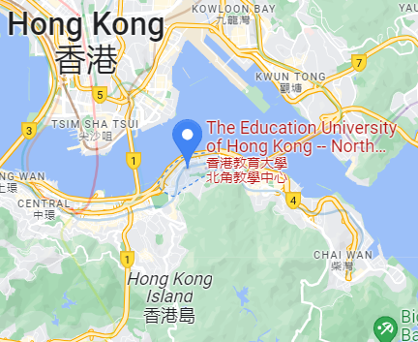
Our Locations
Tseung Kwan O Study Centre Library
(1 King Yin Lane, Tseung Kwan O)
Different Opening Hours
https://www.lib.eduhk.hk/opening-hours/mmw-library
North Point Study Centre
(Self Pick-up Station and Book Return only)
Mong Man Wai Library
(Block C, Tai Po Campus)
The Basics

Slide 5
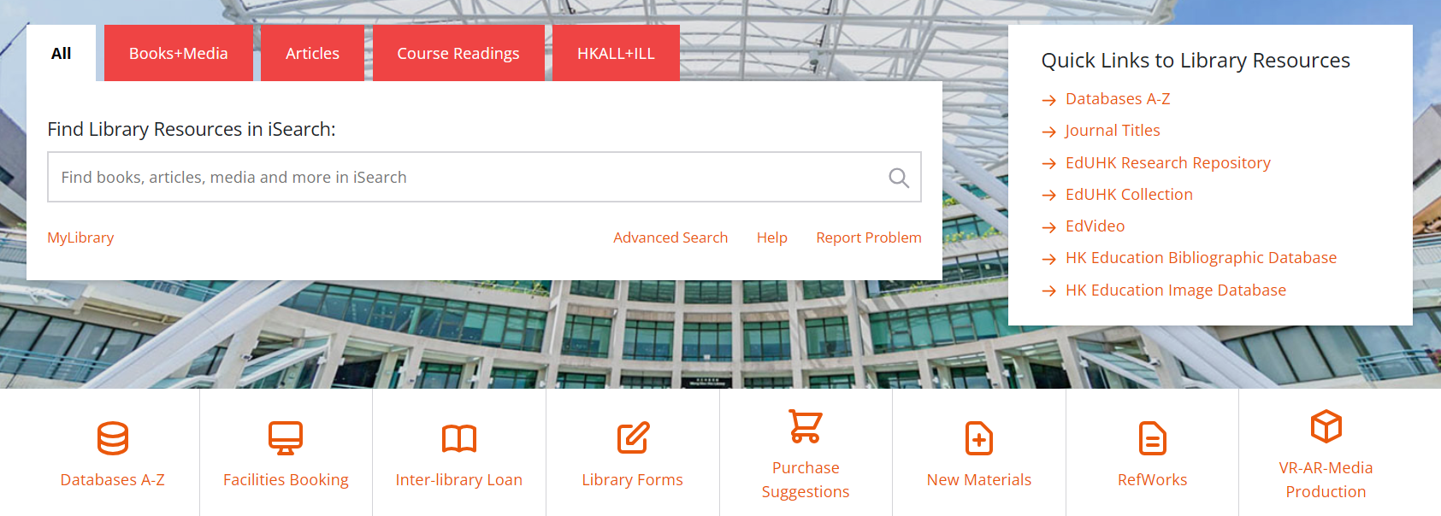
iSearch
One-stop search for multiple information sources, such as Library books, databases, e-journals and more.
Limit the results by the search scope menu
Enter your search terms
The Basics

Slide 6
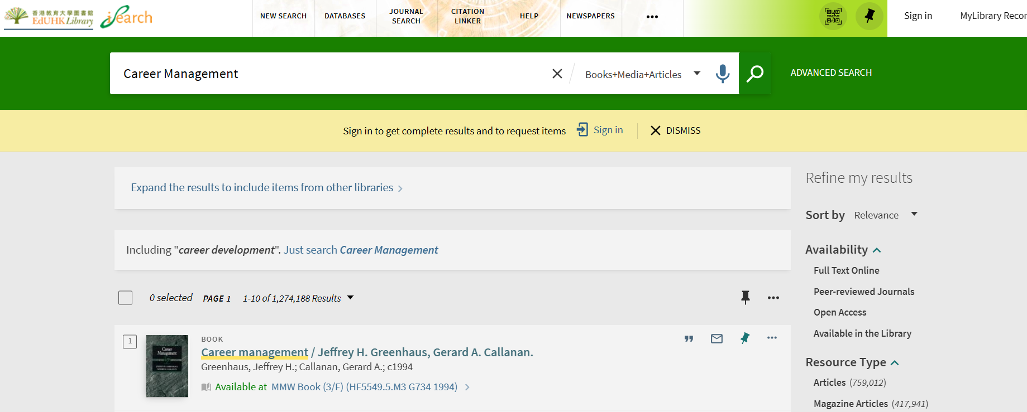
iSearch
Example: Finding the call number & location of a physical book
The Basics

Slide 7
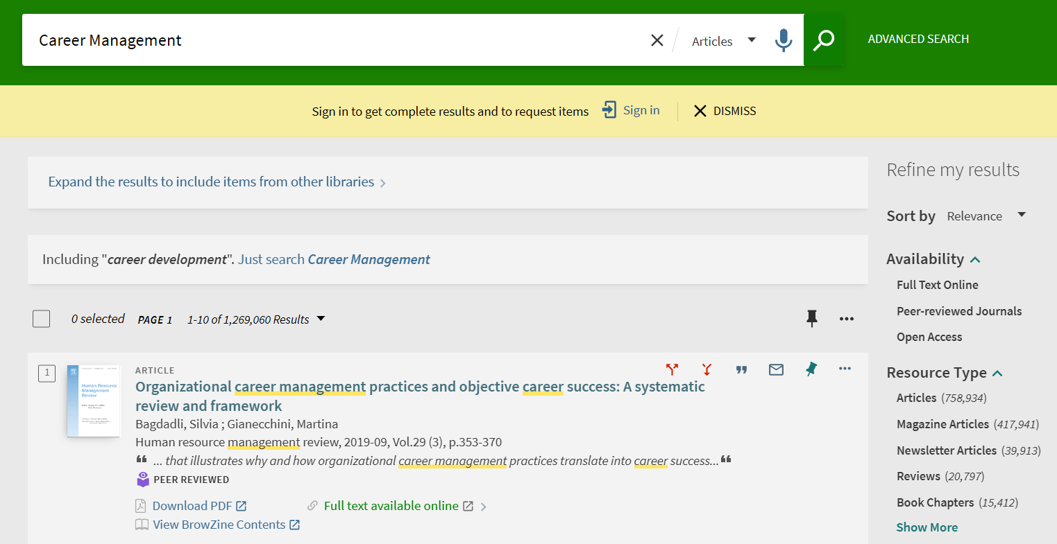
iSearch
Example: Finding journal articles
Select “Articles” from the search scope menu
Click the direct link to check for full text
The Basics

Slide 8

Tips and Highlights using Library –
Borrowing Matters

Slide 9

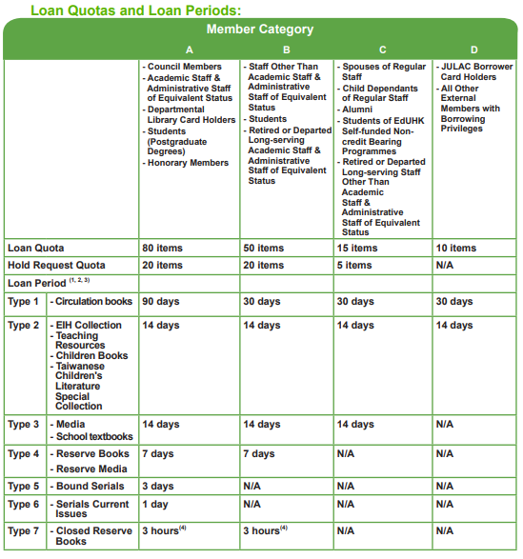
Loan Quota and Loan Period
Academic Staff
Staff Dependant Card
Apply for Staff Dependant Card at HRO
Library privileges granted automatically
Staff responsible for any overdue, damage or loss of items
Child dependants below age of 12 must be accompanied by their parents when staying inside the Library
Notes:
The initial loan periods of 14-day, 30-day and 90-day loan items will be reduced to 7 days, 15 days and 30 days respectively if the items have been held by other users when the items are being checked out.
Borrowers must return their loan items before the expiry of their library membership.
Please refer to the Library Website for details of materials included under each type of loan items.
Three-hour loan items are for in-library use only. Some 3-hour loan items are restricted to specific types of library users. Please contact library counters for details.
Tips and Highlights Using Library – Borrowing Matters

Slide 10
Renew
All loans with a loan period of 14 days or more may be renewed up to the maximum loan period specified below unless a hold or a recall has been placed.
Borrowers can renew their loans in person or online via the Library System anytime before the due date.
Overdue items are not renewable.
Automatic renewal of EdUHK Library items (HKALL items excluded) three days before the due date.
Initial Loan Period | Maximum Loan Period after Renewals
14 days | 56 days
30 days | Unlimited
90 days | Unlimited
Tips and Highlights Using Library – Borrowing Matters

Slide 11
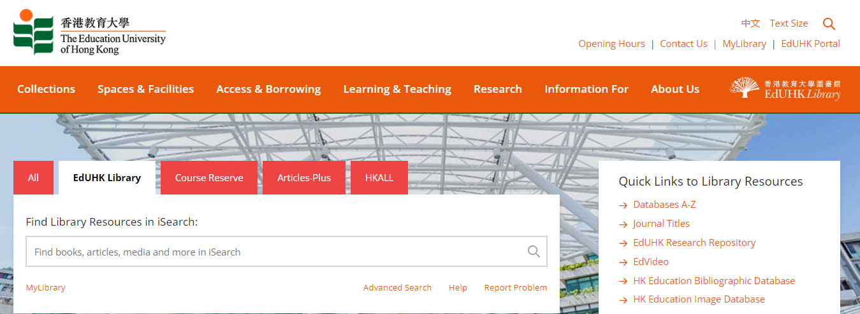
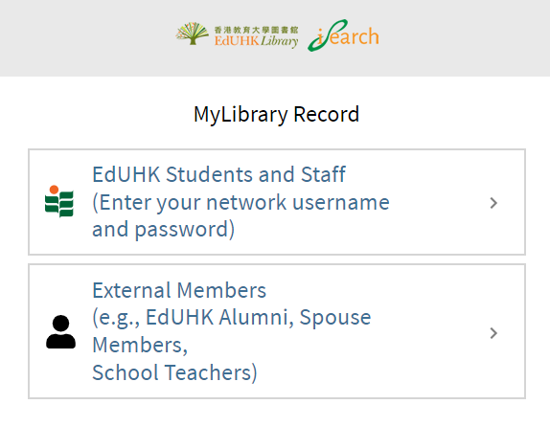
MyLibrary Record
Sign in to MyLibrary Record to view your loan record, renew your loan items, check your loan history, view request status, save searches and search results, etc.
Tips and Highlights Using Library – Borrowing Matters

Slide 12
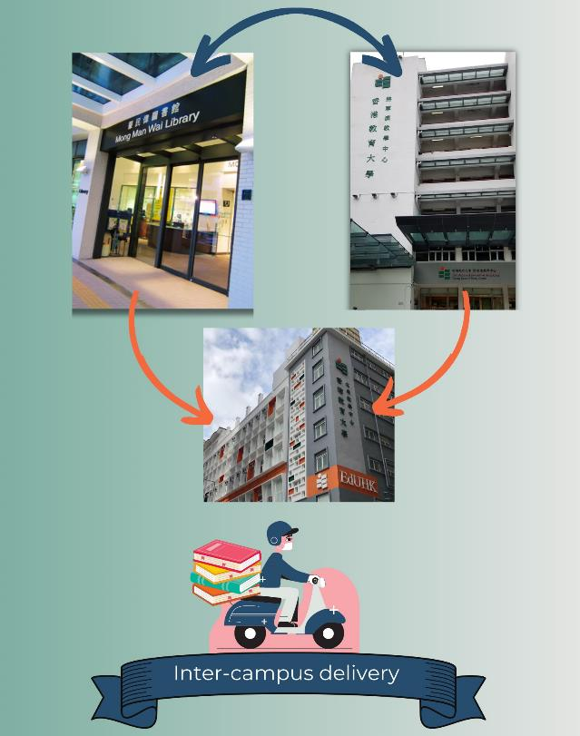
Inter-campus Delivery
Staff can request loanable materials housed in Tai Po MMW Library to be sent to the Tseung Kwan O Study Centre Library for borrowing, or vice versa. Loanable materials from above libraries can be sent to North Point Study Centre for borrowing.
Only available for loan materials can be requested for delivery. For items on loan, they can be delivered at different libraries.
Items cannot be requested for delivery within the same library. Otherwise, items will be delivered to the another library automatically.
Tips and Highlights Using Library – Borrowing Matters

Slide 13
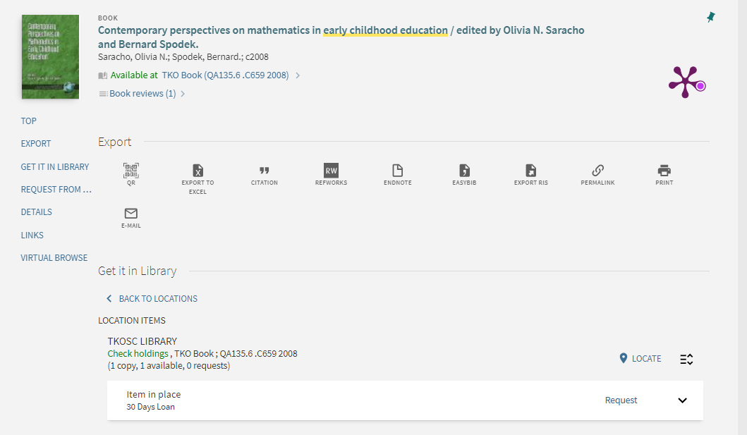
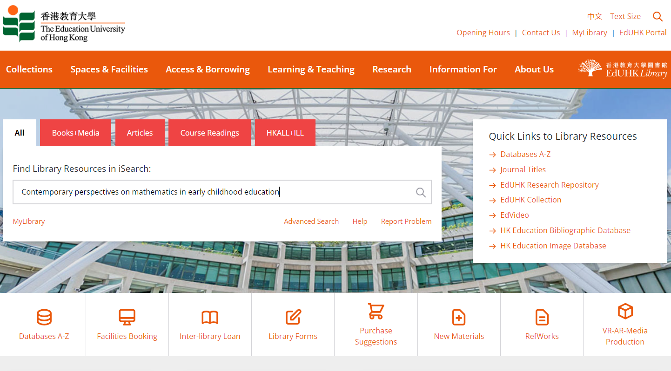
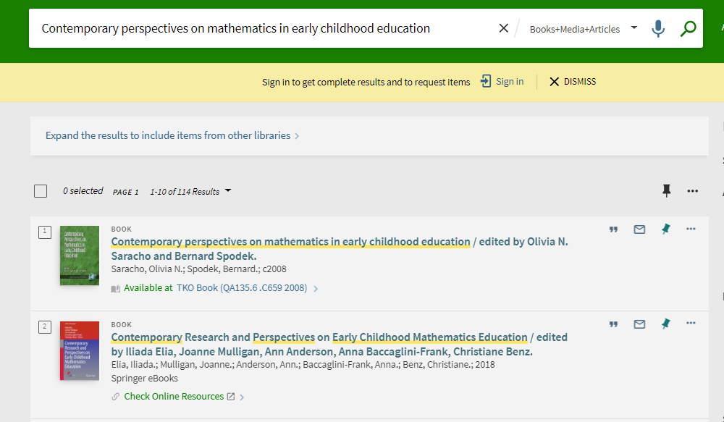
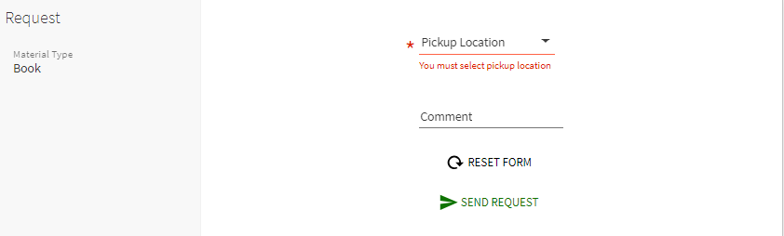
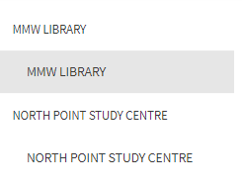
How to Request Items
(Inter-campus Delivery)
Select Pickup Location
TKO book
Click Request
Tips and Highlights Using Library – Borrowing Matters

Slide 14

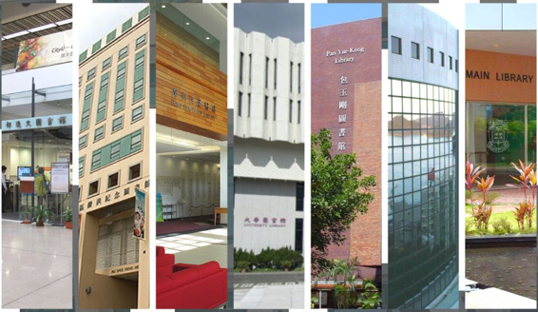
TIPS AND HIGHLIGHTS
USING LIBRARY –
USING OTHER LIBRARIES

Slide 15

Requesting Items Not Available at EdUHK
Hong Kong Academic Library Link (HKALL)
  Request for books from 7 other local university libraries
  Fast turnaround (normally within 3 working days)
  For academic staff, you have 30 HKALL book loan quota and 30 days of initial loan period (Max. loan period: 90 days, subject to recall)
Inter-library Loan (ILL) & Document Delivery Service (DDS)
  Request a book, or a copy of journal article or book chapter
  Sourced from other local or overseas libraries with service agreements
Tips and Highlights Using Library – Using Other Libraries

Slide 16
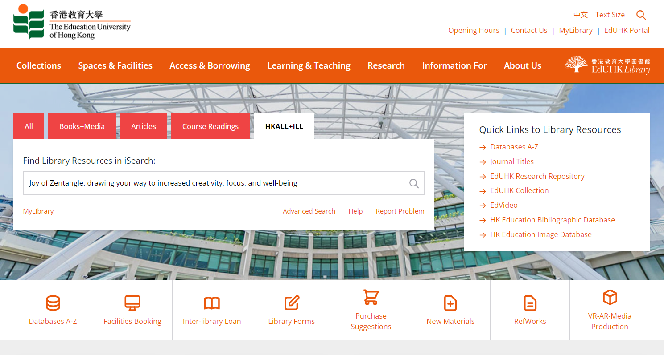
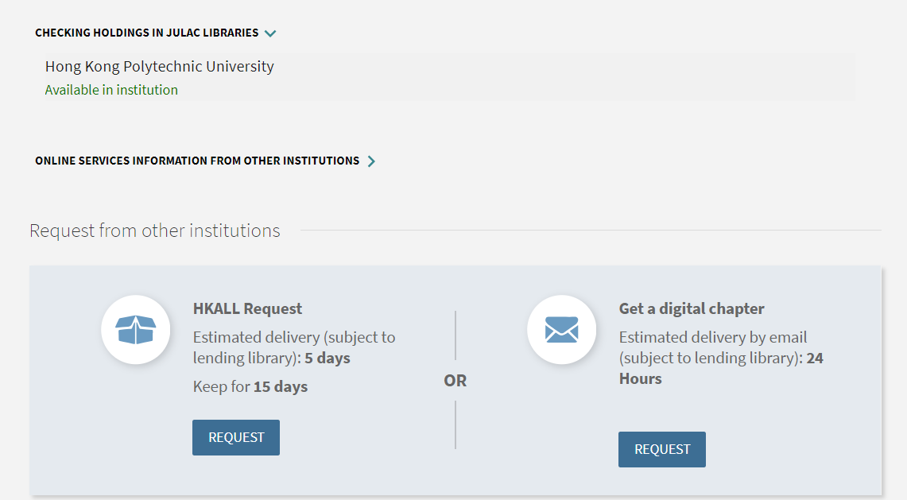
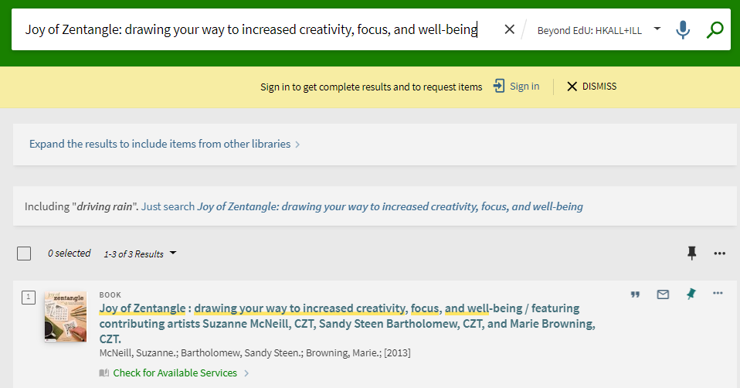
How to Request HKALL, ILL & DDS
Step 1: Sign in
Use DDS service to get a digital copy of one chapter
Use HKALL service to get a physical copy from other 7 UGC university libraries
Step 2: Check for Available Services
Tips and Highlights Using Library – Using Other Libraries

Slide 17
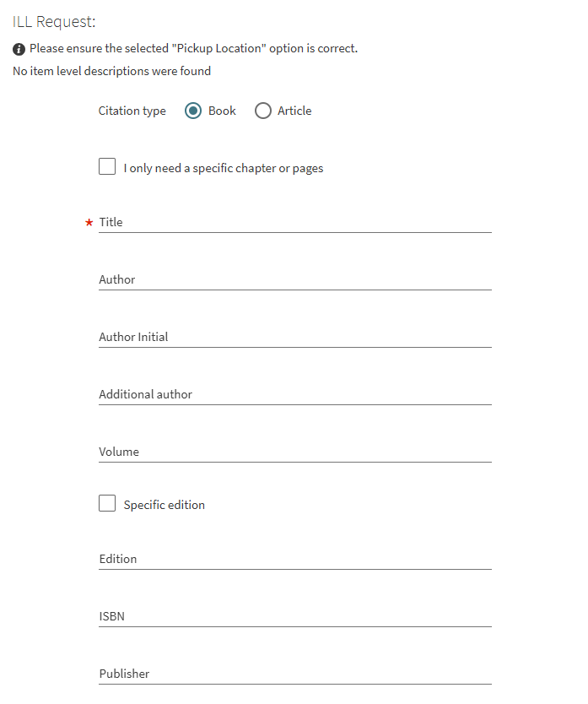
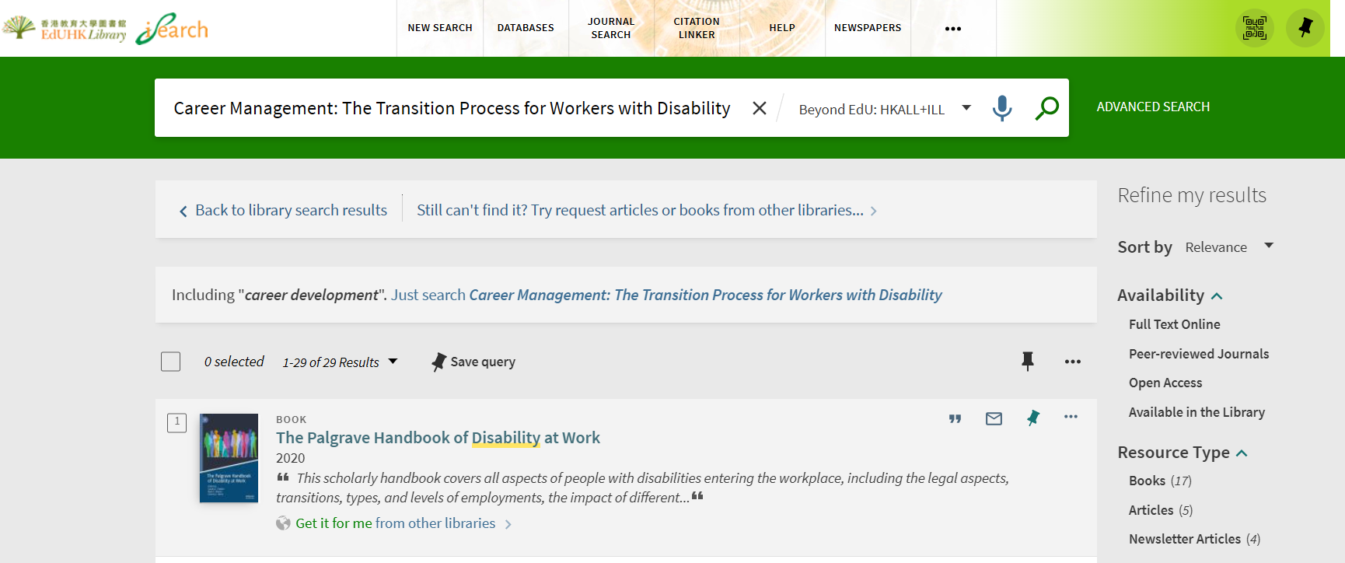
How to Submit ILL Form
Tips and Highlights Using Library – Using Other Libraries

Slide 18










In-Person Access to Other Libraries
JULAC Card (academic staff and administrative staff of equivalent status)
  Access and borrow materials from other 7 UGC libraries
  Return of (non-overdue) books borrowed with JULAC Card at Circulation Counter
Institutional Reader Card
  Access to partner libraries:
  HKSKH Ming Hua Theological College, HKAPA, HKSYU, HK Sports Institute, HKMU, Tung Wah College, University of Macau and VTC
  Borrow the card from the Circulation Counter
Tips and Highlights Using Library – Using Other Libraries

Slide 19
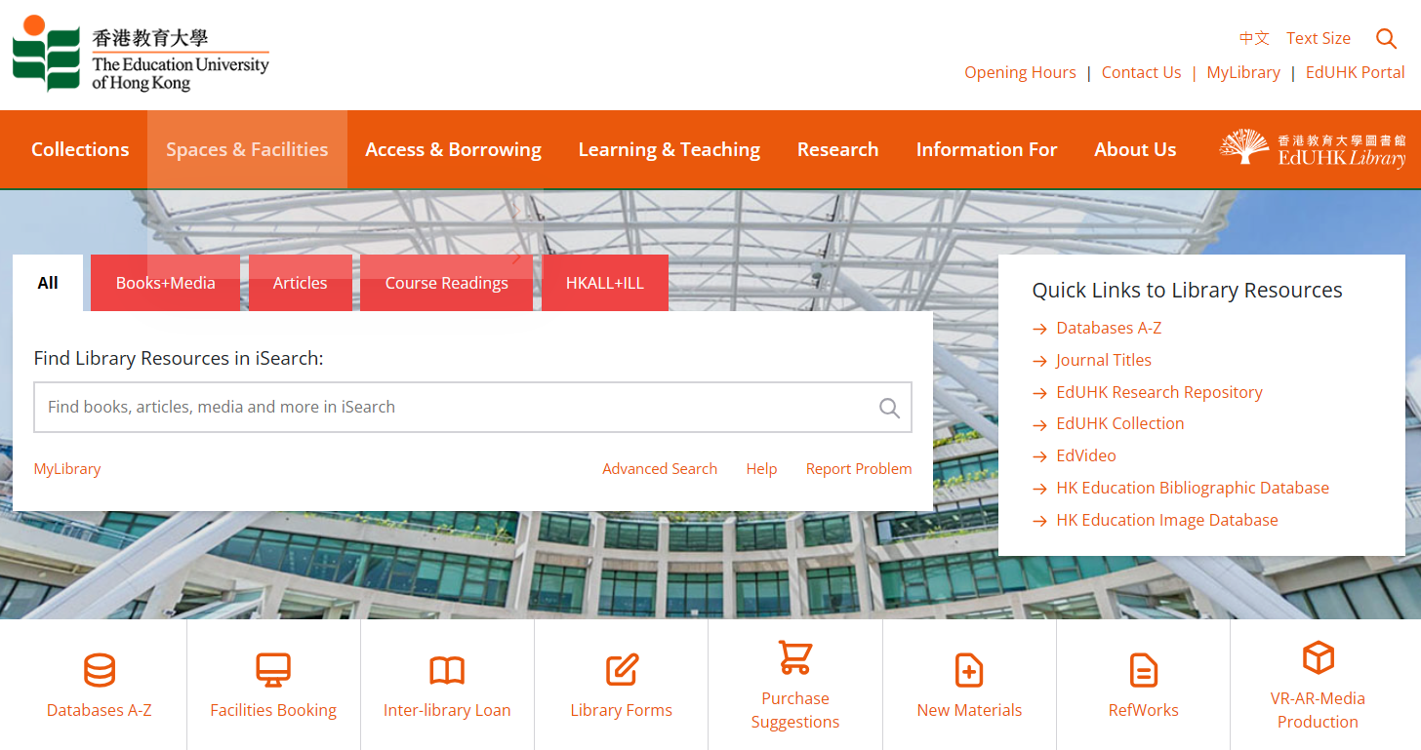
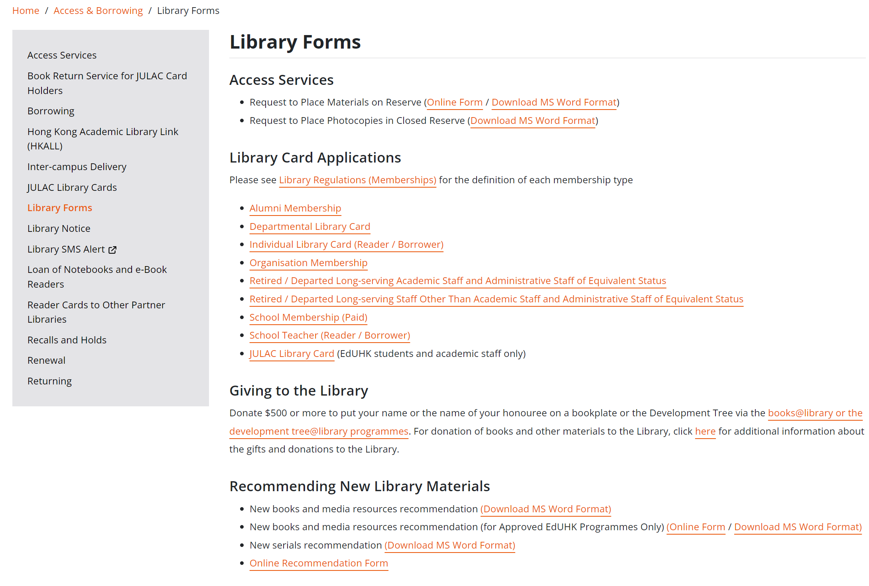
Apply JULAC Card Online
Tips and Highlights Using Library – Using Other Libraries

Slide 20

TIPS AND HIGHLIGHTS
USING LIBRARY –
YOUR
RECOMMENDATIONS

Slide 21

Recommendations
Tips and Highlights Using Library – Your Recommendations

Slide 22
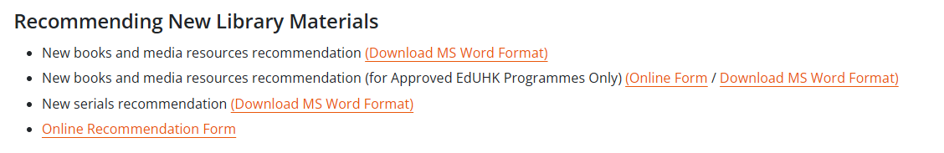
Recommendations
For textbook/reading list of EdUHK programmes
Tips and Highlights Using Library – Your Recommendations

Slide 23
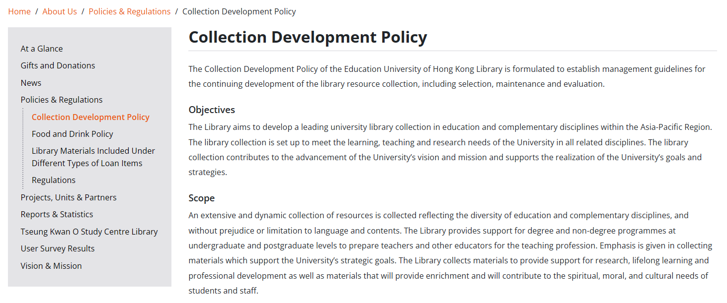
E-Priority Policy
E-Priority Policy:
To achieve better accessibility and availability of resources, and to support e-learning of the University, electronic formats of resources are preferred. If purchase of the materials in print is required, the Library will consider the request on a case by case basis.
Tips and Highlights Using Library – Your Recommendations

Slide 24
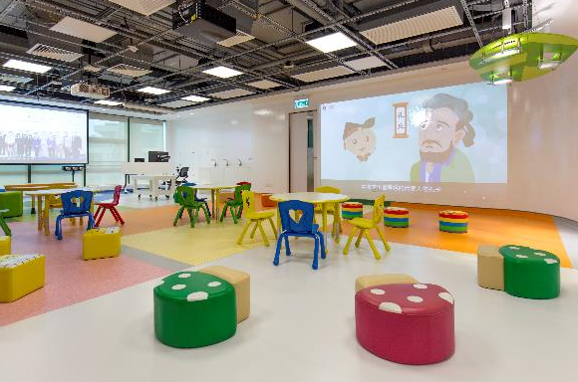
TIPS AND HIGHLIGHTS
USING LIBRARY –
TEACHING – RELATED
SUPPORT

Slide 25

  Place Materials in Reserve
Academic Staff can request to place library materials or personal copies of books in the Reserve Collection or the Closed Reserve
  Library homepage > Library Forms > Access Services
Choice of Reserve location (Quiet Zone on G/F of MMW Library or TKOSC Library) and loan period (7-day loan or in-library use only)
Media items can also be put on reserve (7-day loan or in-library use only)
Tips and Highlights Using Library – Teaching-related Support

Slide 26
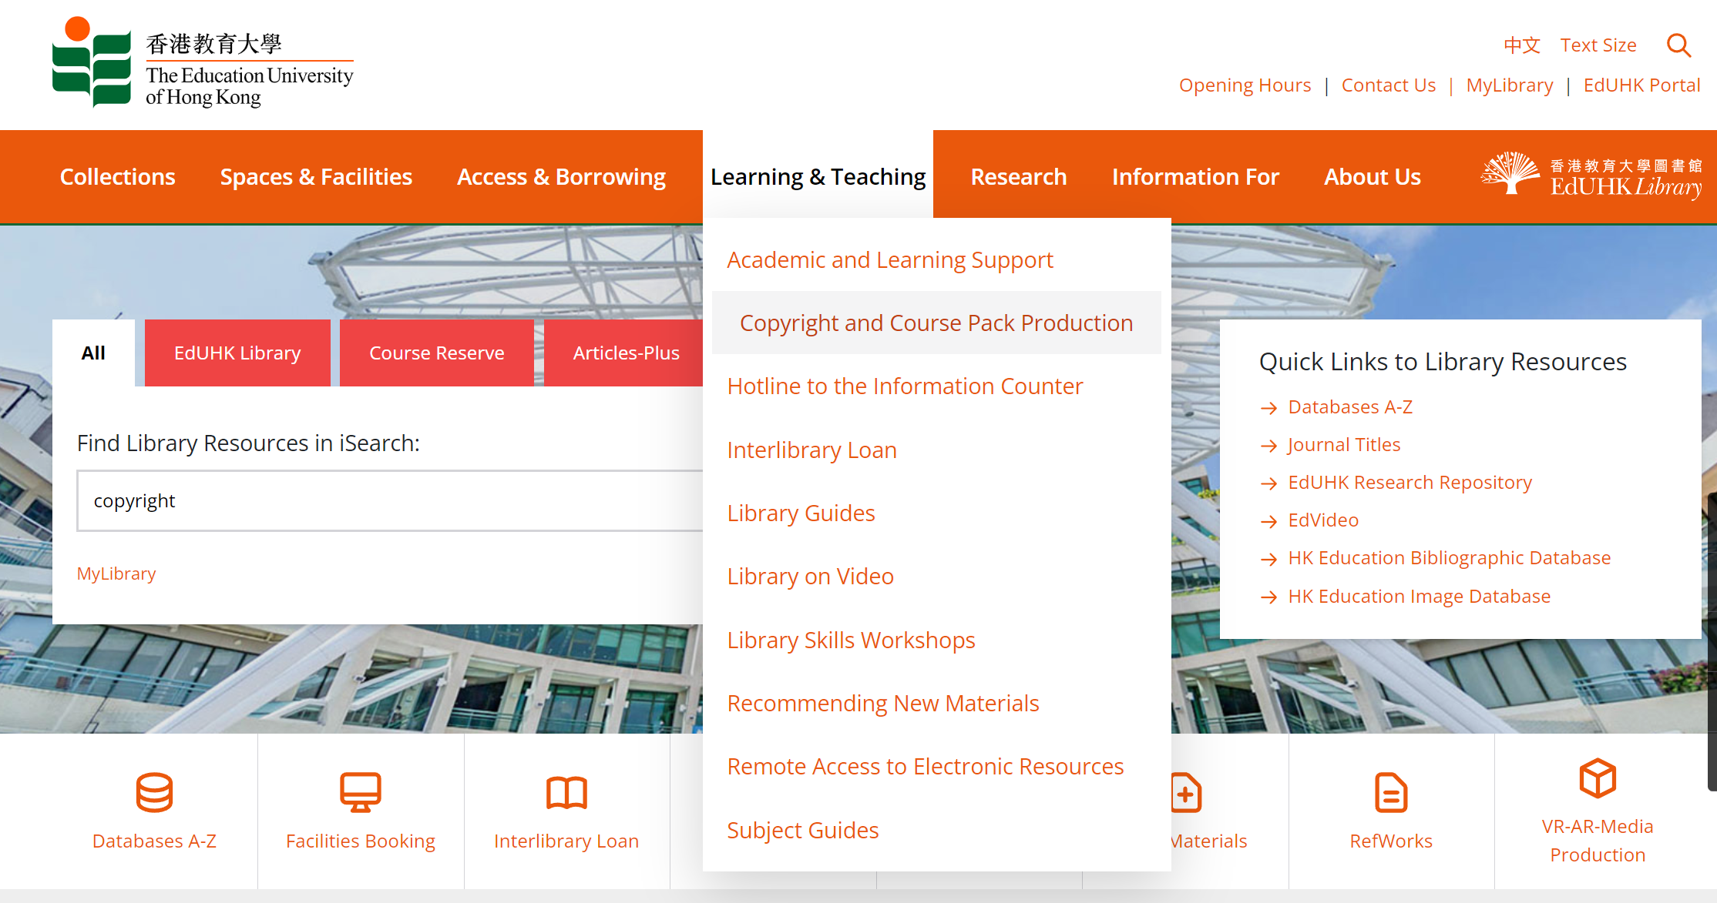
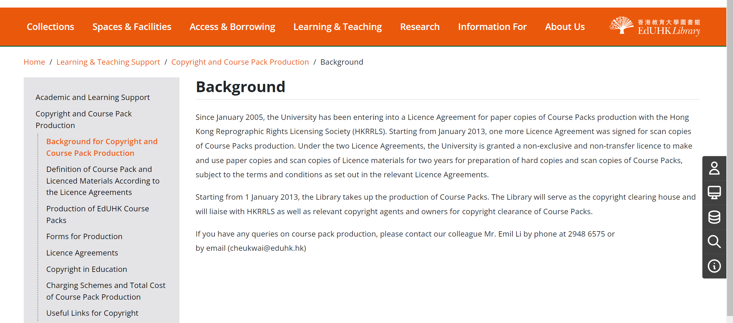
Course Pack Production
Tips and Highlights Using Library – Teaching-related Support

Slide 27
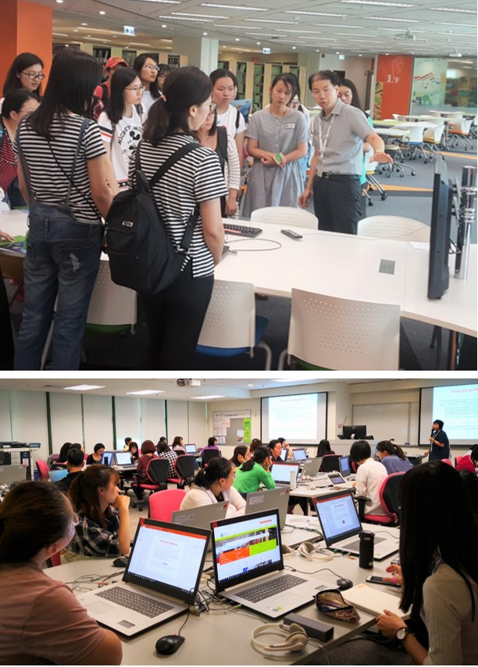
Library Skills Workshops for Your Students
We can tailor-make library workshops for your students
  For a special topic
  For a particular database
  On citation style / use of RefWorks
Evening / weekend hours of teaching at TKO Study Centre can also be arranged
For details, please visit Request a Workshop webpage
Tips and Highlights Using Library – Teaching-related Support

Slide 28






TIPS AND HIGHLIGHTS
USING LIBRARY –
RESEARCH SUPPORT

Slide 29

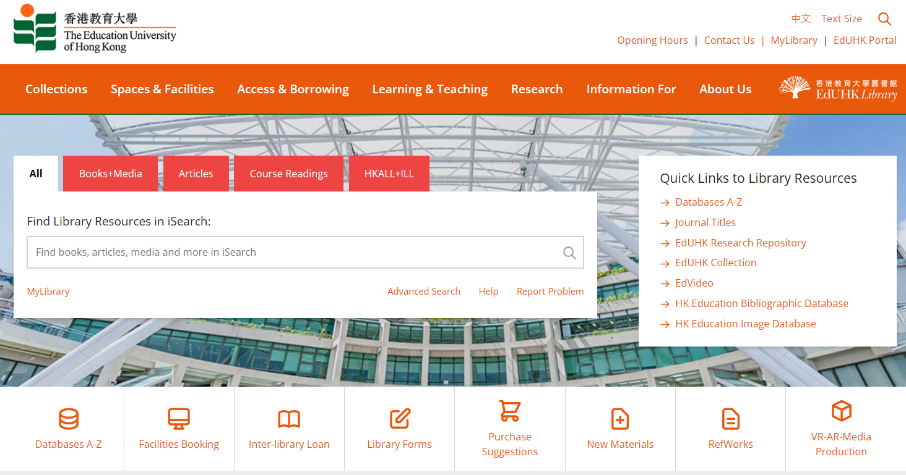
Electronic Resources
> 300 E-Databases
> 137,000 E-Journal Titles
> 2.5 Million E-Books
To access e-database, start from “Databases A-Z”
Tips and Highlights Using Library – Research Support

Slide 30

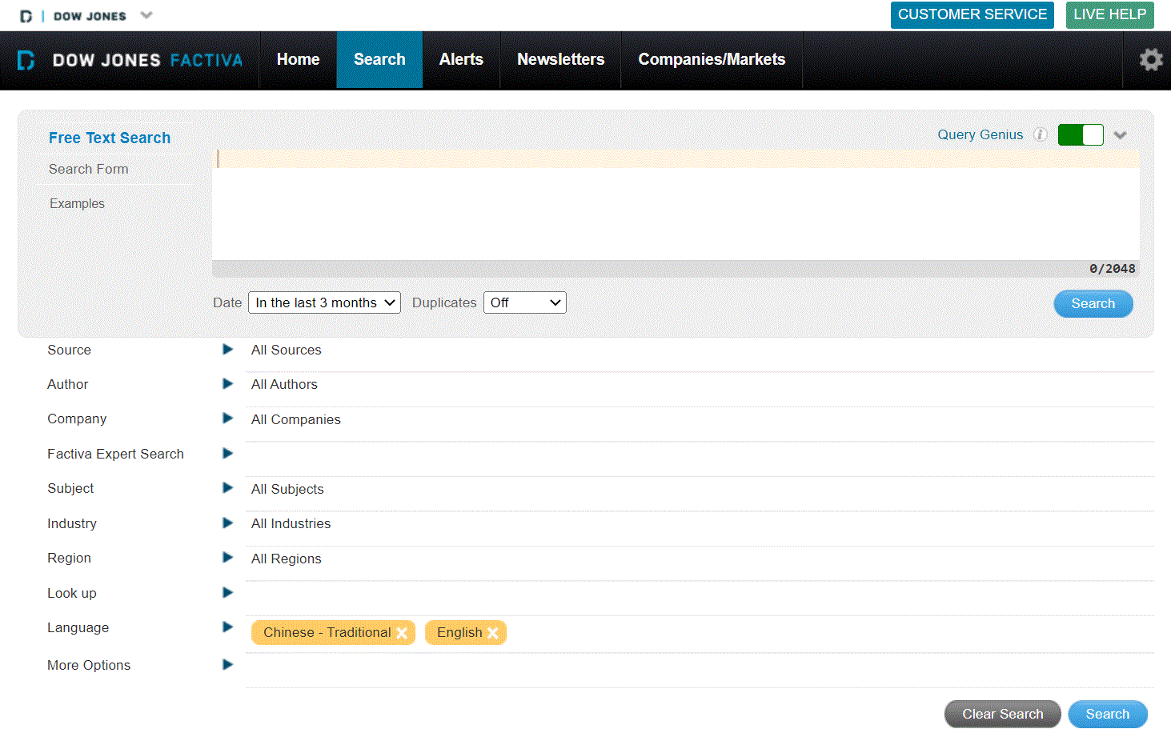
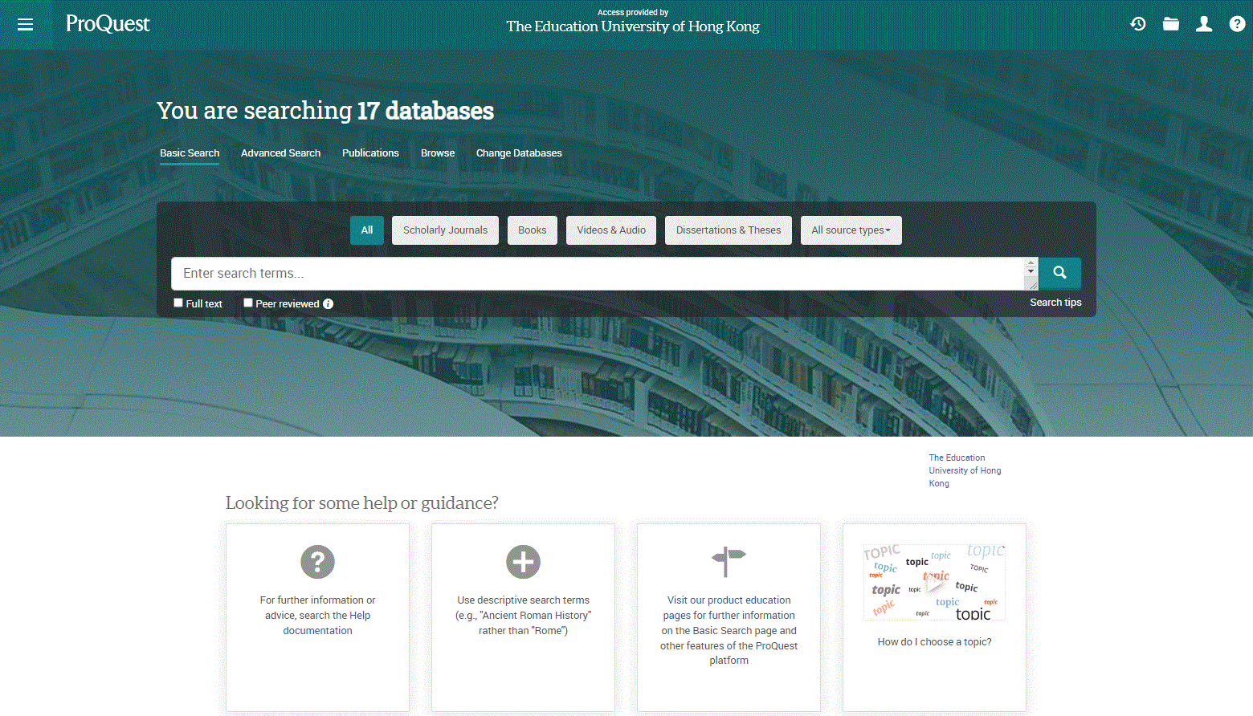
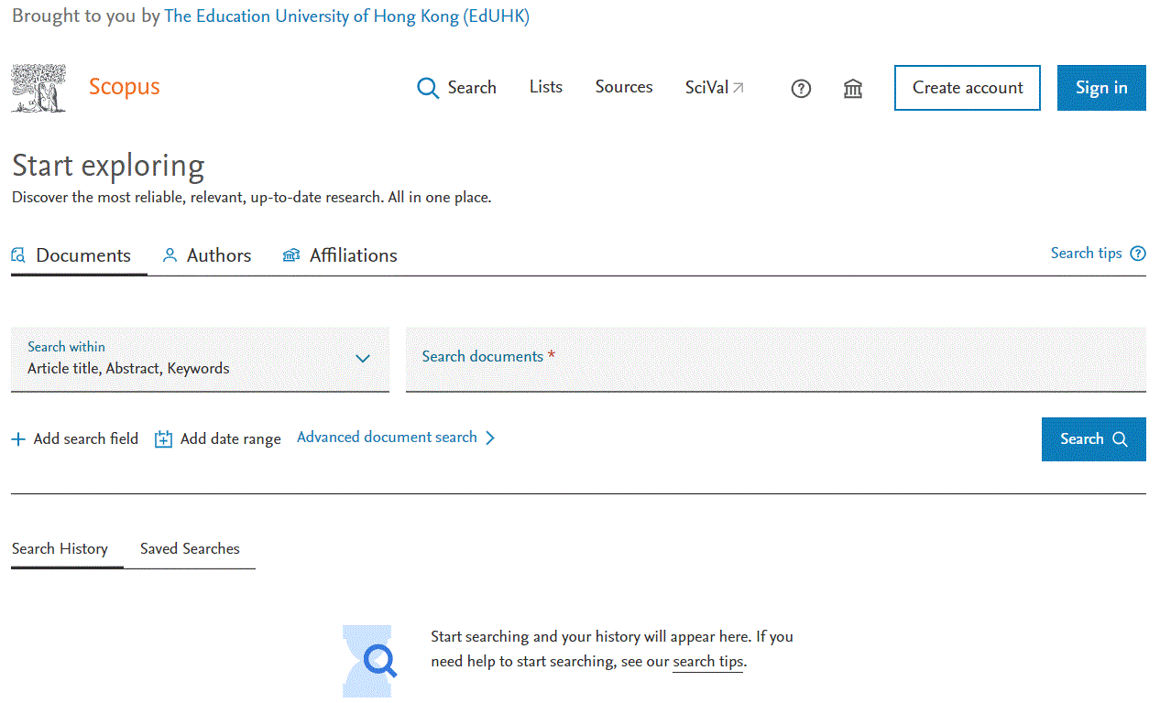
E-Databases
The Library has more than 300 e-databases of different subject areas:
Academic Search Ultimate
Scopus
Web of Science
Factiva
ProQuest Databases
Social Sciences Citation Index
ACI 學術引用文獻資料庫
華藝線上圖書館 Airiti Library
CNKI 中國知網
中國學位論文全文數據庫
漢籍電子文獻資料庫
… and more
Join our workshops to discover how the databases can help your research
Tips and Highlights Using Library – Research Support

Slide 31
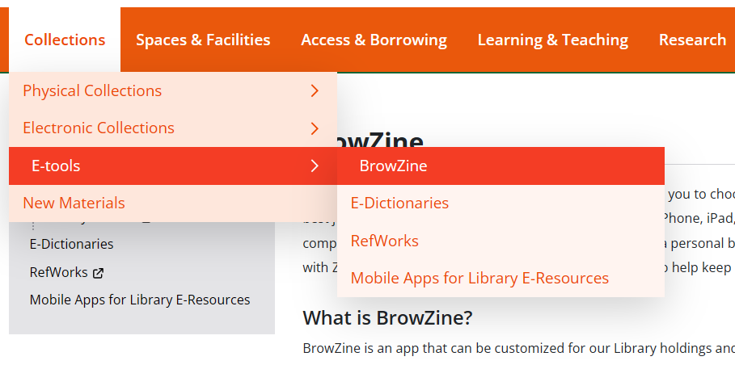
BrowZine
Tips and Highlights Using Library – Research Support

Slide 32
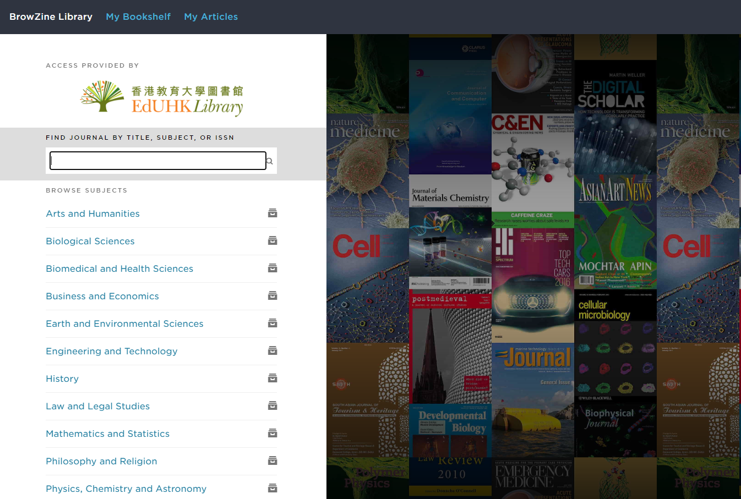
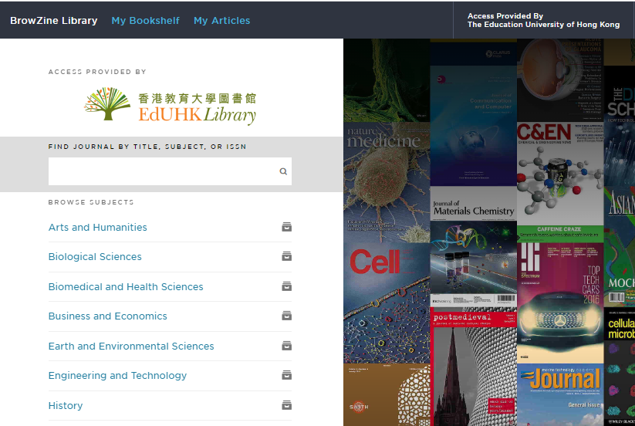
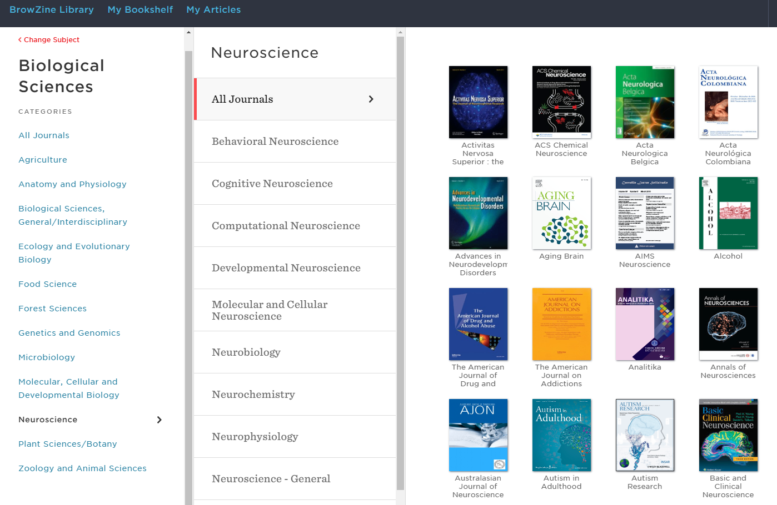
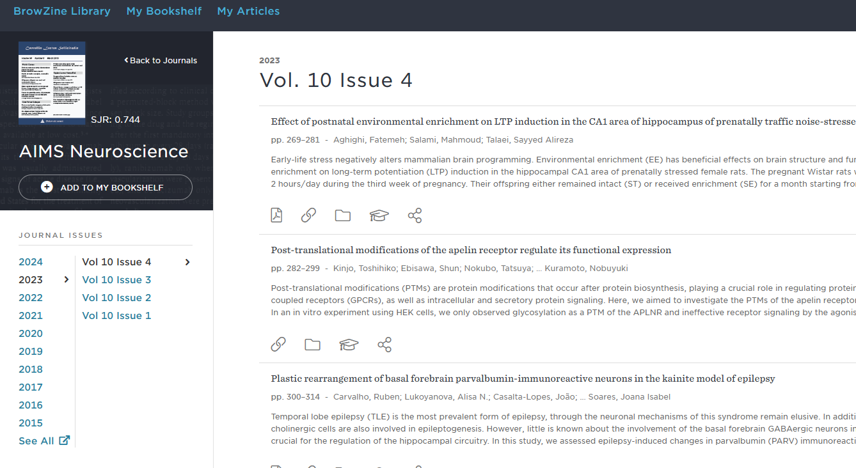
BrowZine
Browse selected EdUHK subscribed journals
Track newly released articles and journal issues
Save favorite journals and articles
Download articles for offline reading
Tips and Highlights Using Library – Research Support

Slide 33
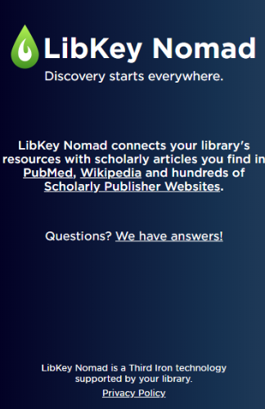
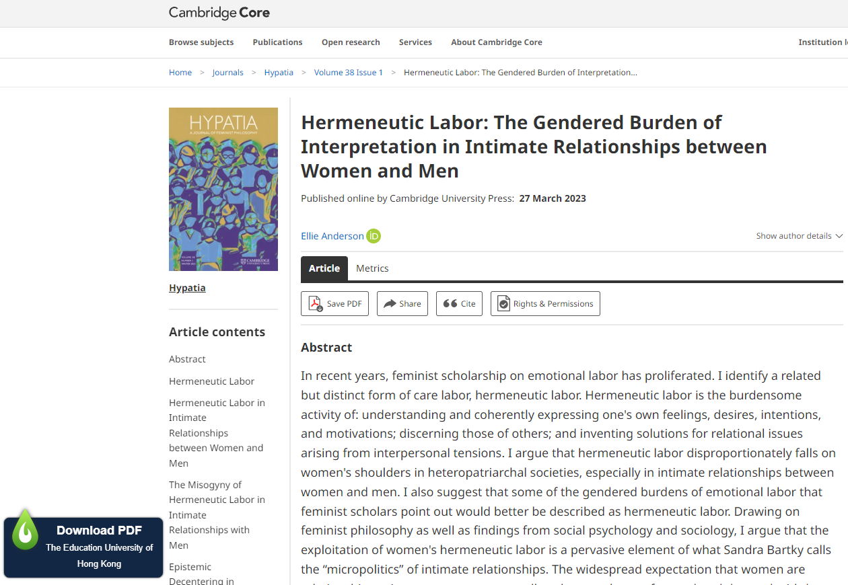
Libkey Nomad
A browser add-on for different browsers that provides access to articles available through Library subscriptions
Tips and Highlights Using Library – Research Support

Slide 34
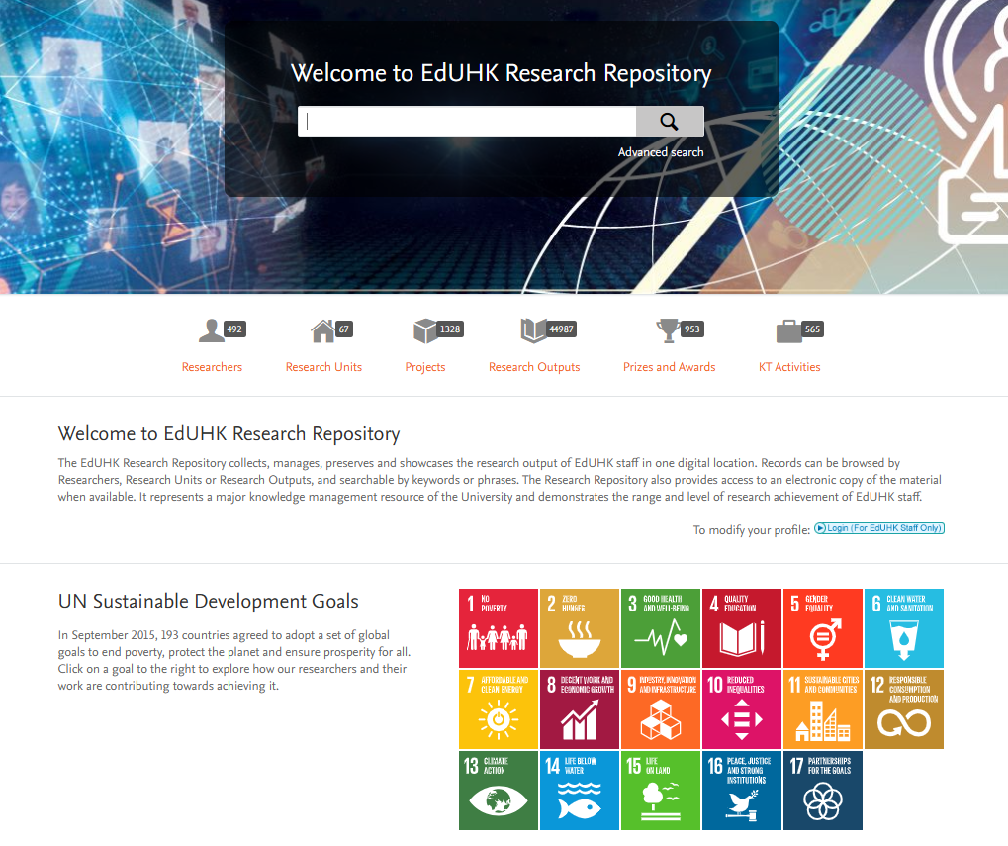
EdUHK Research Repository
Digital collection of research output of the University
Demonstrates the range & level of staff research achievement
Provides access to electronic copy when available
Staff are encouraged to deposit pre-print version of articles
Increase the visibility of your research output while the Library handles the copyright clearance
Tips and Highlights Using Library – Research Support

Slide 35
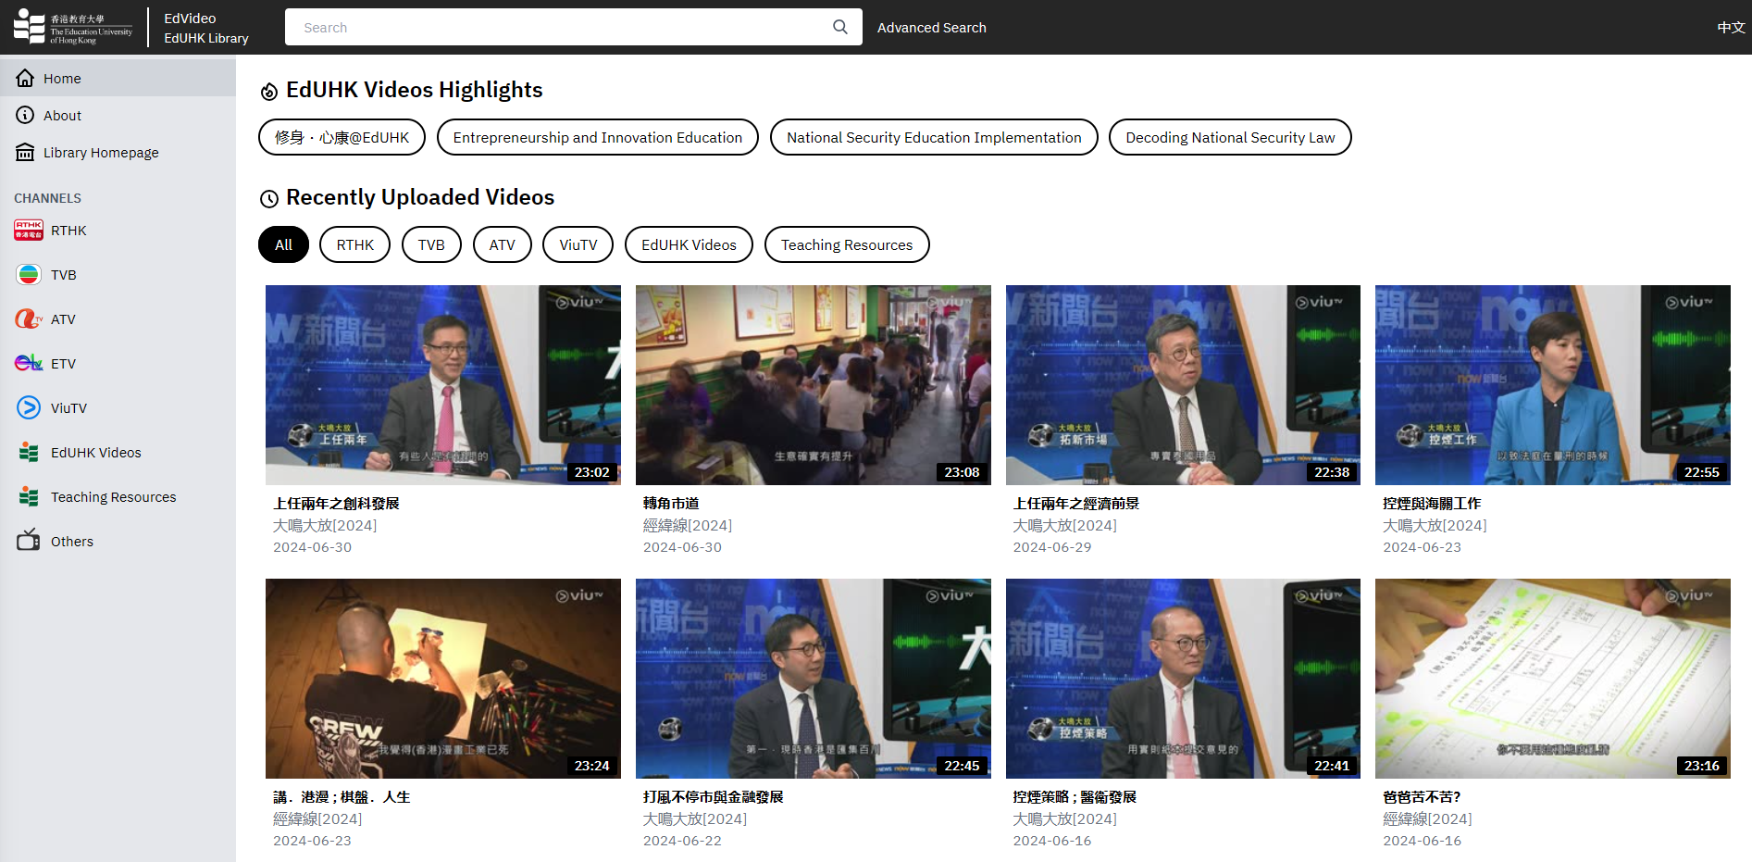
EdVideo (Local TV Programmes)
Video-on-demand service which features education related and current affairs programmes from RTHK, TVB, former ATV, former ETV and ViuTV
Tips and Highlights Using Library – Research Support

Slide 36
Library Research Services
Provide comprehensive range of services to support your research needs
  Research Support Subject Guide https://libguides.eduhk.hk/researchsupport
  Bibliographic Management Tools: RefWorks https://libguides.eduhk.hk/refworks/getstarted
  ORCID Registration Service for EdUHK Staff https://www.lib.eduhk.hk/research-support/eduhk-library-orcid-registration-service
  Open Access https://libguides.eduhk.hk/OpenAccess
  Publishing and Scholarly Communication https://libguides.eduhk.hk/researchsupport/publishing-scholarly-communication
  scite_ : AI tool for research https://scite-ai.ezproxy.eduhk.hk/
  Research Evaluation Metrics https://www.lib.eduhk.hk/research-support/research-evaluation-metrics
Tips and Highlights Using Library – Research Support

Slide 37
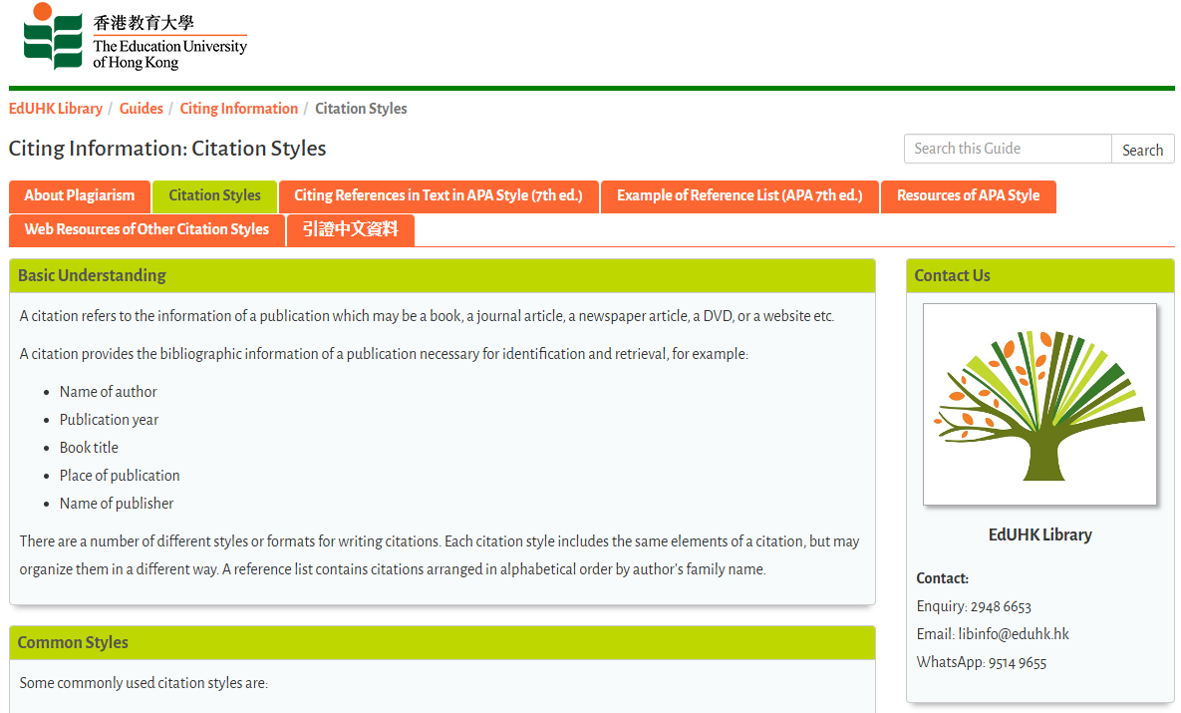
Citation Information
https://libguides.eduhk.hk/citing-information/citation-styles
Information about citing sources, including:
How to avoid plagiarism
Overviews of common citation styles, such as APA, MLA, Chicago, and Harvard
Examples of citing various source types in APA style
Instructions for citing Chinese publications and references
Tips and Highlights Using Library – Research Support

Slide 38

ORCID Registration Service for EdUHK Staff
An ORCID iD is a persistent identifier that will distinguish you from other researchers throughout your scholarly career.
By registering with the EdUHK Library, EdUHK researchers can upload their research outputs from the EdUHK Research Repository directly to ORCID and create a new ORCID iD during the process if they do not already have an ORCID iD.
To register for this service, you may either make an appointment to register in person or follow the self-registration guideline to register online.
Tips and Highlights Using Library – Research Support

Slide 39

Open Access
Transformative Agreement (TA)
The Library has entered into TA with Cambridge University Press (CUP), Association for Computing Machinery (ACM) and Springer Nature to enable EdUHK researchers to publish articles in open access journals without having to pay Article Processing Charge (APC).
The quota for Springer Nature for 2024 has been used up now, so Springer Nature has therefore turned off option of APC waiver eligibility for 2024. It will be turned on again when the next term of agreement begins on 1 January 2025.
Tips and Highlights Using Library – Research Support

Slide 40
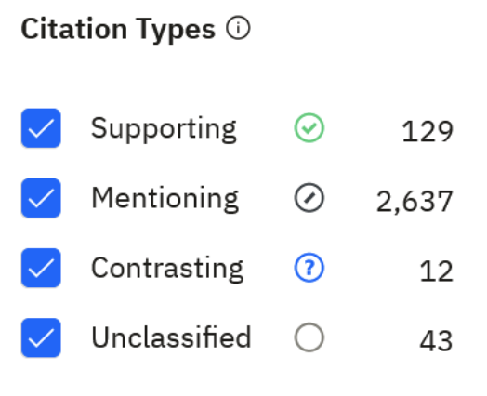
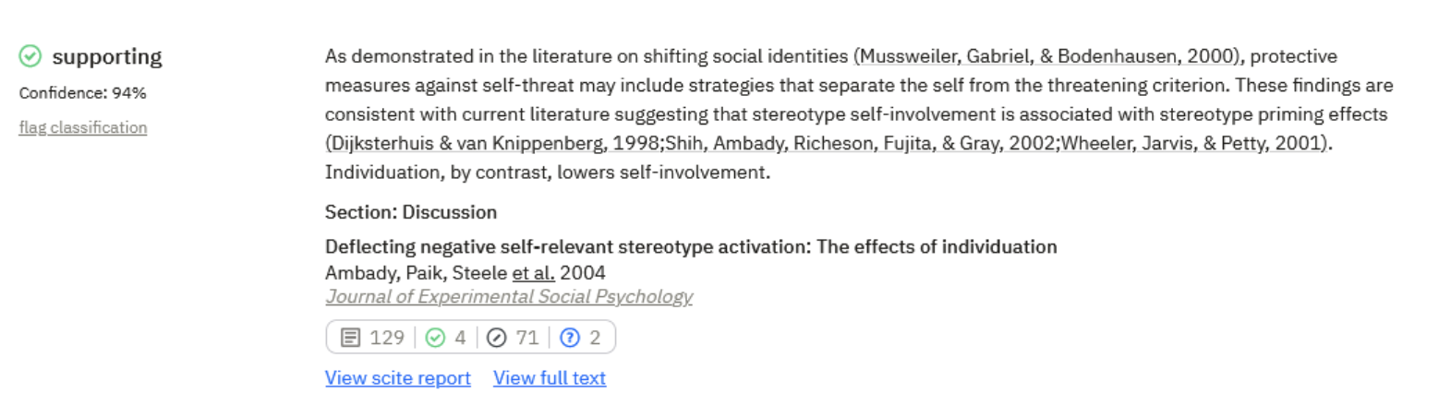
Scite_
An AI-powered research platform providing enhanced citation analysis of academic publications.
Provides more than just a count of the number of citations a publication has received, but also how a publication has been cited by others, such as the context in which it was cited and whether the citation offers supporting or contrasting evidence, or simply mentions the publication.
User guide can be found at https://libguides.eduhk.hk/scite/introduction
Tips and Highlights Using Library – Research Support

Slide 41
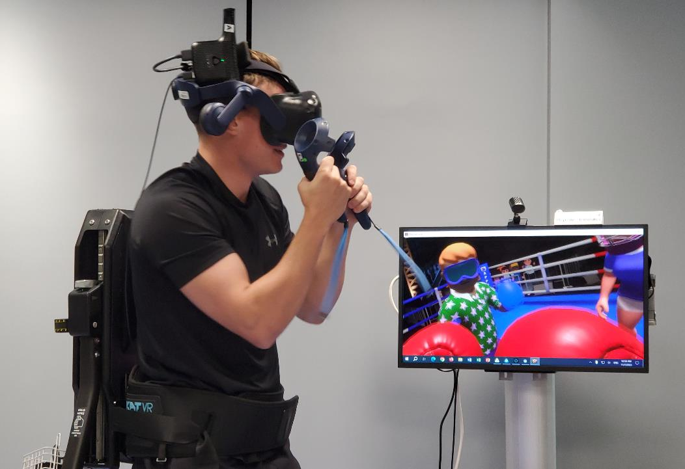
OTHER FACILITIES
AND SERVICES

Slide 42

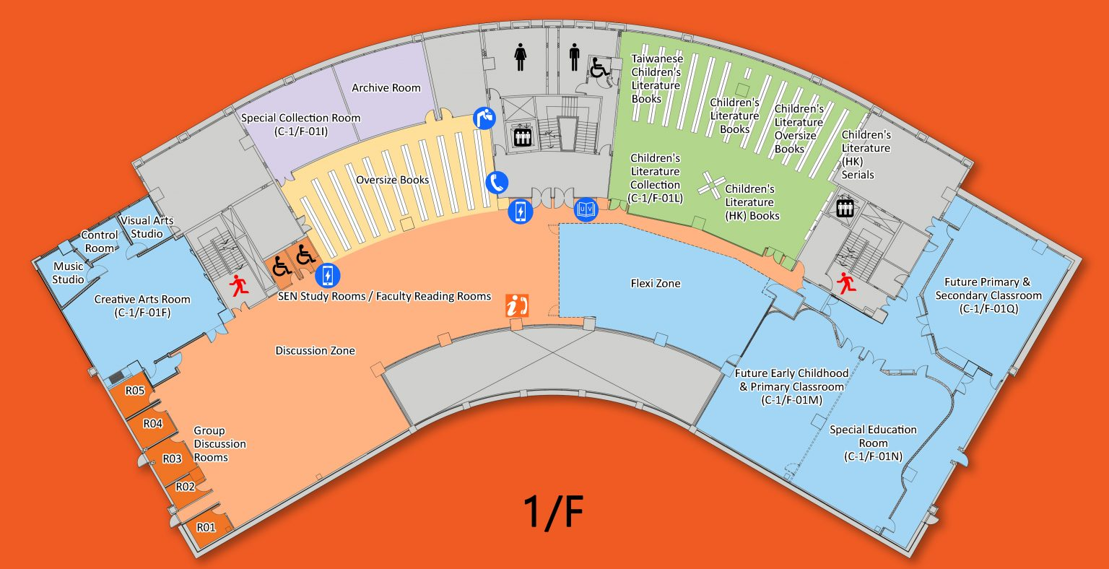
SEN Study Rooms /
Faculty Reading Rooms at 1/F
https://www.lib.eduhk.hk/rooms-spaces/sen-study-rooms-faculty-reading-rooms
2 rooms on 1/F serving both as SEN Study Rooms as well as Faculty Reading Rooms for all academic and teaching staff
Priority given to SEN students
2 hours per session; max 6 active sessions
Must check in on-site within 15 minutes of start time
Other Facilities and Services

Slide 43


Research Commons at 4/F
https://www.lib.eduhk.hk/rooms-spaces/research-commons
Login to the Booking System at https://www.lib.eduhk.hk/facilities-booking/ and select the desired time slots
Check in within 15 minutes after the start of each booking session
Other Facilities and Services

Slide 44






Future Classrooms
https://www.lib.eduhk.hk/rooms-spaces/future-classrooms
Eight Future Classrooms will allow students and academic/teaching staff of EdUHK to experience innovative learning and teaching with the latest technologies in the years to come.
Academic and teaching staff can reserve these rooms for classes via iBooking (https://ibooking.eduhk.hk/) in advance.
Other Facilities and Services

Slide 45



Video Production in Library
Professional video production equipment has been set up at the MMW Library to support production of teaching videos by academic and teaching staff.
Creative Lab (G/F) https://www.lib.eduhk.hk/rooms-spaces/future-classrooms/creative-lab
    equipped with video-conferencing system, 4K video viewing and production equipment as well as VR and AR production facilities
Mini Theatre (3/F) https://www.lib.eduhk.hk/rooms-spaces/mini-theatre
    facilitates 4K video viewing, lectures and special functions
Media Production Lab (3/F) https://www.lib.eduhk.hk/rooms-spaces/media-production-lab
    equipped with Mac Pros, high-end PCs and 4K video production facilities
“Visual Arts Studio” in Creative Arts Room (1/F) https://www.lib.eduhk.hk/rooms-spaces/future-classrooms/ca-room
Other Facilities and Services

Slide 46

Information Counter (G/F, MMW Library)
Tel: 2948 6653
WhatsApp: 9514 9655
Email: libinfo@eduhk.hk
Your Departmental Librarian
https://www.lib.eduhk.hk/contact/departmental-librarians

