Slide 1

Finding hong kong history
EdUHK Library
Oct 2025
Notes:
New database
中港電視電影資料庫

Slide 2
Outline
Hong Kong History in iSearch
Databases for Journal Articles
Databases for News
  Factiva
  ProQuest Historical Newspapers: South China Morning Post (1903-2001)
  WisersOne
Databases for E-Book
  Chinamaxx Digital Libraries
E-resources about Hong Kong History
Other Libraries’ Digitization Projects
Internet Resources

Slide 3
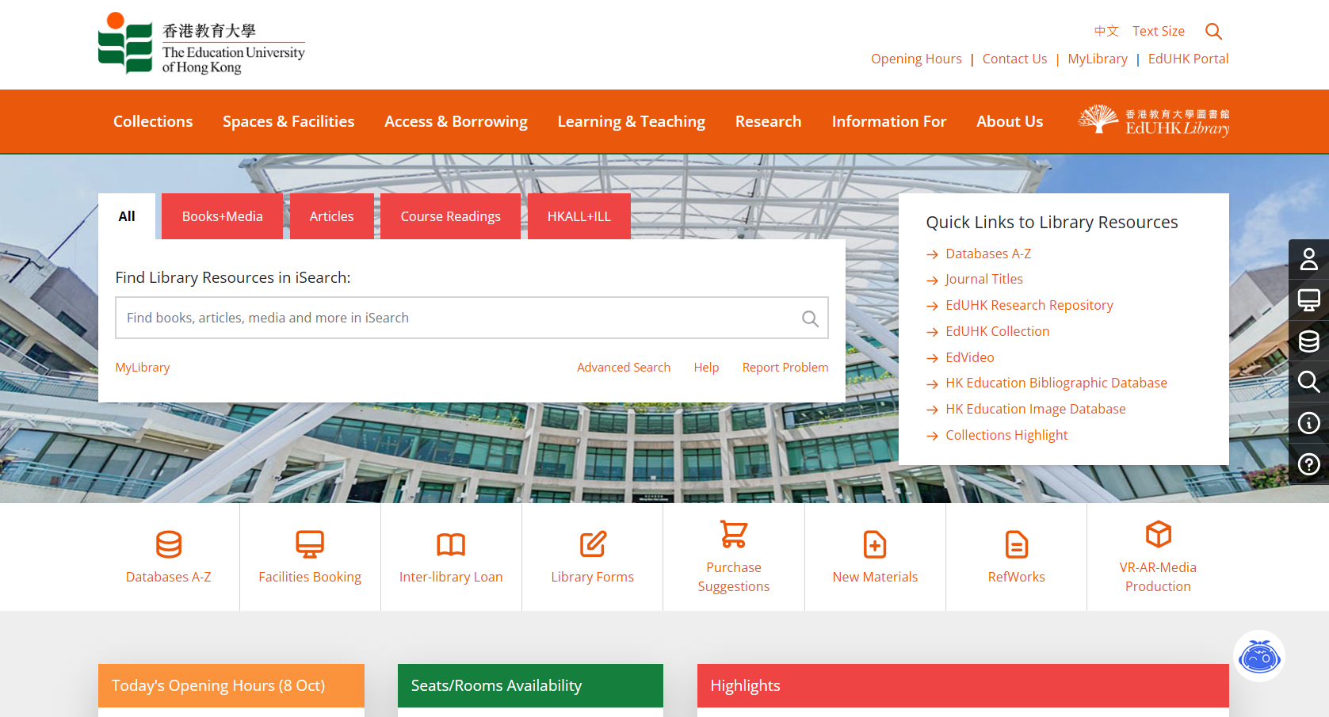
iSearch - Basic Information
iSearch on the Library Homepage
Enter your search terms

Slide 4
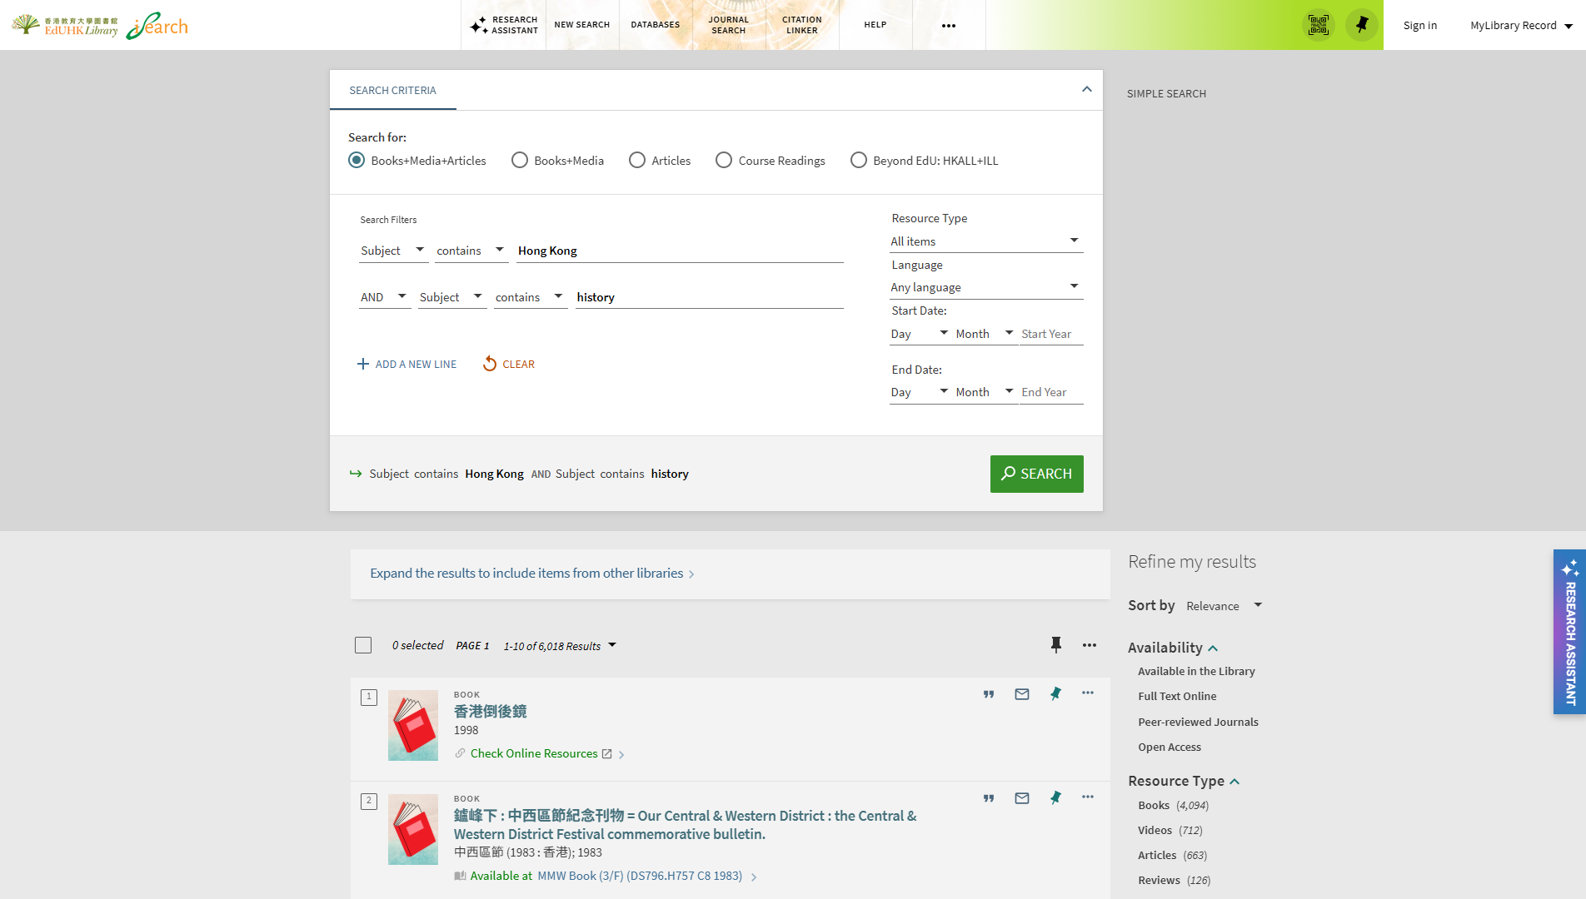
Hong Kong History in iSearch

Slide 5
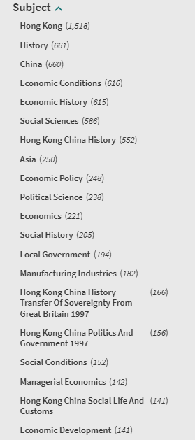
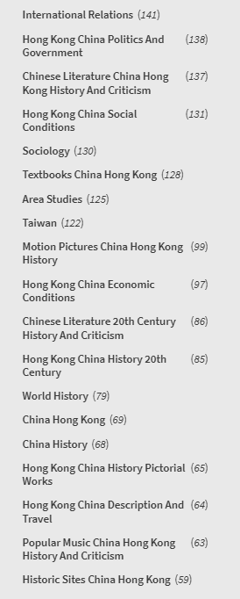
Hong Kong History in iSearch
Add subjects to focus on specific areas

Slide 6
Hong Kong History in iSearch
Use more keywords to narrow down the search
Gender
New Territories
Popular Culture
Art
Chinese
Social life and customs
Motion pictures
Foreign influences
Hong Kong
Tai Po
Youth
Film
History
Older people
Etiquette
Economic conditions
Children
Cheung Chau
Urbanization
Recreation
Travel
Women
China
Social conditions
Education
Government
Pictorial Works
Jews
Civilization

Slide 7
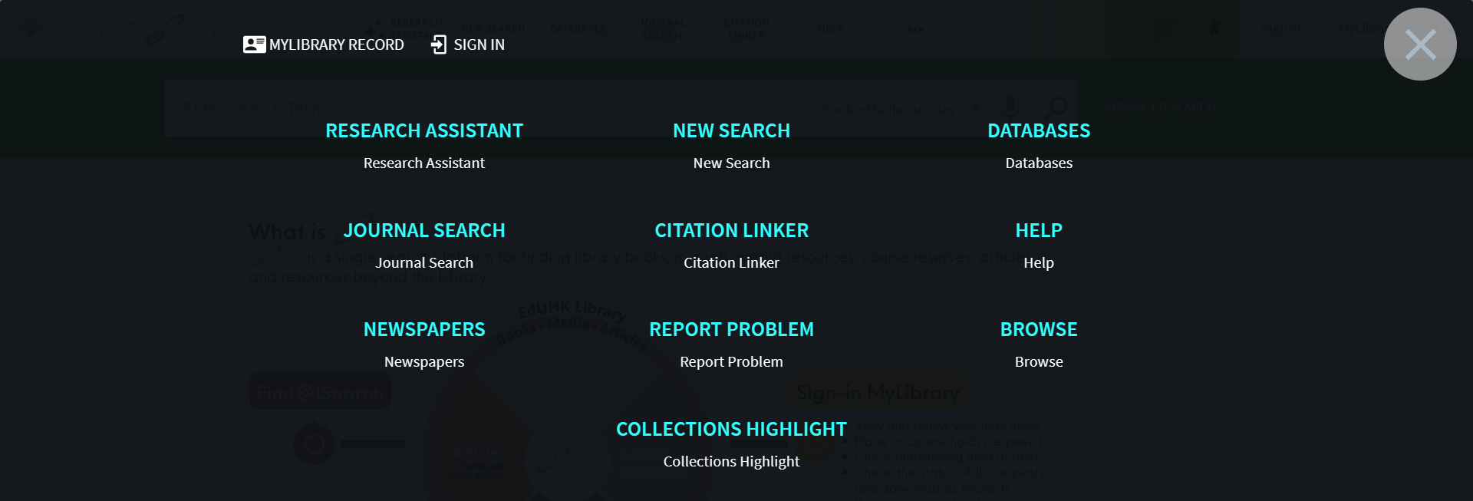
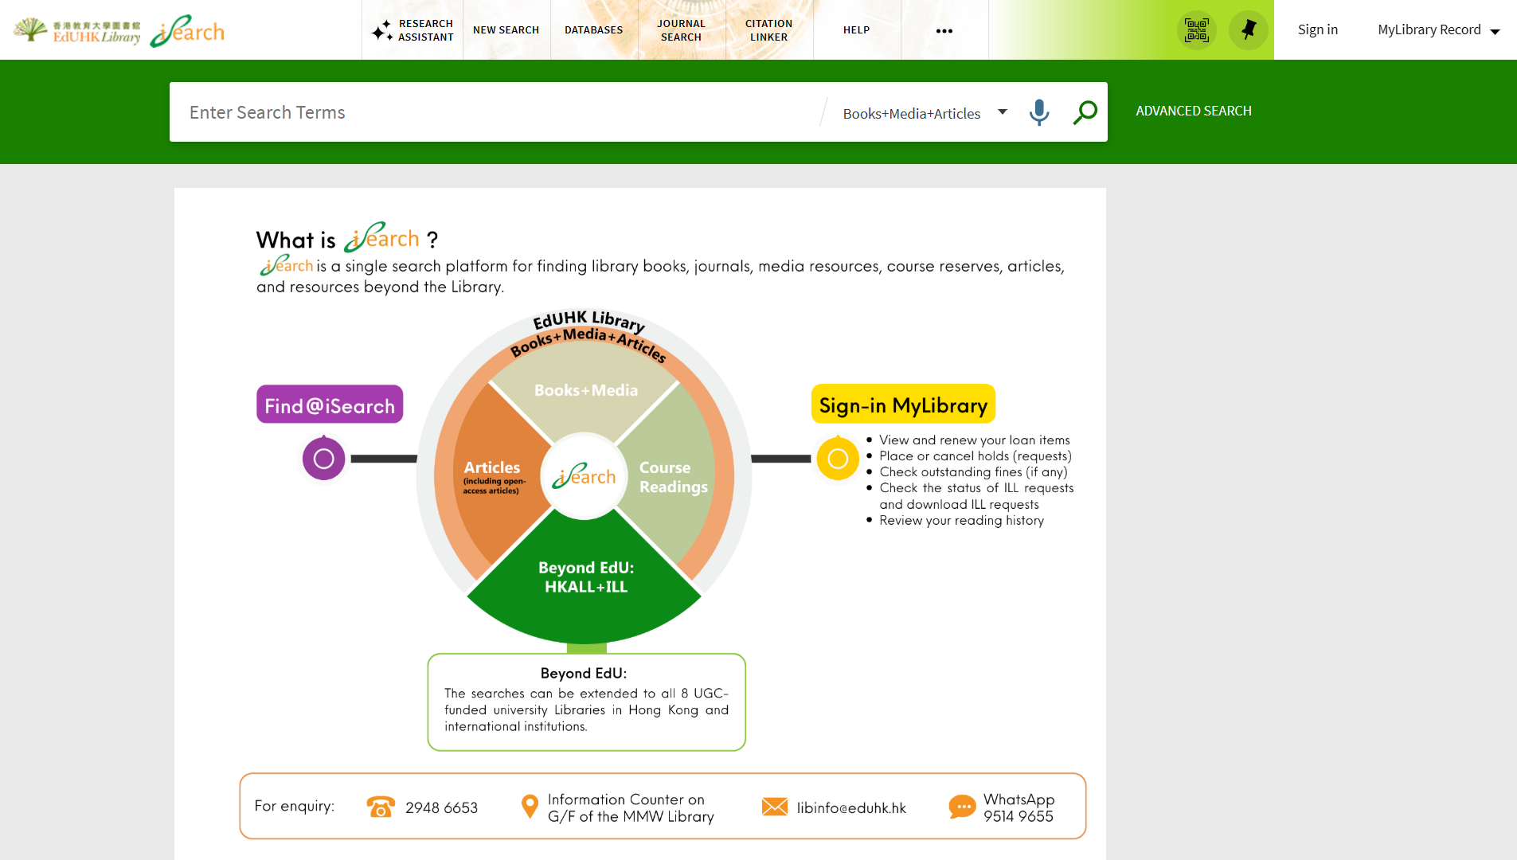
Hong Kong History in iSearch – Browse Function

Slide 8

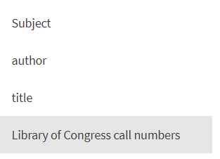
Hong Kong History in iSearch – Browse Function

Slide 9
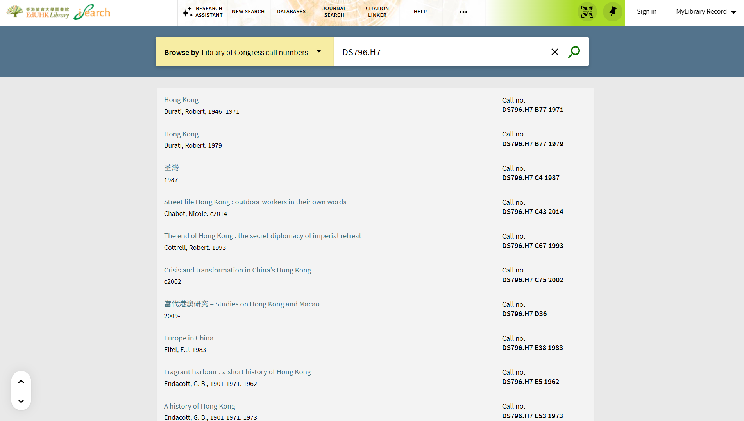
Hong Kong History in iSearch – Browse Function
Tip: Organize results in the same order as they appear on the shelves.
Browse by call number: DS796.H7 (Hong Kong History)

Slide 10
Useful Subject Headings
Tip: Find print and electronic materials
Hong Kong (China) -- Sub-topic
  Hong Kong (China) -- Anecdotes
  Hong Kong (China) -- Antiquities
  Hong Kong (China) – Appropriations and expenditures
  Hong Kong (China) -- Census
  Hong Kong (China) -- Civilization
  Hong Kong (China) -- Guidebooks
  Hong Kong (China) -- History
  Hong Kong (China) -- In motion pictures
  Hong Kong (China) -- Pictorial works
  Hong Kong (China) -- Politics and government
  Hong Kong (China) -- Social conditions
  Hong Kong (China) -- Social life and customs …
Topic -- China -- Hong Kong
  Art -- China -- Hong Kong
  Architecture -- China -- Hong Kong
  Housing policy -- China -- Hong Kong
  Popular culture -- China -- Hong Kong …

Slide 11
Databases for Journal Articles
Academic Search Ultimate (via EBSCO)
Coverage: Index 1984+ Full Text 1990+
Academic Search Ultimate offers access to resources cited in key subject indexes. The combination of academic journals, magazines, periodicals, reports, books and videos meets the needs of scholars in virtually every discipline ranging from astronomy, anthropology, biomedicine, engineering, health, law and literacy to mathematics, pharmacology, women’s studies, zoology and more.

Slide 12
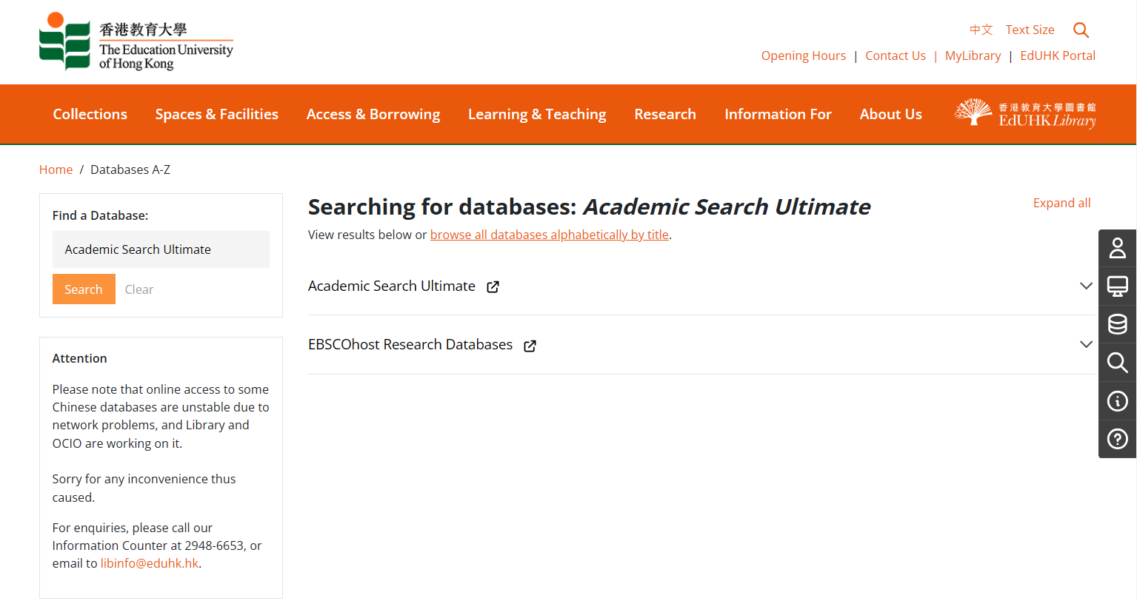
Databases for Journal Articles
Academic Search Ultimate (via EBSCO)

Slide 13
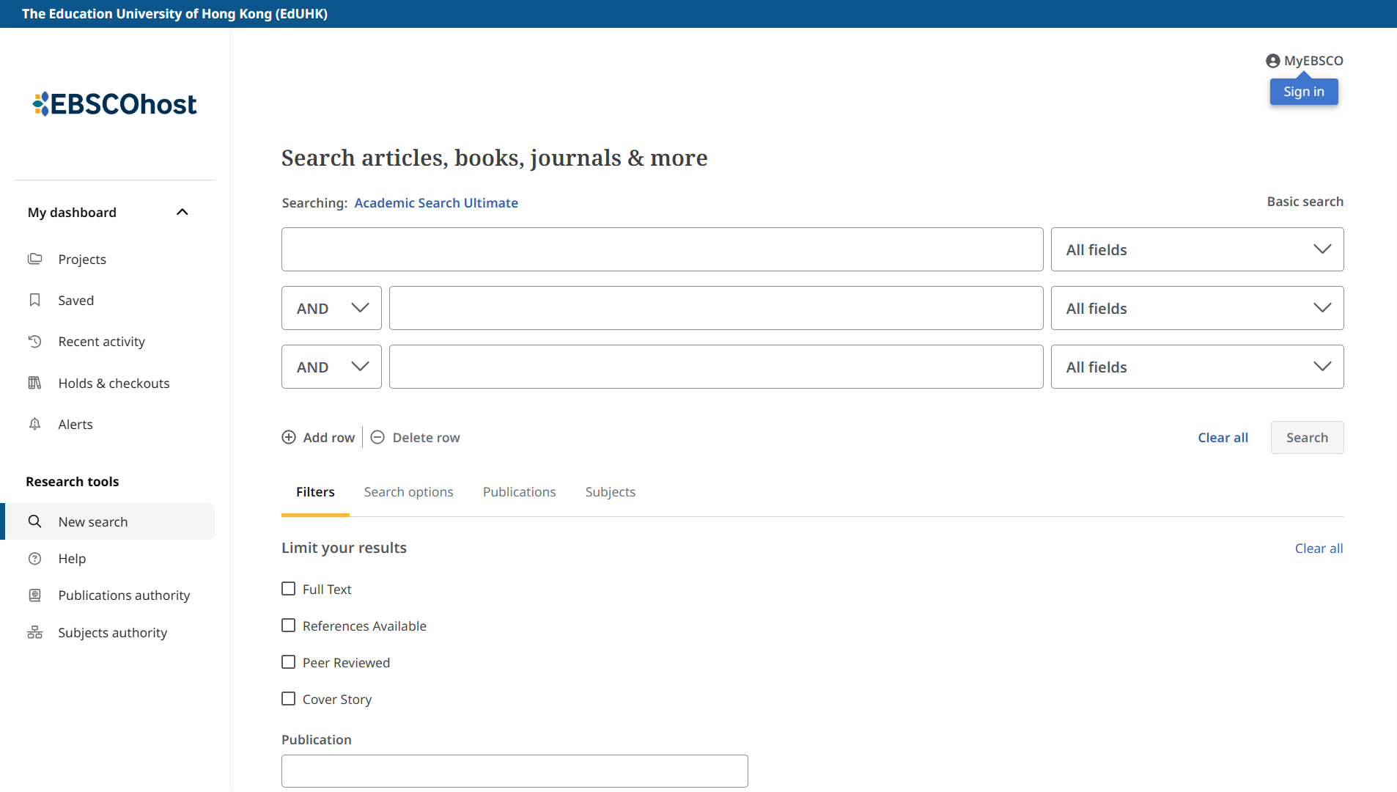
Databases for Journal Articles
Academic Search Ultimate (via EBSCOhost)

Slide 14
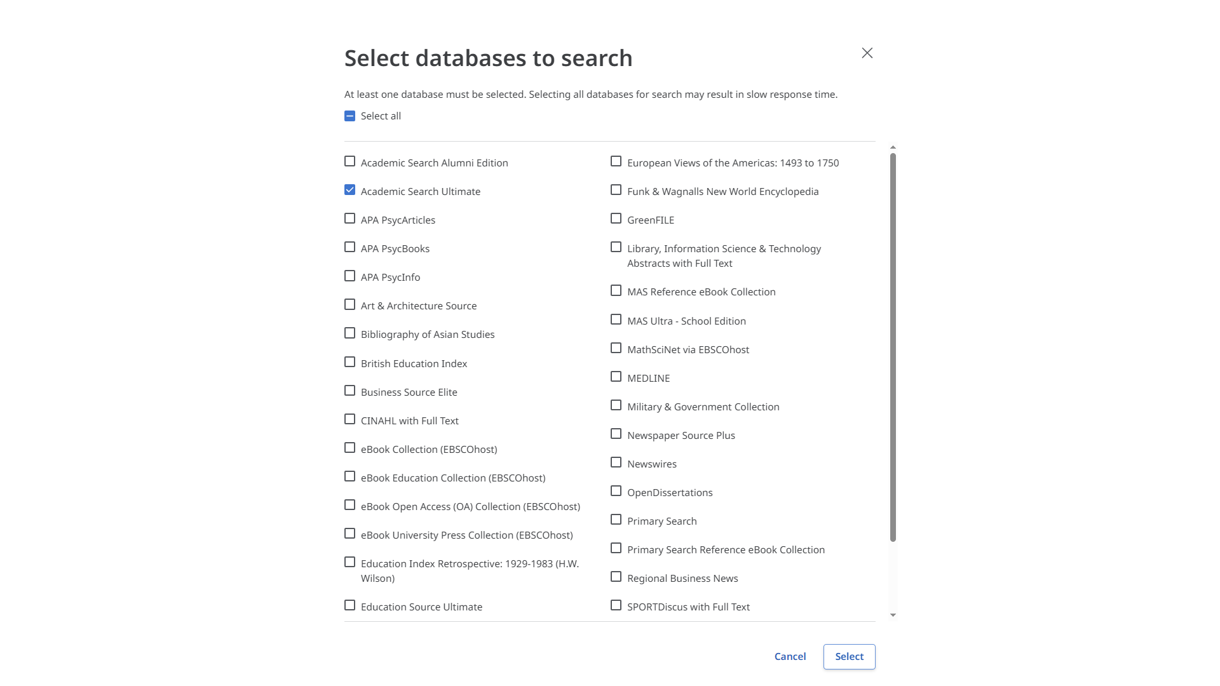
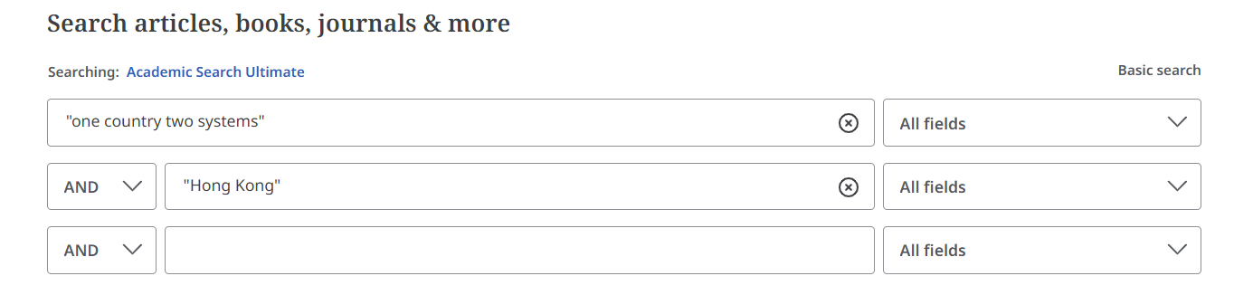
Databases for Journal Articles
Academic Search Ultimate (via EBSCOhost)

Slide 15
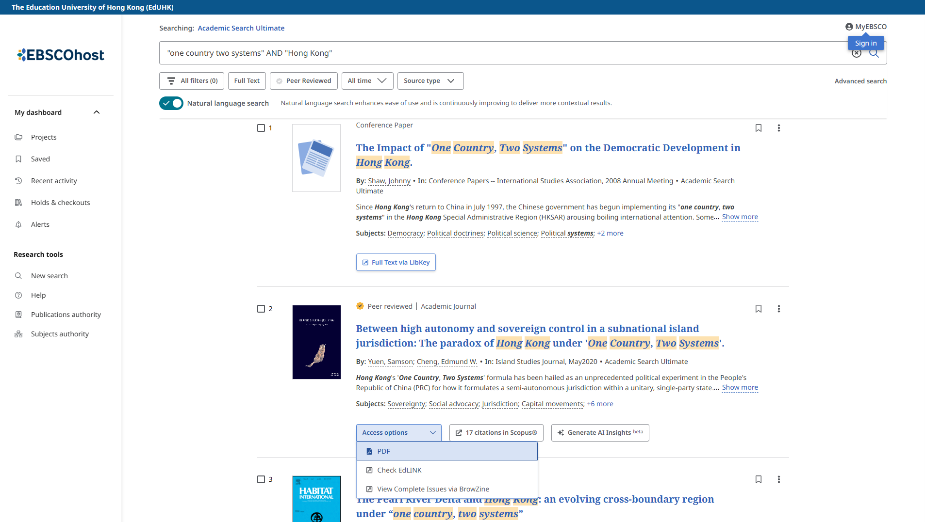
Databases for Journal Articles
Academic Search Ultimate (via EBSCOhost)
Search results page
Full text available

Slide 16
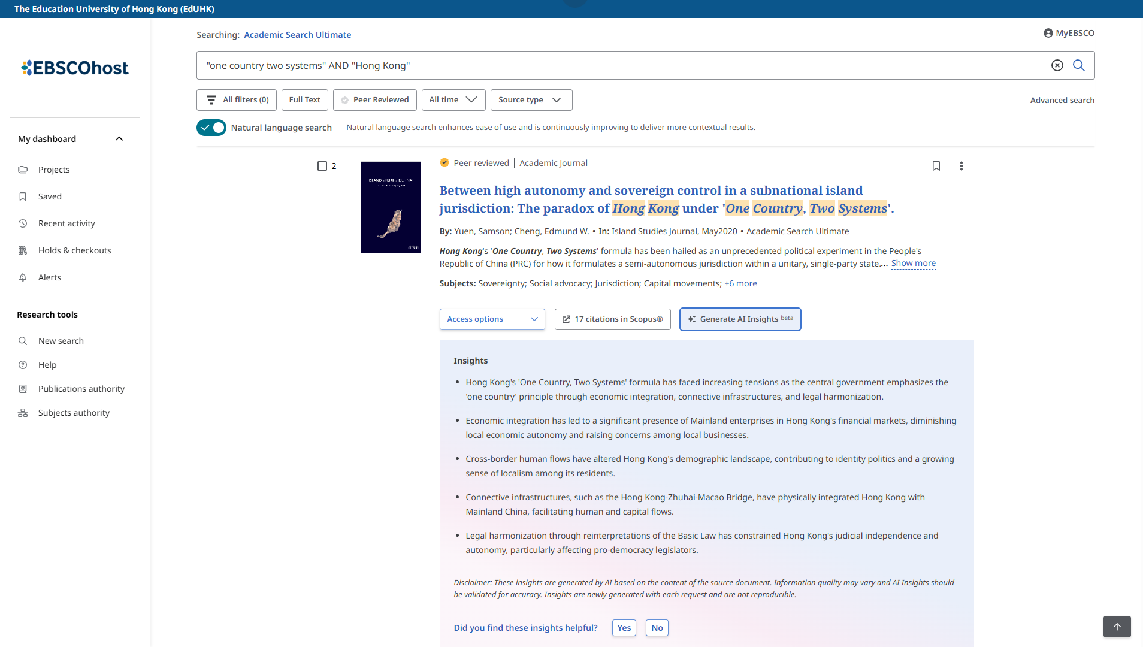
Databases for Journal Articles
Academic Search Ultimate (via EBSCOhost)
Tip: Refine your results
Refine your results by: Publication Date, Databases, Source Types, Subject, Publication, etc.
AI Insights offer concise summaries, presenting 2-5 key points for each document

Slide 17
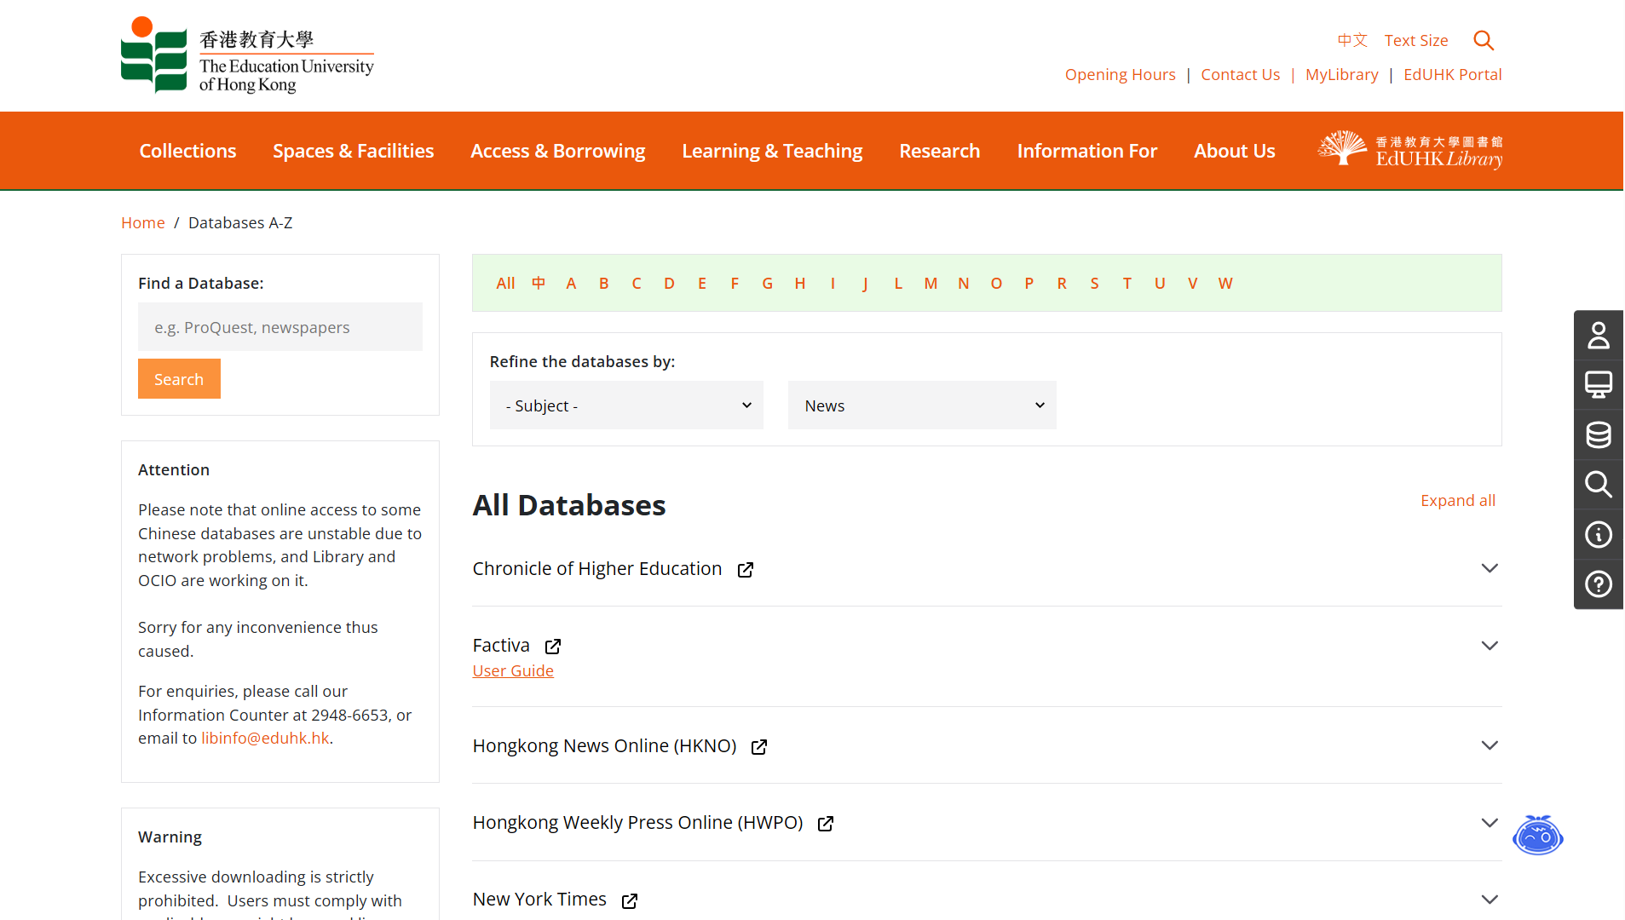
Databases for News
The Library subscribes to a number of online newspaper services, such as Factiva, South China Morning Post (ePaper edition) and WisersOne, providing online access to a range of newspapers from Hong Kong, China, Taiwan and overseas.
EdUHK Library Homepage > Databases A-Z > Refine the databases by “News”

Slide 18
Databases for News – Factiva
https://www.lib.eduhk.hk/databases/factiva
Factiva is a valuable research tool for many disciplines, including political science, media studies, business, technology studies, social science, journalism, the arts, and more. The comprehensive database allows users to browse through a collection of global content sources from 200 countries, in 26 languages – including newspapers, continuously updated newswires from Dow Jones and Reuters, journals and magazines, websites, blogs, and multimedia. [6 concurrent users only]

Slide 19
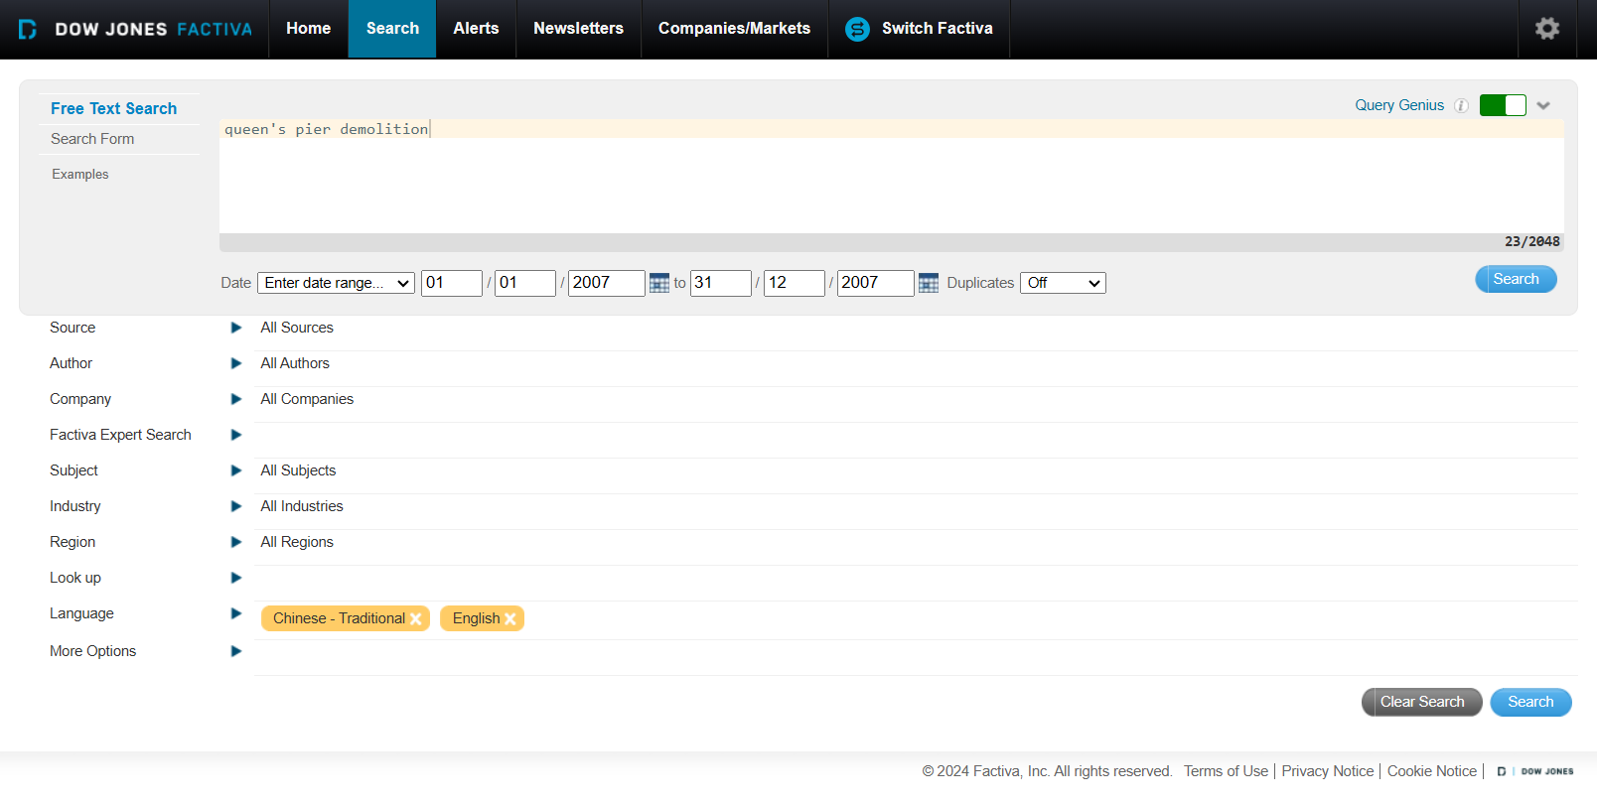
Databases for News - Factiva
Run a basic search with your search term(s)
Enter your search term(s) in Free Text Search box

Slide 20
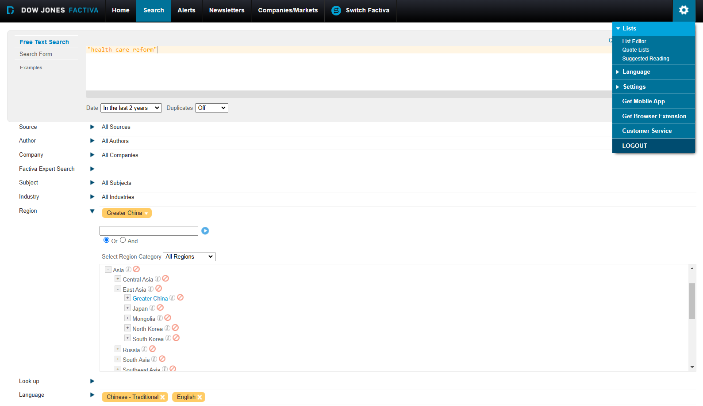
Databases for News - Factiva
Free Text Search, e.g. “health care reform” + last 2 years + Greater China
More search tips
Click the arrow to expand the menu from each category

Slide 21
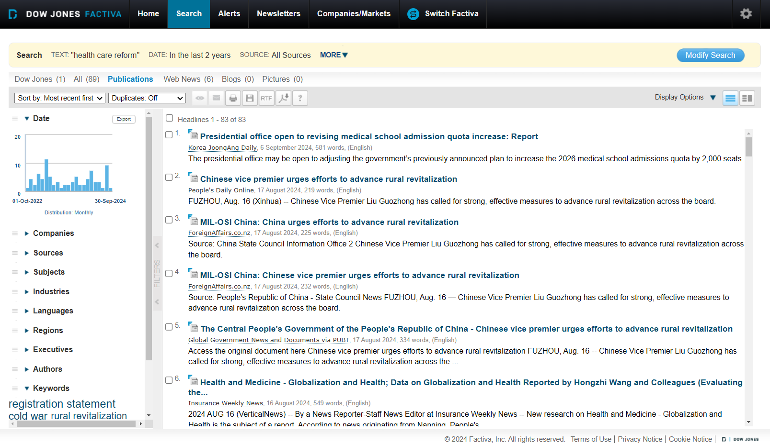
Databases for News - Factiva
No. of results by sources
Result list
Filter and refine search results

Slide 22
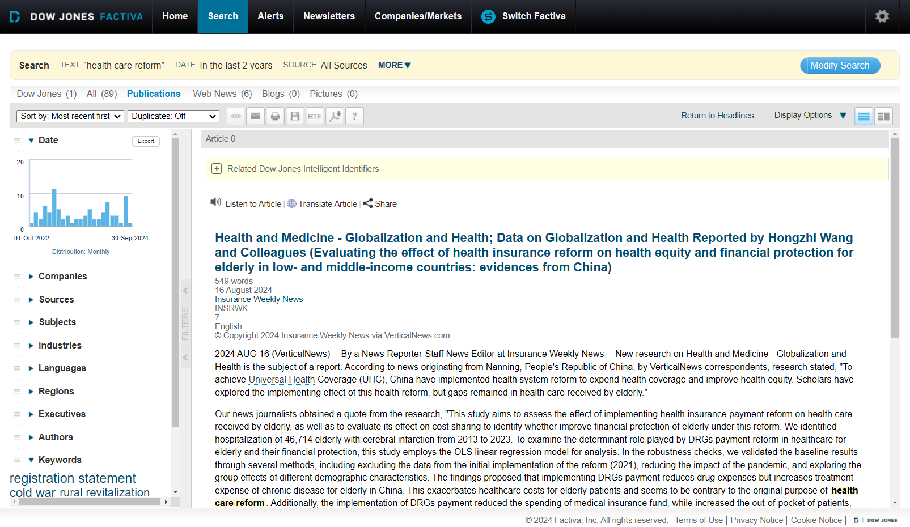
Databases for News - Factiva
Email, print or save the article
Listen to the article or have it translated into another language

Slide 23
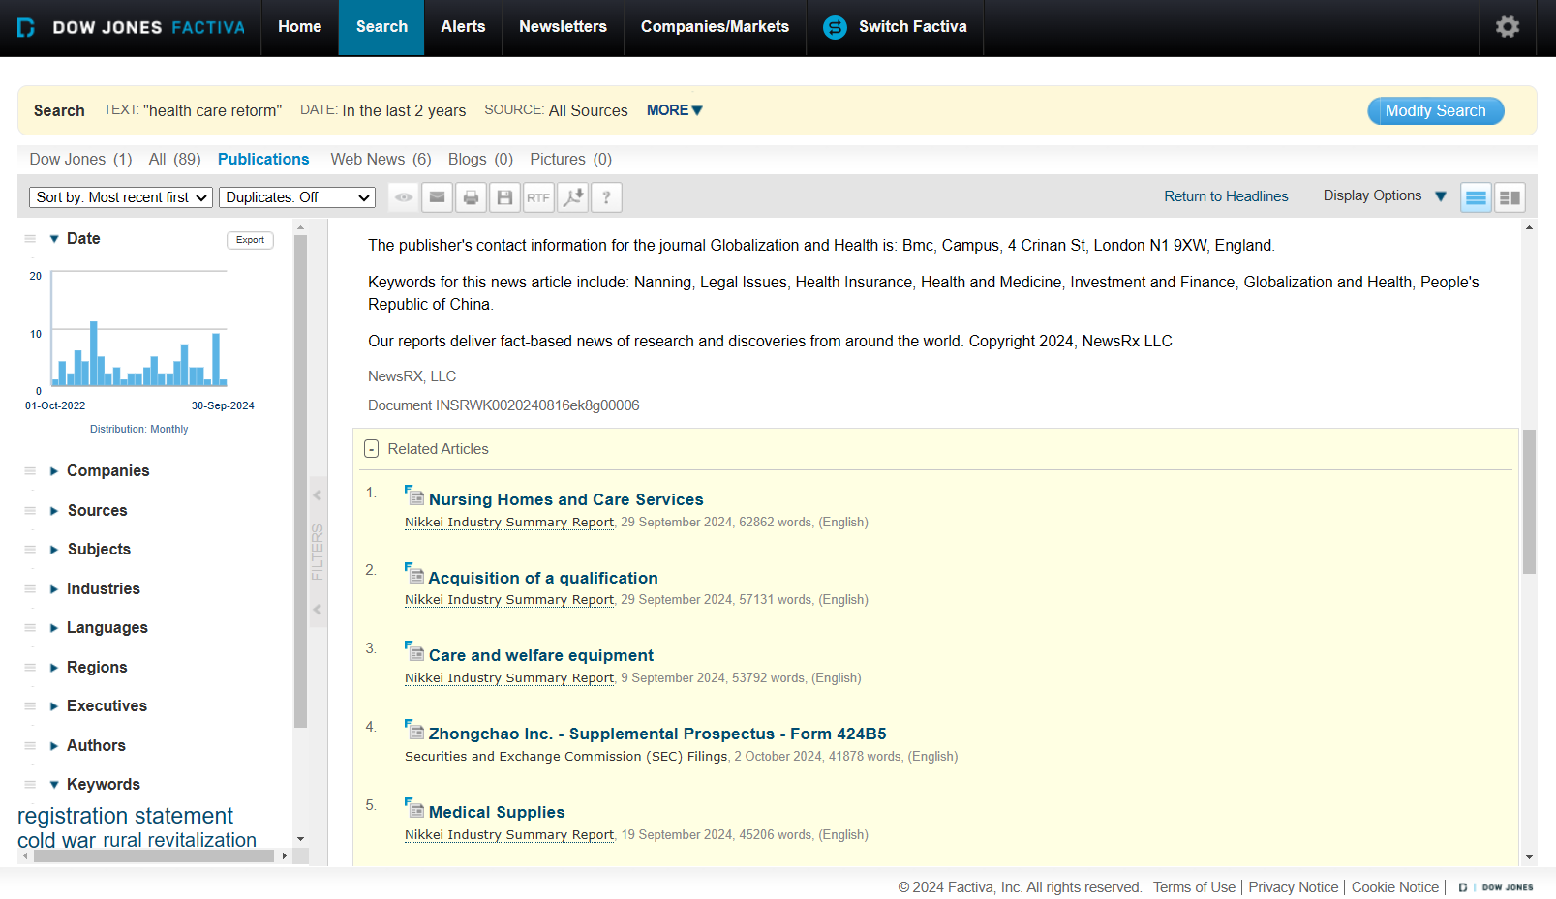
Databases for News - Factiva
Browse other related articles

Slide 24
Databases for News
ProQuest Historical Newspapers: South China Morning Post (1903-2001)
With searchable, full text coverage from South China Morning Post’s origin in 1903 up to and including 2001, users will be able to search the entirety of the newspaper including advertisements, editorials, cartoons, and photographs that illuminate history as much as the news articles.

Slide 25
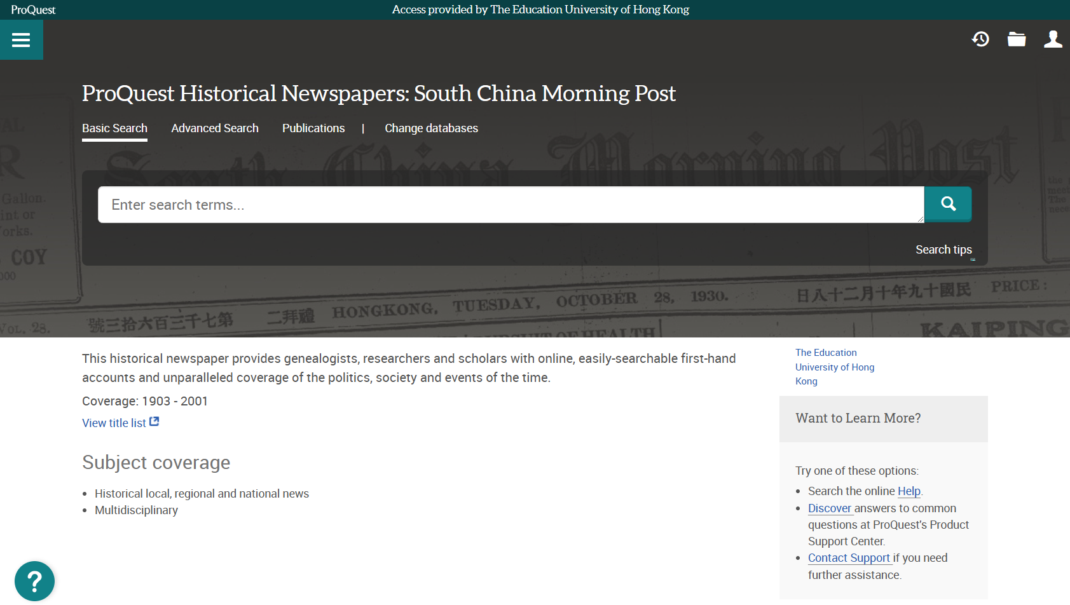
Databases for News
ProQuest Historical Newspapers: South China Morning Post

Slide 26
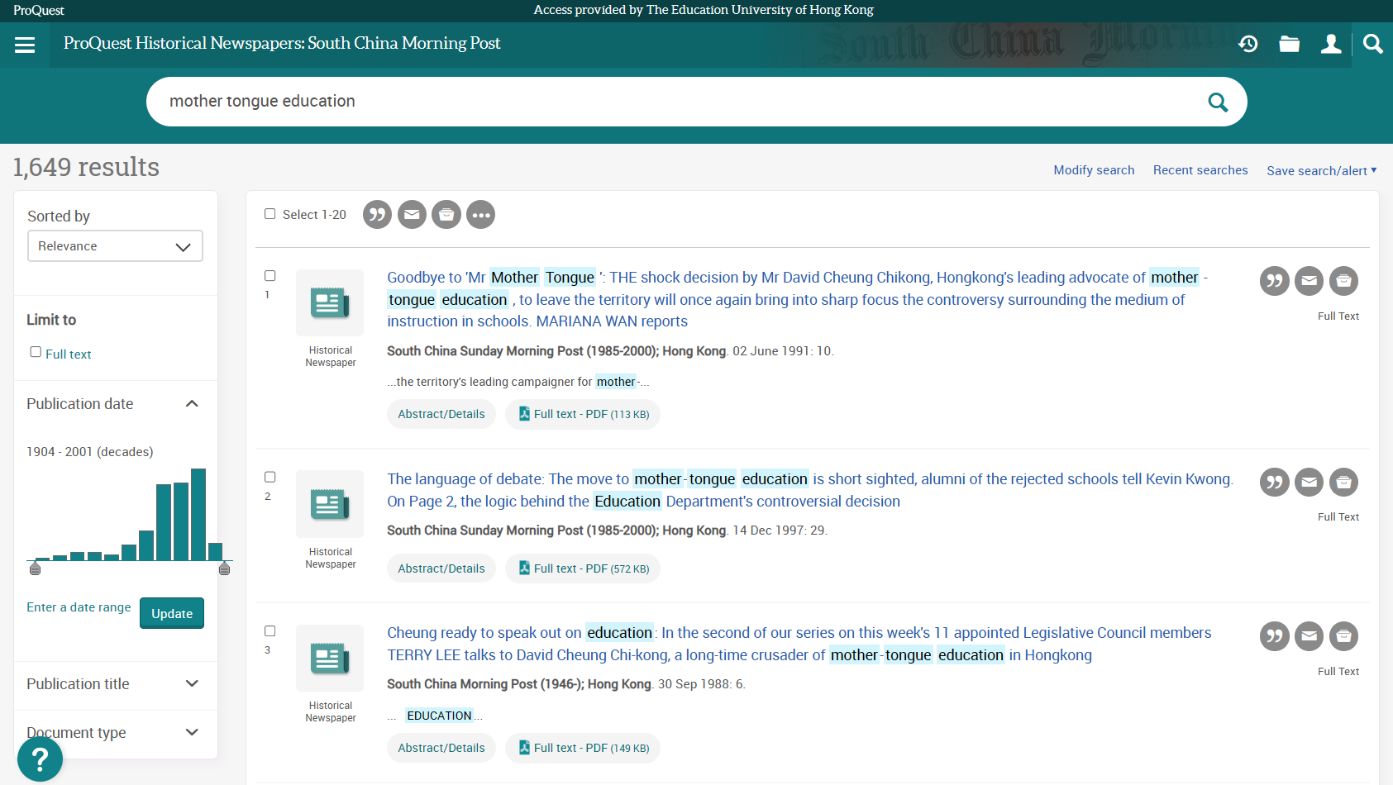
Databases for News
ProQuest Historical Newspapers: South China Morning Post
Search for news articles on mother tongue education

Slide 27
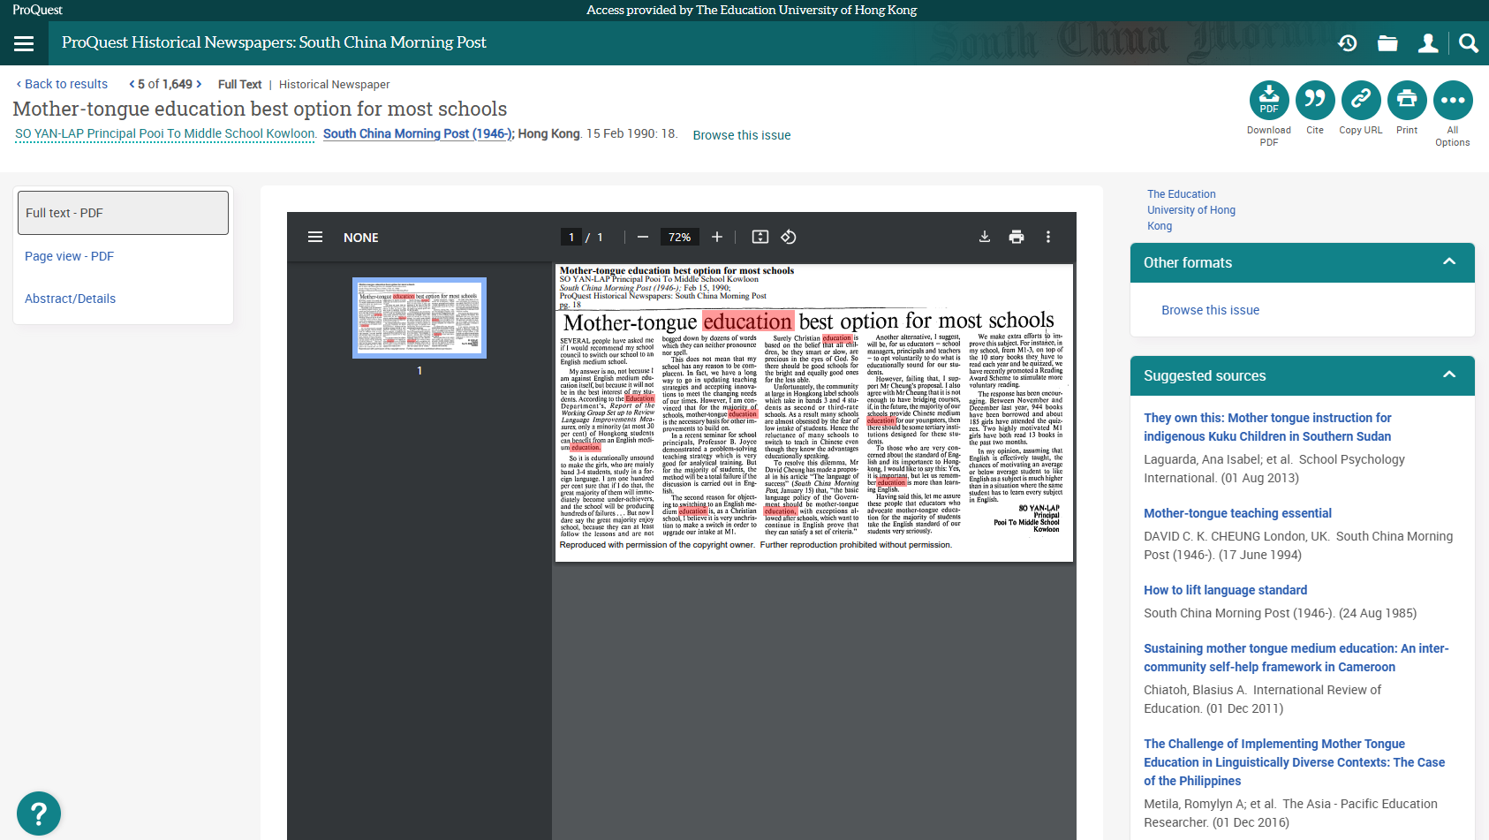
Databases for News
ProQuest Historical Newspapers: South China Morning Post

Slide 28
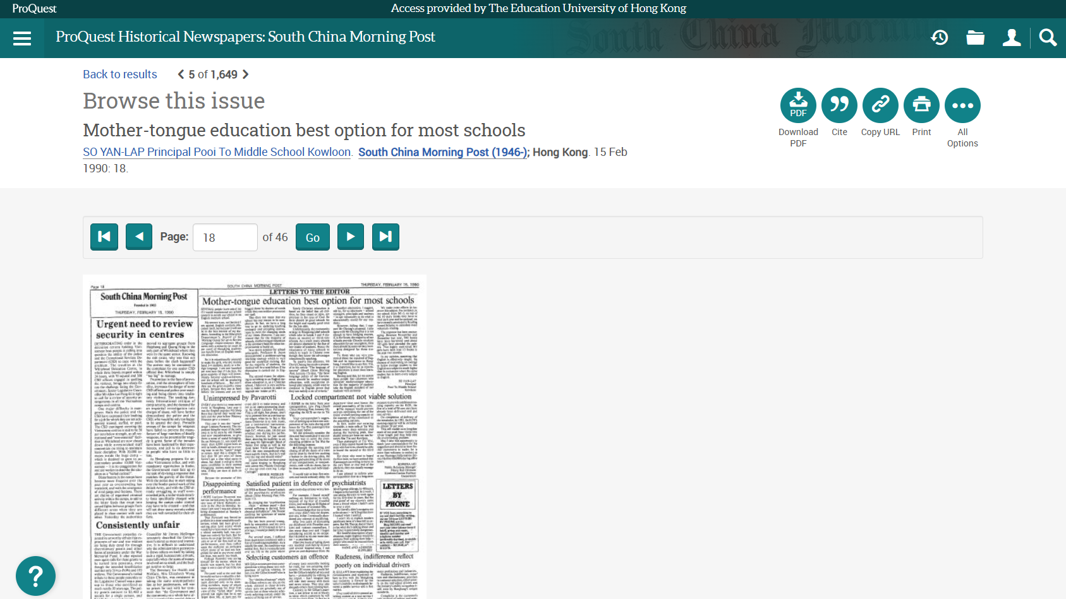
Databases for News
ProQuest Historical Newspapers: South China Morning Post
Browse other articles from the same issue

Slide 29
Exercise
Use the Advanced Search option to check with the editorial of South China Morning Post on 9 Oct 1925.

Slide 30
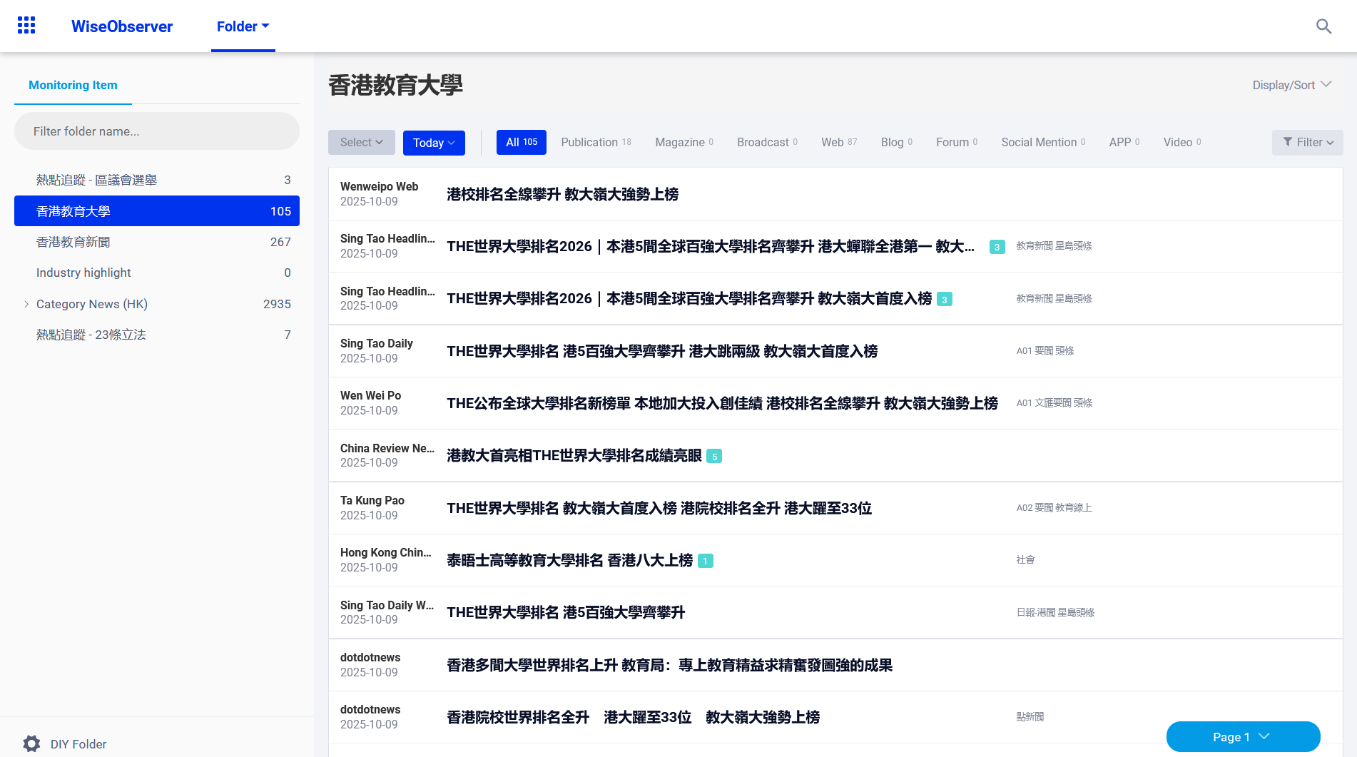
Databases for News - WisersOne
  資料庫包括WiseObserver新聞瀏覽，瀏覽每天報刊新聞及WiseSearch新聞檢索，檢索本地報刊、大中華地區及海外不同類別資訊的報刊媒體。
Default mode allows you to browse EdUHK news
Search in this folder
Browse news by category (see next slide)
Click the headline to view the full text

Slide 31
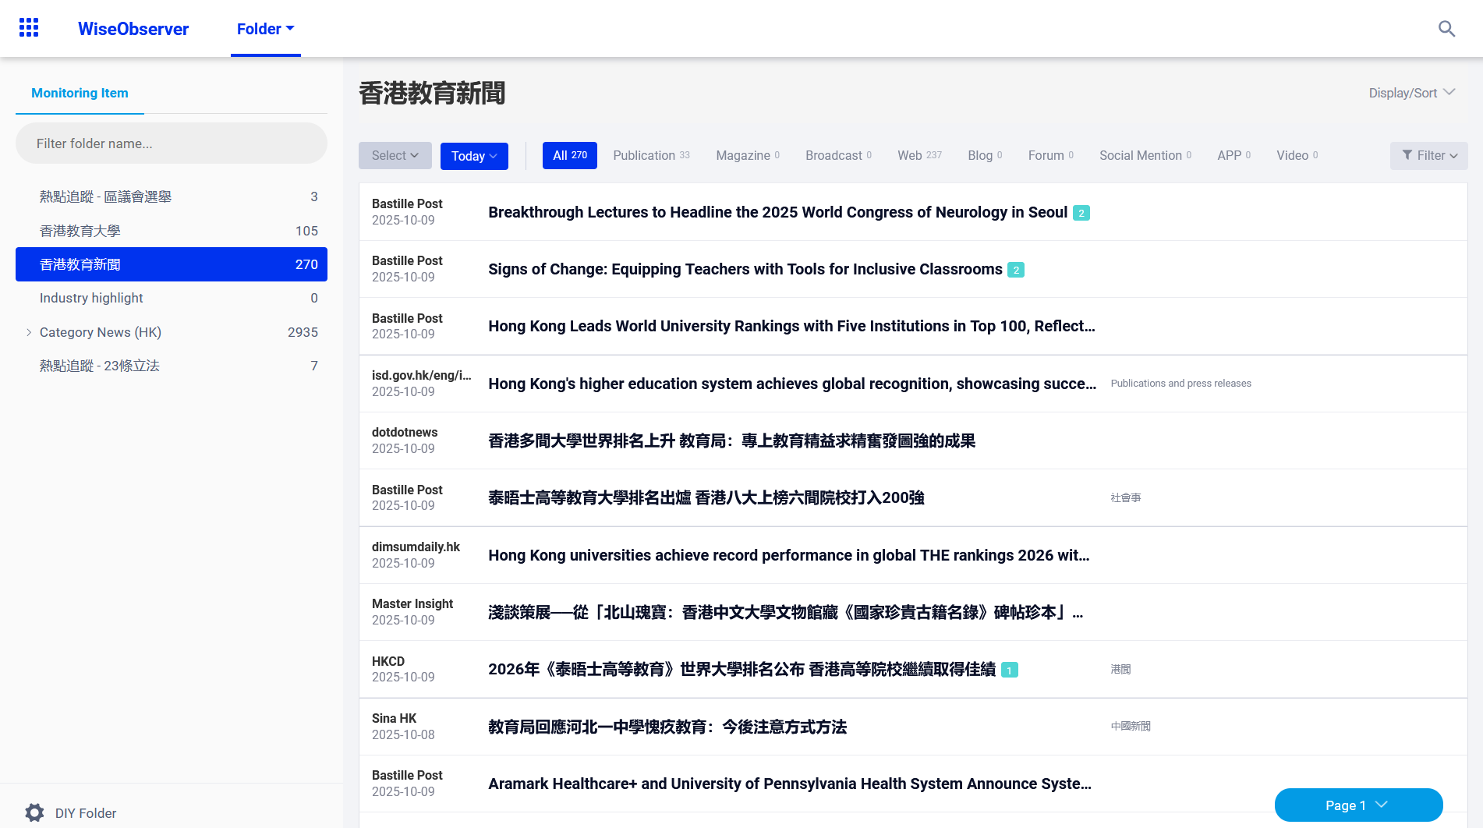
Databases for News - WisersOne
Browsing News by Category

Slide 32
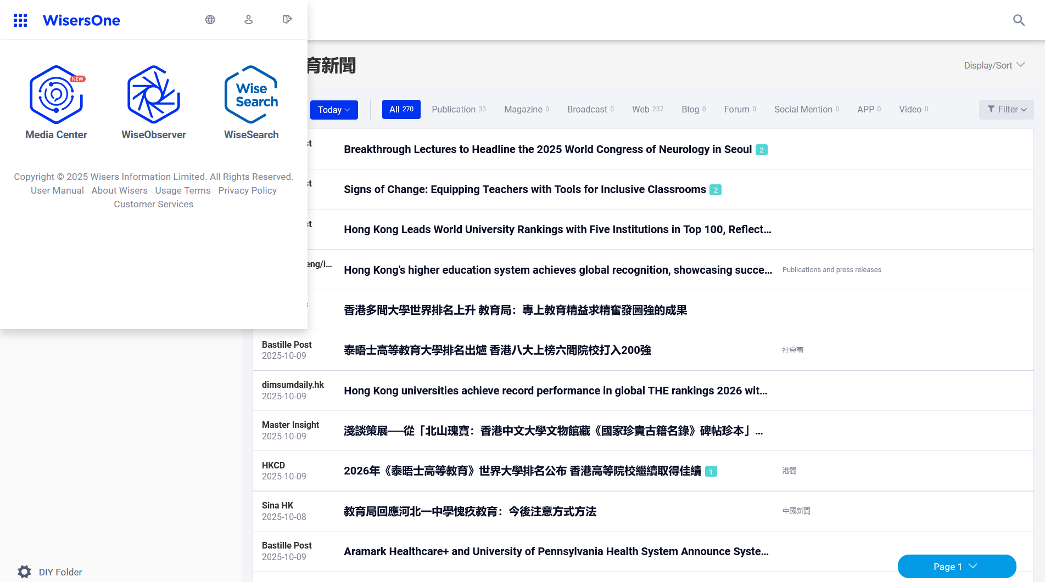
Databases for News - WisersOne
Search Interface

Slide 33
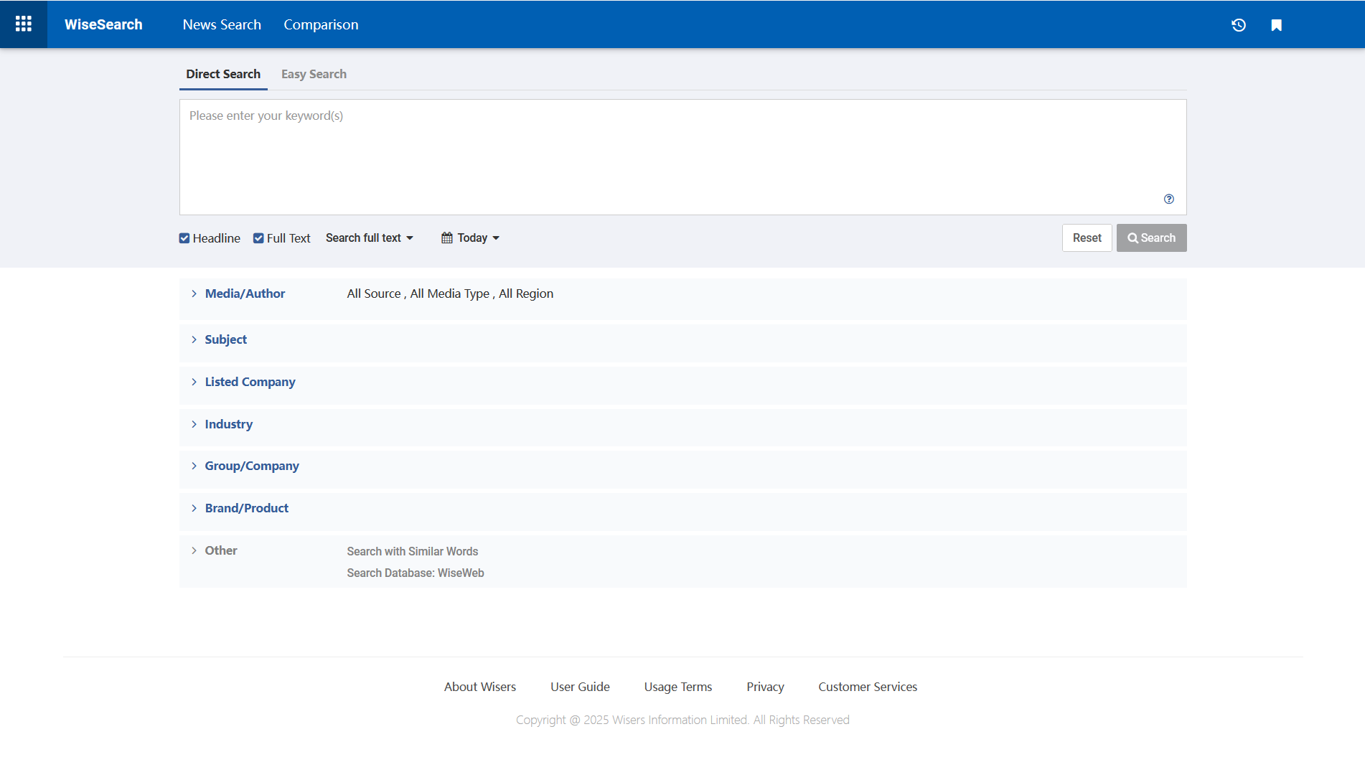
Databases for News - WisersOne
Search Interface
Search tips

Slide 34
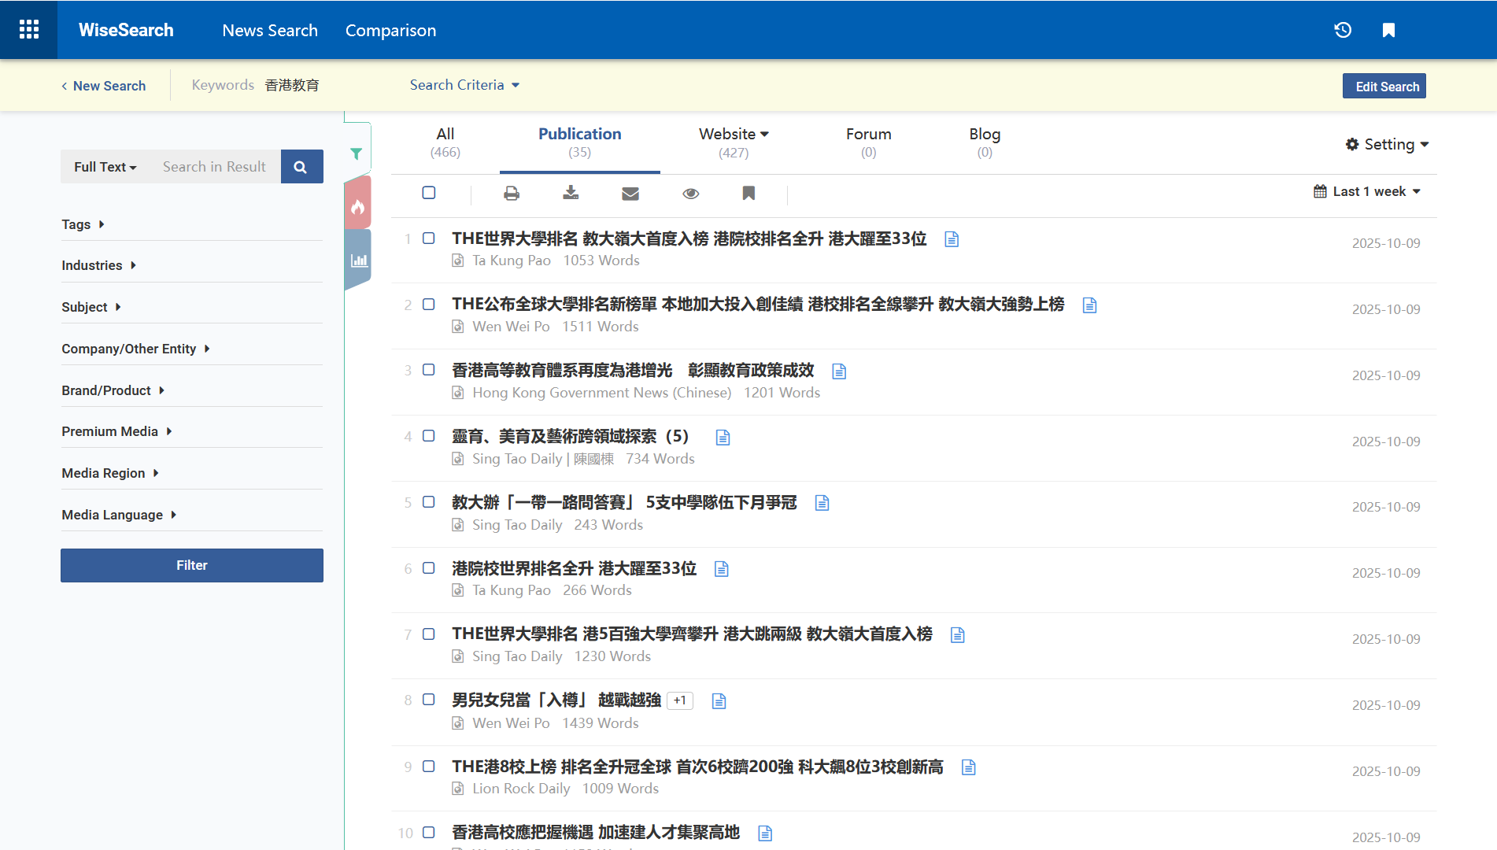
Databases for News - WisersOne
Search Result Page
Modify your search criteria
Narrow down the search by adding additional terms
To print, download, email, browse and bookmark a batch of articles.
Show similar headline and content

Slide 35
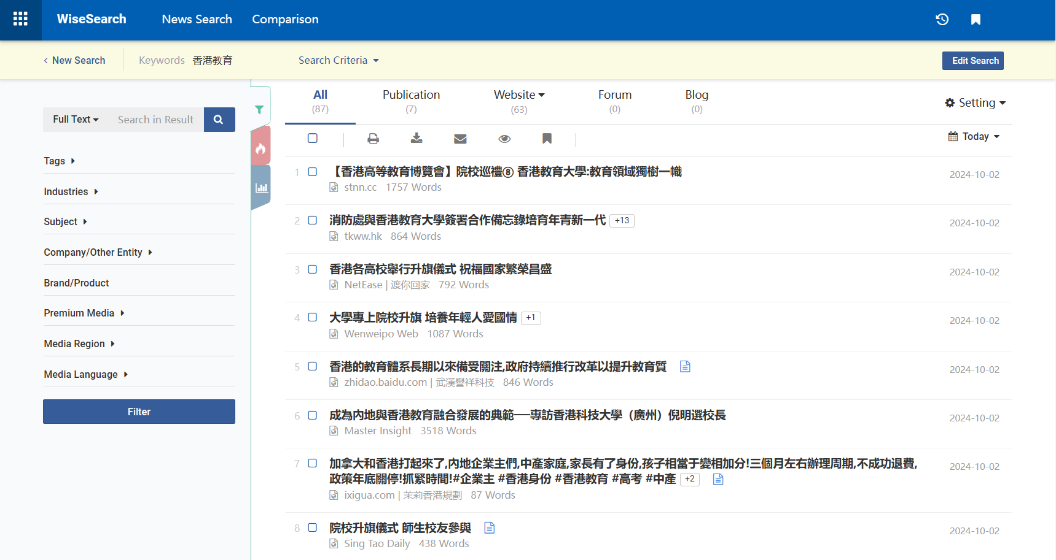
Databases for News - WisersOne
Search Result Page
Modify your search criteria
Narrow down the search by adding additional terms
To print, download, email, browse and bookmark a batch of articles.
Show similar headline and content

Slide 36
Databases for News - WisersOne
Export: Max documents per download / email / print
Max documents per download: 200 articles
Max documents per email: 100 articles (suggest not more than 15 articles)
Max documents per print: 100 articles
Max documents per add to my folder: 200 articles

Slide 37
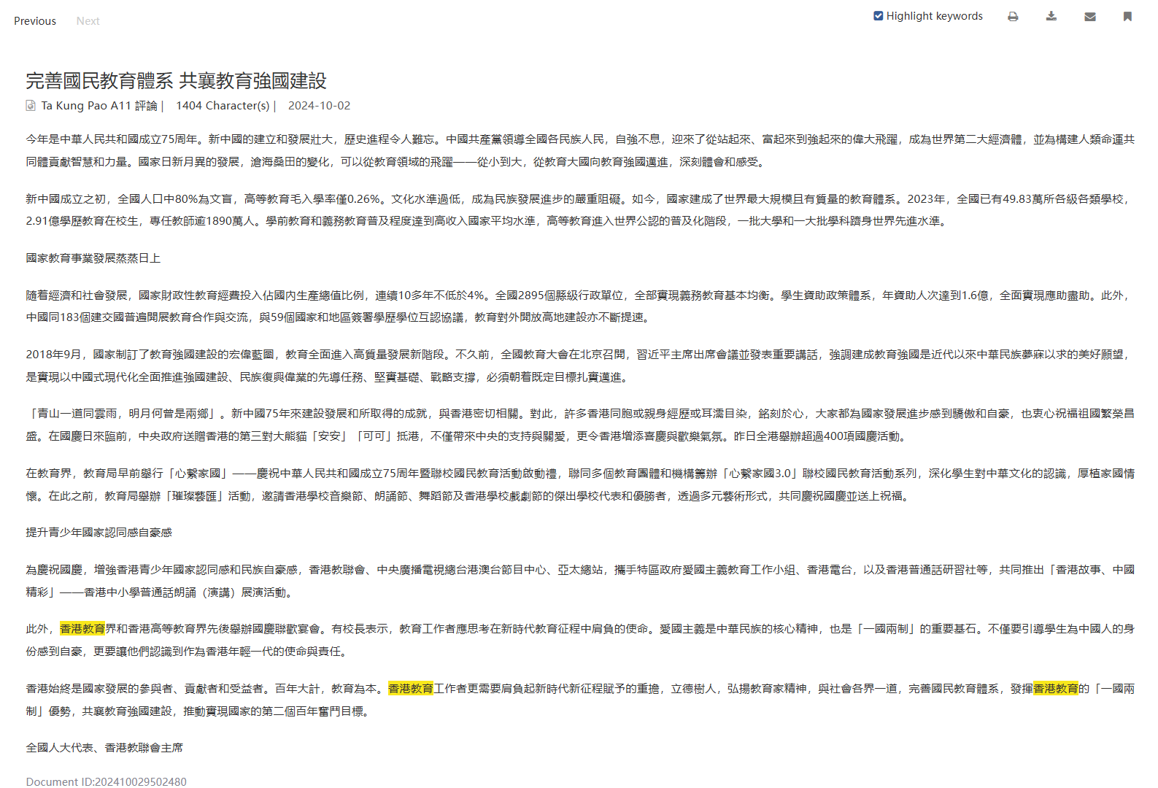
Databases for News - WisersOne
Browse article
Click here to enable/disable the highlight function

Slide 38
Other Format of News Articles
Back issues of newspapers in hard copies (4/F):
Print copies of HK newspapers are kept in the Library for the latest 2 months
Microform format (3/F):
Ming Pao Daily News 明報 (1959-2021)
Sing Tao Daily 星島日報 (1938-2009)
South China Morning Post 南華早報 (1984-2013)
The Standard 英文虎報 (2002-2009)
News clippings (Remote Storage):
Hong Kong newspaper clippings index (1980-1999) https://www.lib.eduhk.hk/permalink/record/alma991001103979703410
Hong Kong newspaper clippings (1993-1999) https://www.lib.eduhk.hk/permalink/record/alma991004696219703410

Slide 39
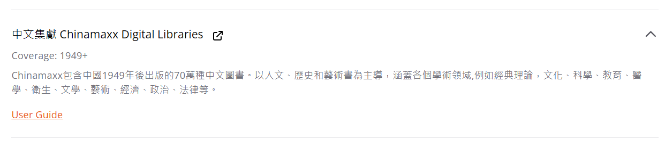
Databases for E-Book

Slide 40
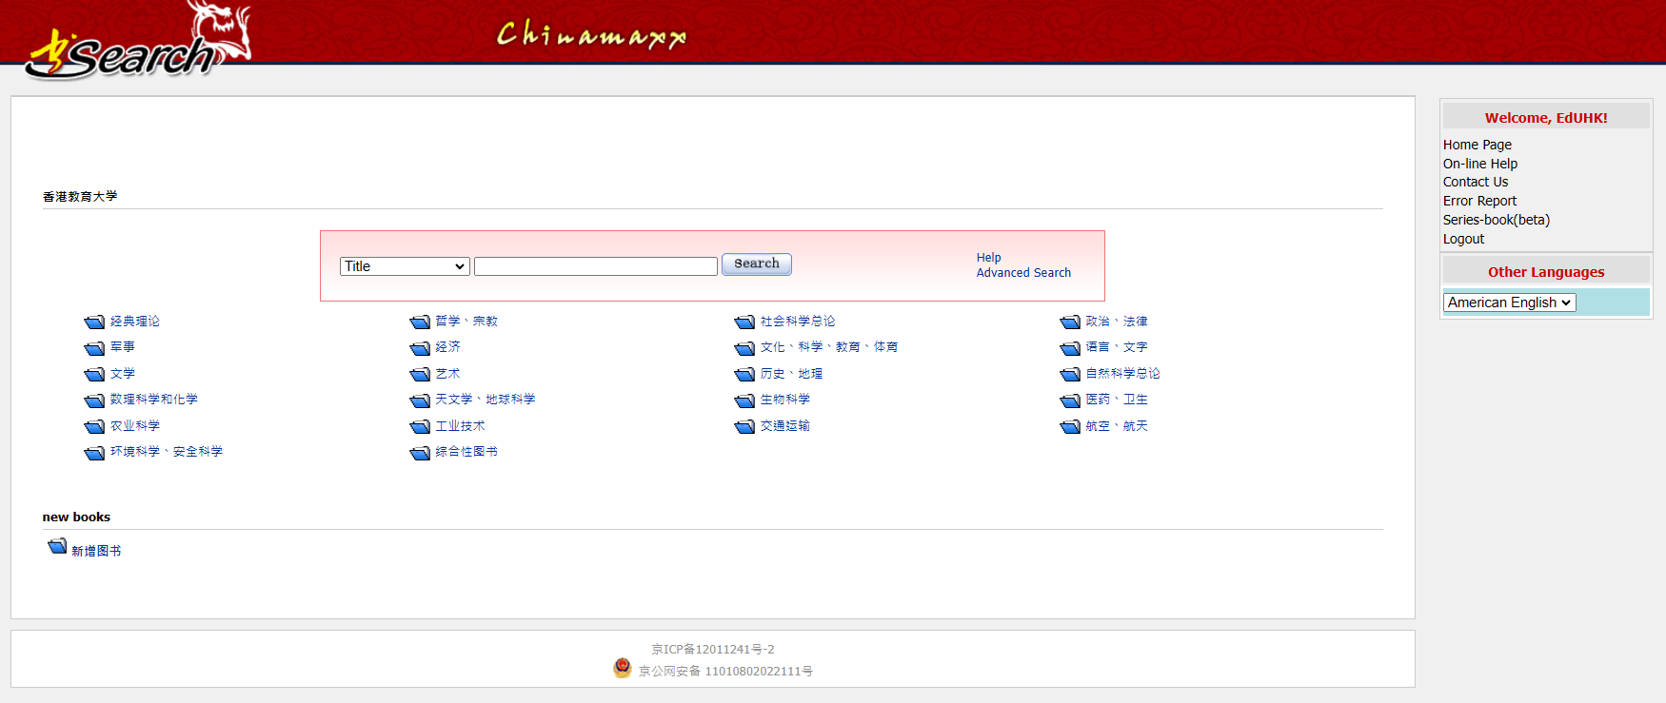
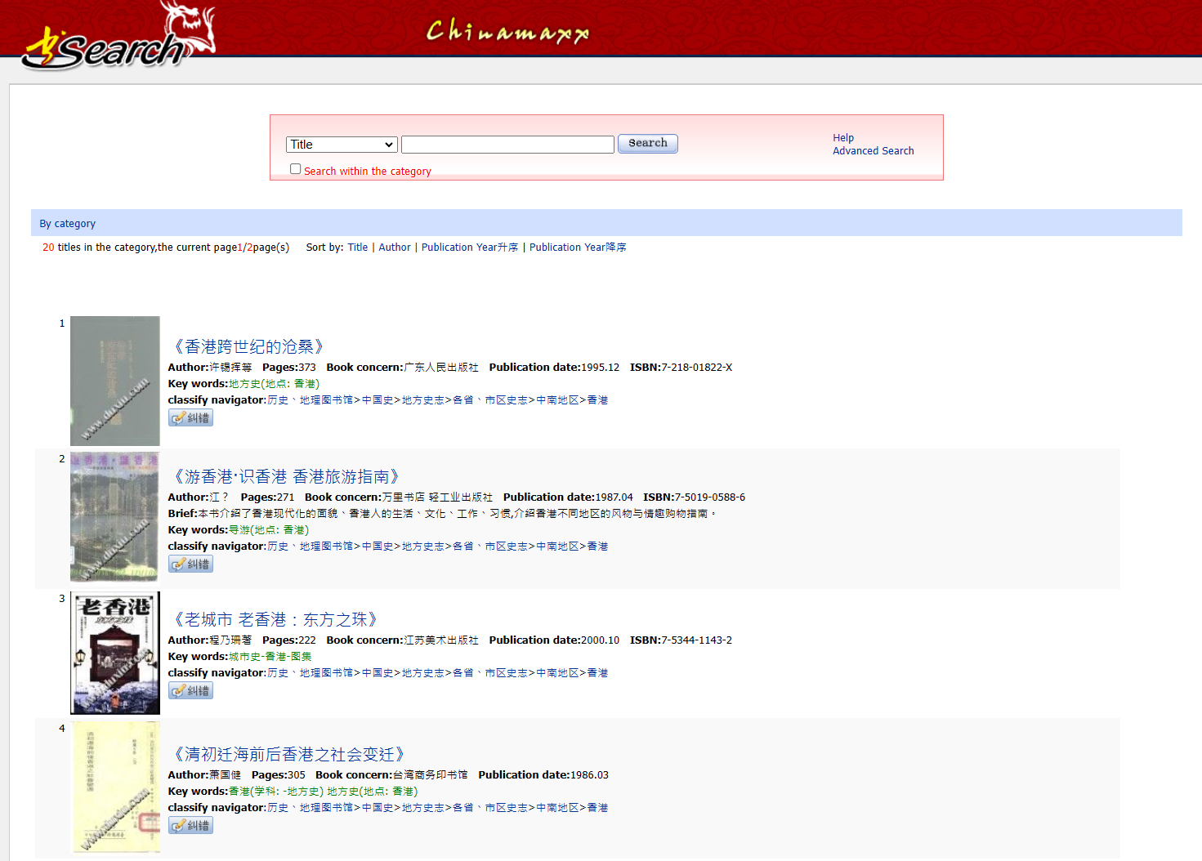
Databases for E-Book
Browse by Category in Chinamaxx
歷史、地理 > 中國史 > 地方史志 > 各省、巿區史志 > 中南地區 > 香港
40

Slide 41
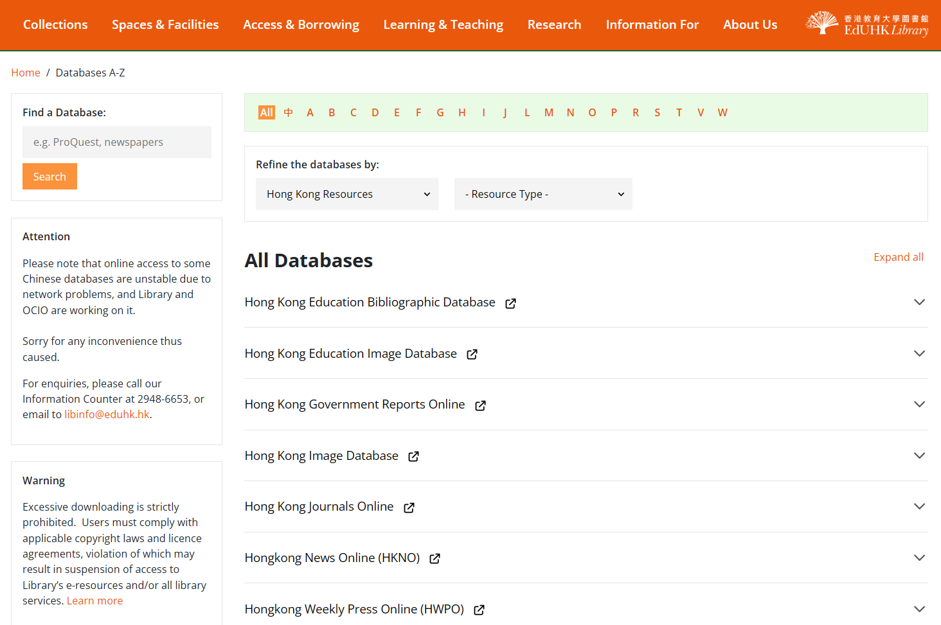
E-Resources about Hong Kong History

Slide 42
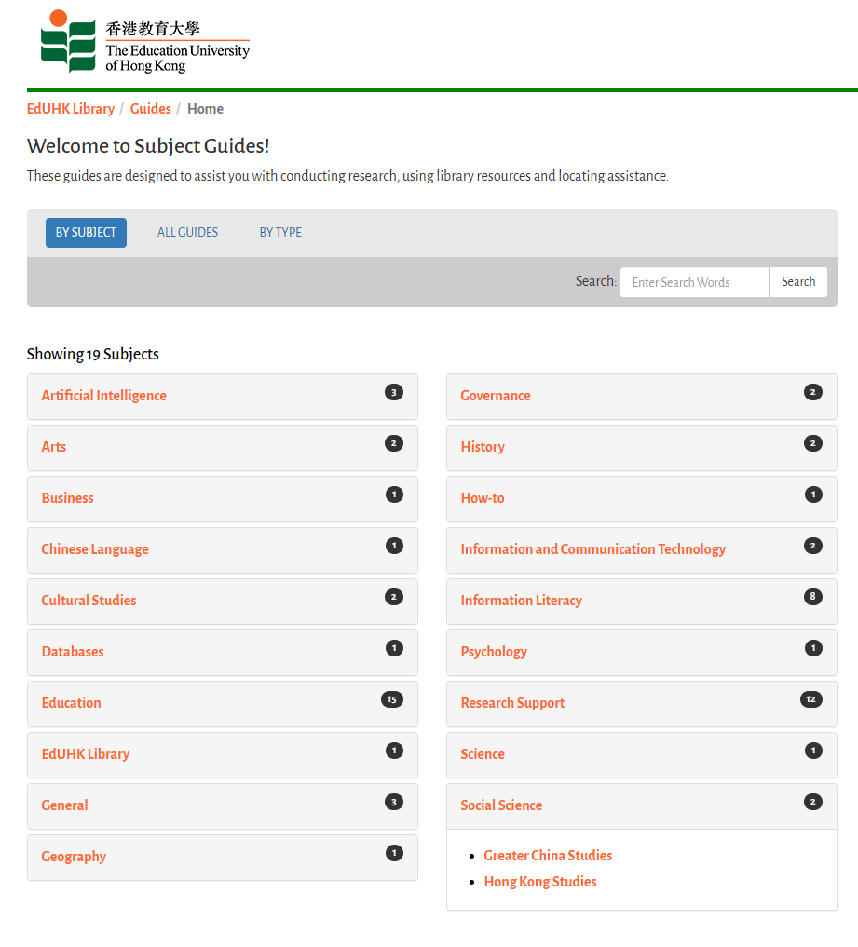
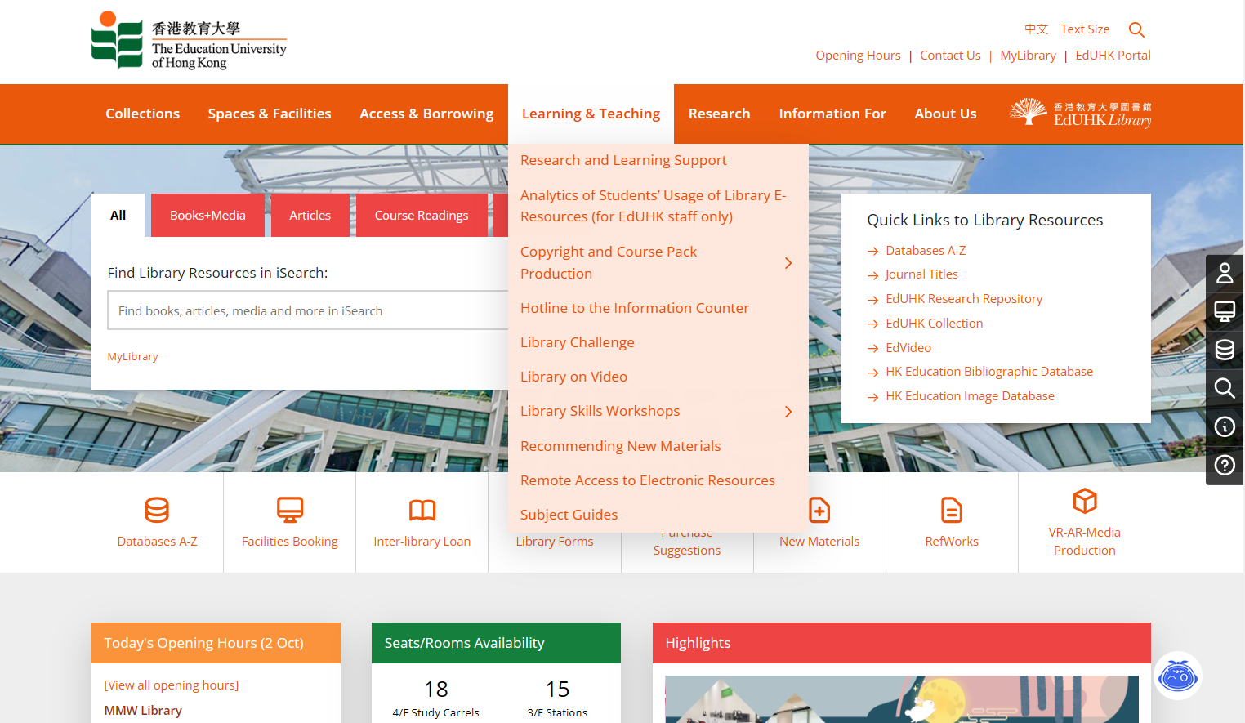
E-Resources about Hong Kong History

Slide 43
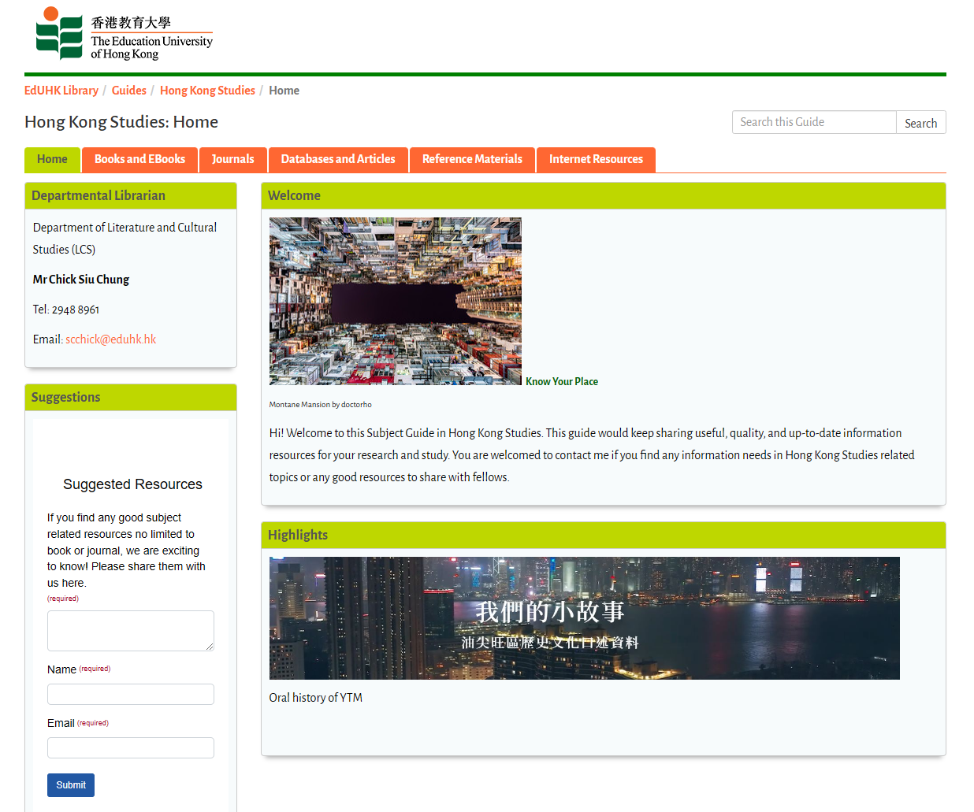
E-Resources about Hong Kong History

Slide 44
Other Libraries’ Digitization Projects
HKUL Digital Initiative – from HKU
https://lib.hku.hk/database/
CUHK Digital Repository – from CUHK
https://repository.lib.cuhk.edu.hk/
Elsie Tu Digital Collection – from HKBU
https://library.hkbu.edu.hk/collections/special-collections-archives/digitization-projects/elsie-tu-digital-collection/
Multimedia Information System (MMIS) – from Hong Kong Public Libraries
https://mmis.hkpl.gov.hk/
中港電視電影資料庫 – from HKBU
https://digital.lib.hkbu.edu.hk/film-tv/
華人剪報資料庫 – from HKBU
https://digital.lib.hkbu.edu.hk/newsclipping/
近代史數位資料庫 – from Academia Sinica
http://mhdb.mh.sinica.edu.tw/

Slide 45
Hong Kong Government Reports Online
https://sunzi.lib.hku.hk/hkgro/
A full-text image database providing online access to pre-World War II issues of four major government publications, namely, Administrative Report, Hong Kong Sessional Papers, Hong Kong Hansard and Hong Kong Government Gazette.
Contains a wide range of information, such as official notifications, proceedings of the Legislative Council, statistics, and reports of government departments and special committees, etc.
Coverage: 1842-1941

Slide 46
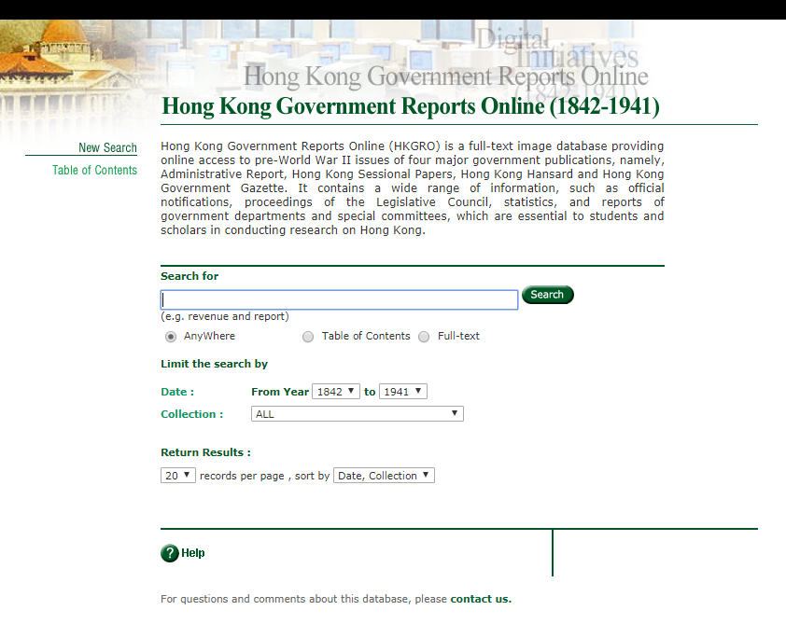
Hong Kong Government Reports Online

Slide 47
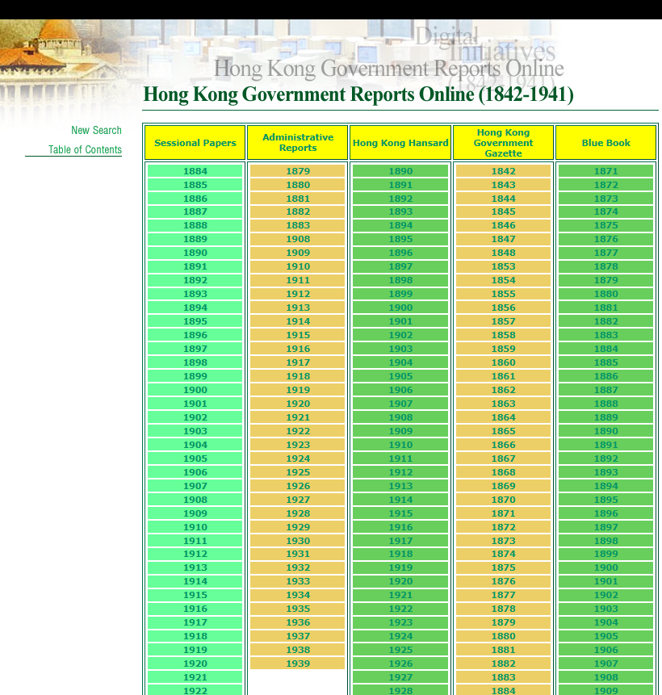
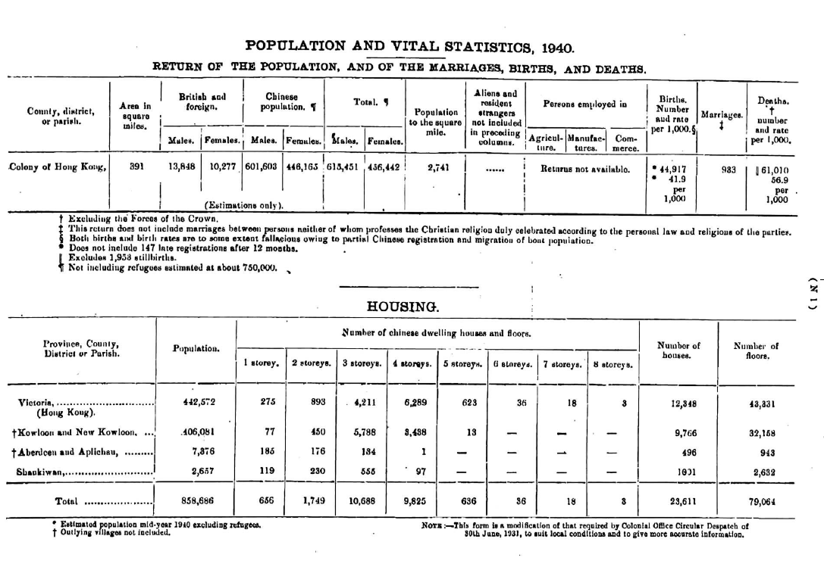

Example: Search the population statistics of 1940 from Blue Book

Slide 48
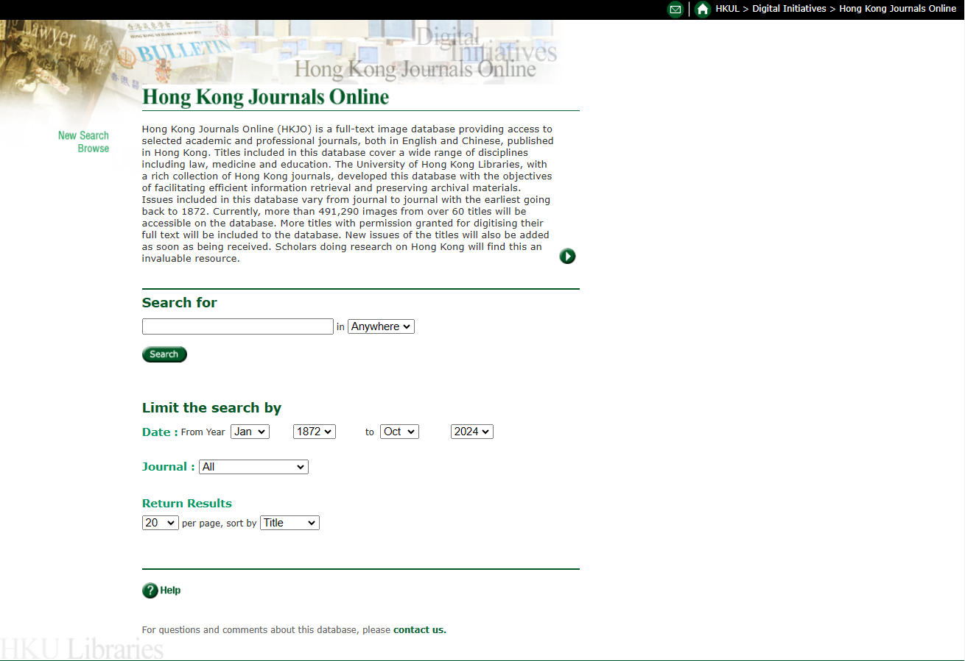
Hong Kong Journals Online
https://hkjo.lib.hku.hk/
A full-text image database providing access to selected academic and professional journals, both in English and Chinese, published in Hong Kong
Covers a wide range of disciplines including law, medicine and education, with the earliest issues going back to 1872
Provides more than 491,290 images from over 60 titles

Slide 49
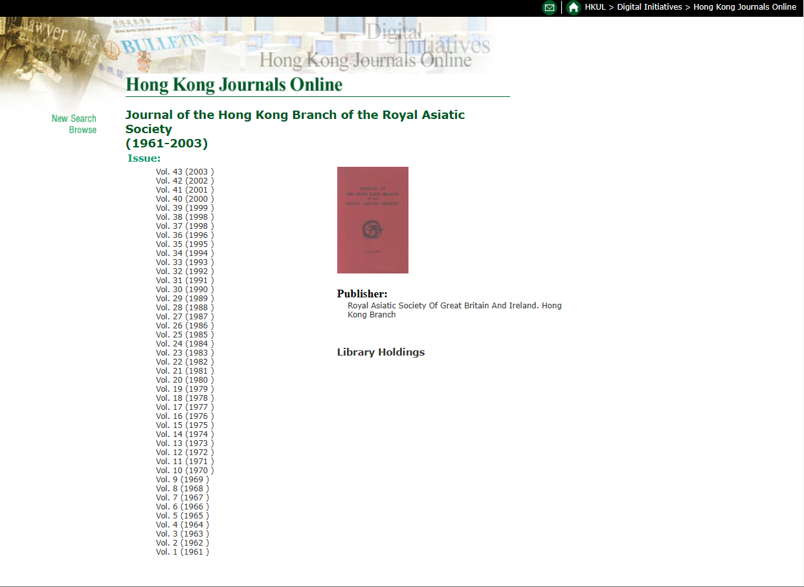
Example: Journal of the Hong Kong Branch of the Royal Asiatic Society

Slide 50
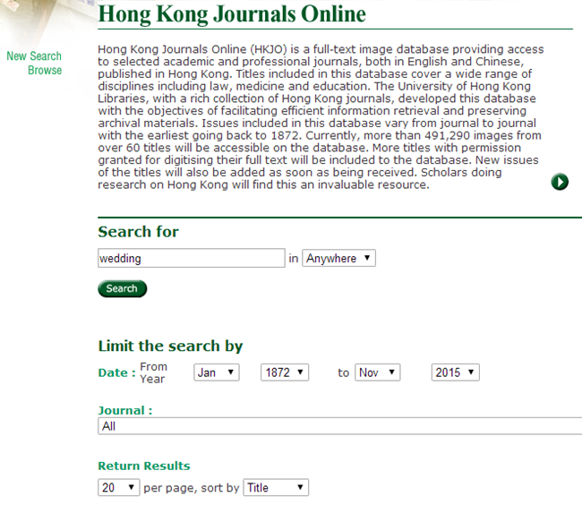
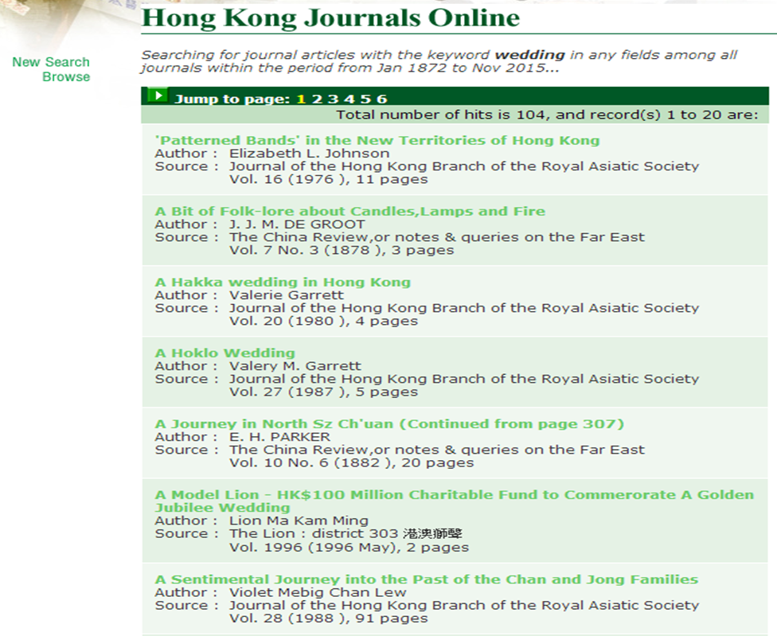

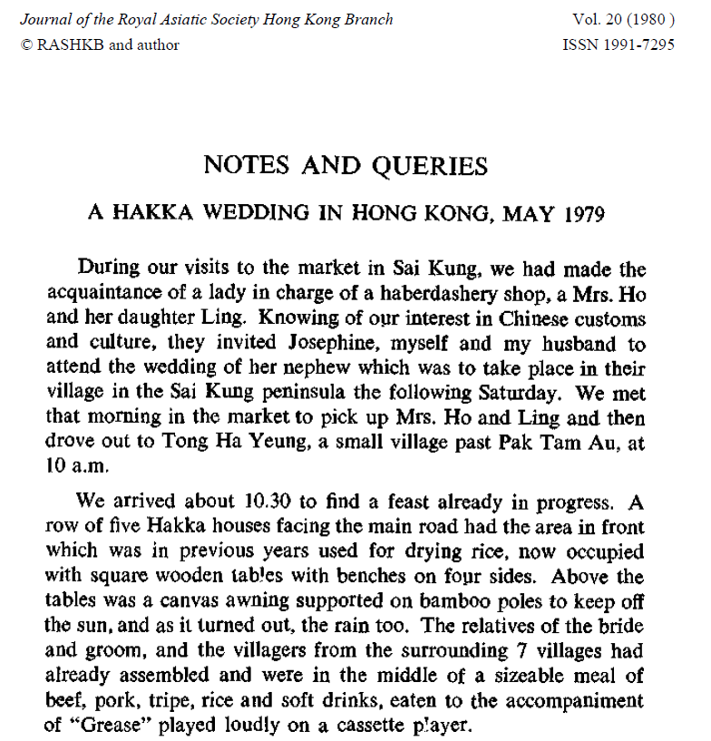
Example: Search wedding customs in Hong Kong

Slide 51
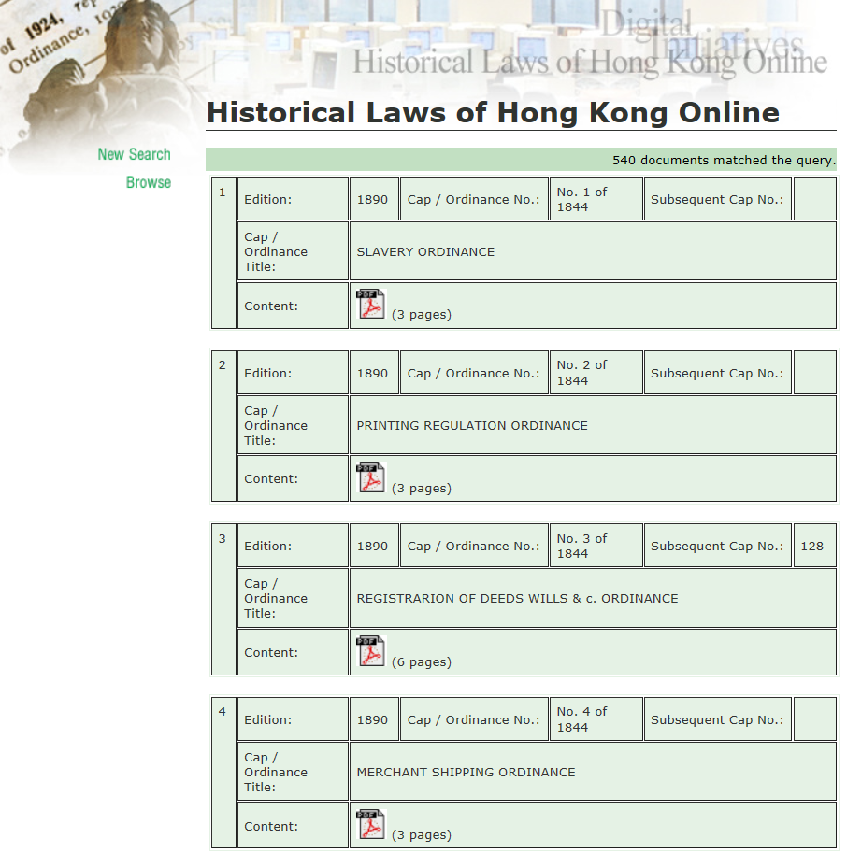
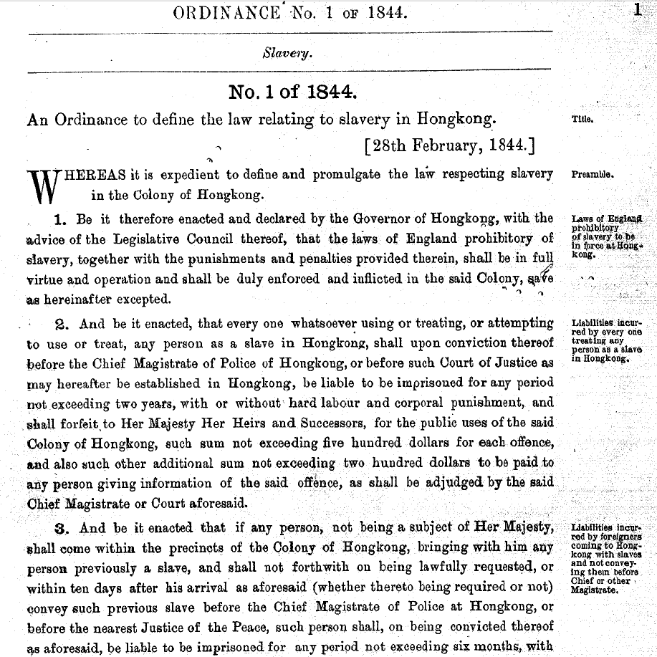
Historical Laws of Hong Kong Online
http://oelawhk.lib.hku.hk/exhibits/show/oelawhk/home
A full-text image database providing access to past revised editions of Hong Kong Laws
Comprises a total of seven consolidations of the laws of Hong Kong: 1890, 1901, 1912, 1923, 1937, 1950, and 1964 (last updated to 1989).

Slide 52
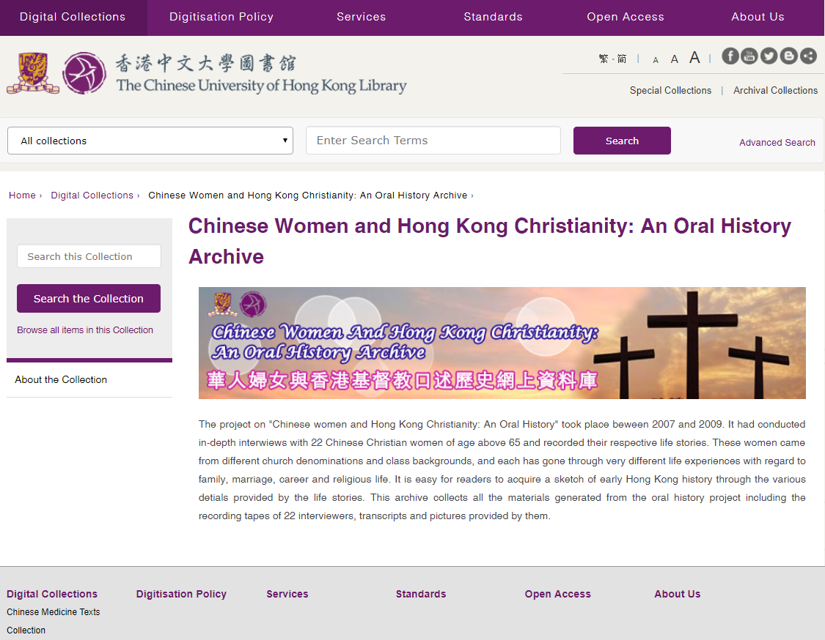
Chinese Women and Hong Kong Christianity: An Oral History Archive
http://repository.lib.cuhk.edu.hk/en/collection/women-christianity
It had conducted in-depth interviews with 22 Chinese Christian women of age above 65 and recorded their respective life stories.
It collects recording tapes of 22 interviewers, transcripts and pictures provided by them.

Slide 53
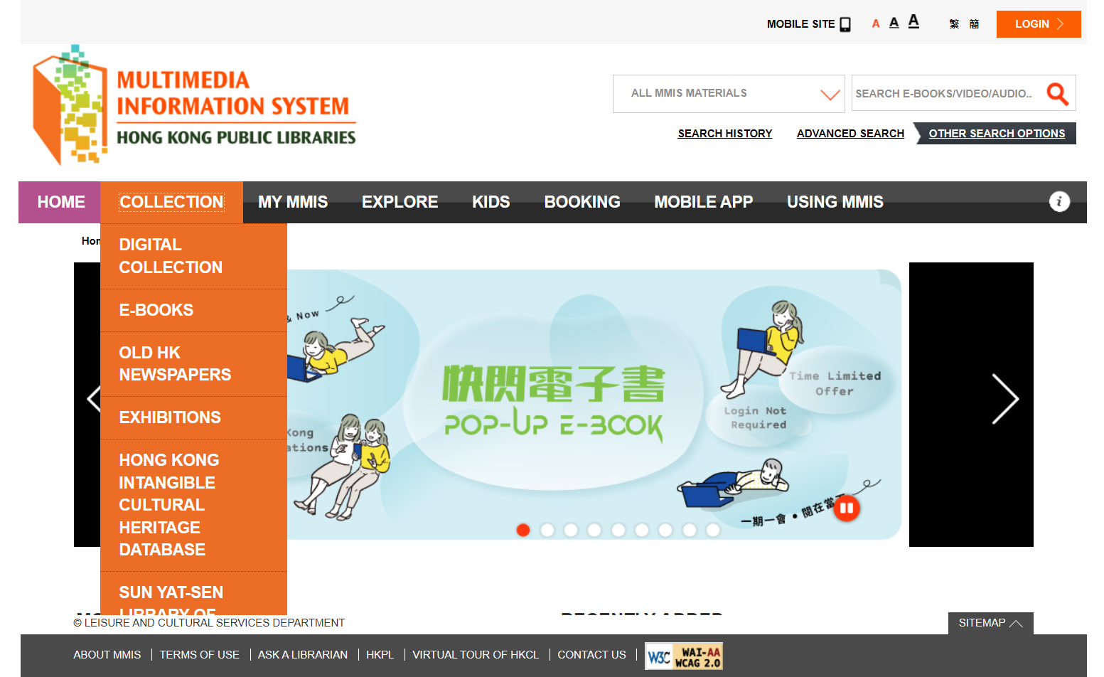
Multimedia Information System
of Hong Kong Public Libraries
https://mmis.hkpl.gov.hk/
MMIS provides a rich collection of digitized format of materials on microfilms, clippings, maps, posters, house programmes etc.
The Old Hong Kong Newspapers Collection is a selective collection of major old Hong Kong Newspapers published from early Hong Kong to nowadays, aiming at preserving historical news reporting of Hong Kong for reference and research.

Slide 54

Coverage of the Old HK Newspapers

Slide 55

View all items by title

Slide 56



Example: Search with keywords 母語教學

Slide 57
HKSAR Official Websites
Free access to the official documents and publications from the websites of HKSAR such as:
GovHK https://www.gov.hk/
news.gov.hk https://www.news.gov.hk/
Hong Kong Yearbook https://www.yearbook.gov.hk/
Gazette https://www.gld.gov.hk/egazette/

Slide 58

Hong Kong Yearbook
https://www.yearbook.gov.hk/
Official Annual Report of the HKSAR
Available online from 1997 onwards

Slide 59
Points to Note:
Other than the Hong Kong Yearbook, you may also consult The Other Hong Kong Report published by Chinese University Press from 1989 to 1998 recording the trends and changes in HK before and after 1997.
Click the URL https://www.lib.eduhk.hk/permalink/record/alma991000076189703410 to view the holding records in the Library.

Slide 60

Hong Kong Memory
https://www.hkmemory.hk/
Hong Kong Memory (HKM) is a multi-media web site that gives free and open access to digitized materials on Hong Kong’s history, culture and heritage. The materials include text documents, photographs, posters, sound recordings, motion pictures and videos.

Slide 61


Example: To locate the history of public housing

Slide 62


Oral history archives are also provided in this database

Slide 63
Q & A
Library Information Counter
G/F, Mong Man Wai Library
Tel: 2948 6653
WhatsApp: 9514 9655
Email: libinfo@eduhk.hk

