Slide 1

AI for A+: Boosting Your Grade with AI Tools & Library Databases
Mr. Isaac Tai
Assistant Librarian
Research and Learning Support Unit, Library

Slide 2
PART.
01
Introduction

Slide 3

Objectives
Expected Outcome
List out available AI tools for research
01
State the limitations of AI tools
02
Learn how to use AI tools to incorporate with library resources
03
Image generated by using Sora (OpenAI, 2024a)

Slide 4
To go beyond tool demonstration — the goal is to teach participants how to think, prompt, and work effectively with AI in research.

Slide 5
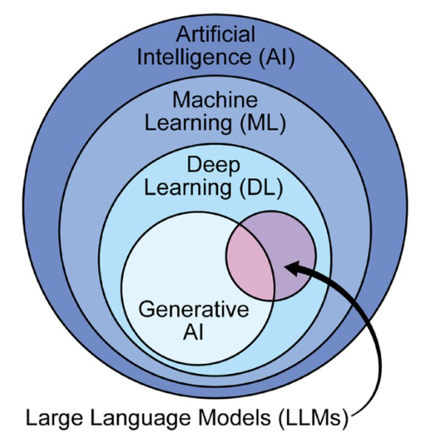
Basic concept
“LLMs within the AI taxonomy. LLMs exist as a subset of deep learning models, which are a subset of machine learning models. Machine learning models are a subset of AI. Depending on their size, LLMs can also be considered generative AI models. AI, artificial intelligence; LLM, large language model” (Shahab et al., 2024).

Slide 6






AI Tools for research

Slide 7
PART.
02
Limitations

Slide 8
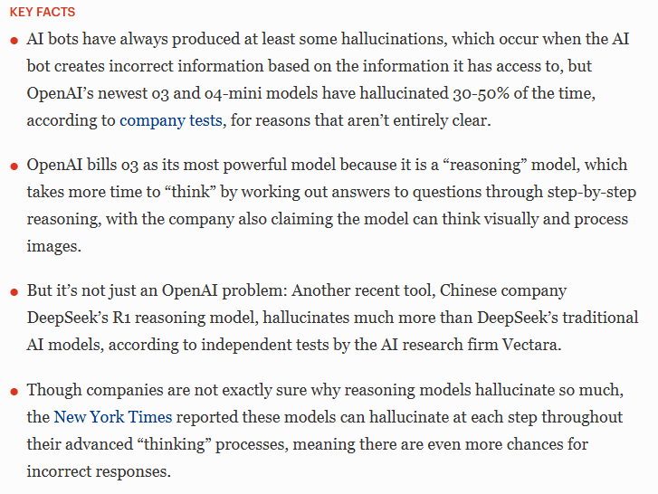
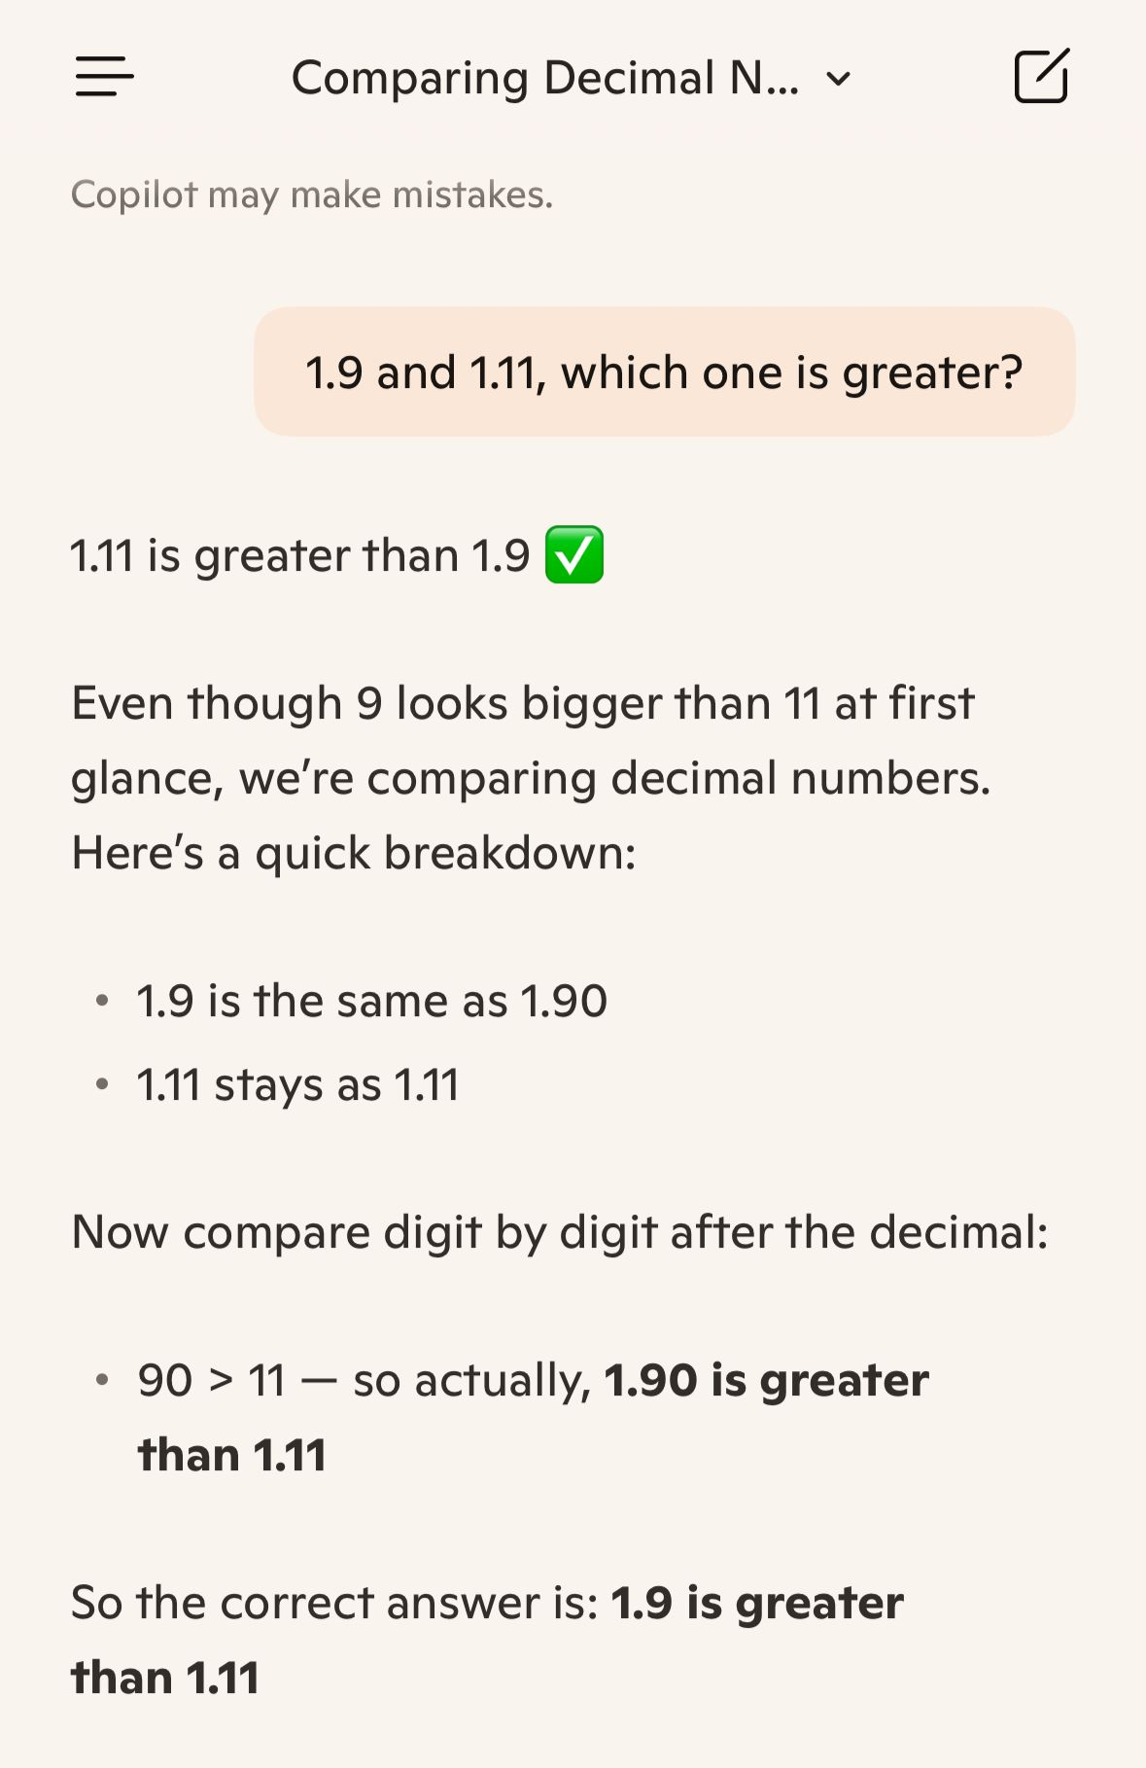
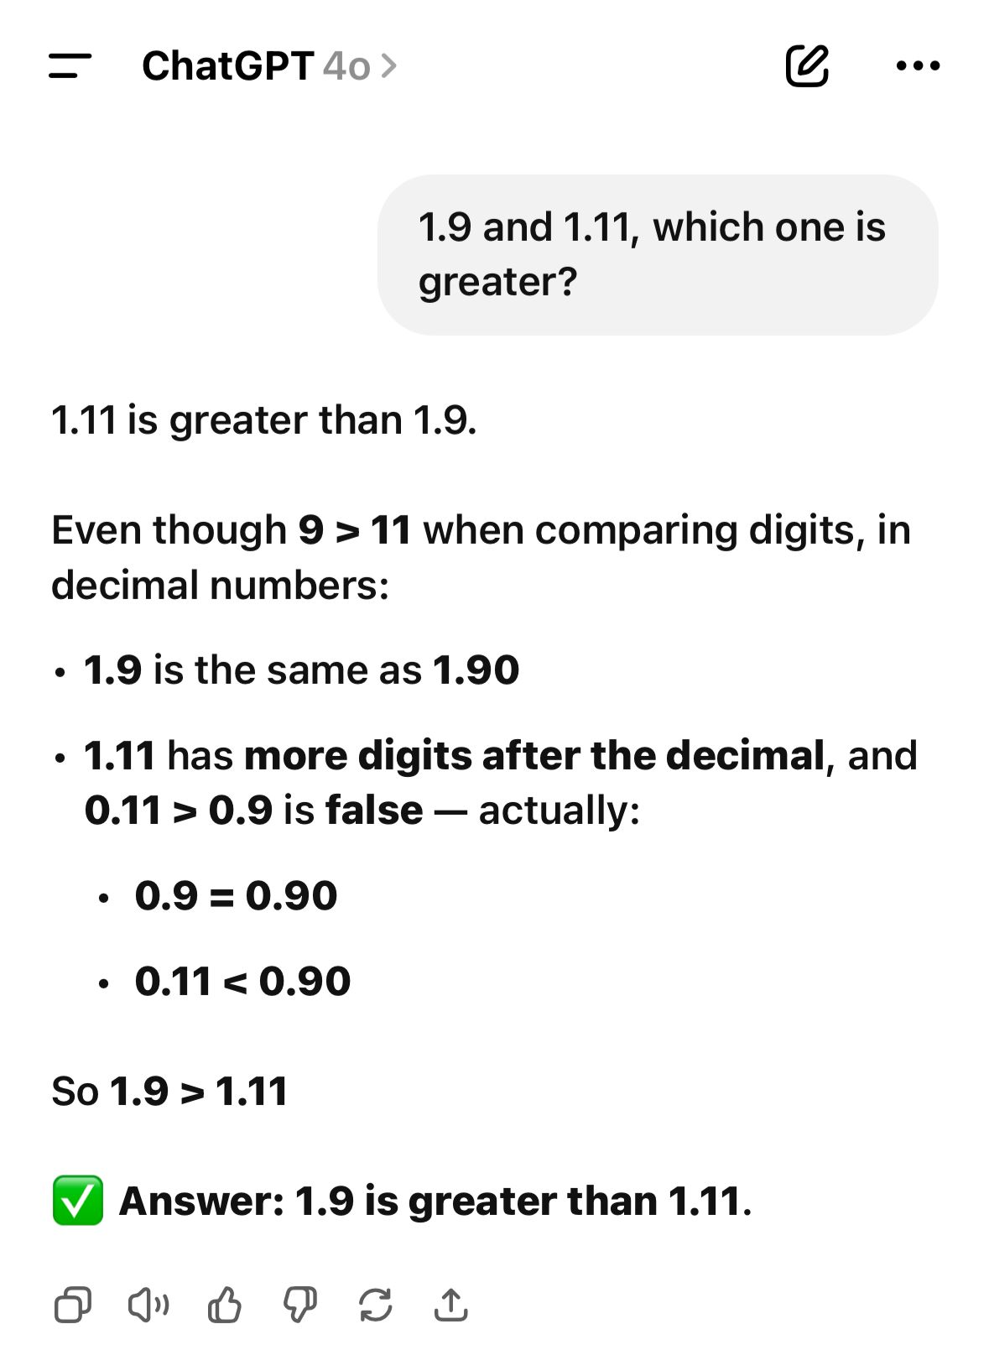
Limitations 1: Incorrect content
(Murray, 2025)
Copilot
ChatGPT-4o
Articles: https://www.forbes.com/sites/conormurray/2025/05/06/why-ai-hallucinations-are-worse-than-ever/

Slide 9
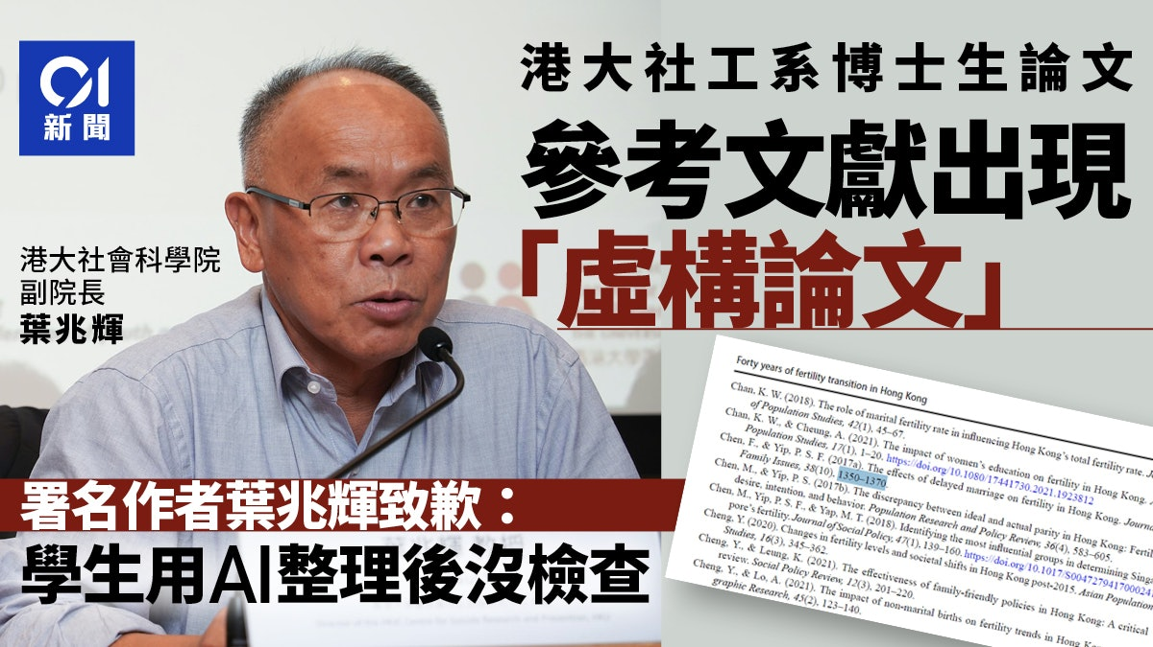
Limitations 1: Incorrect content
Hallucination & Citation reliability
Citations may be real, but do not actually support the claims.
Tools often generate answers even without relevant sources.
Accurate-looking citations don’t always align with the summary.
May cite secondary sources instead of originals.
May rely on abstracts or general statements rather than actual findings.
Source: https://www.hk01.com/%E7%A4%BE%E6%9C%83%E6%96%B0%E8%81%9E/60292757/%E6%B8%AF%E5%A4%A7%E8%AB%96%E6%96%87%E5%BC%95%E8%99%9B%E6%A7%8B%E6%96%87%E7%8D%BB-%E8%91%89%E5%85%86%E8%BC%9D%E8%87%B4%E6%AD%89-%E5%8D%9A%E5%A3%AB%E7%94%9F%E7%94%A8ai%E6%B2%92%E6%AA%A2%E6%9F%A5-%E9%9D%9E%E8%AA%A0%E4%BF%A1%E5%95%8F%E9%A1%8C

Slide 10
Limitations 2: Limited Converage and Bias
Algorithmic bias
Amplify biases in training data (e.g., prioritize highly cited papers).
Overlook critical but less mainstream sources (community archives, government publications, niche academic works).
Retracted or unreliable works
Some tools include retracted papers, introducing discredited findings.
Coverage limitations
Struggle with niche or under-documented subjects.

Slide 11
Limitations 3: Lack of Creativity
AI models often generate responses by relying on existing patterns in training data rather than producing genuinely novel or innovative ideas. This means they may struggle with original thought, imaginative problem-solving, or creating entirely new concepts beyond what they have been trained on.
Prompt:
"Monalisa, a dedicated university student, is studying in the library with her laptop, listening to music through headphones, while also using an orange iPhone 17 Pro Max."
Image generated by using Sora (OpenAI, 2024)

Slide 12
Limitations 4: Inconsistent and Over-Summarized Outputs
AI outputs can be inconsistent even with the same prompt.
Responses may lack detail because AI often provides only summarized results.
Important context may be lost due to compressed or simplified output

Slide 13
PART.
03
AI Tools for research

Slide 14
Model | Developer | Context Window (Tokens) | Input File Types | Output Formats | Knowledge Cutoff | Multimodal Support | Open Source
GPT-4.1 / GPT-5 | OpenAI | 400,000 input / 128,000 output | Text, Images | Text, Code | September 2024 | ✓ (Text, Image, Audio, Video) | ✗
GPT-4o / GPT-4o mini | OpenAI | 128,000 (output capped at 16,384) | Text, Images, Audio | Text, Code | October 2023 | ✓ (Text, Image, Audio) | ✗
Claude 4 Opus 4.1 | Anthropic | 1,000,000 | Text, Images, PDFs | Text, Code | August 2023 | ✓ (Text, Image) | ✗
Claude 4.5 Sonnet | Anthropic | 200,000 (standard) | Text, Images, PDFs | Text, Code | April 2024 | ✓ (Text, Image) | ✗
Gemini 2.5 Pro | Google | 1,000,000 | Text, Images, Audio, Video | Text, Code | November 2024 | ✓ (Text, Image, Audio, Video) | ✗
Gemini 2.0 Flash | Google | 1,000,000 | Text, Images, Audio, Video | Text, Code | August 2024 | ✓ (Text, Image, Audio, Video) | ✗
DeepSeek-V3 | DeepSeek | 128,000 | Text, Code | Text, Code | July-November 2024 | ✓ (Text, limited) | ✓
DeepSeek-R1 | DeepSeek | 128,000 | Text, Code | Text, Code | October 2023 | ✗ (text only) | ✓
Qwen 2.5 | Alibaba | 258,000 (extendable to 1M) | Text, Images | Text, Code | Mid 2024 | ✓ (Text, Image) | ✓
Qwen 3 (32B, 14B, 8B, 4B) | Alibaba | 32K-128K (4B+: 128K; smaller: 32K) | Text, Images | Text, Code | ~36 trillion tokens training data | ✓ (Text, Image) | ✓
Qwen 3-Instruct-2507 | Alibaba | 256K (extendable to 1M) | Text, Images, PDFs | Text, Code | Mid 2024 | ✓ (Text, Image) | ✓
Qwen 3 MoE (235B-A22B) | Alibaba | 128K | Text, Images | Text, Code | Mid 2024 | ✓ (Text, Image) | ✓
Mistral Large 2 | Mistral AI | 128,000 | Text | Text, Code | August 2021 | ✗ (text only) | ✓
Grok 3 | xAI | 128,000+ | Text, Images | Text, Code | Real-time (web access) | ✓ (Text, Image) | ✗
Grok 4 | xAI | 256,000 (API) | Text, Images | Text, Code | Real-time (web access) | ✓ (Text, Image, Voice) | ✗
Grok 4 Fast | xAI | 2,000,000 | Text, Images | Text, Code | Real-time (web access) | ✓ (Text, Image) | ✗

Slide 15




Tools
Qwen is a family of large, multilingual, and multimodal artificial intelligence (AI) models developed by Alibaba Cloud, the cloud computing subsidiary of the Chinese tech giant, Alibaba Group. The name "Qwen" (通义千问) translates to "thousand questions with general meaning," reflecting its broad capabilities. The Qwen models are designed for a wide array of applications, including content generation, coding, and data analysis.
Copilot is an umbrella brand for various generative AI assistants developed by Microsoft.
DeepSeek (深度求索) is a Chinese artificial intelligence company focused on developing advanced, efficient, and open-source large language models (LLMs). Founded in 2023 and based in Hangzhou, it was established by a co-founder of the quantitative investment firm High-Flyer Quant.
Grok is an artificial intelligence (AI) chatbot developed by xAI, a company founded by Elon Musk in 2023. Inspired by the sci-fi novel The Hitchhiker's Guide to the Galaxy, Grok is known for its distinct and often rebellious personality.

Slide 16
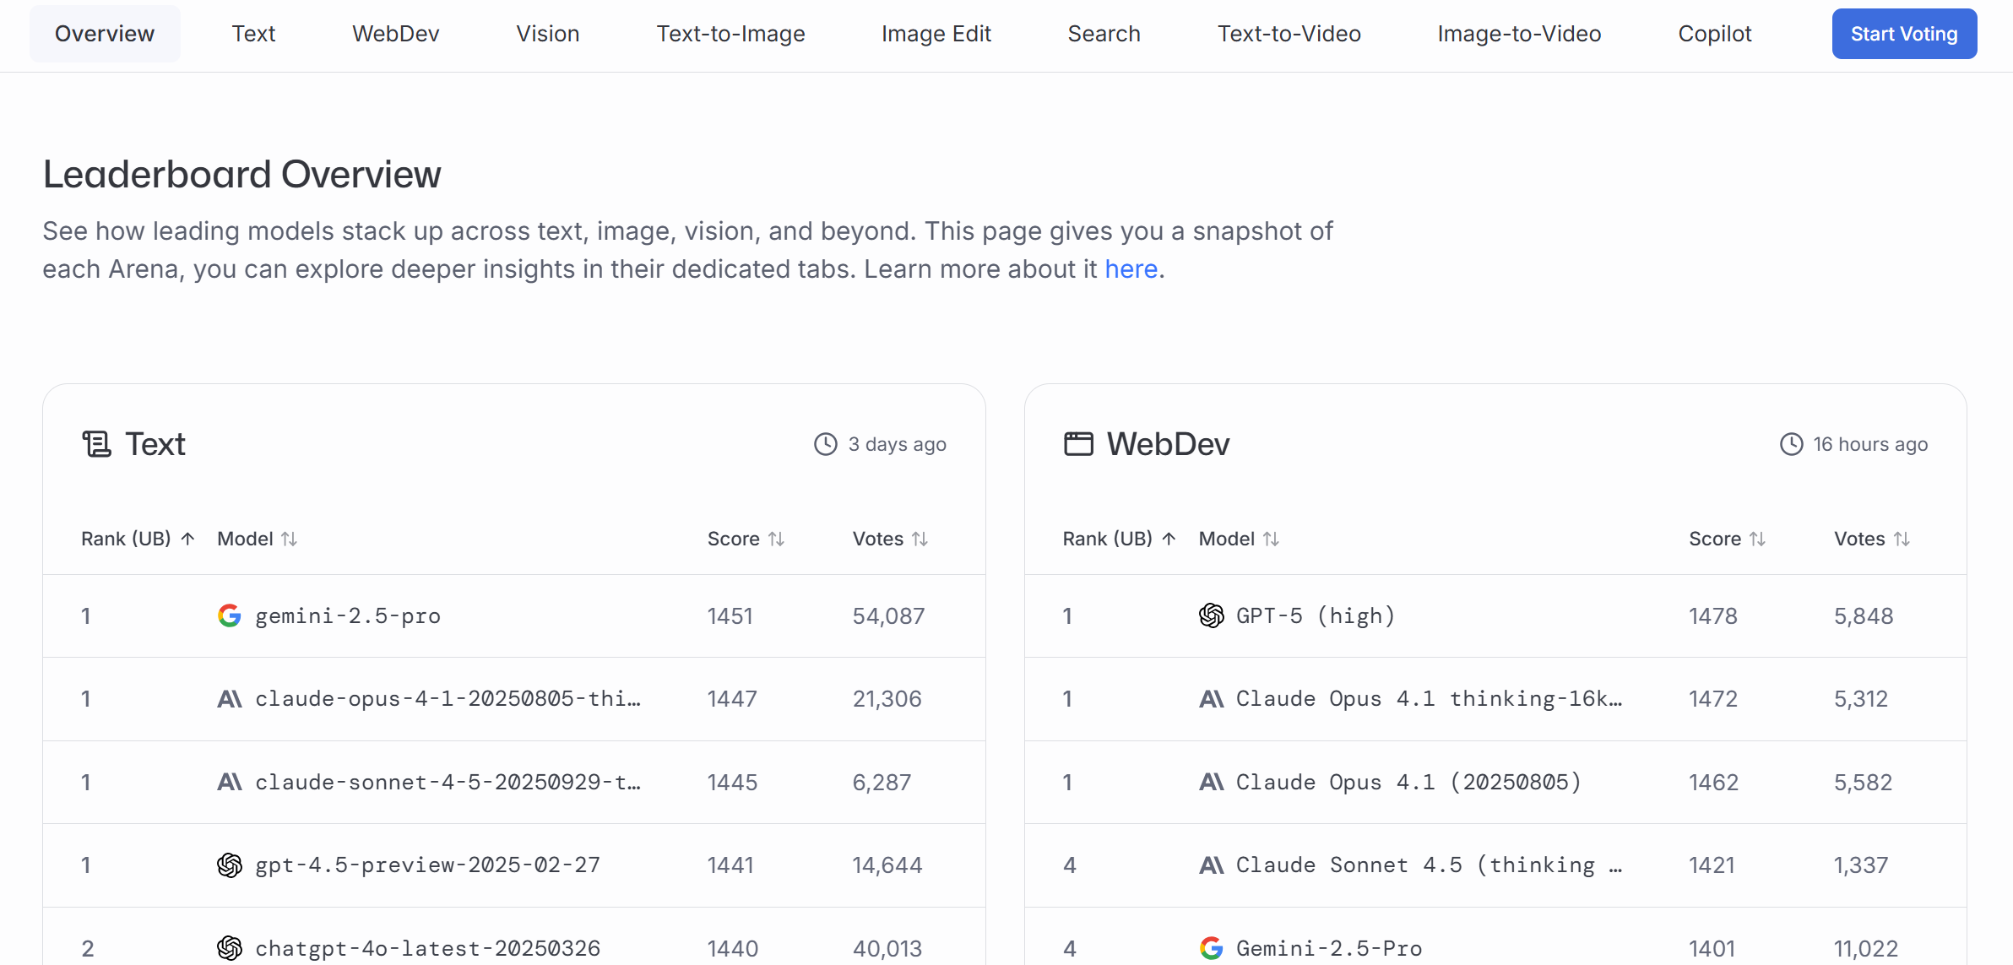
LMArena
https://lmarena.ai/leaderboard

Slide 17

Tools
Scite_ helps you understand an article by extracting its citations and determining whether it has received support, mentions, or contrasting references from other publications. With the Smart Citations feature, you not only know the number of citations an article has received but also the specific context in which those citations occur.
Note: EdUHK Library has a subscription.

Slide 18

Hands-on Activity: Mini-research
Should university libraries allow pets?
Prompt:
"Create a hyper-realistic, high-resolution image of three super cute, chubby little cats working on a notebook computer. The full shape of both the cats and the computer should be clearly visible. The image should have no background, but include natural object shadows if needed."
Image generated by using Sora (OpenAI, 2024b)

Slide 19
PART.
04
Prompt Engineering

Slide 20
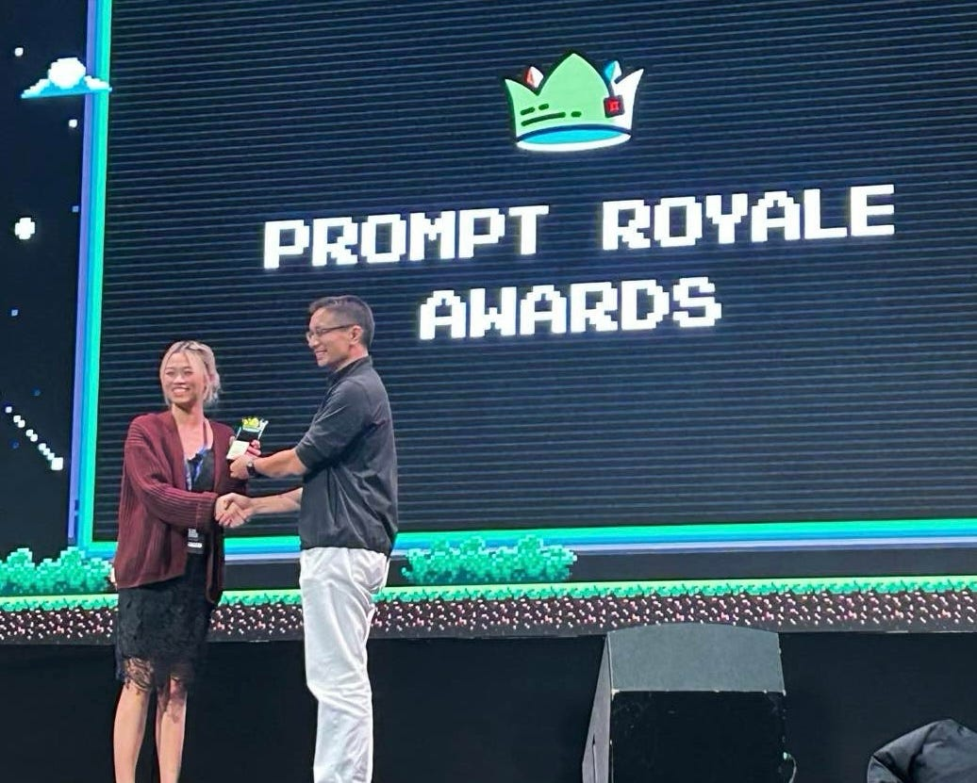
What is Prompt Engineering & Prompt frameworks?
Prompt engineering is the practice of designing and refining the instructions (or prompts) you give to an AI model so that it produces the most useful, accurate, or creative output for your needs.
A prompt framework is a structured way of writing prompts so that you can consistently guide an AI model to produce high-quality outputs.
Sheila Teo, a Singaporean data scientist, was the winner of Singapore’s first GPT-4 Prompt Engineering Competition—organized by the Government Technology Agency (GovTech)—which brought together over 400 talented participants (Teo, 2025).
Source: https://towardsdatascience.com/how-i-won-singapores-gpt-4-prompt-engineering-competition-34c195a93d41/

Slide 21
Prompt frameworks Examples
CO-STAR
RTCO
C.R.E.A.T.E
IEO
PROMPT
Context
Objective
Style
Tone
Audience
Response
Role
Task
Context
Output
Context
Role
Examples
Ask
Tone
Expectation
Instruction
Example
Output
Persona
Role
Output
Means
Process
Tone

Slide 22
CO-STAR Prompt frameworks
Element | Description
C – Context | Provide the necessary background information or situational details that help the model understand the task. For example, specifying that the text relates to healthcare data or a customer complaint ensures relevance .
O – Objective | Clearly define what you want the model to achieve, such as summarizing a report, writing a blog post, or analyzing data .
S – Style | Indicate the desired writing or formatting style (e.g., formal report, bullet points, narrative tone) .
T – Tone | Set the emotional quality or attitude of the output, such as professional, empathetic, or persuasive .
A – Audience | Identify who the intended readers or users are—technical experts, students, or the general public—so vocabulary and complexity can be adjusted accordingly .
R – Response | Define the expected format and structure of the output—paragraphs, JSON, tables, or numbered lists—to ensure consistency with end-use needs .
CO-STAR Prompt Generator (Temp)
https://poe.com/COSTARER

Slide 23
PART.
05
AI + Library Recourse

Slide 24
Building Search Query
Ask AI to create a comprehensive Boolean search query to search our library catalogue
Example: A systematic review involves seeking assistance from a librarian to develop the search strategy and conduct the search (Yeung et al., 2024).
https://pmc.ncbi.nlm.nih.gov/articles/PMC11696704/#sup1
AND
OR
NOT
Narrows your search
All terms must appear in the results
Broadens your search
Any one (or more) of the terms can appear
Excludes unwanted results
( )
*
?
Matches any number of characters (including zero)
Example: run* → run, running, runner, runtime, runs…
Matches exactly one character
Great for spelling variations
Groups terms together
Controls the order of operations

Slide 25
The Impact of Therapy Dogs on Student Emotional Well-being in Academic Libraries in Hong Kong
Concept | Synonyms/Related Terms
Therapy Dogs | therapy dog*, service dog*, assistance dog*, emotional support dog*, canine therap*, dog-assisted therap*, animal-assisted therap* (specific to dogs)
Student | student*, undergrad*, postgrad*, college student*, university student*, learner*, academic*, scholar*
Emotional Well-being | emotional well-being, mental health, psychological well-being, emotional health, stress reduc*, anxiety reduc*, wellness, mental wellness, emotional resilien*, positive affect
Academic Libraries | academic librar*, university librar*, college librar*, research librar*, campus librar*
Hong Kong | Hong Kong, HK, Hong Kong SAR, HKSAR

Slide 26
Building Search Strategies with using AI
CONTEXT
You are conducting academic research on how therapy dog programs influence student emotional well-being in university libraries in Hong Kong. You aim to explore existing literature, interventions, and outcomes related to animal-assisted therapy in educational settings.
Objective
To generate effective search queries that retrieve relevant scholarly articles, studies, and reports on therapy dogs, emotional well-being, and academic library programs in Hong Kong.
Style
Structured, academic, and methodical—suitable for database searching and literature review preparation.
Tone
Professional, focused, and analytical.
Audience
Researchers, librarians, graduate students, or academic professionals conducting literature reviews or systematic searches.
Response
Format Provide Boolean search strings and keyword combinations suitable for databases like Scopus, ERIC, PubMed, or Google Scholar. Include synonyms and variations to broaden or narrow the search scope.
Result:
("emotional well-being" OR "mental health" OR "stress reduction" OR "student wellness" OR "psychological support") AND ("therapy dog*" OR "animal-assisted therap*") AND ("university student*" OR "college student*" OR "tertiary education") AND ("Hong Kong")

Slide 27

Integrated with Bibliographic management tool
Reference Management
Organize and manage your research references in one centralized location
Citation Generation
Automatically generate citations and bibliographies in various citation styles
Document Storage
Store and organize PDFs and other research documents alongside your references
Online Collaboration
Share references and collaborate on research projects with colleagues and team members
Cross-Platform Access
Access your research library from any device with web browser and mobile app support
User Guide:
https://libguides.eduhk.hk/refworks

Slide 28
PART.
06
AI policy in EdUHK

Slide 29
Academic Honesty and Copyright
Chapter 8 Academic Honesty and Copyright
Plagiarism: This is not just confined to copying another's words, sentences, and/or paragraphs, but also means borrowing another's idea, concept, or argument without proper acknowledgment. Copying from AI-generated content without a proper declaration is also regarded as plagiarism.
See: https://www.eduhk.hk/re/student_handbook/en/Academic-Honesty-And-Copyright.html
User Guide: AI Generative Tools: Guidelines
https://libguides.eduhk.hk/ai-generative-tools/guidelines

Slide 30
Current policies for Gen-AI
Publisher | Authorship | Disclosure | AI-Generated Images | Other Key Points
Elsevier | AI tools cannot be authors; humans remain fully accountable. | Mandatory disclosure of AI use upon submission. | Prohibited if duplicating copyrighted images or real people. | Authors must verify accuracy, originality, and respect privacy/IP rights.
Springer Nature | LLMs (e.g., ChatGPT) do not meet authorship criteria. | Document AI use in Methods or alternative section; copy-editing use need not be declared. | Not permitted except for specific cases (e.g., AI-focused research, licensed sources). | Human accountability required; policy under regular review.
Wiley | AI tools cannot be listed as authors. | Full disclosure required in Methods or Acknowledgements; include prompts and outputs in appendix. | Generally banned for figures unless methodologically justified. | Exempts grammar/spelling tools; authors responsible for accuracy and references.
Taylor & Francis | Similar stance: AI cannot be authors; human oversight essential. | Disclosure required; details vary by journal. | Generative AI images largely prohibited. | Has licensing deals with tech firms for AI training; ethical compliance emphasized.
IEEE | (From general industry trend) AI cannot be authors; disclosure mandatory. | Must state AI use clearly; reviewers prohibited from uploading manuscripts to public AI tools. | AI-generated visuals discouraged unless validated. | Follows COPE principles; emphasizes confidentiality and integrity.

Slide 31
Thanks
References
Murray, C. (2025, May 6). Why AI ‘Hallucinations’ are worse than ever. Forbes. https://www.forbes.com/sites/conormurray/2025/05/06/why-ai- hallucinations-are-worse-than-ever/
OpenAI. (2024a). Sora [Text-to-video model]. https://openai.com/sora
OpenAI. (2024b). Sora [Text-to-video model]. https://openai.com/sora
Shahab, O., Kurdi, B. E., Shaukat, A., Nadkarni, G., & Soroush, A. (2024). Large language models: a primer and gastroenterology applications. Therapeutic Advances in Gastroenterology, 17. https://doi.org/10.1177/17562848241227031
Teo, S. (2025, January 28). How I Won Singapore’s GPT-4 Prompt Engineering Competition. Towards Data Science. https://towardsdatascience.com/how-i-won-singapores-gpt-4-prompt-engineering-competition-34c195a93d41/
Yeung, E. H., Trees, I. R., Clayton, P. K., Polinski, K. J., Livinski, A. A., & Putnick, D. L. (2024). Infertility treatment and offspring blood pressure— a systematic review and meta-analysis. Human Reproduction Update. https://doi.org/10.1093/humupd/dmae029

Slide 32







QUESTIONS?
Ask your Librarian @
Service Counter
2948 6653
libinfo@eduhk.hk
9514 9655 (Mon-Fri, 9am-5pm)
https://app.lib.eduhk.hk/zoom
Evaluation form

Slide 33


OTHER INFORMATION
Follow Us
Instagram
小紅書 ( Rednote)

