Slide 1


HOW TO FIND RELIABLE NEWS SOURCES FOR RESEARCH
Research and Learning Support Unit, Library
30 November 2025

Slide 2

TABLE OF CONTENTS
01 | Overview of News Resources
02 | Mastering News Databases
03 | Other Newspapers Resources
Contents
Factiva
ProQuest Historical Newspapers: South China Morning Post (1903-2001)
SCMP (ePaper edition)
WisersOne (New platform of WiseNews)
PressReader
Then, we wll talk about this.

Slide 3
OVERVIEW
Section 01
Overview of News Resources

Slide 4
Newspaper in the Library
Hard copies
News clippings
Microform format
(Remote Storage):
Hong Kong newspaper clippings index (1980-1999) https://www.lib.eduhk.hk/permalink/record/alma991001103979703410
Hong Kong newspaper clippings (1993-1999) https://www.lib.eduhk.hk/permalink/record/alma991004696219703410
Back issues of newspapers in hard copies (4/F):
Print copies of HK newspapers are kept in the Library for the latest 2 months
Current issues (The Lounge - G/F)
Ming Pao Daily News 明報 (1959-2023)
Sing Tao Daily 星島日報 (1938-2009)
South China Morning Post 南華早報 (1984-2013)
The Standard 英文虎報 (2002-2009)

Slide 5
Newspaper in the Library
Factiva — 200 countries in 26 languages — 6 concurrent users
PressReader — 6000+ magazines and newspapers — 100 countries in 60+ languages — app is available
South China Morning Post — 4 platforms with different coverage — an important English-language newspaper in Hong Kong
WisersOne — Hong Kong-based newspaper databases — coverage: 1998+
Education News Clippings — developed by EdUHK Library — coverage: 1987-1999
端傳媒 Initium Media — Hong Kong local media — online media — 50 concurrent users
Hongkong Weekly Press Online — coverage: 1920-1929
Hongkong News Online — coverage: 1941-1945 — 5000+ pages

Slide 6
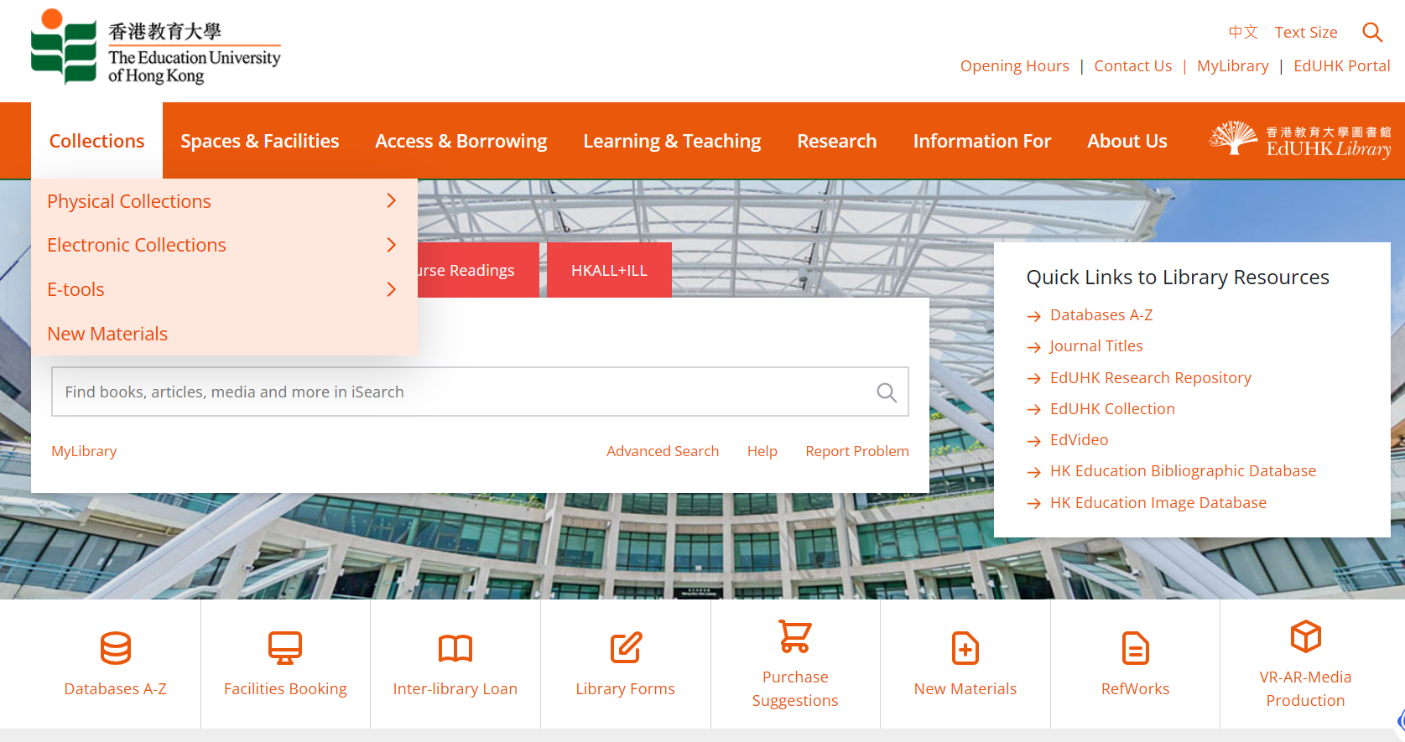
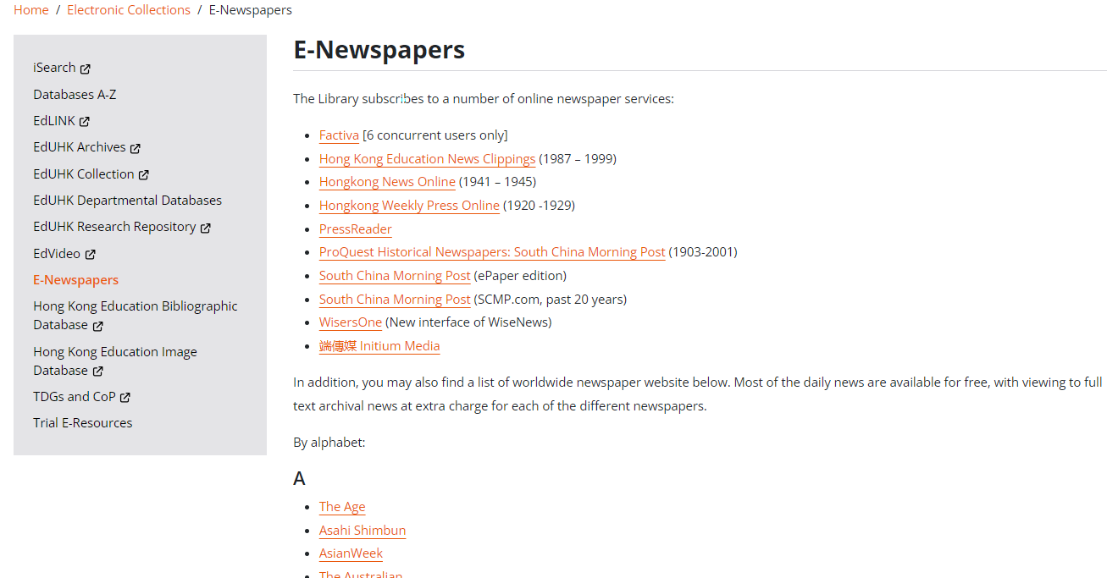
E-Newspapers @ EdUHK Library
EdUHK Library Homepage > Collections> Electronic Collections > E-Newspapers
6

Slide 7
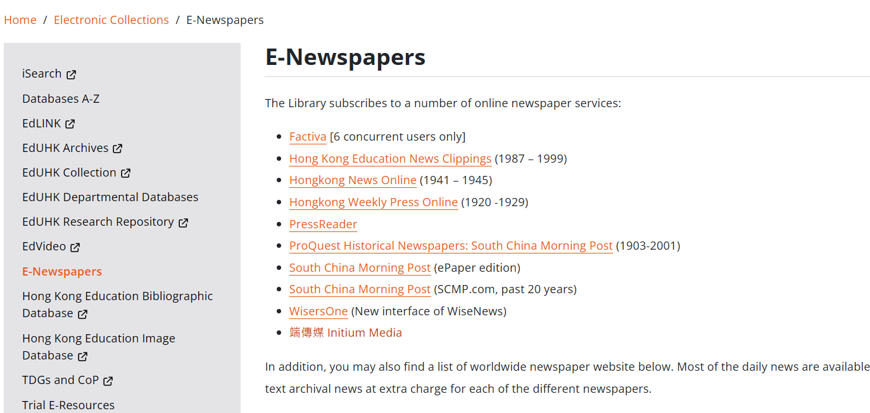
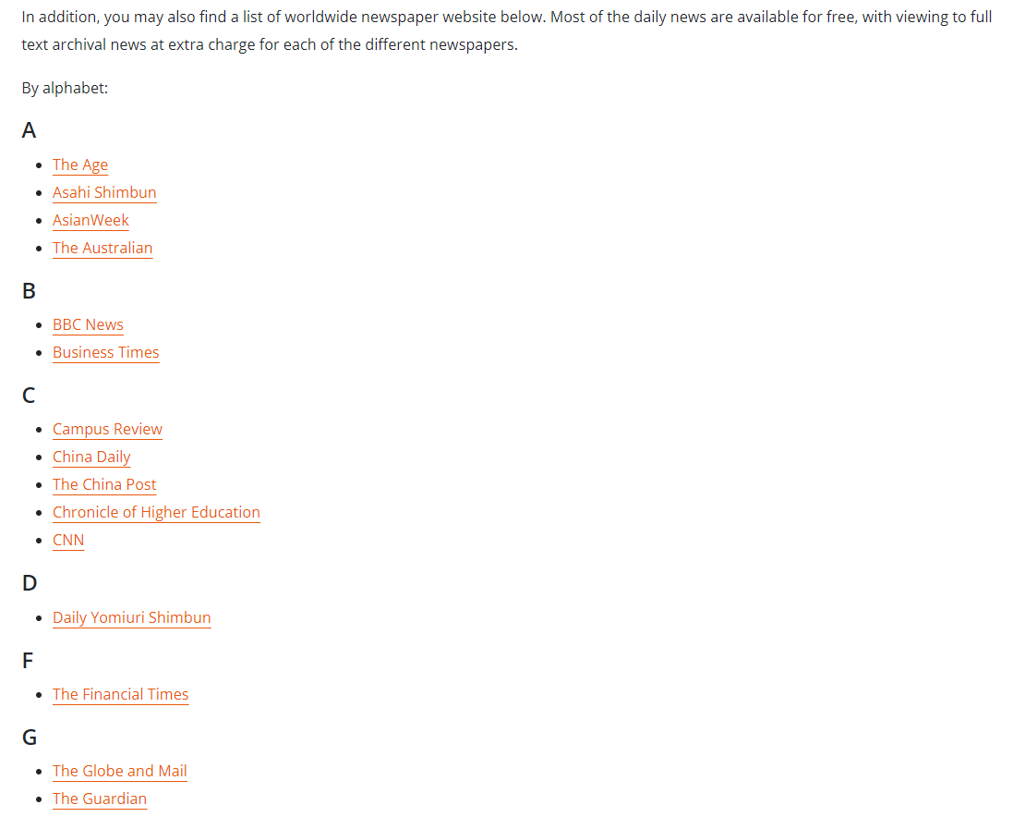
E-Newspapers @ EdUHK Library
EdUHK Library Homepage > Collections> Electronic Collections > E-Newspapers
Library subscribed News databases
-Worldwide newspaper website
-Most of the daily news are available for free
7

Slide 8
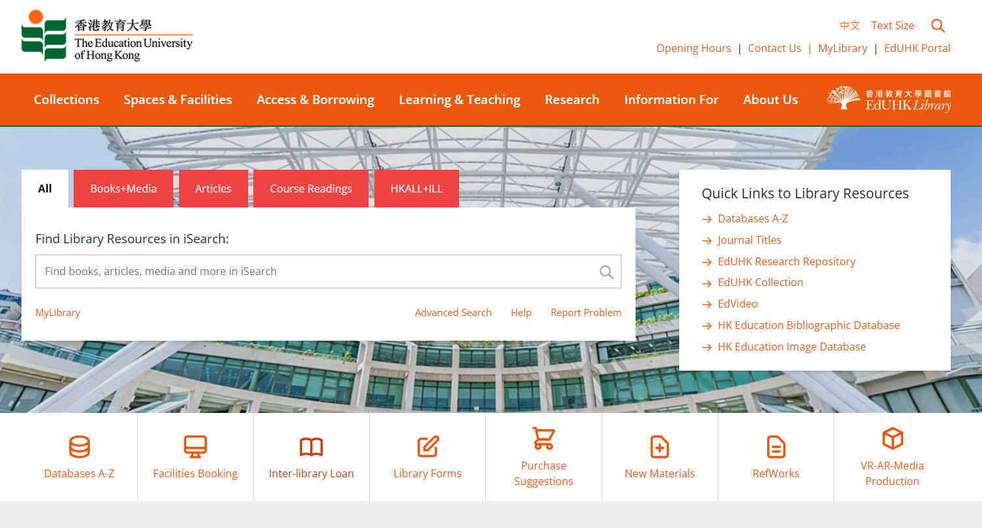
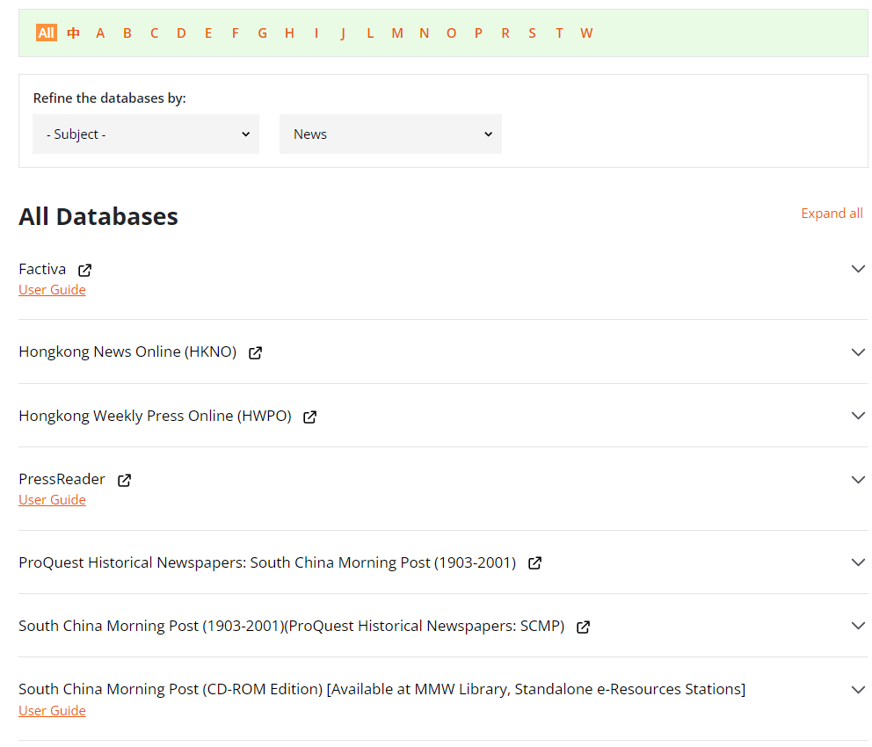
How to Access News Databases
EdUHK Library Homepage > Database A-Z List > Select “News” in “Resource Type”
8

Slide 9
Factiva
Factiva is a business information and research tool that provides worldwide full text coverage of …
Newspapers
Trade publications
Newswires
Media Transcripts
Analyst reports
Regional profiles
Market data
Factiva can be used to trace industry development and global market activity, monitor current news, and research a public or private company.
From 200 countries, in 26 languages
6 concurrent users only

Slide 10
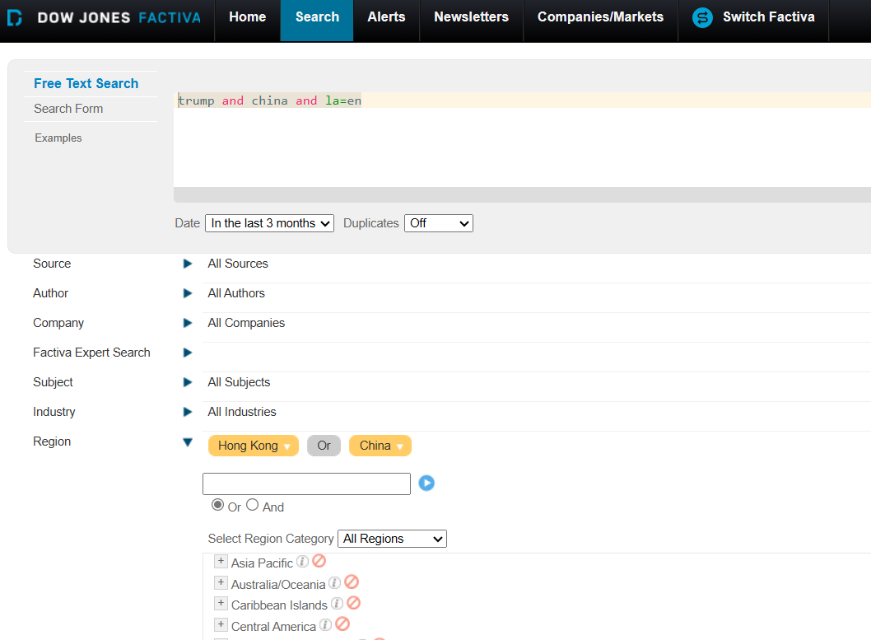
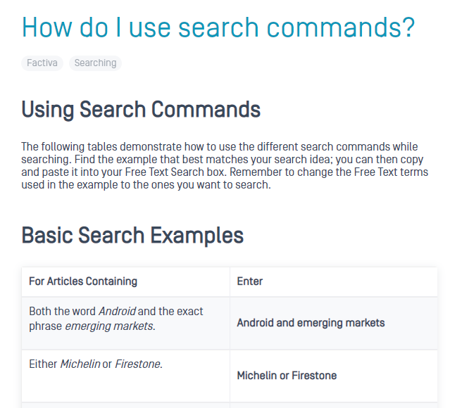
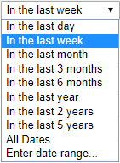
Basic Search Commands: Words in a Specific field
Search Boolean operator or commands e.g. and, or, la,
10
Notes:
trump and china and la=en

Slide 11
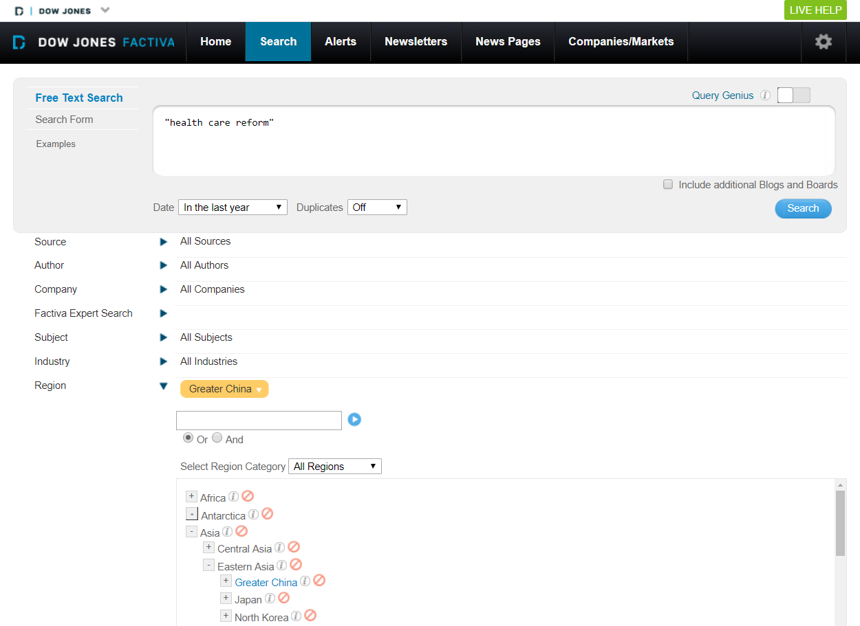
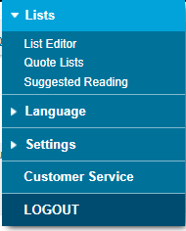
Free Text Search, e.g. “health care reform” + latest year + Greater China
See next slide
More search tips
Click the arrow to expand the menu from each category
11

Slide 12
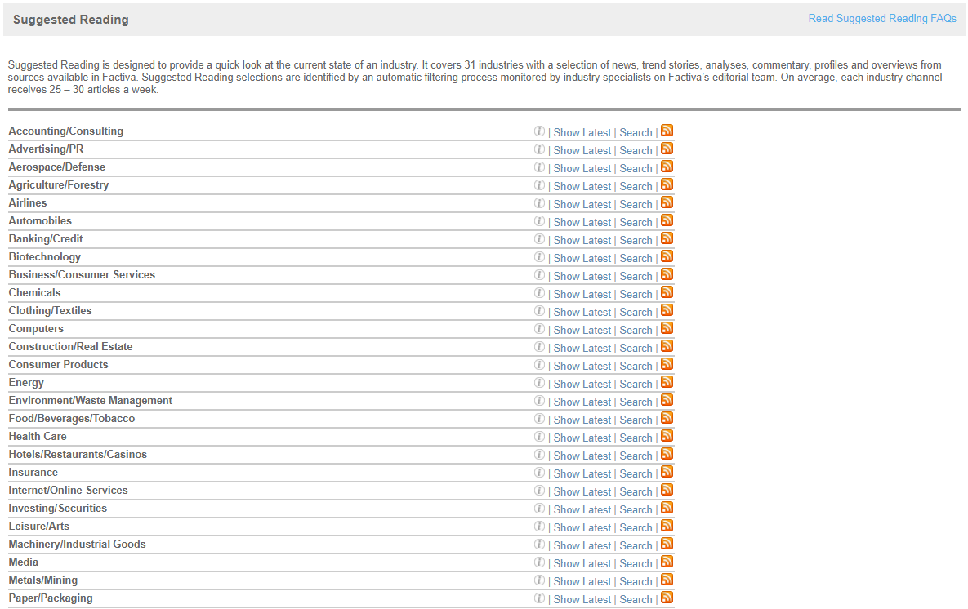
Suggested Reading
Suggested Reading is designed to provide a quick look at the current state of an industry
Click “Show Latest” to find news by industry

Slide 13
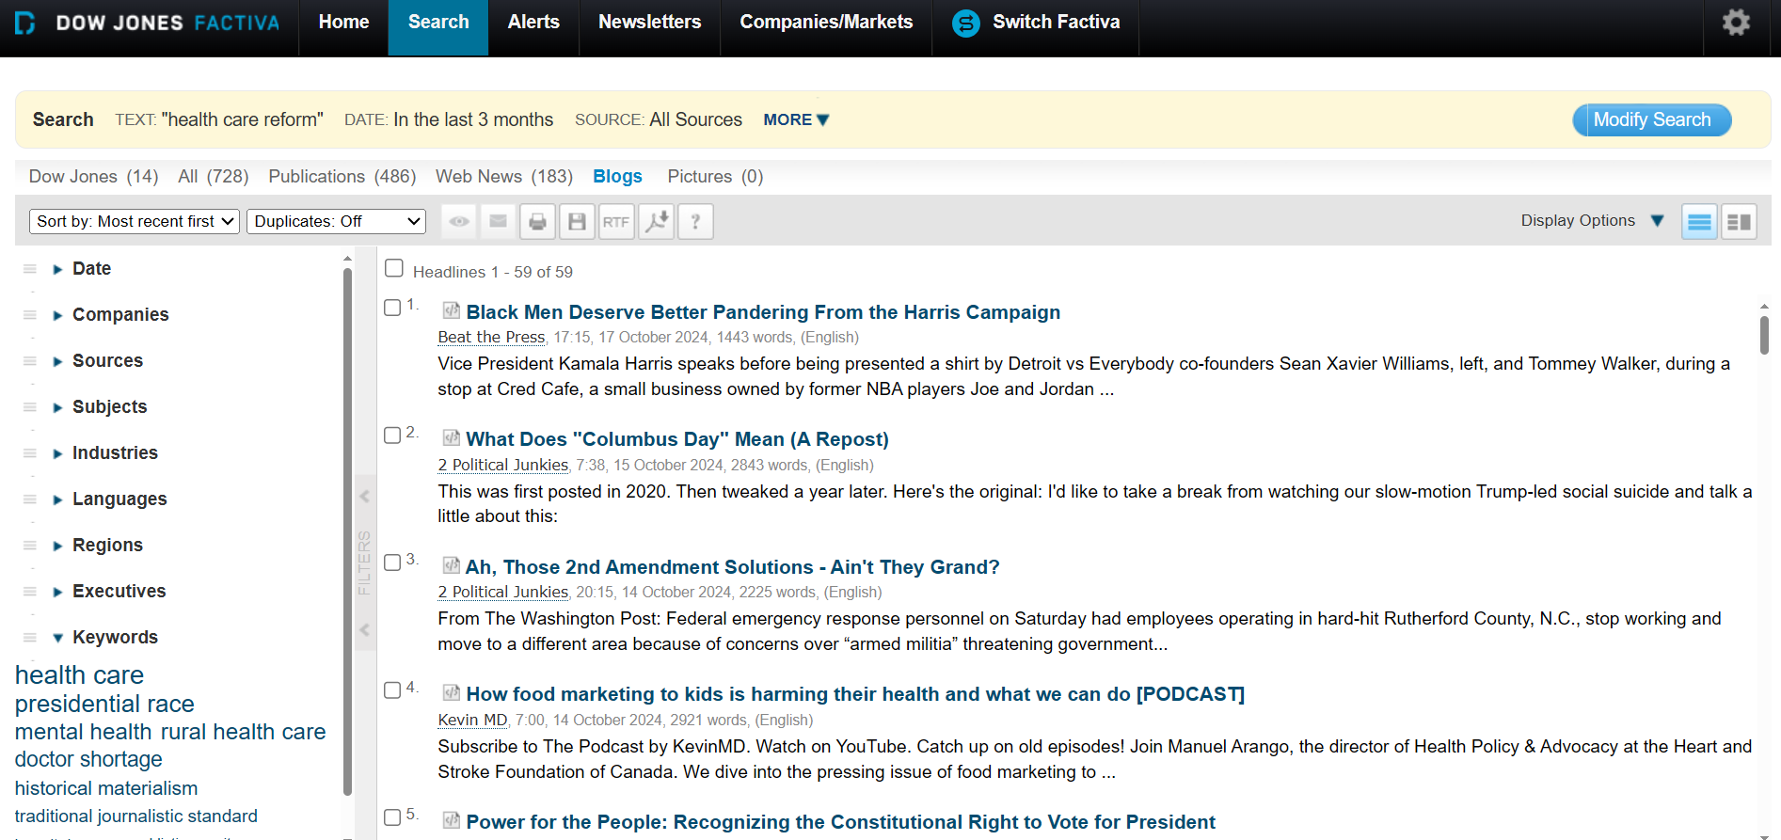
No. of results by sources
Refine result with more
Result list
13

Slide 14
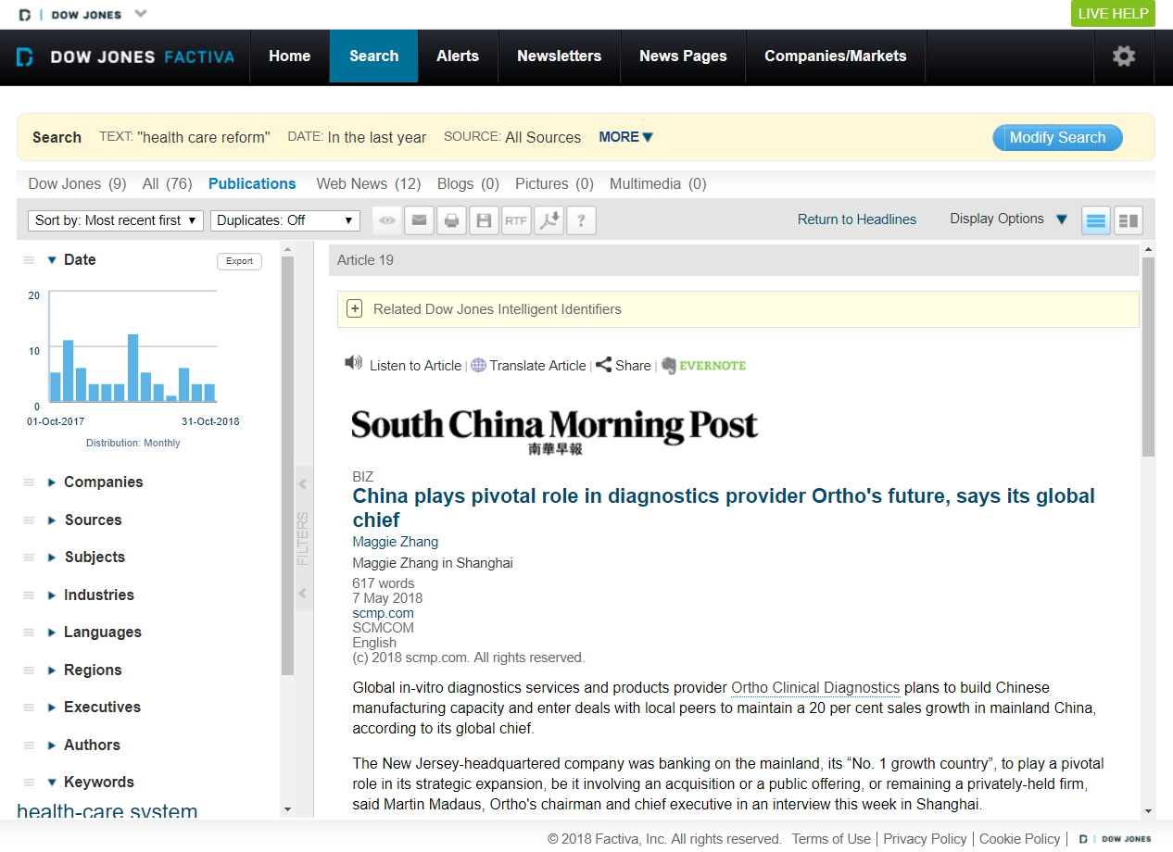
Email, print or save the article
Listen to the article or have it translated into another language
14

Slide 15
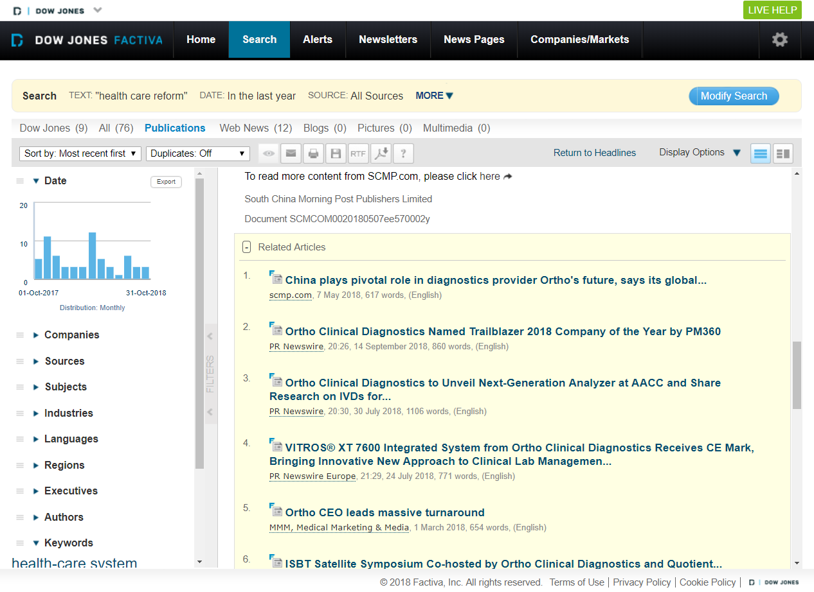
Browse other related articles
15

Slide 16
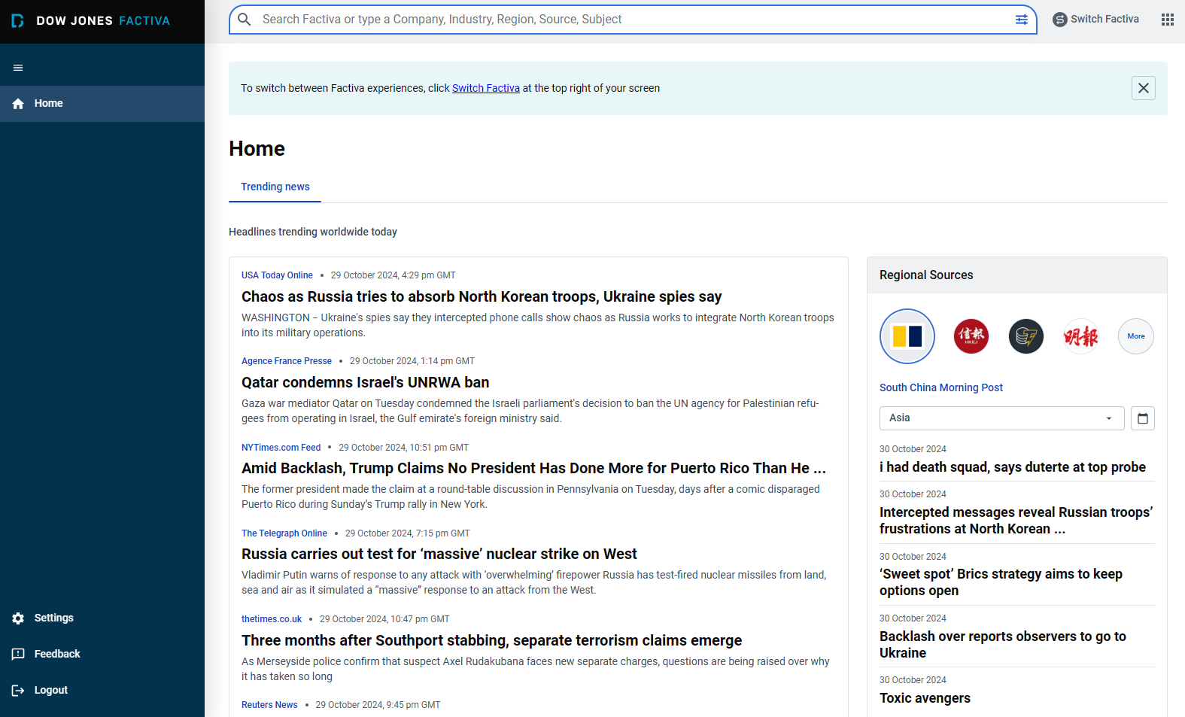
Switch Factiva

Slide 17
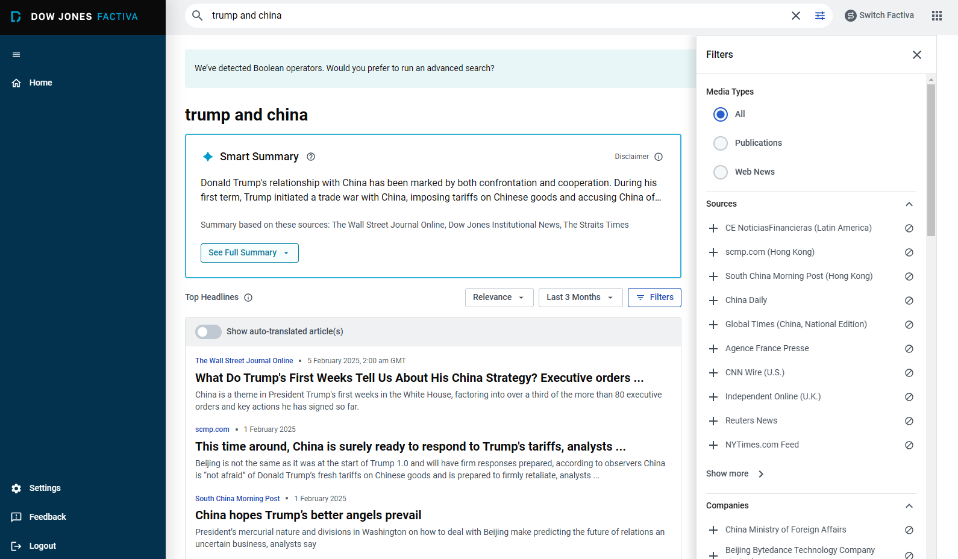
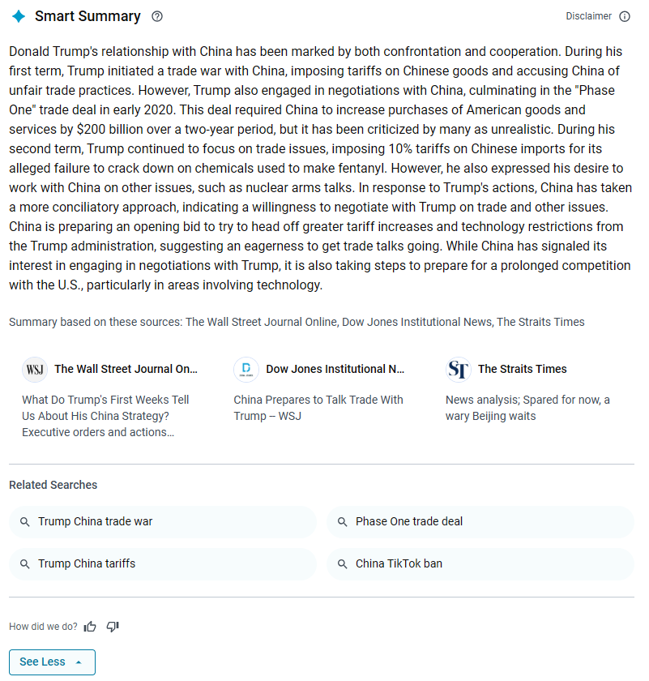

Slide 18

Hands-on Practice:
Using advanced search options to locate news from mainland China news sources between 2020-2024 related to "outbound tourism"

Slide 19
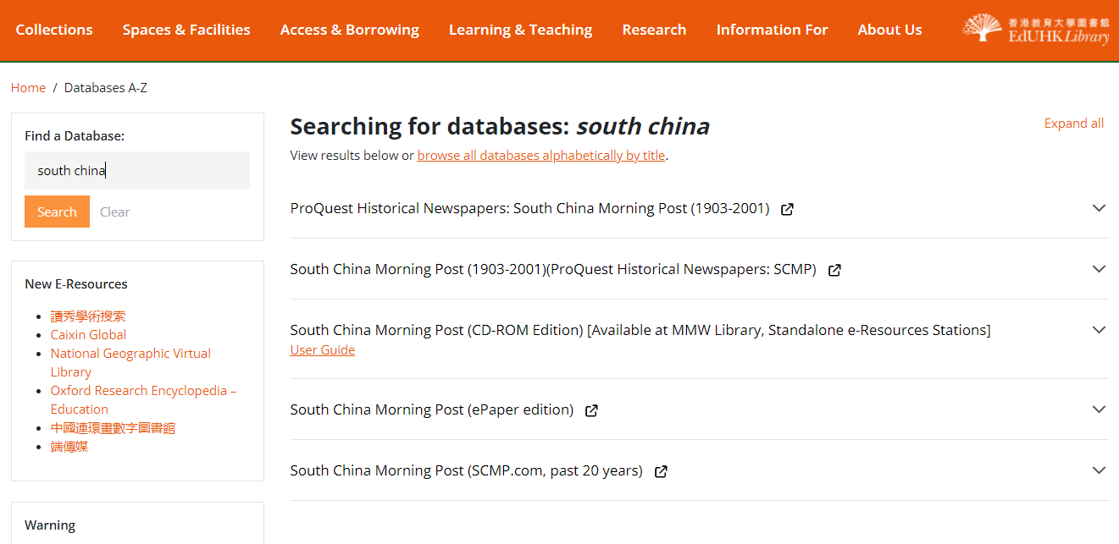
South China Morning Post
The Library provides 4 platforms to cover different periods of content in SCMP
Coverage: 1903-2001
Coverage:
1993 - 1997
Coverage:
Aug 2018 - current
Coverage:
Past 20 years

Slide 20
ProQuest Historical Newspapers:
South China Morning Post (1903-2001)
Coverage: 1903 - 2001
With searchable, full text coverage from South China Morning Post’s origin in 1903 up to and including 2001, users will be able to search the entirety of the newspaper including advertisements, editorials, cartoons, and photographs that illuminate history as much as the news articles.
20

Slide 21
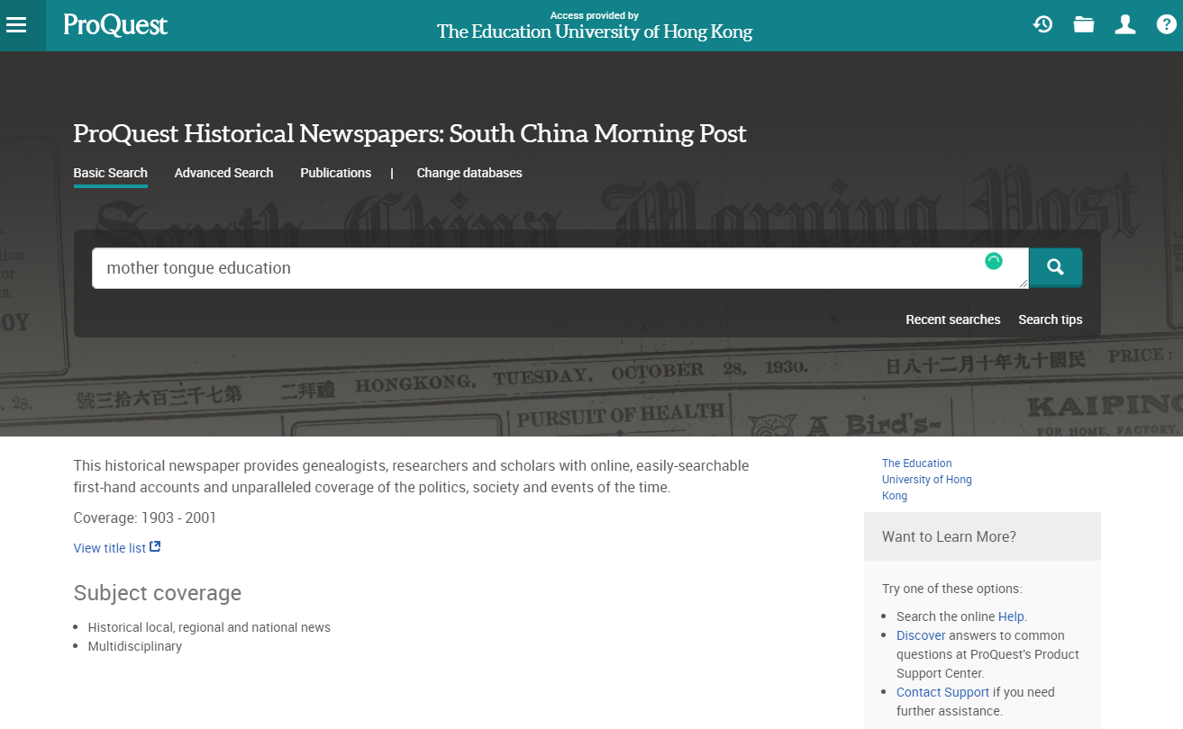
Download a title list
21

Slide 22
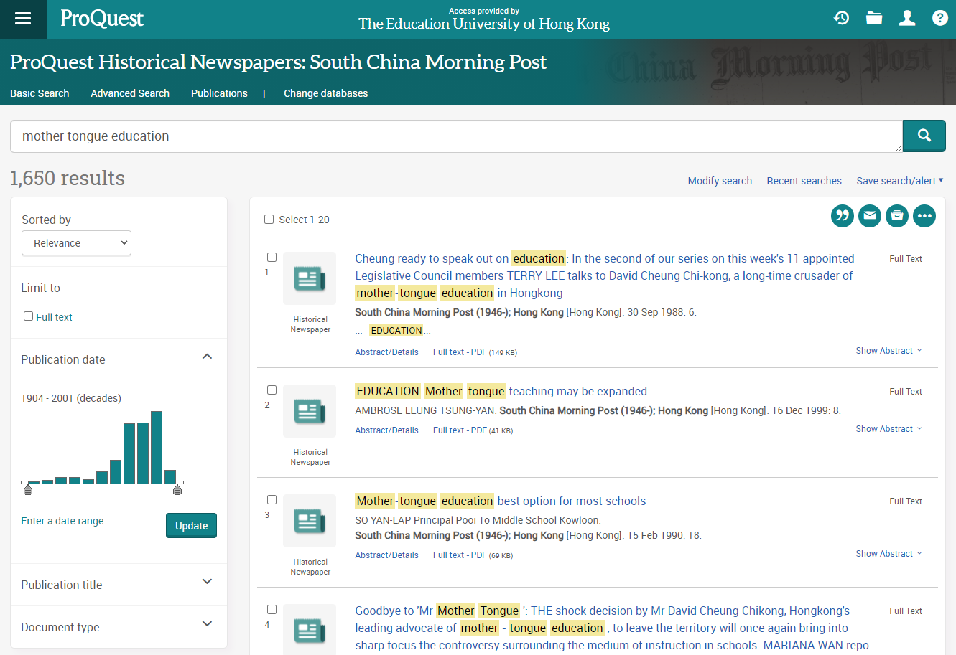
Search for news articles on “mother tongue education”
22

Slide 23
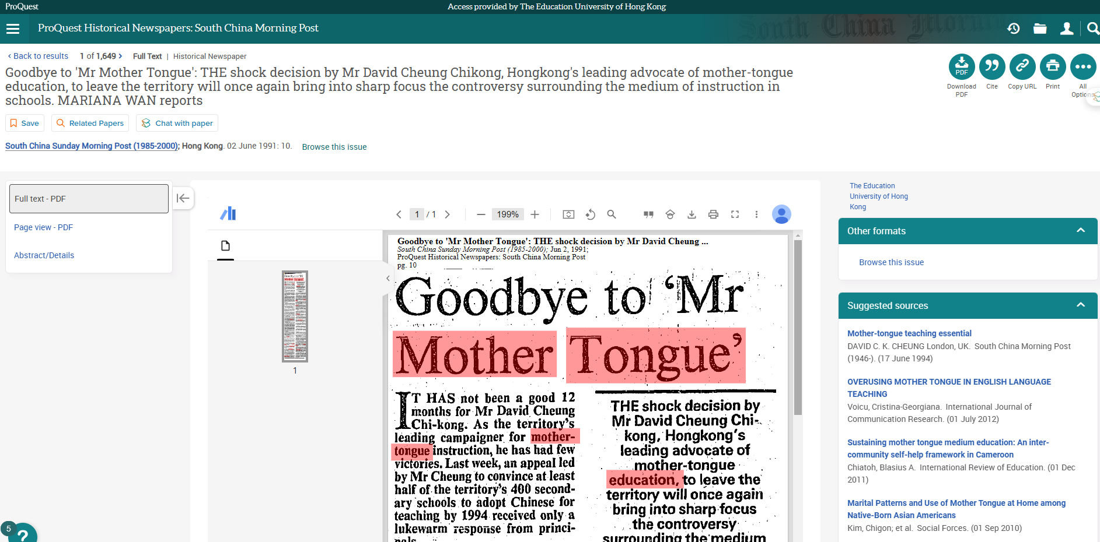
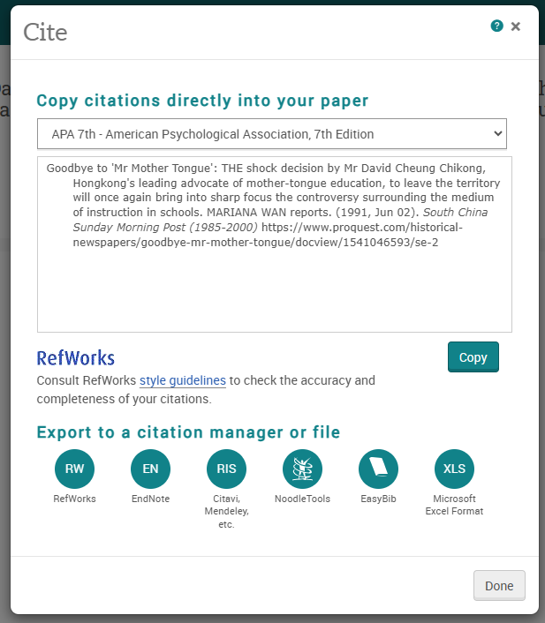
Print / download the article
See next slide
23

Slide 24
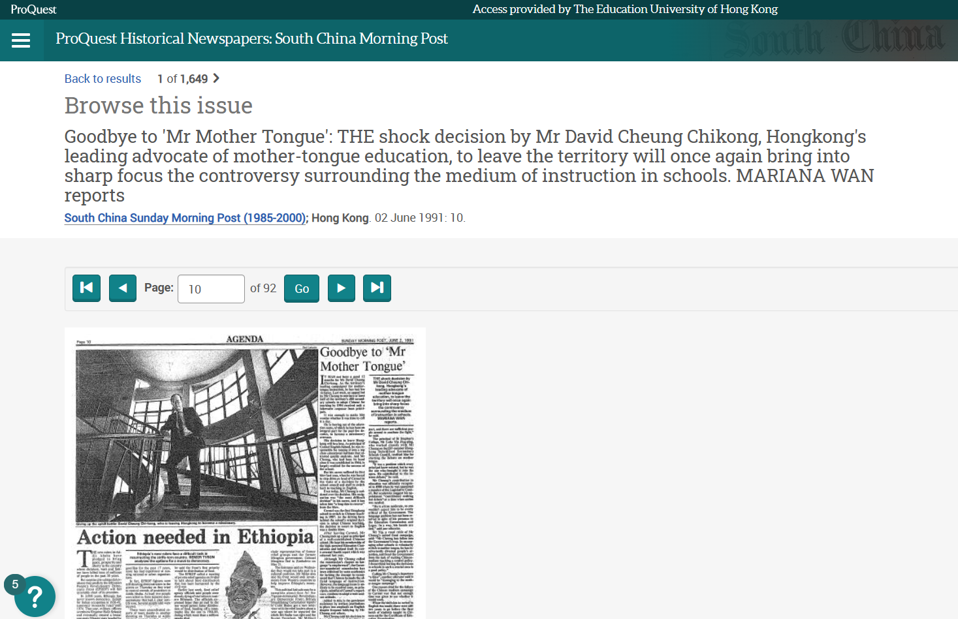
Browse other articles from the same issue
24

Slide 25
Hands-on Practice:
Use the Advanced Search option to check with the editorial of South China Morning Post on 16 Oct 1918

Slide 26
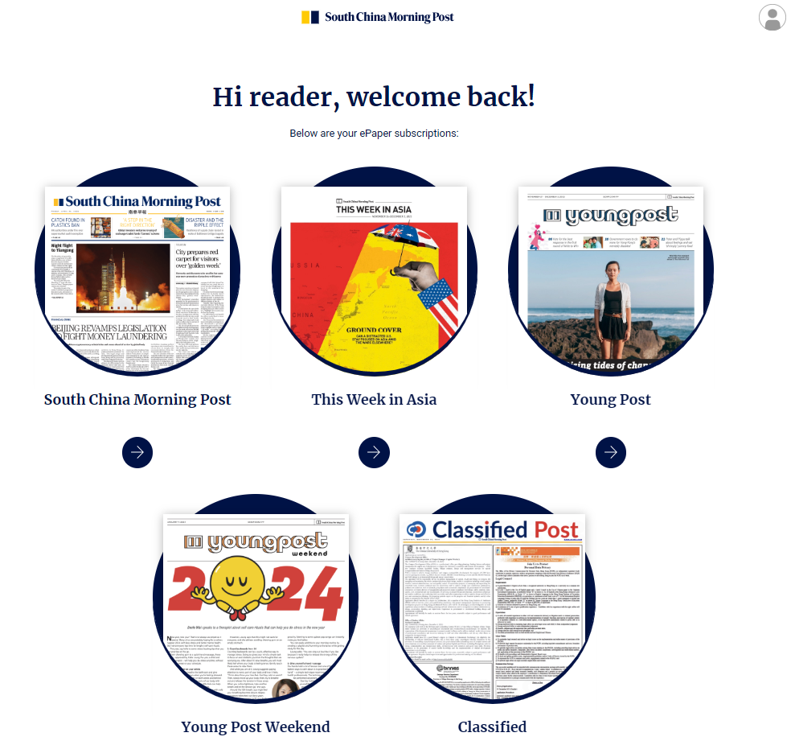
SCMP (ePaper edition)
Read issues from Aug 2018 to latest with ePaper archive
Download the PDF and read offline on desktop or tablet
26

Slide 27
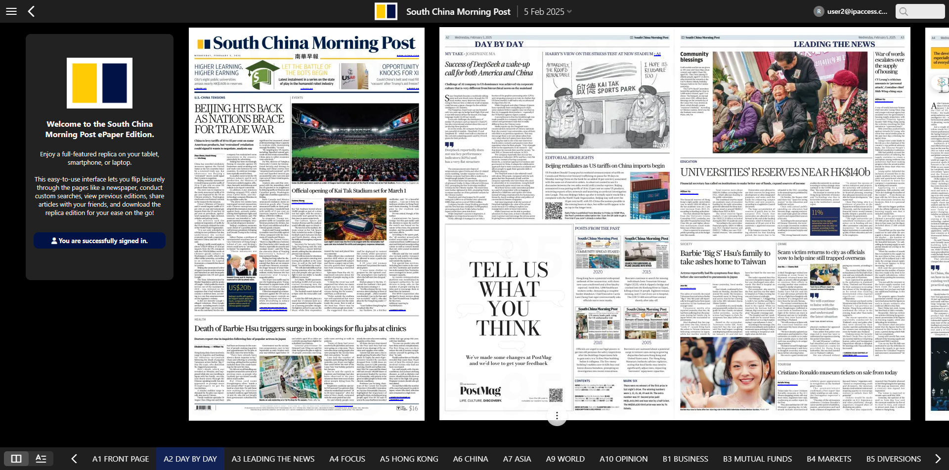
Browse contents of different dates and issues
Search keywords
Articles appear in an easy-to-read horizontal stream
View articles exactly as they appear in print

Slide 28
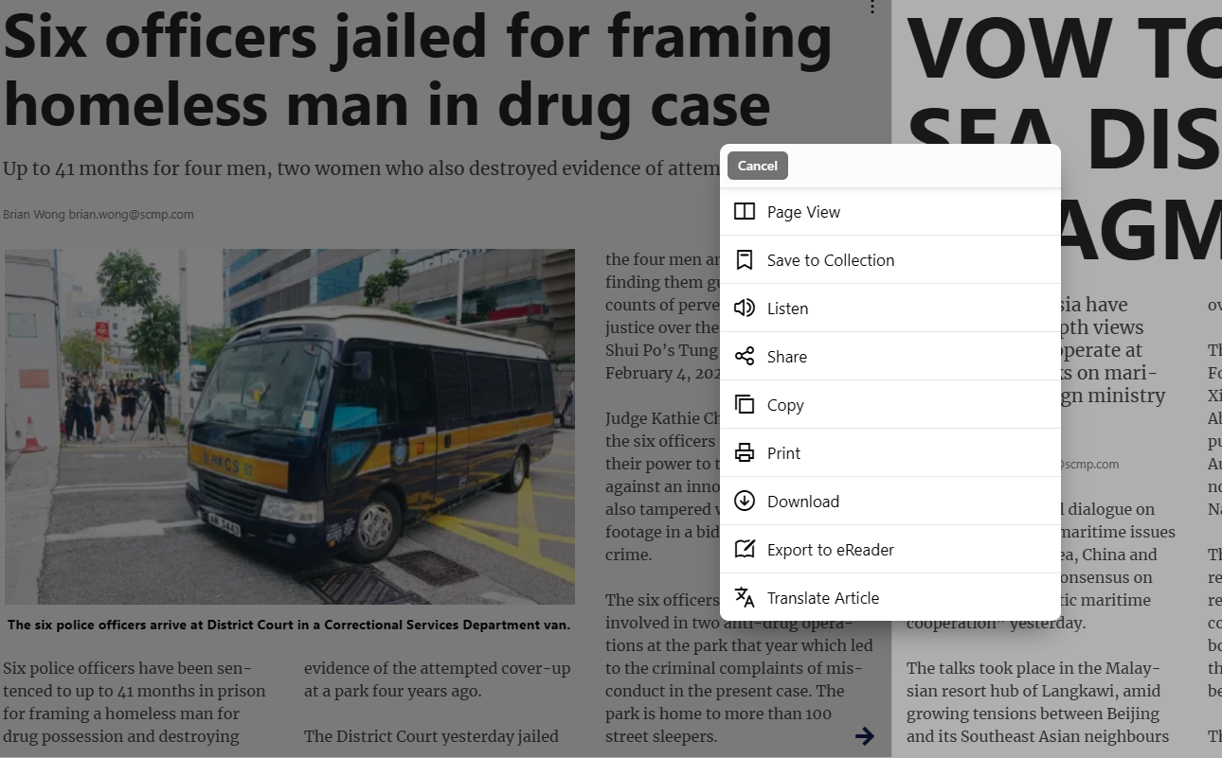

Slide 29
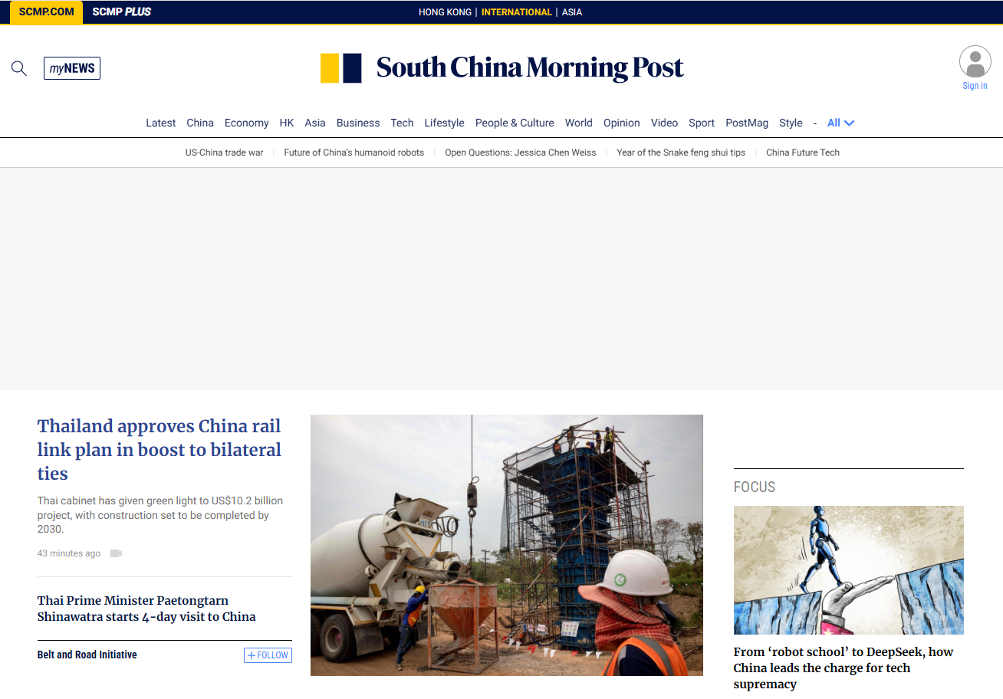
SCMP.com (Past 20 years)
20-year news archive
Provide simple search only
29

Slide 30
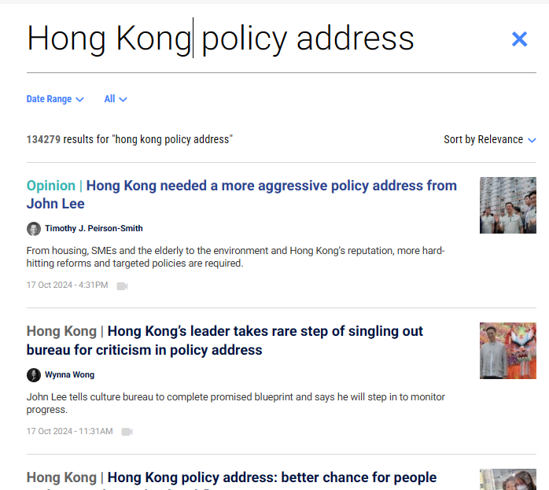
Example: search for “Hong Kong policy address”

Slide 31

Share the Article on Social Media
31

Slide 32
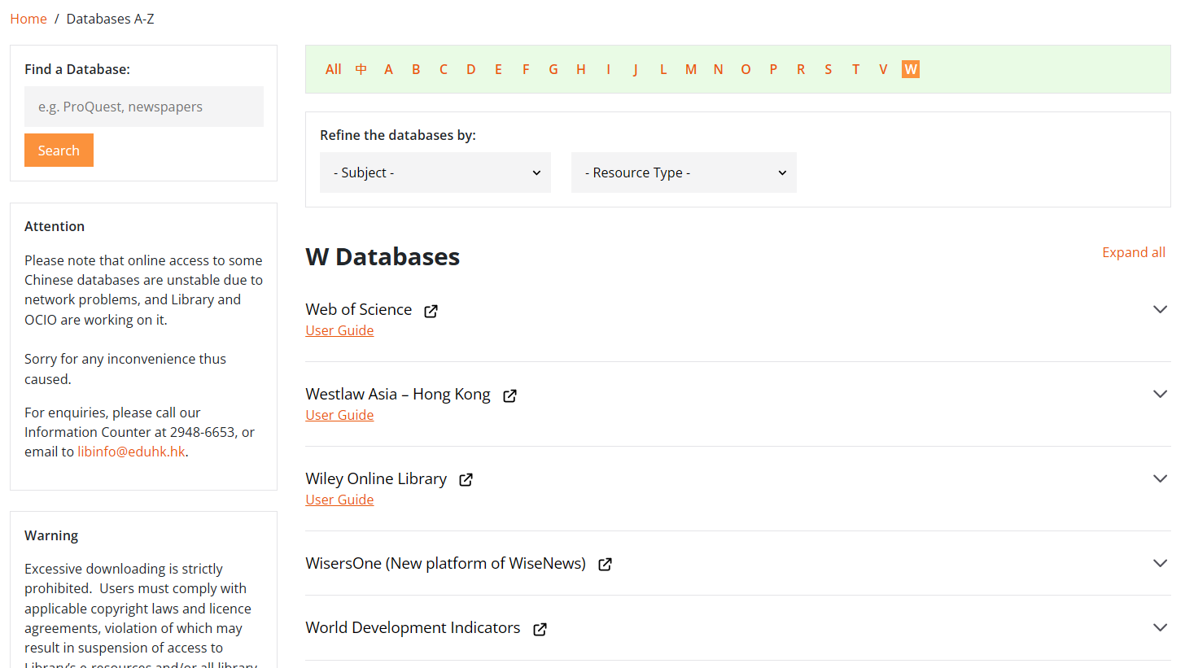
WisersOne
Coverage: 1998+
This is the new platform of WisesNews. It includes WiseObserve and WiseSearch. Contents mainly in Chinese.
32

Slide 33
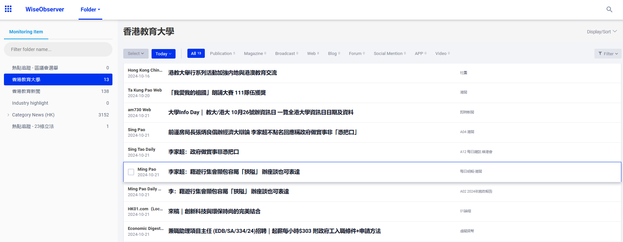
Homepage - WiseObserver
Enter the search interface
Default mode allows you to browse EdUHK news
Search in this folder
Browse news by category
Click the headline to view the full text
33

Slide 34
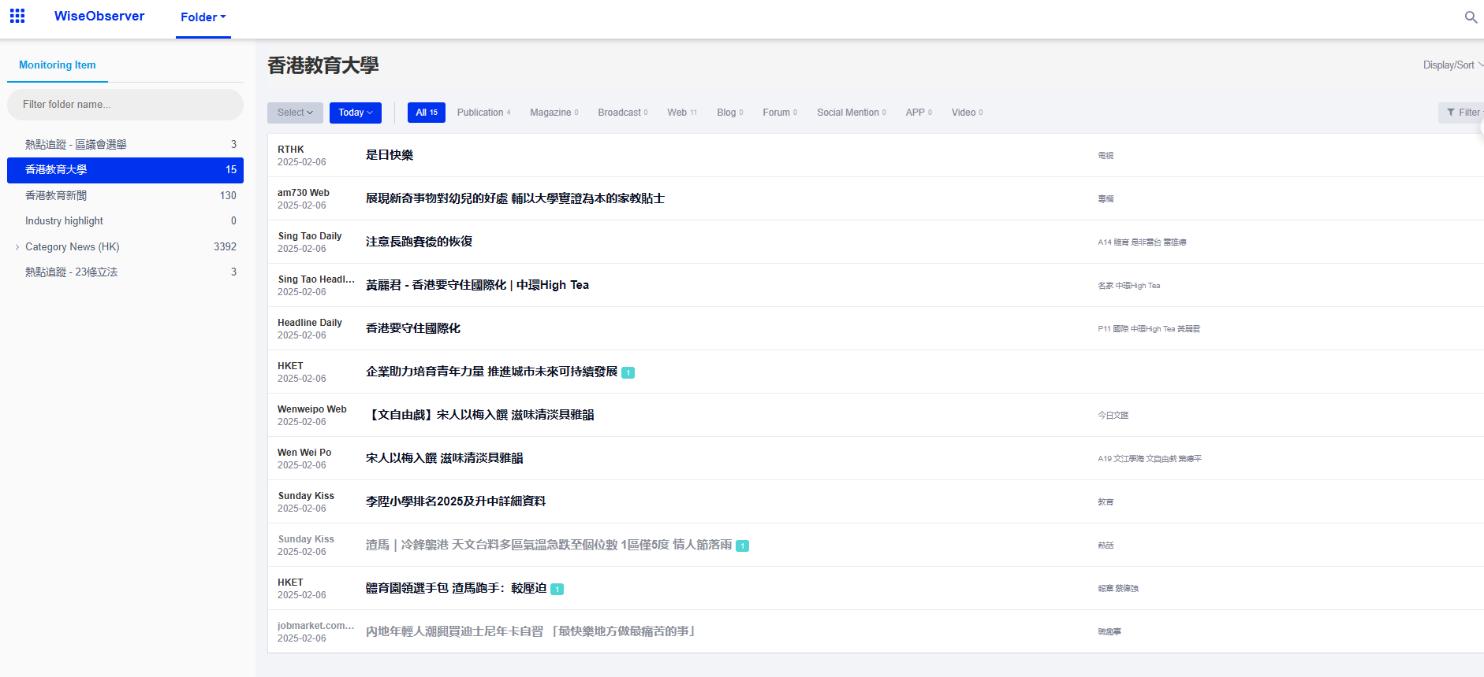
Browsing News by Category
34

Slide 35
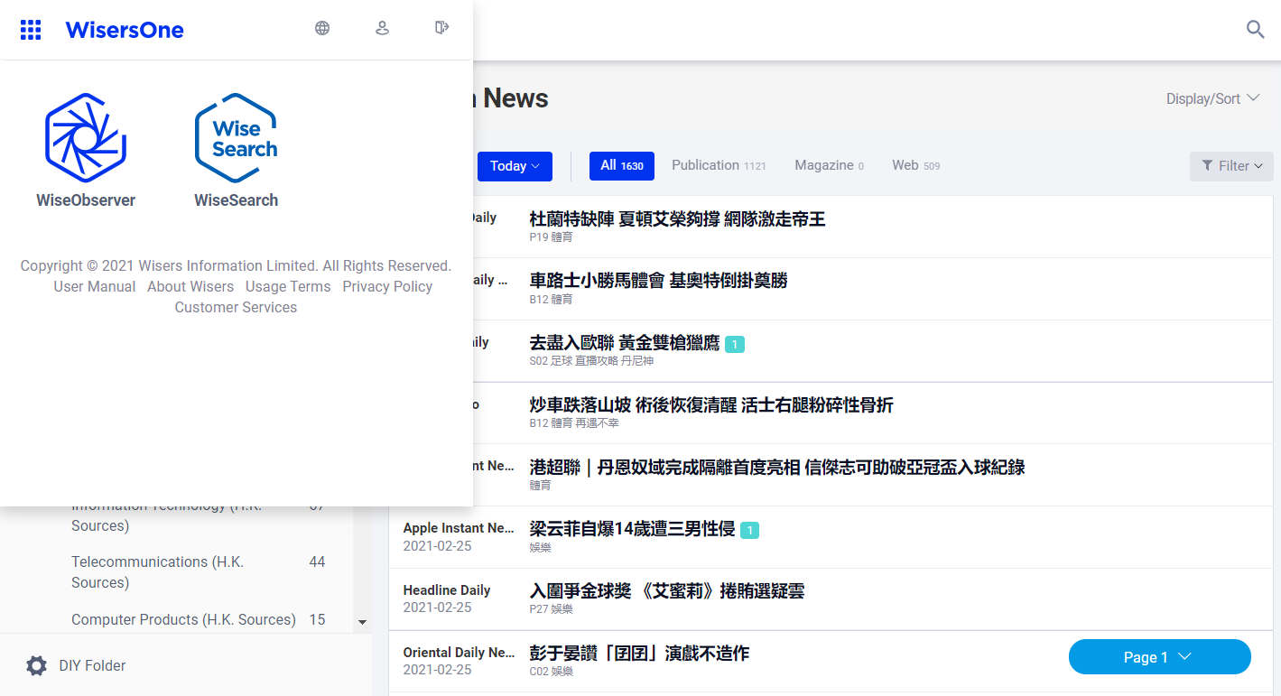
WiseSearch - Search Interface

Slide 36
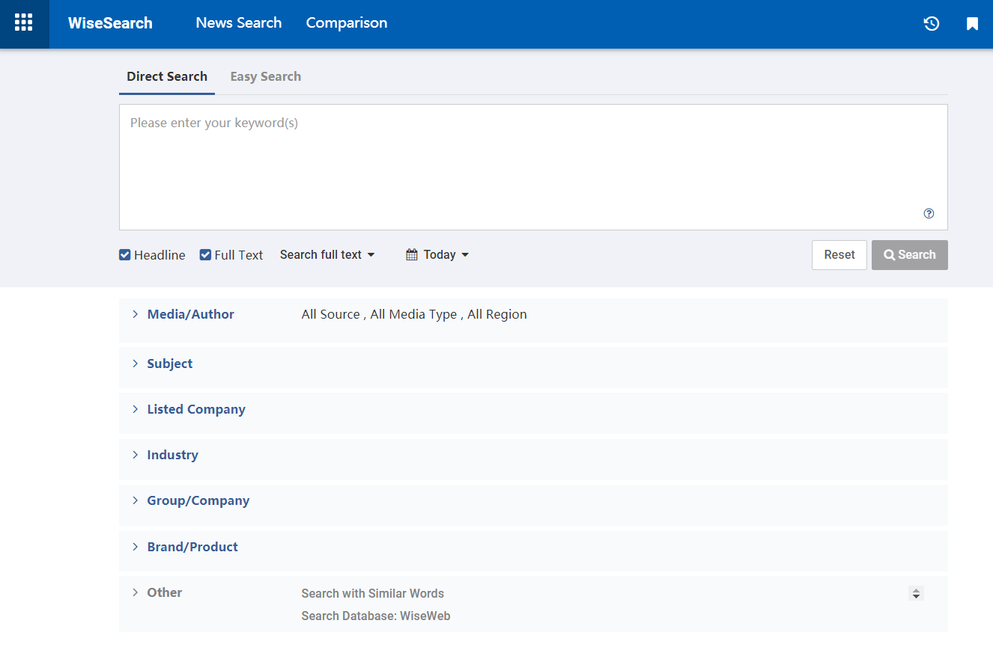
WiseSearch - Search Interface
Search tips
36

Slide 37
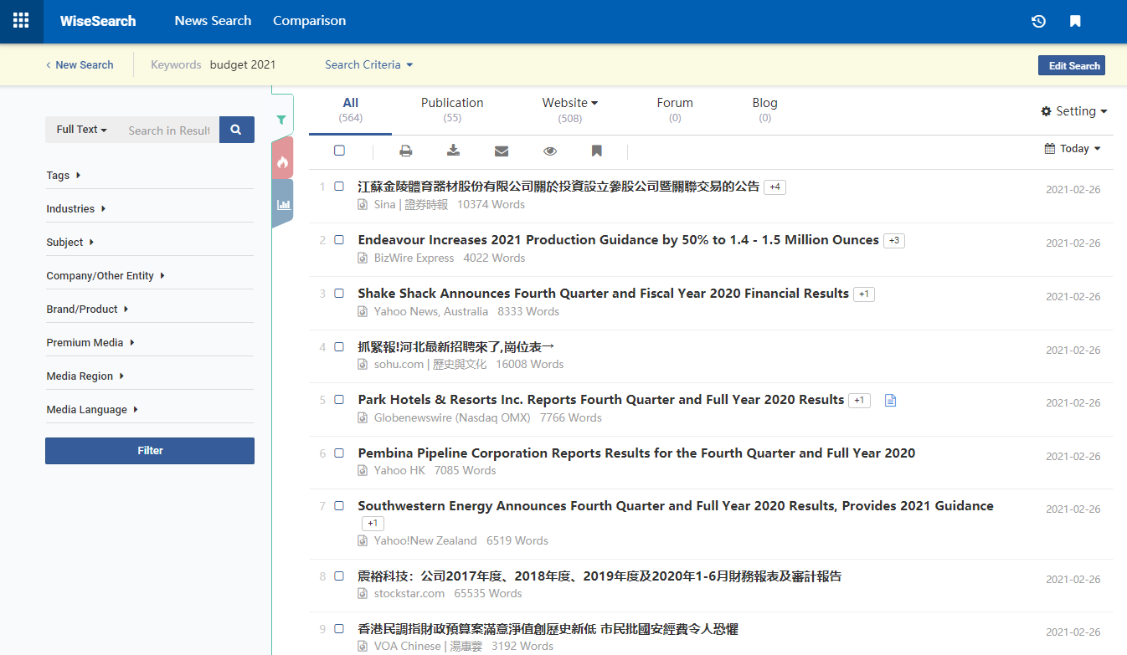
WiseSearch - Search Result Page
Narrow down the search by adding additional terms
Modify your search criteria
To print, download, email, browse and bookmark a batch of articles.
Text icon means full text available
37

Slide 38
Export: Max documents per download / email / print
Max documents per download: 200 articles
Max documents per email: 100 articles (suggest not more than 15 articles)
Max documents per print: 100 articles
Max documents per add to my folder: 200 articles
38

Slide 39
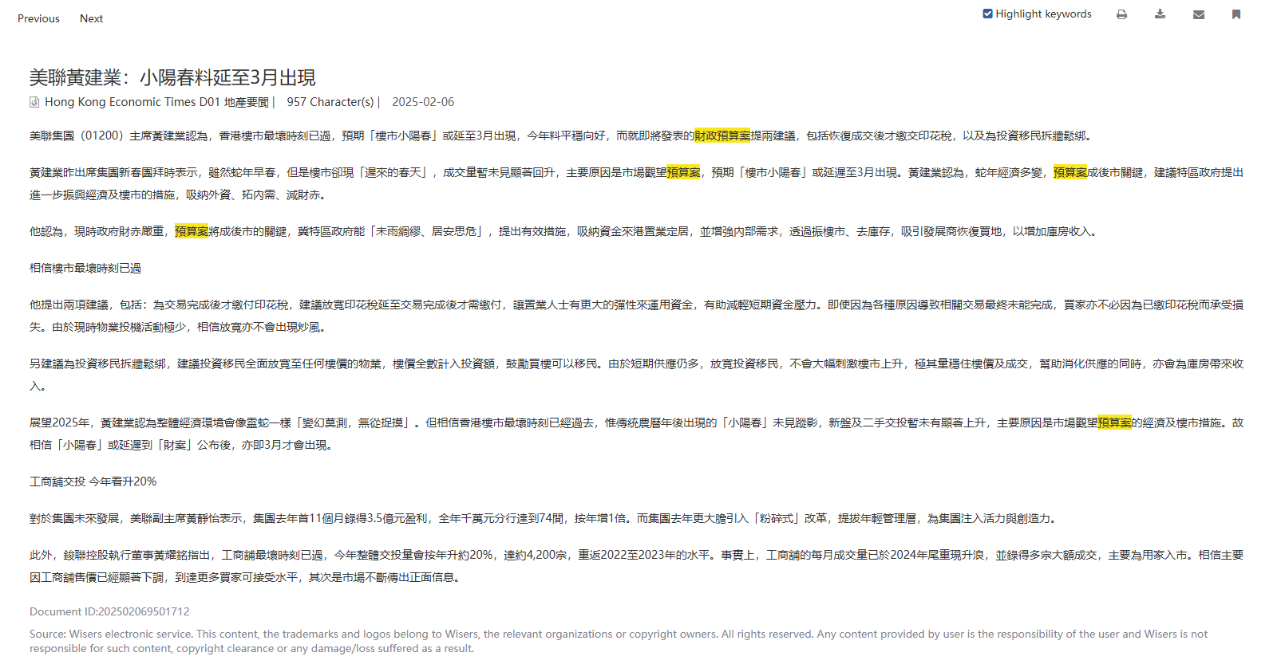
Modify the Search in a Record
Click here to enable/disable the highlight function
39

Slide 40

PressReader
Offers access to more than 6,000 newspapers and magazines from more than 100 countries in 60+ languages
Support multiple platforms, such as online, on mobile device, tablet or eReader
40

Slide 41
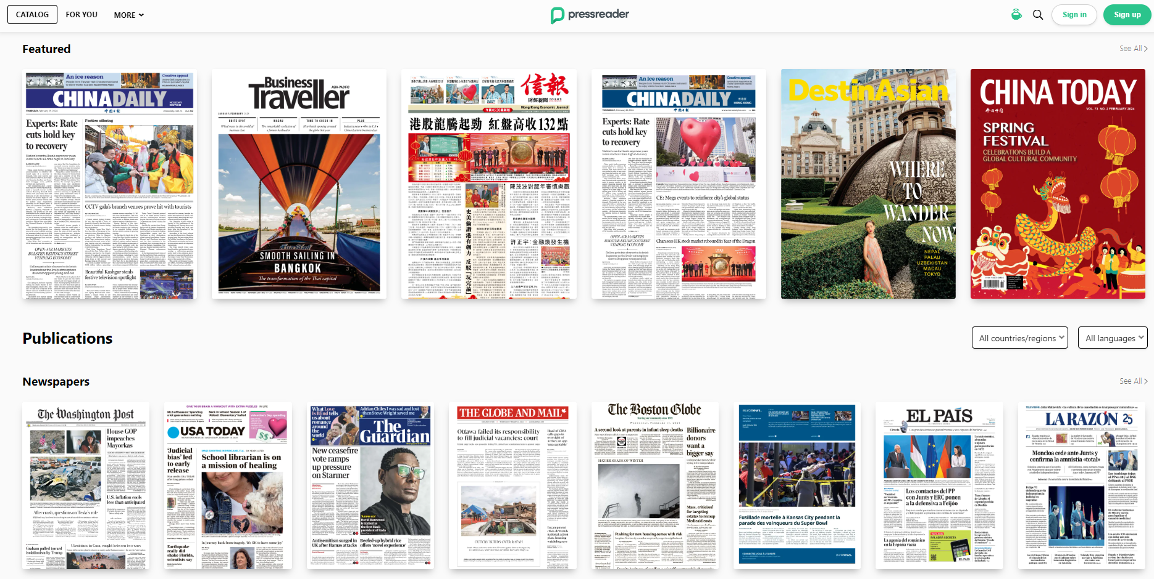
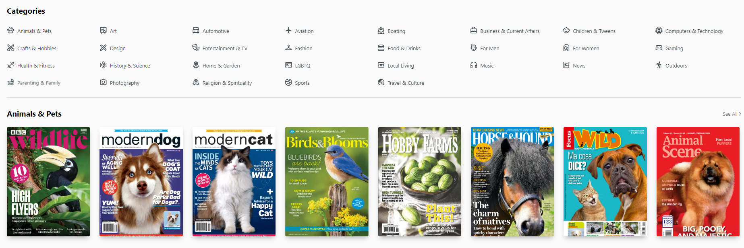
1: Search
4: Scroll down to select more categories
3: Select Language
2: Select Countries / Regions
41

Slide 42
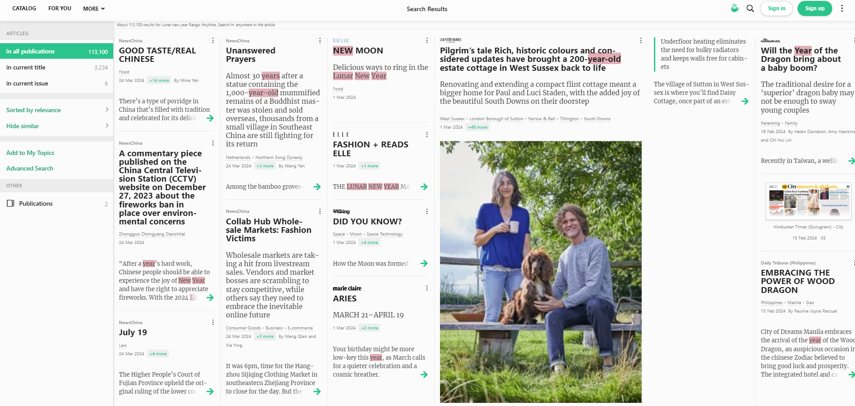
Search Interface
Search in different categories

Slide 43
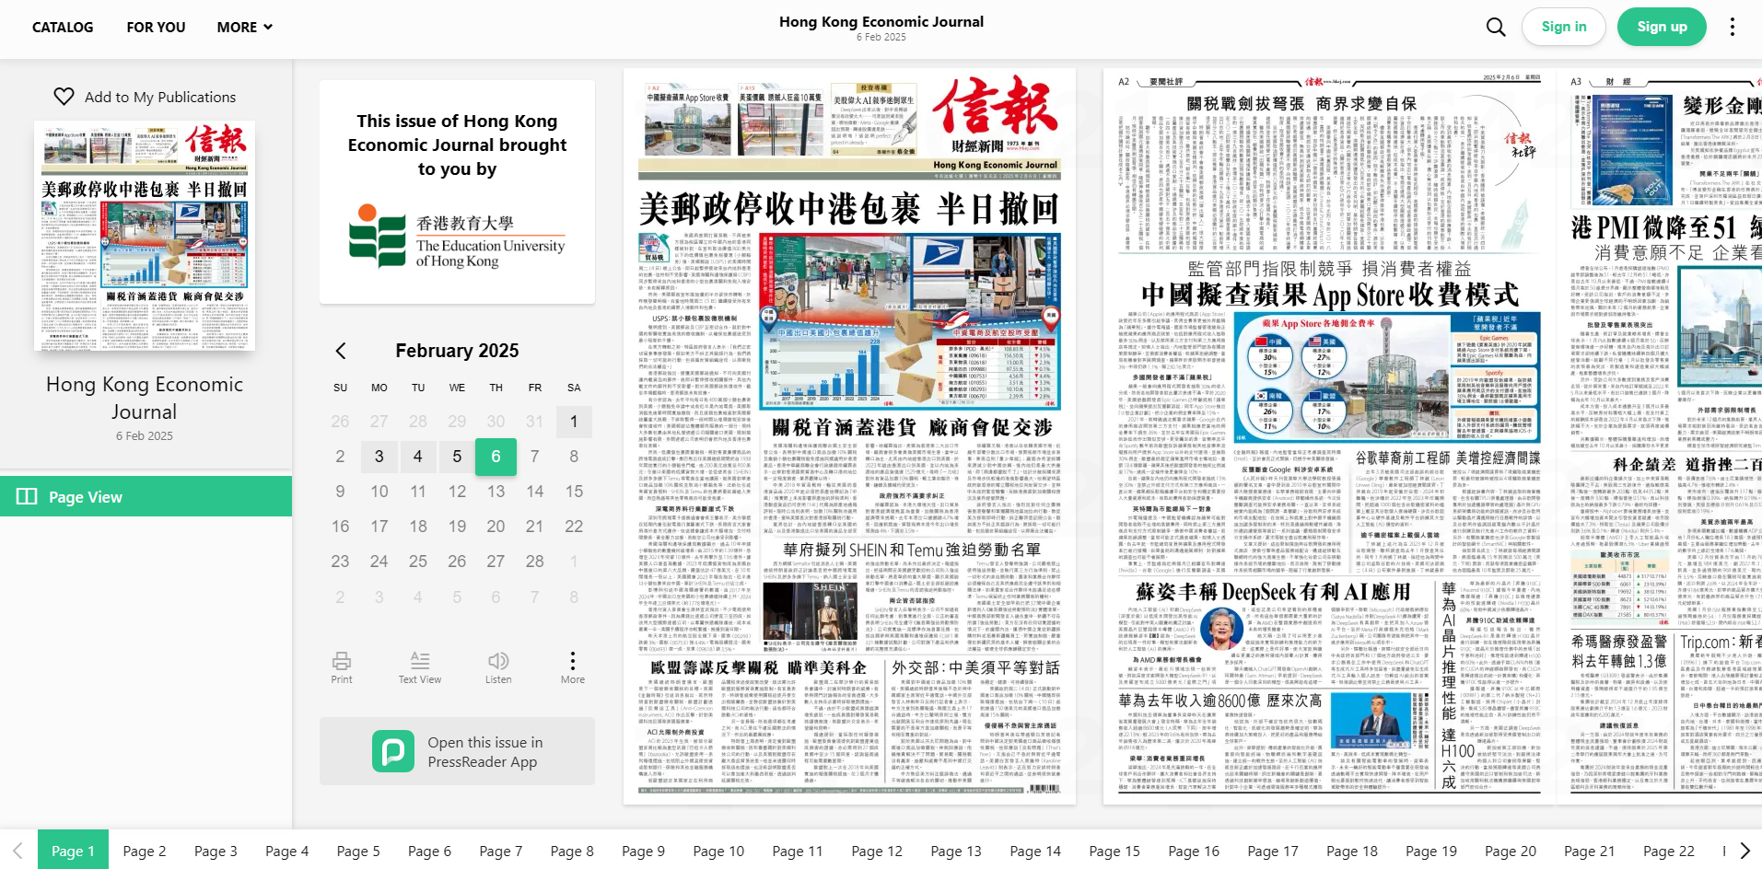
Select specific date
43

Slide 44
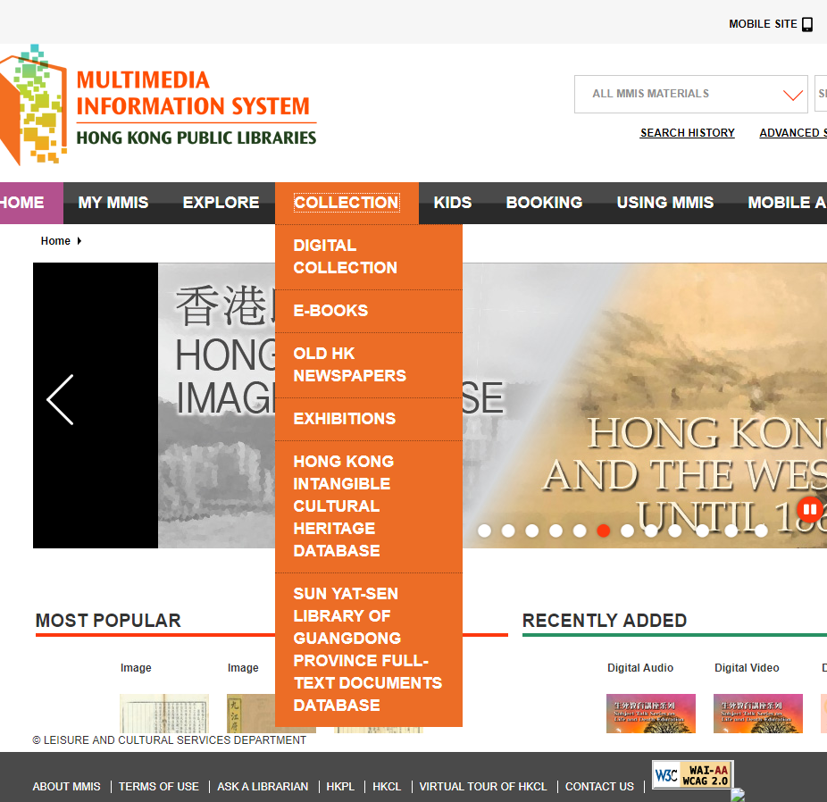
Multimedia Information System of Hong Kong Public Libraries
https://mmis.hkpl.gov.hk
MMIS provides a rich collection of digitized format of materials on microfilms, clippings, maps, posters, house programmes etc.
The Old Hong Kong Newspapers Collection is a selective collection of major old Hong Kong Newspapers published from early Hong Kong to nowadays, aiming at preserving historical news reporting of Hong Kong for reference and research.
44

Slide 45
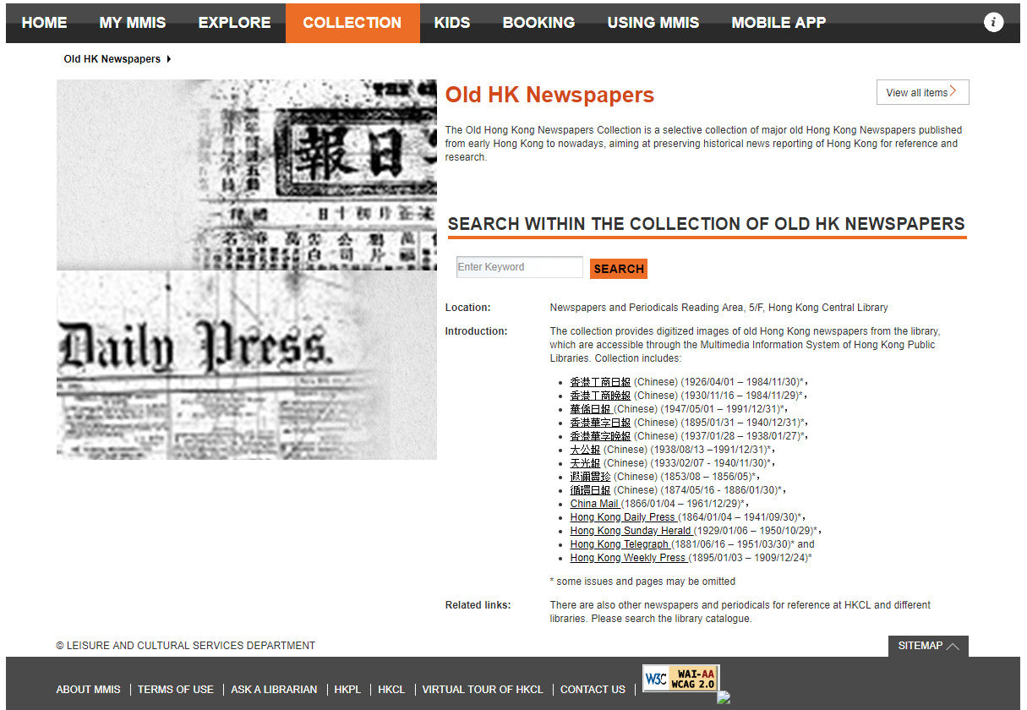
Coverage of the Old HK Newspapers
45

Slide 46
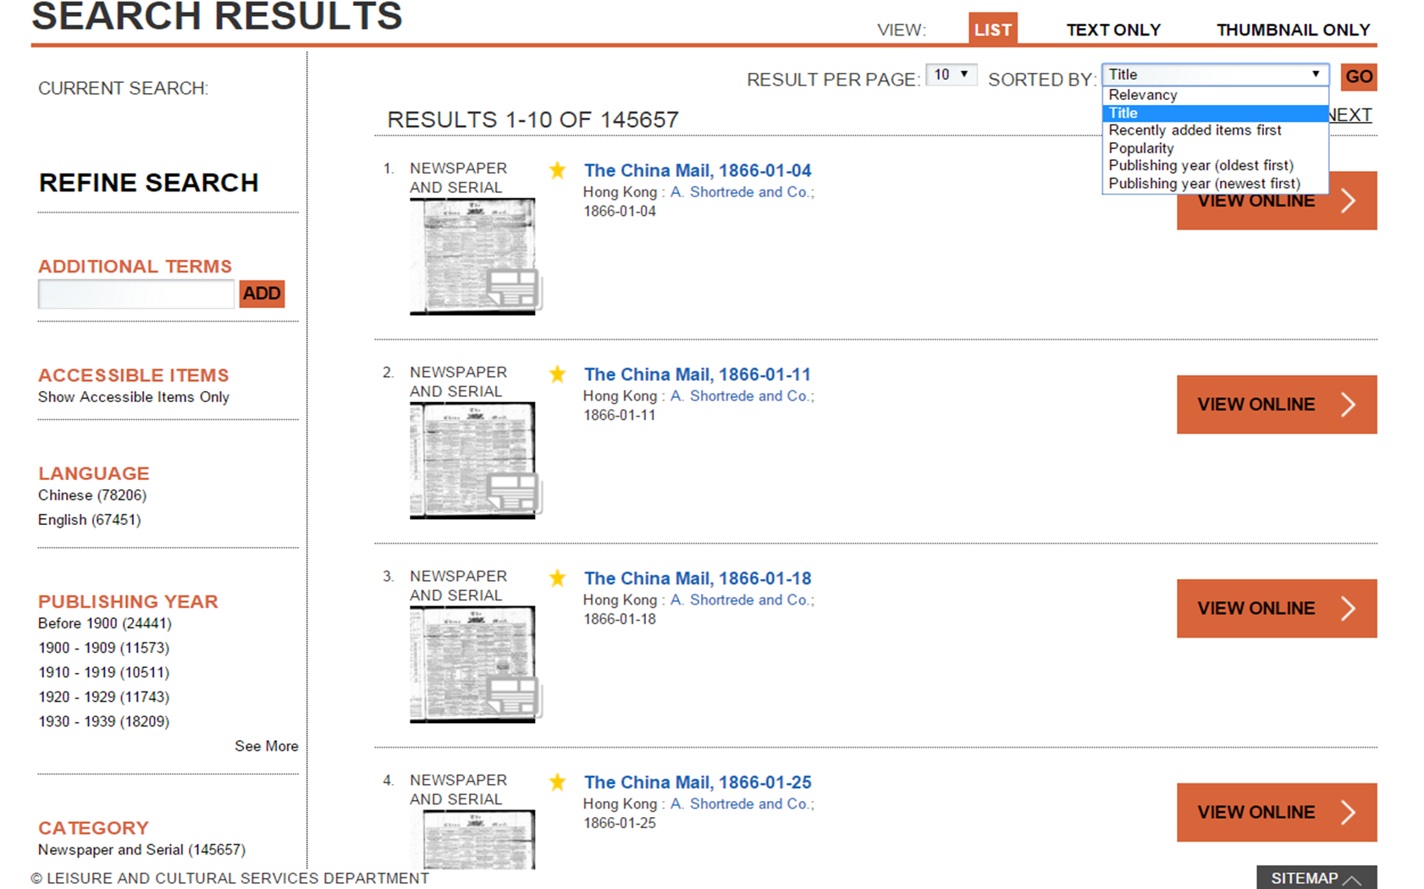
View all items by title
46

Slide 47
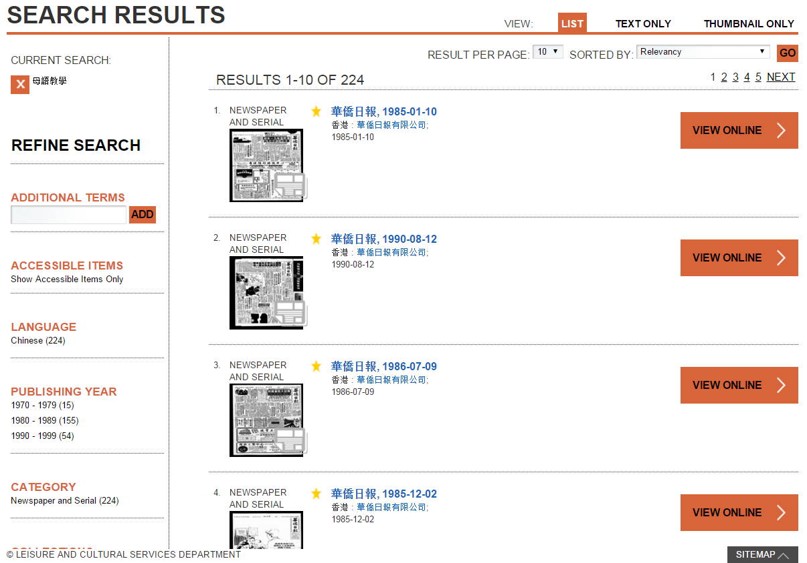

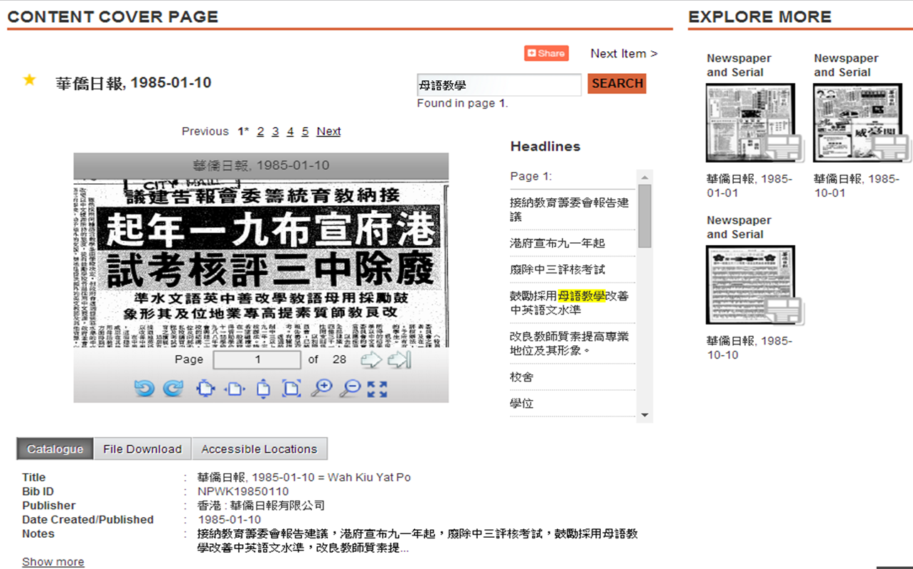
Example : search with keywords 母語教學
47

Slide 48

Evaluation From
48

Slide 49







QUESTIONS?
Ask your Librarian @
Service Counter
2948 6653
libinfo@eduhk.hk
9514 9655 (Mon-Fri, 9am-5pm)
https://app.lib.eduhk.hk/zoom

