Slide 1

Scite: Smart AI Tool For Your Research

Slide 2
Outline
01
02
03
Introduction
Search Literature with Scite
Ask Questions in Scite
04
Reference Check in Scite
05
Scite Table
06
Acknowledge Use of AI-Generated Content

Slide 3
01
Introduction

Slide 4
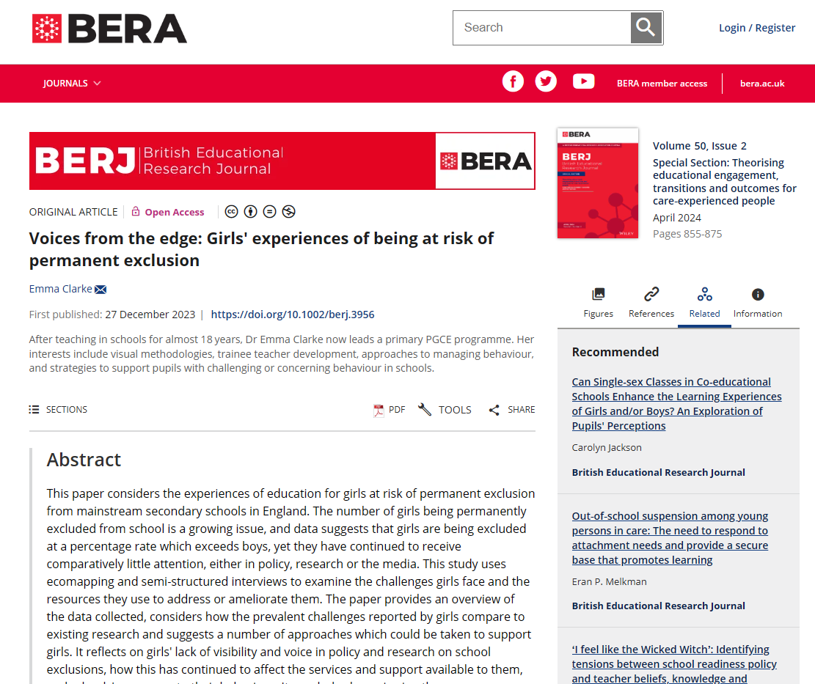
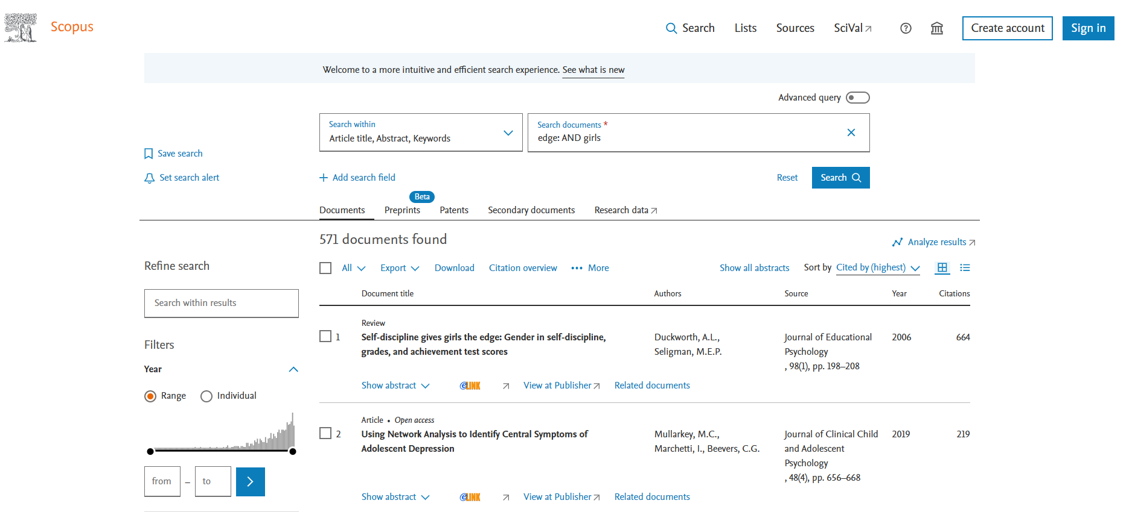
The world without Scite

Slide 5
What is Scite?
If a research paper has 664 times cited by others, does it mean that this paper has higher research impact?
Only the number of citations a publication receives does not really indicate the research impact, but also need to consider how a publication has been cited by others.
Scite is an AI-powered research platform to provide the in-depth insights into how a publication has been cited by others, such as the context in which it was cited and whether the citation offers supporting or contrasting evidence, or simply mentions the publication.

Slide 6
Research Powered by Scite
Discovery |  |  | Writing | Evaluation
Scite Advanced Search Users discover the most supported, contrasted, or overall cited studies. | Scite Assistant Create a couple of paragraphs outlining some information on the topic and include references from research papers. | Scite Report Display how any paper has been discussed in the literature. | Citation Statement Search Find expert analyses and interpretations to and the most appropriate sources to reference. | Reference Check Ensure your references are reliable by understanding if any are retracted or heavily disputed. | Browser Extension Take the power of Scite wherever you read online.

Slide 7
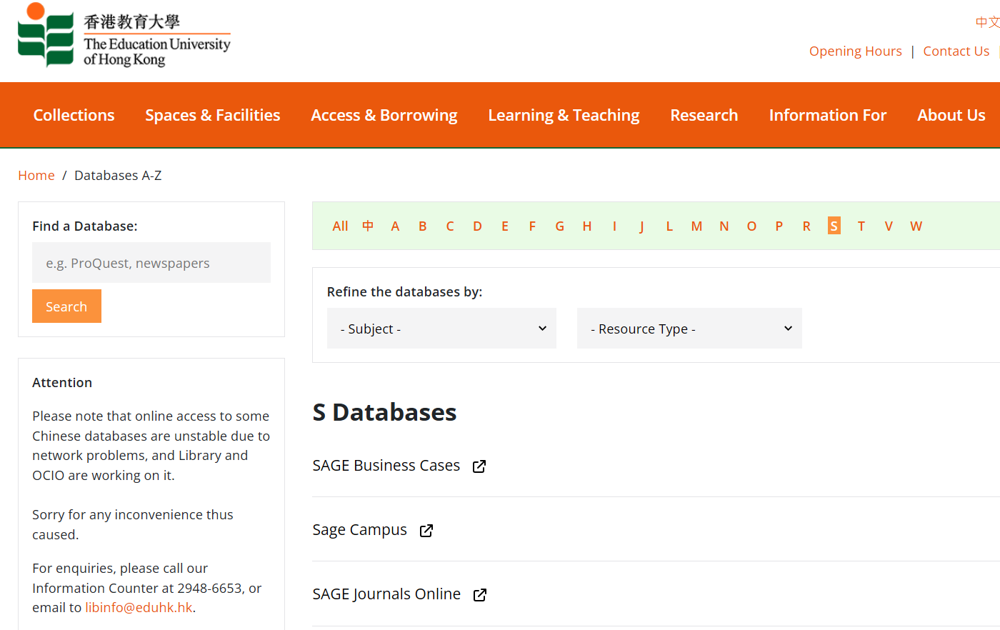
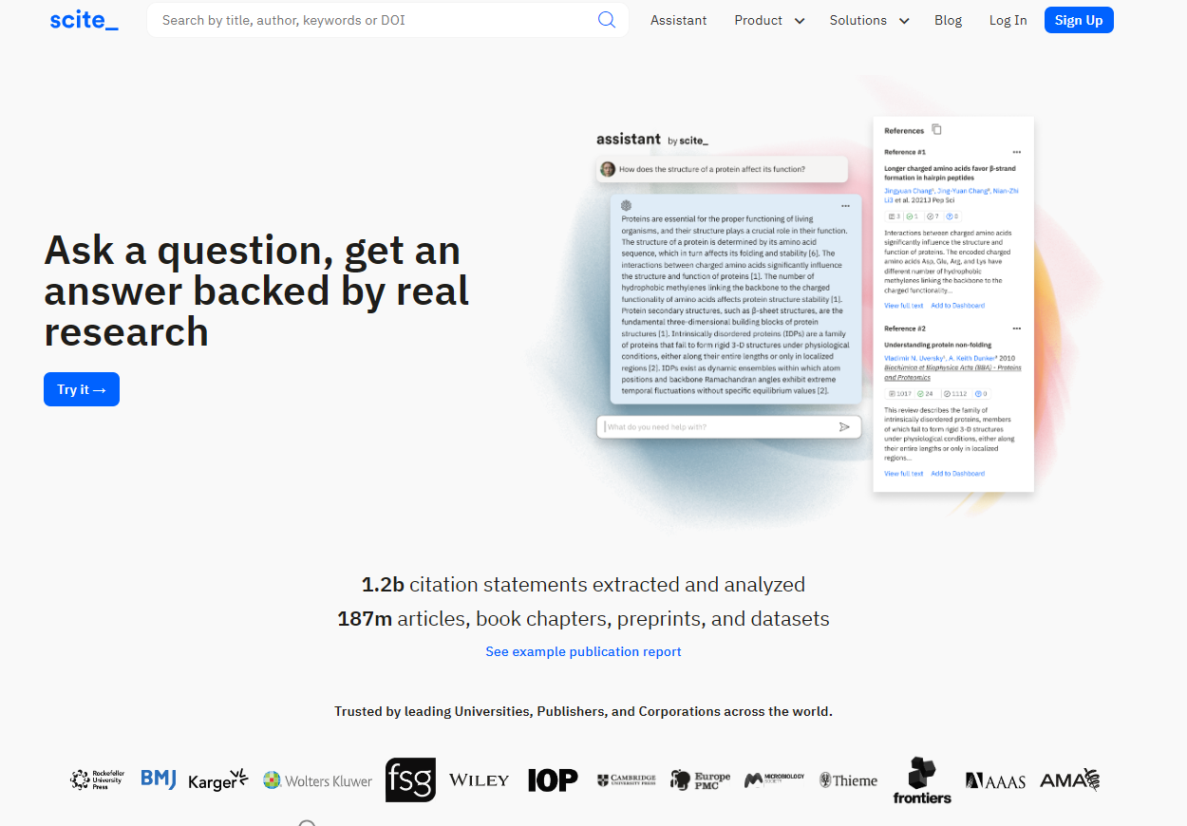
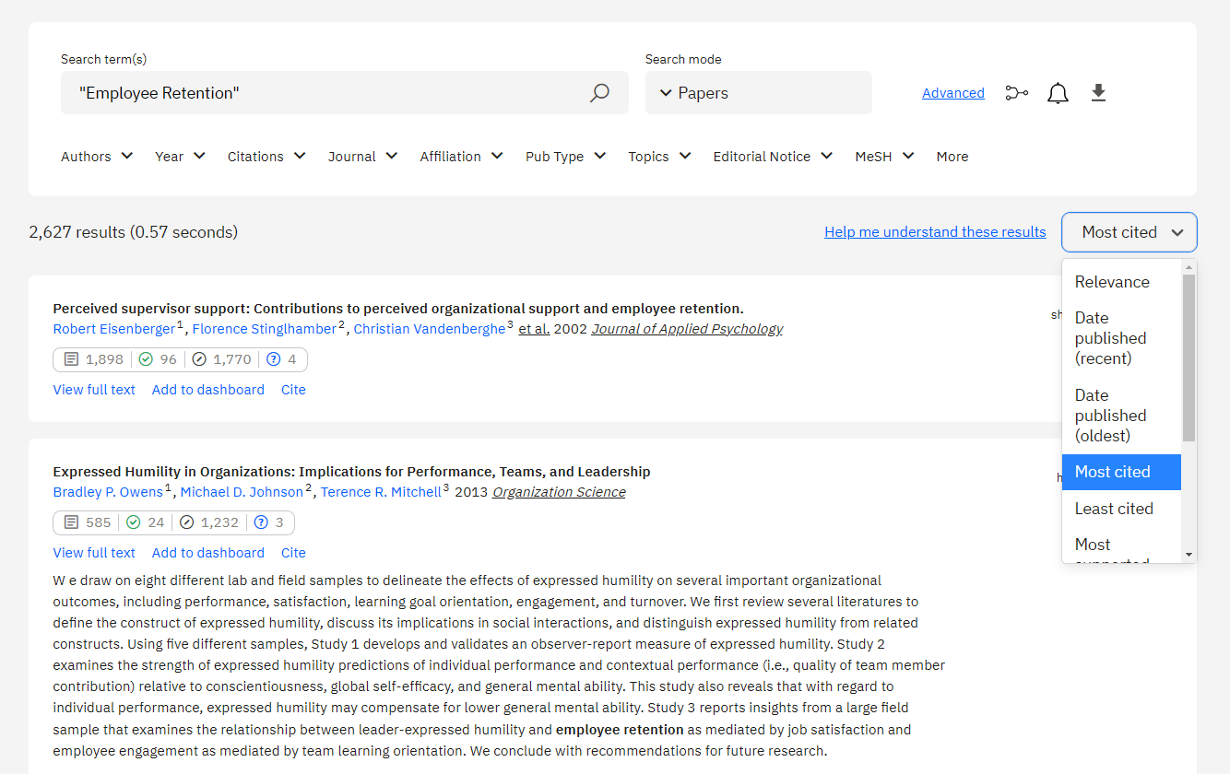
Database A-Z -> Scite

Slide 8
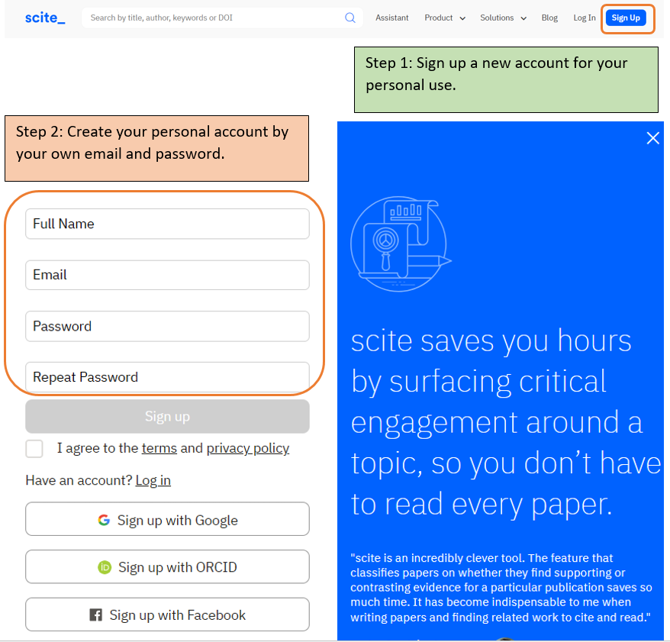
“Sign up” for a personal account by providing their email address and creating a password.
To utilize its premium features, such as:
creating a researcher profile
personalizing a feed
saving searches
creating visualizations of the research
setting up a dashboard
connecting to ORCID
performing reference checks, etc.

Slide 9
02
Search Literature with Scite

Slide 10
Research Problem:
What does social media do to the younger generation’s mental health?

Slide 11
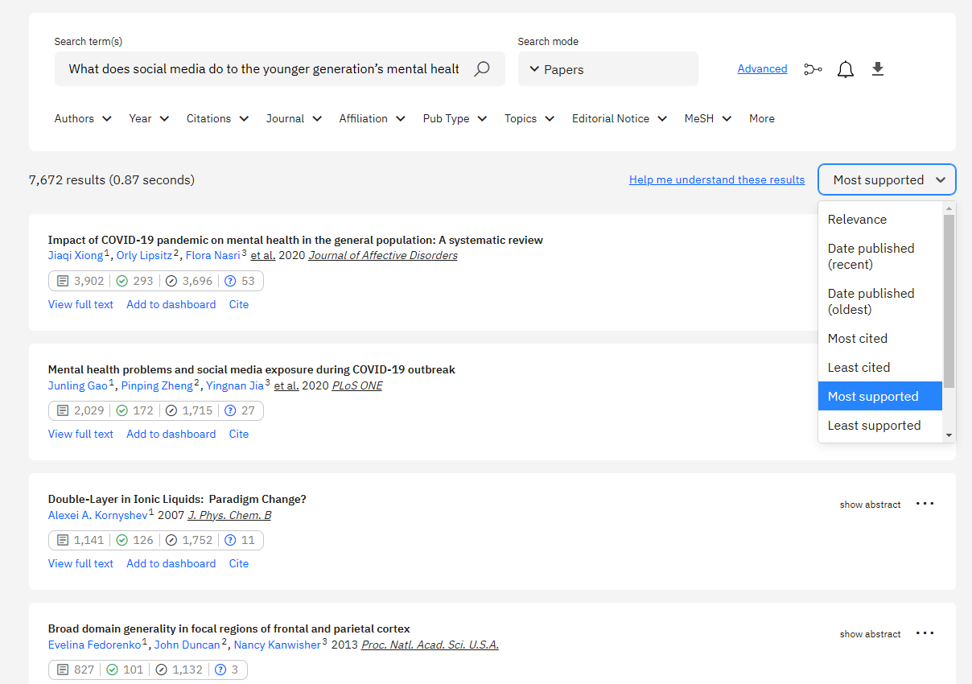
Demo

Slide 12
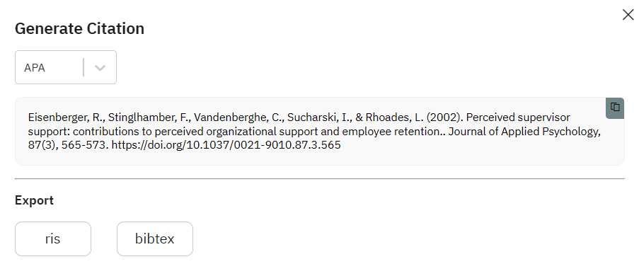
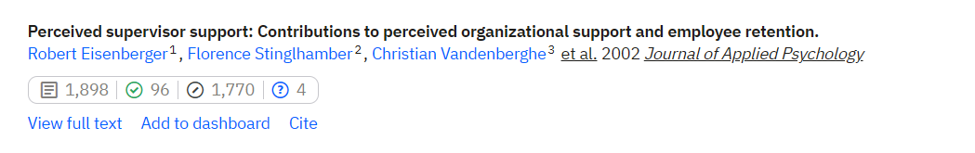
Number of publications citing this work
Number of mentioning citation statements about this work
Number of supporting citation statements about this work
Number of contrasting citation statements about this work

Slide 13
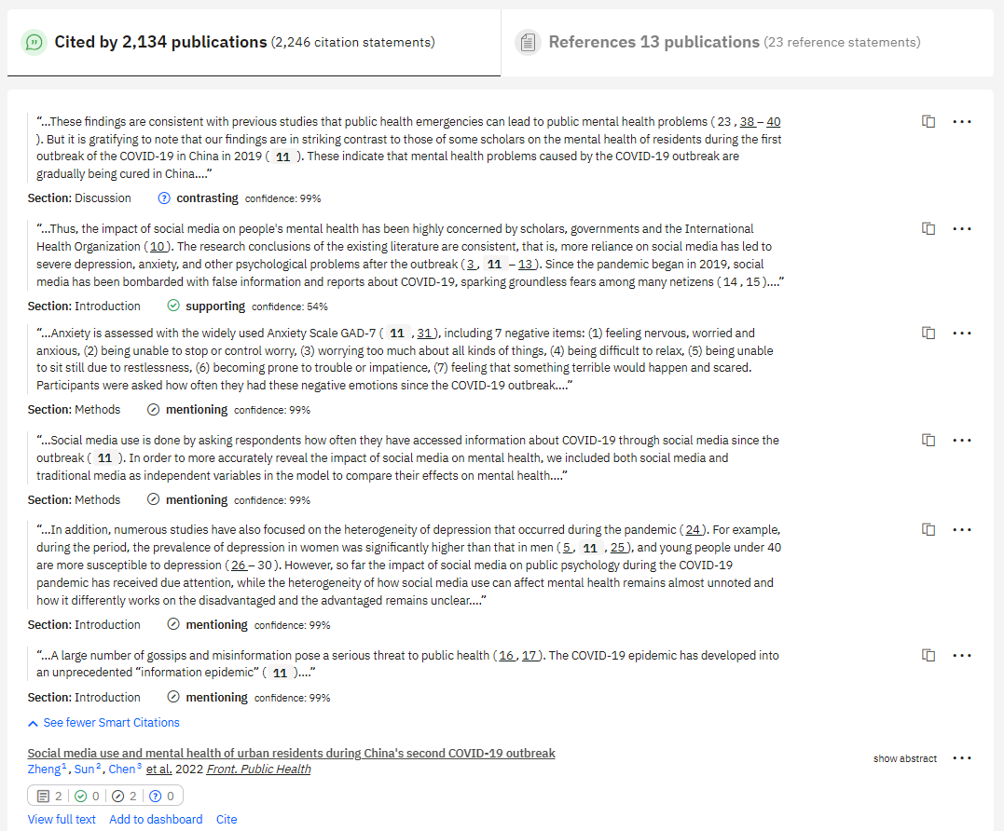
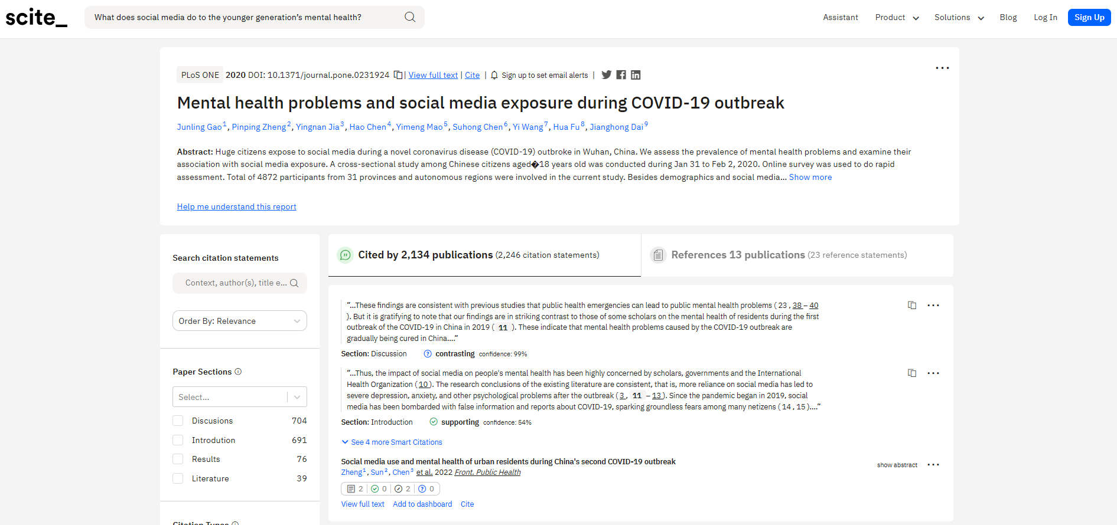
Citation appears in Discussion Section of citing paper, and citation type is regarded as contrasting.
Publications from reference list
Citation appears in Introduction Section of citing paper, and citation type is regarded as supporting.
Publications have cited this paper
Citation appears in Methods Section of citing paper, and citation type is regarded as mentioning.
Citing publication

Slide 14
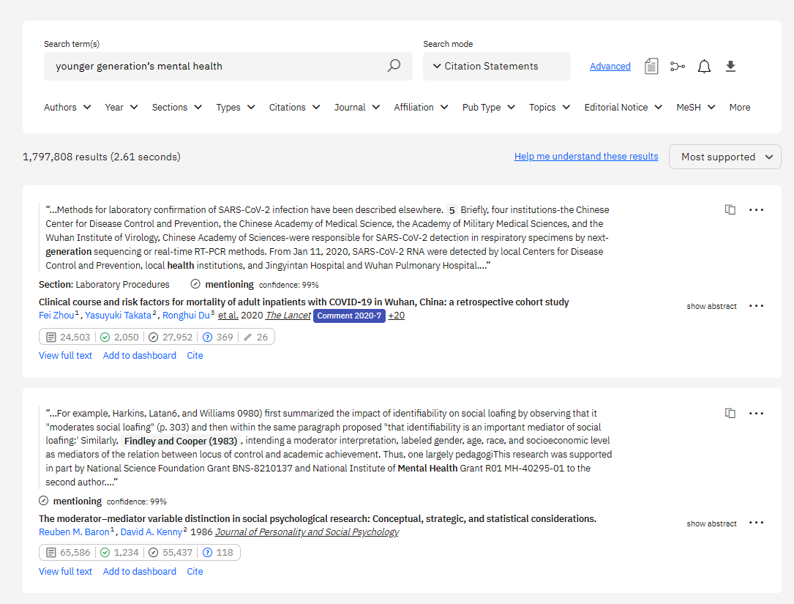
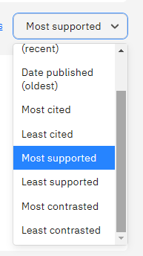
Citation Statement Search

Slide 15
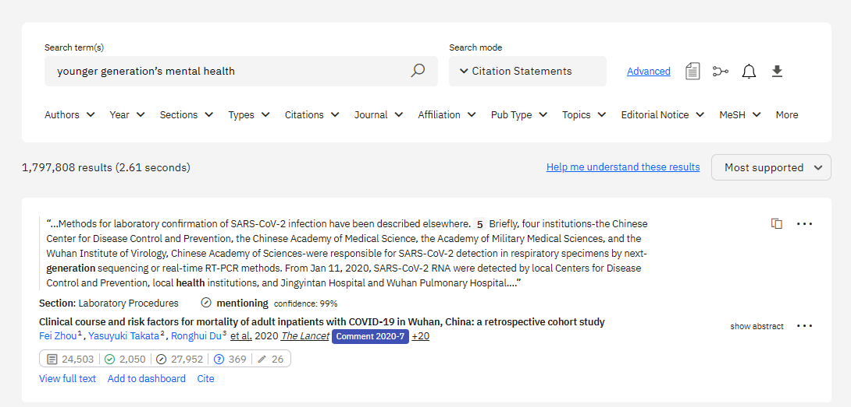
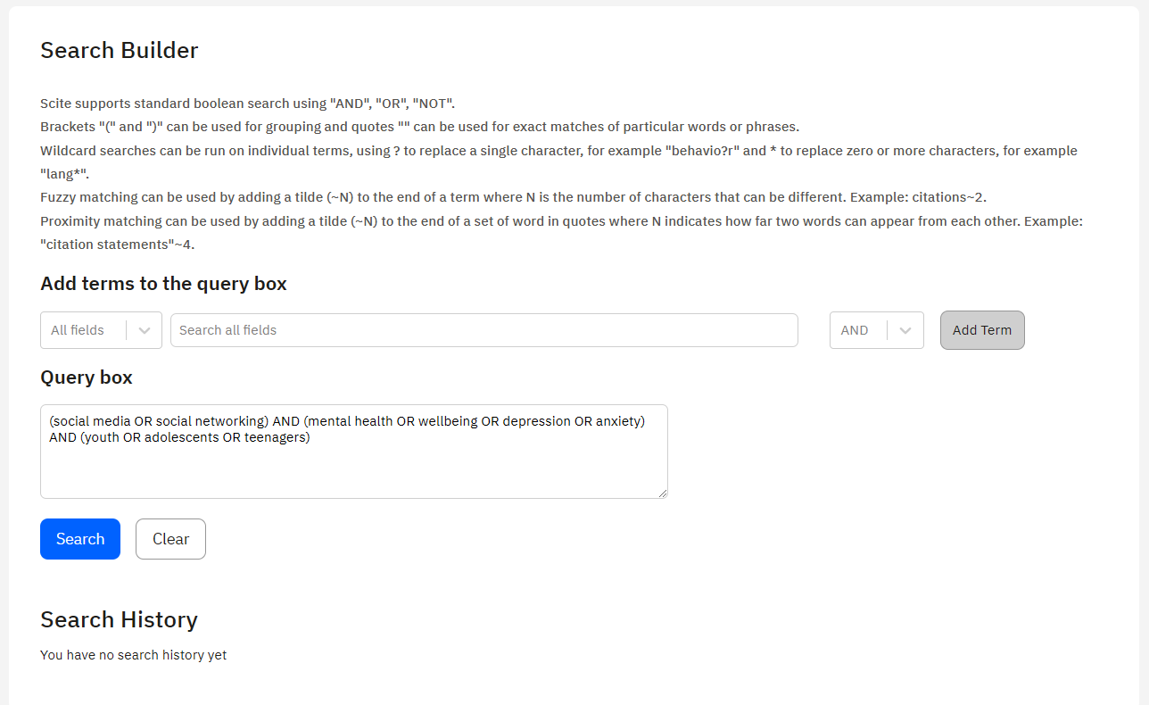
Advanced Search
What does social media do to the younger generation’s mental health?
Notes:
(social media OR social networking) AND (mental health OR wellbeing OR depression OR anxiety) AND (youth OR adolescents OR teenagers)

Slide 16
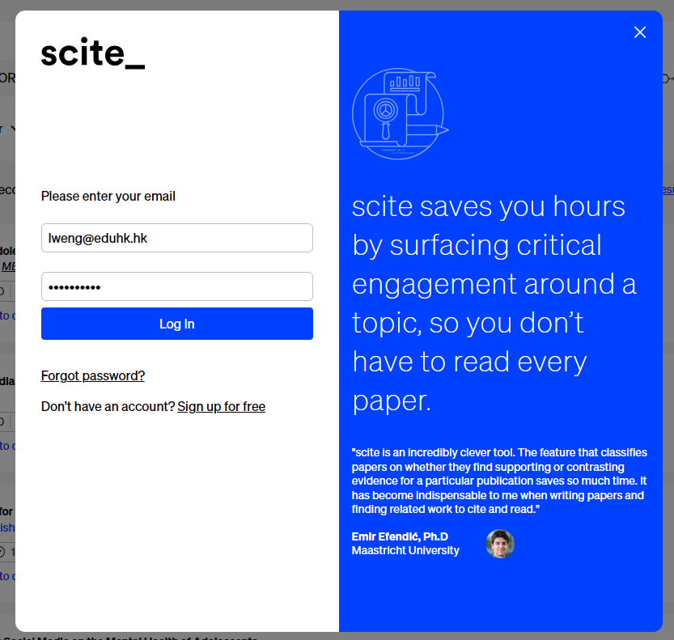
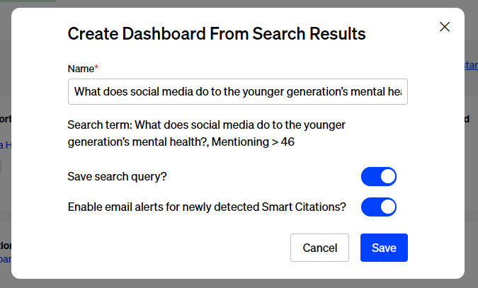
Dashboards
Option 1: Directly create a new dashboard from a search
Demo

Slide 17
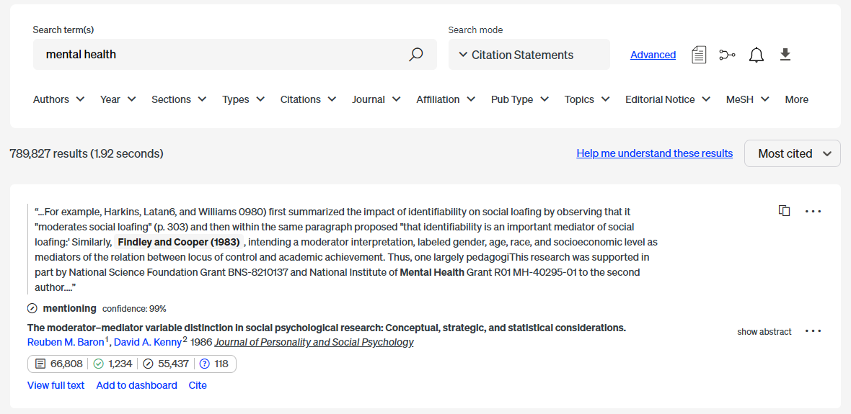
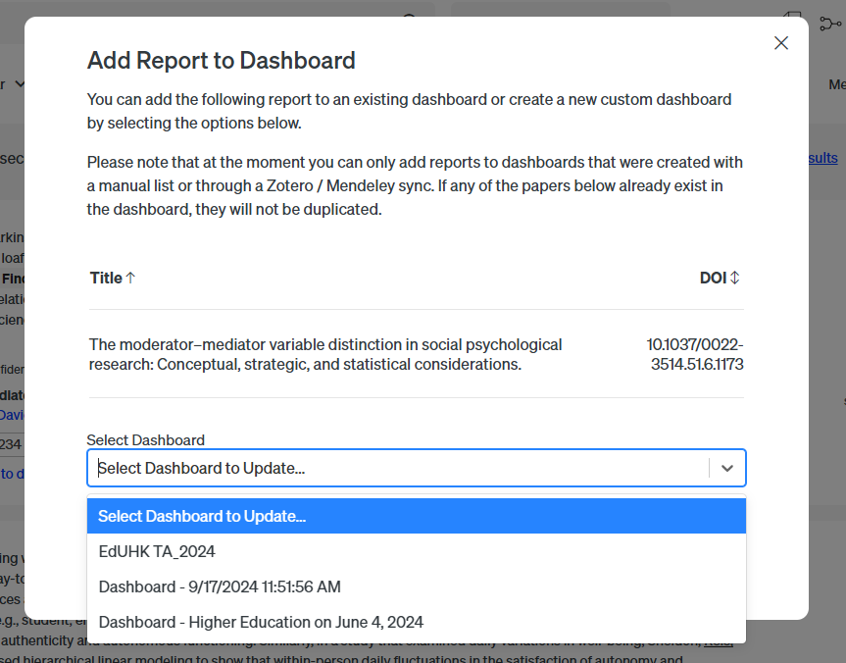
Option 2: Add each publication to the specific dashboard

Slide 18
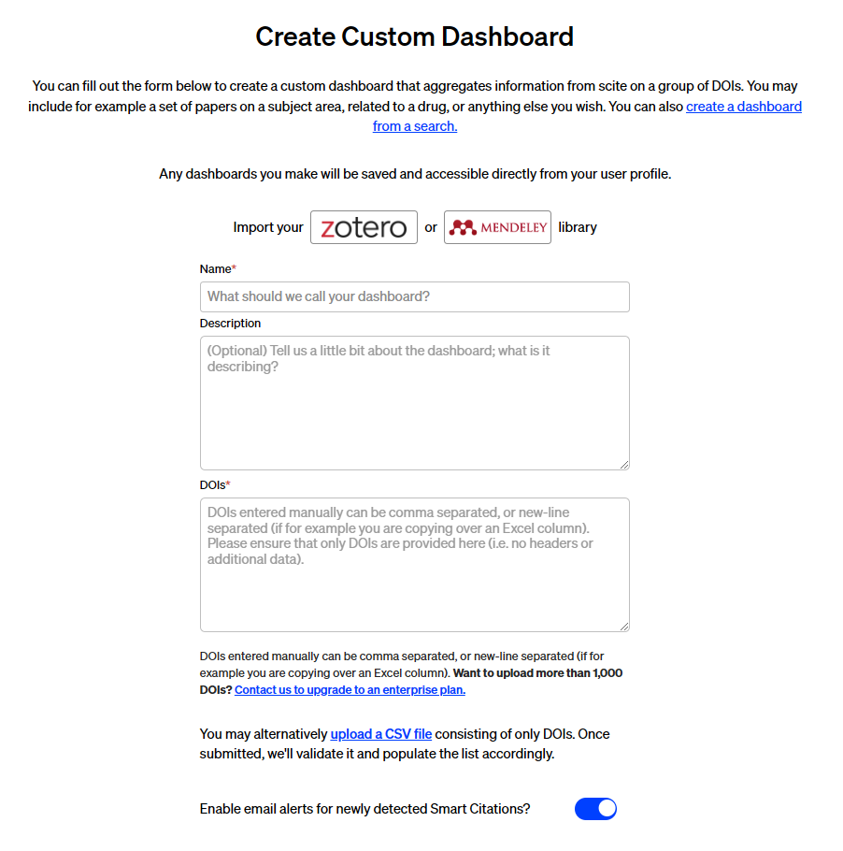
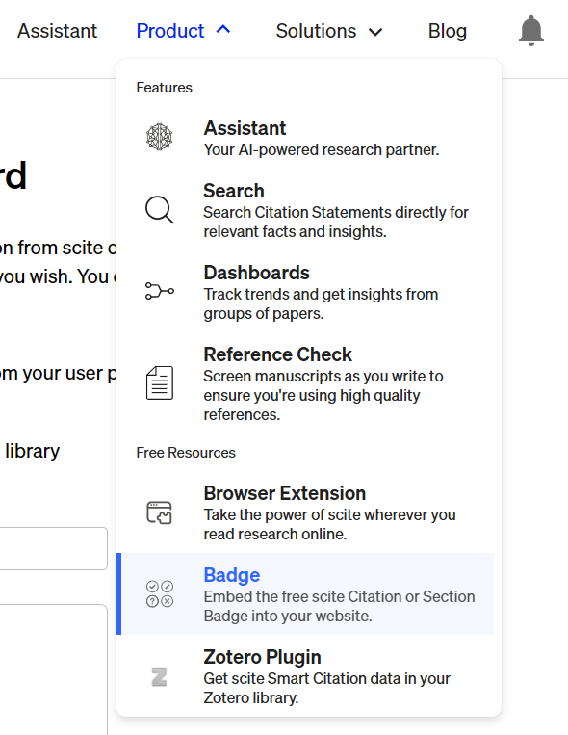
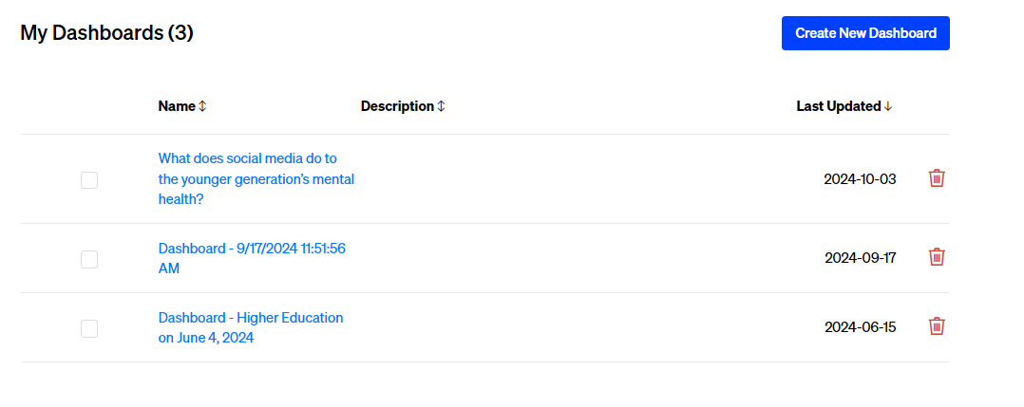
Option 3: Manually create a new dashboard
Four ways you can make a custom dashboard:
Importing your Zotero library
Importing your Mendeley library
Manually entering a comma separated list of valid DOIs
Uploading a CSV file containing a comma separated list of valid DOIs

Slide 19

The Scite plugin is a tool that can be added to web browsers to help users quickly determine if a particular article has been supported by other research or if there is conflicting evidence available.
Browser Plugin

Slide 20
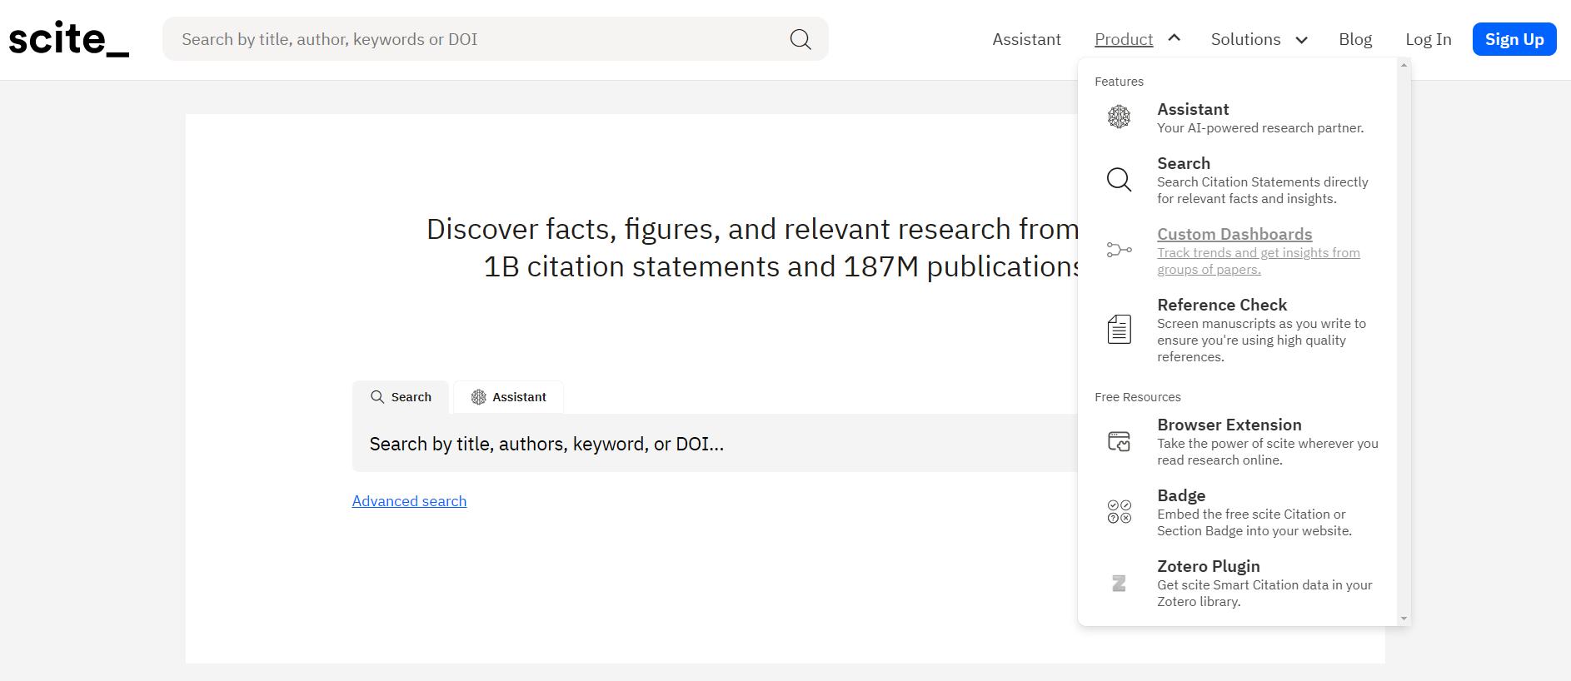
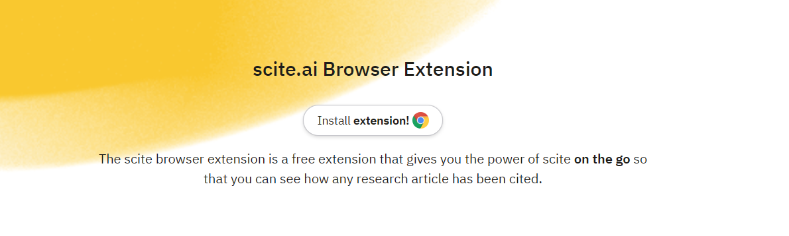
How to install?

Slide 21
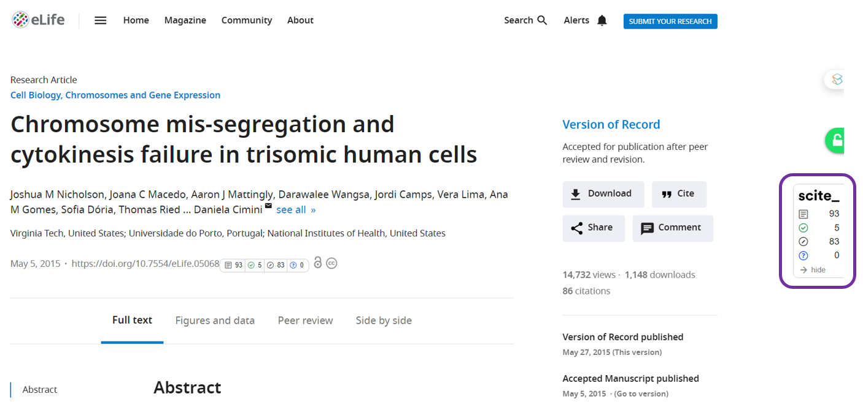
How Browser Plugin Works?
- website page with Scite

Slide 22
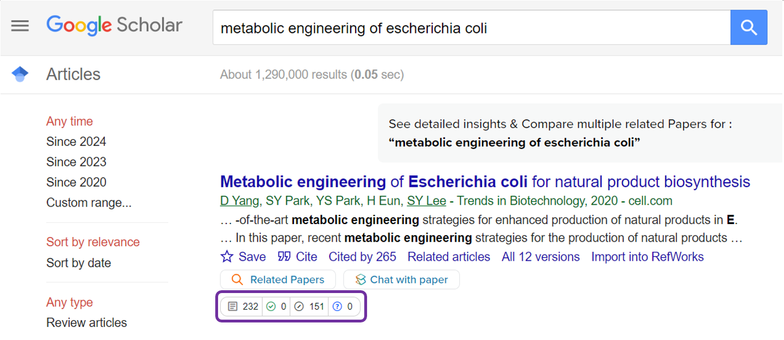
How Browser Plugin Works?
- Google Scholar with Scite

Slide 23
03
Ask questions in Scite - Scite Assistant

Slide 24
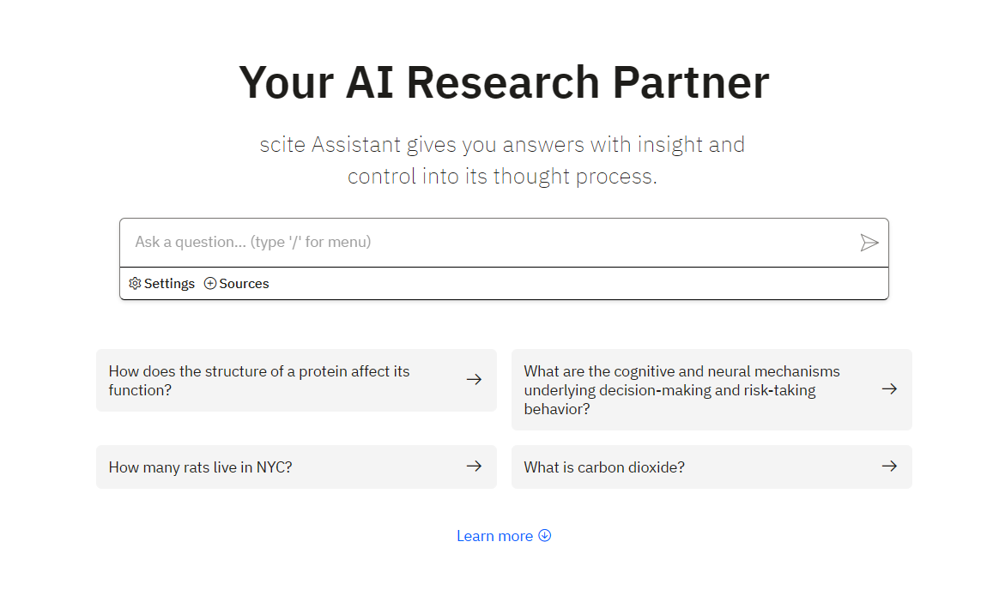
Notes:
The impact of globalization on multinational corporations

Slide 25
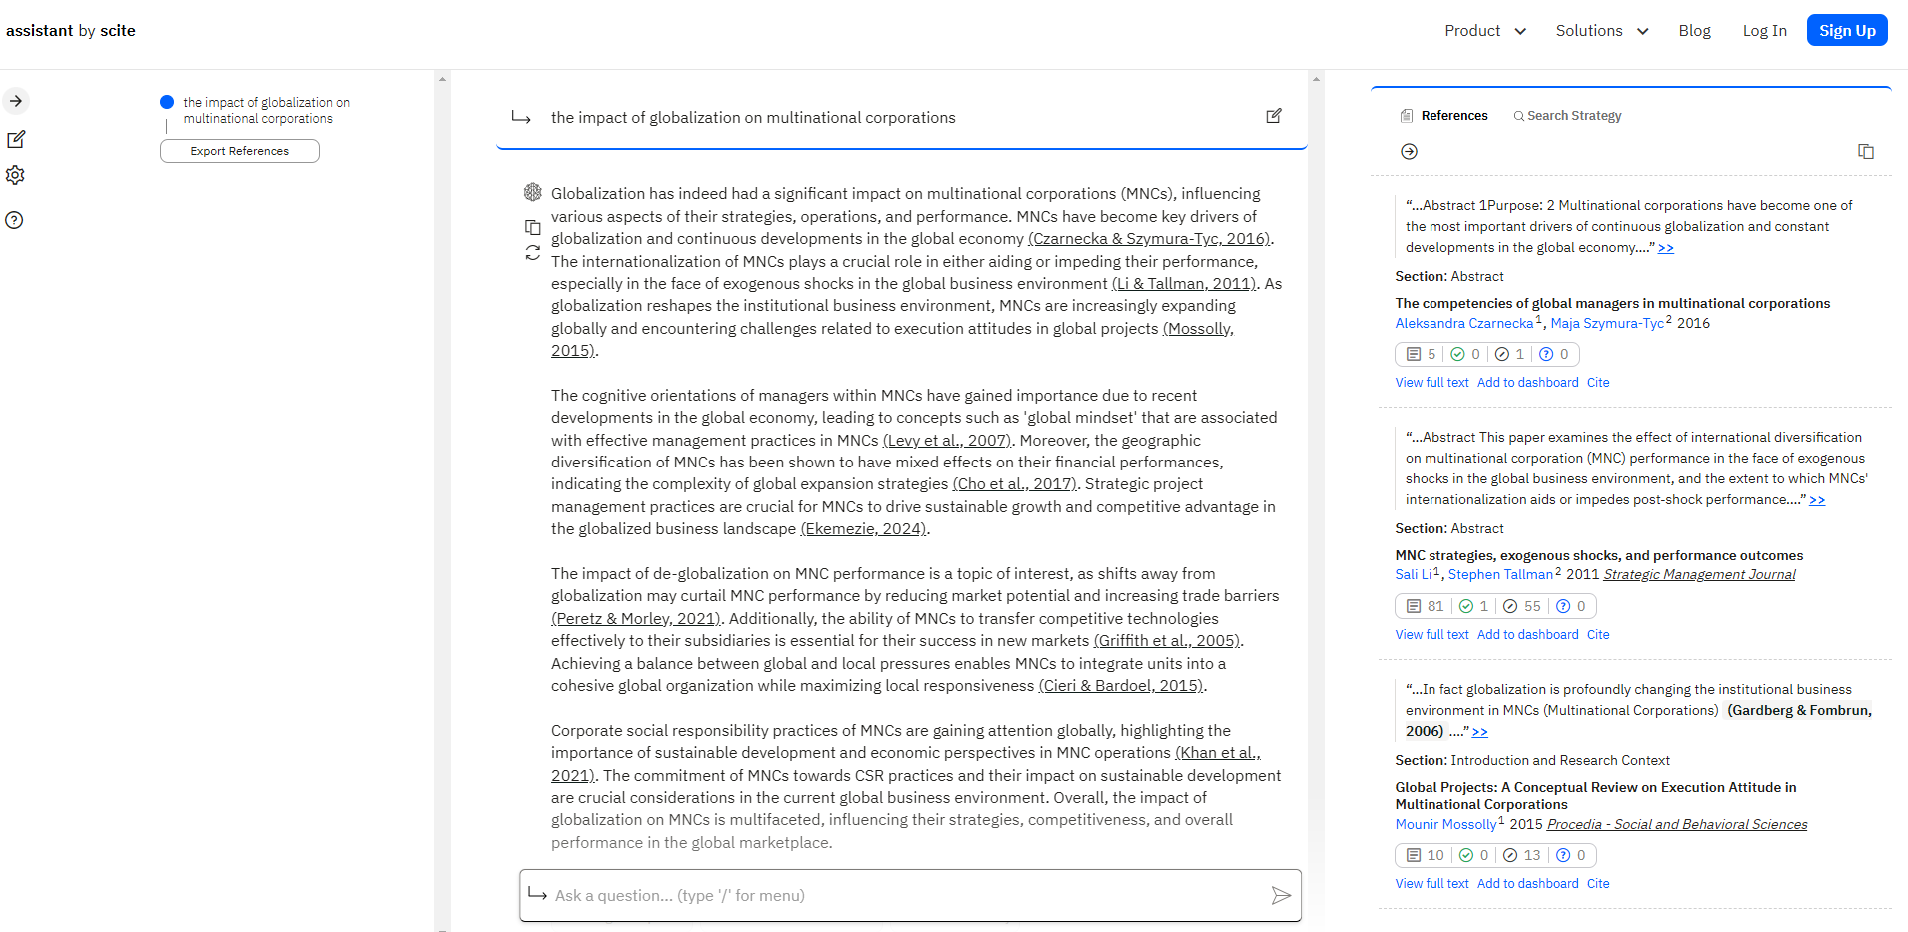
Scite Assistant, an AI chatbot on Scite, can generate summaries with real citations.
Your prompt
Export references used across all responses
Assistant’s response
Reference list used to support the claims in this response
Your follow-ups

Slide 26
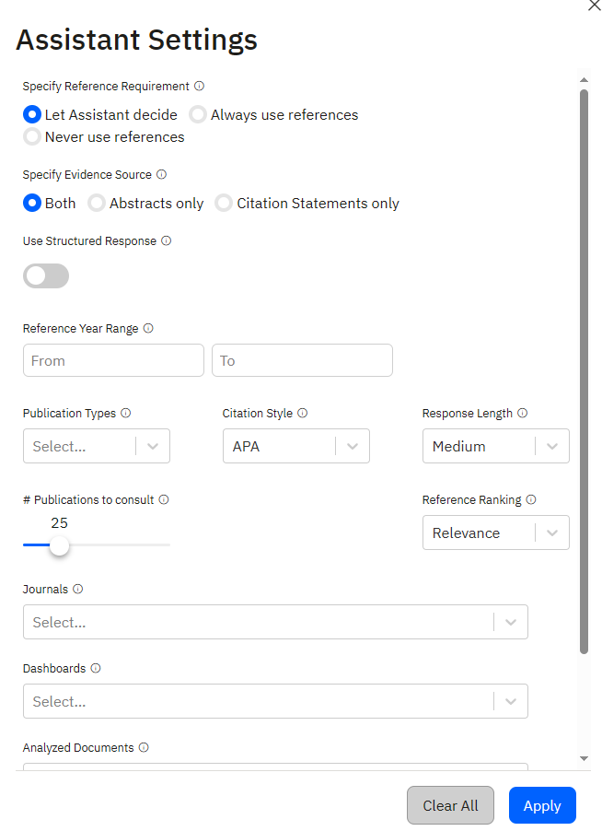
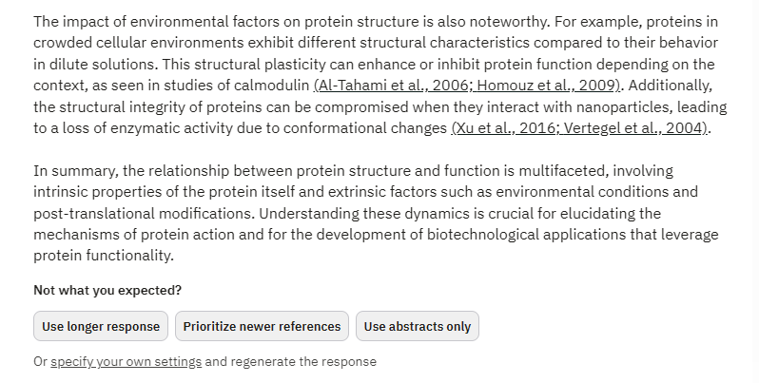

Slide 27
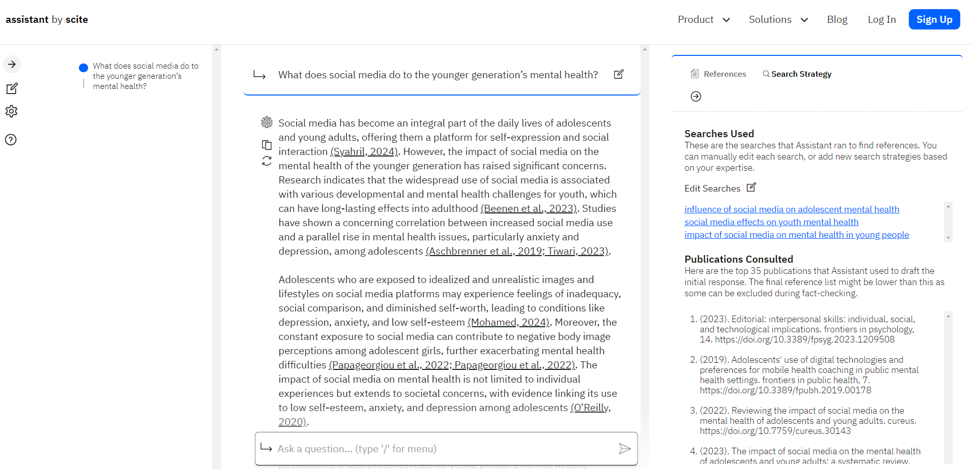
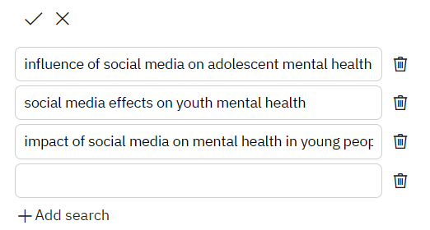
+ social networking
+ depression / anxiety
+ teenagers
Notes:
(social media OR social networking) AND (mental health OR wellbeing OR depression OR anxiety) AND (youth OR adolescents OR teenagers)
You can click each of search statement, you will notice that we are doing our classic keywork searching in Scite database.

Slide 28

Case study: to find a citation
“student’s social interactions can improve learning outcomes and foster a more engaging classroom environment”

Slide 29
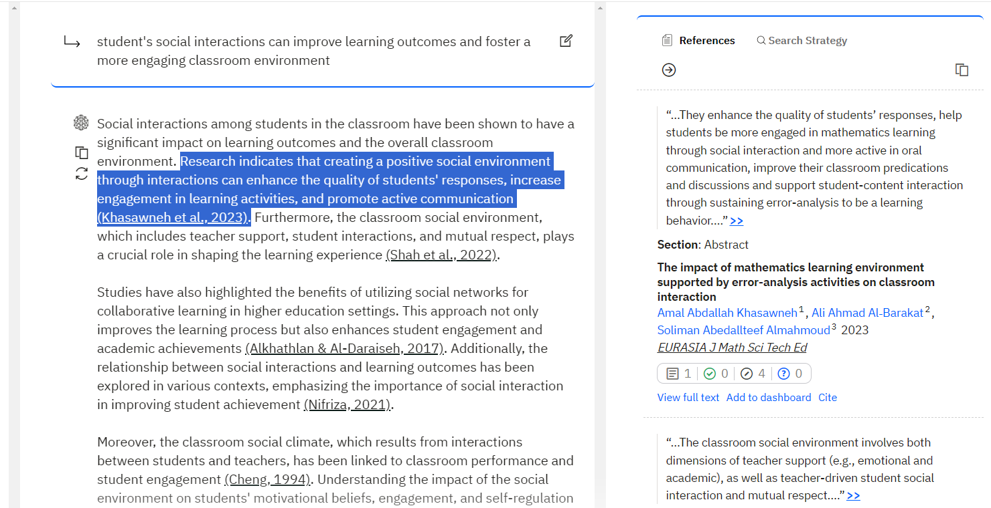
Cite this!

Slide 30
Student's social interactions can improve learning outcomes and foster a more engaging classroom environment (Khasawneh et al., 2023). Studies have also highlighted the benefits of utilizing social networks for collaborative learning in higher education settings. This approach not only improves the learning process but also enhances student engagement and academic achievements (Alkhathlan & Al-Daraiseh, 2017).
What about critical discussion?

Slide 31
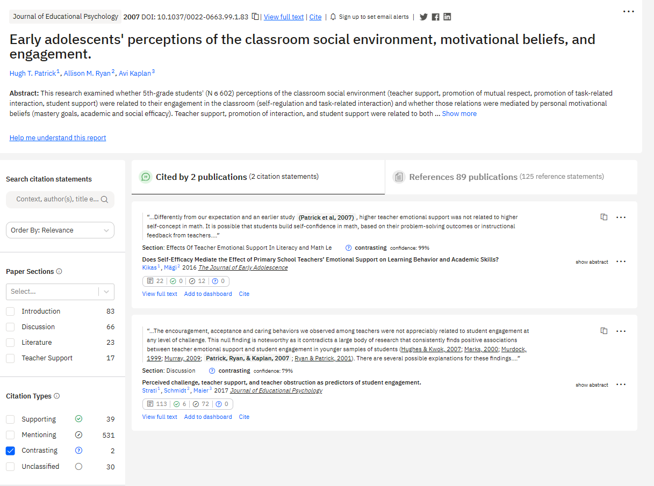
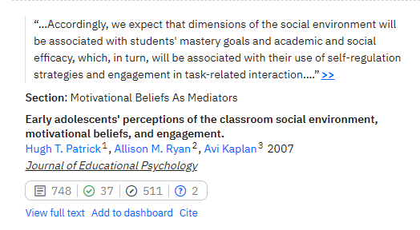
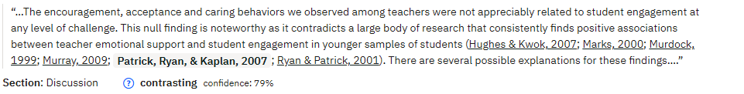
Notes:
Early adolescents' perceptions of the classroom social environment, motivational beliefs, and engagement.

Slide 32
Student's social interactions can improve learning outcomes and foster a more engaging classroom environment (Khasawneh et al., 2023). Studies have also highlighted the benefits of utilizing social networks for collaborative learning in higher education settings. This approach not only improves the learning process but also enhances student engagement and academic achievements (Alkhathlan & Al-Daraiseh, 2017).
However, the encouragement, acceptance and caring behaviors we observed among teachers were not appreciably related to student engagement at any level of challenge. This null finding is noteworthy as it contradicts a large body of research that consistently finds positive associations between teacher emotional support and student engagement in younger samples of students (Hughes & Kwok, 2007; Marks, 2000; Murdock, 1999; Murray, 2009; Patrick, Ryan, & Kaplan, 2007; Ryan & Patrick, 2001).
Repeat these steps to enrich your literature!

Slide 33
04
Reference Check in Scite

Slide 34
Reference Check takes a PDF and generates a report that allows you to:
See how the manuscript cites its own references
See whether any have received editorial notice(s)
Check how many times each reference has been supported or contrasted

Slide 35
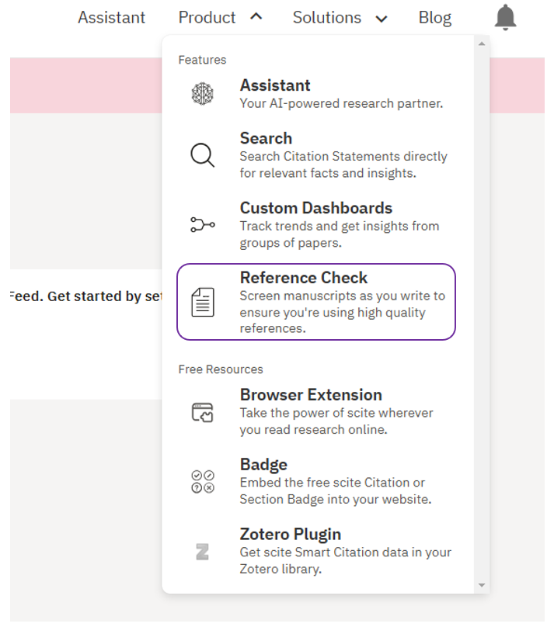
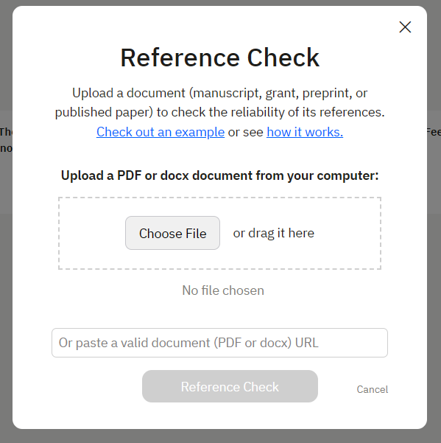
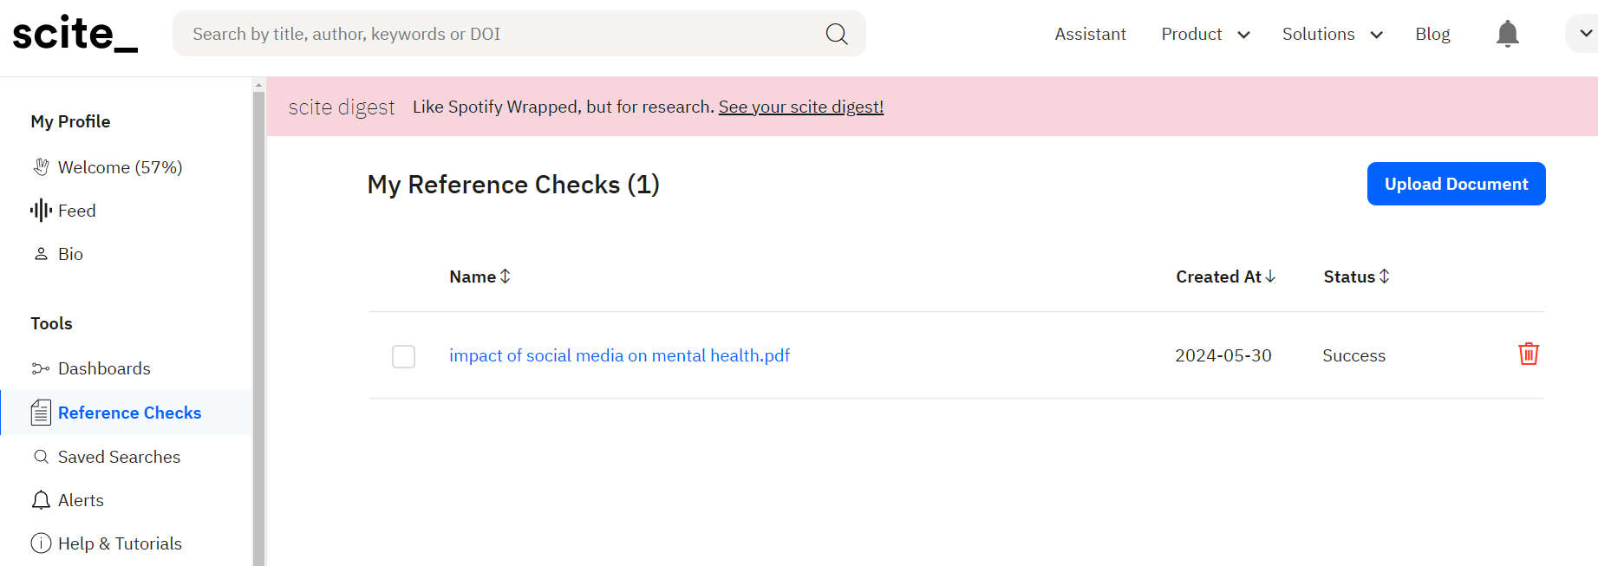
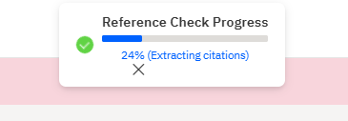

Slide 36
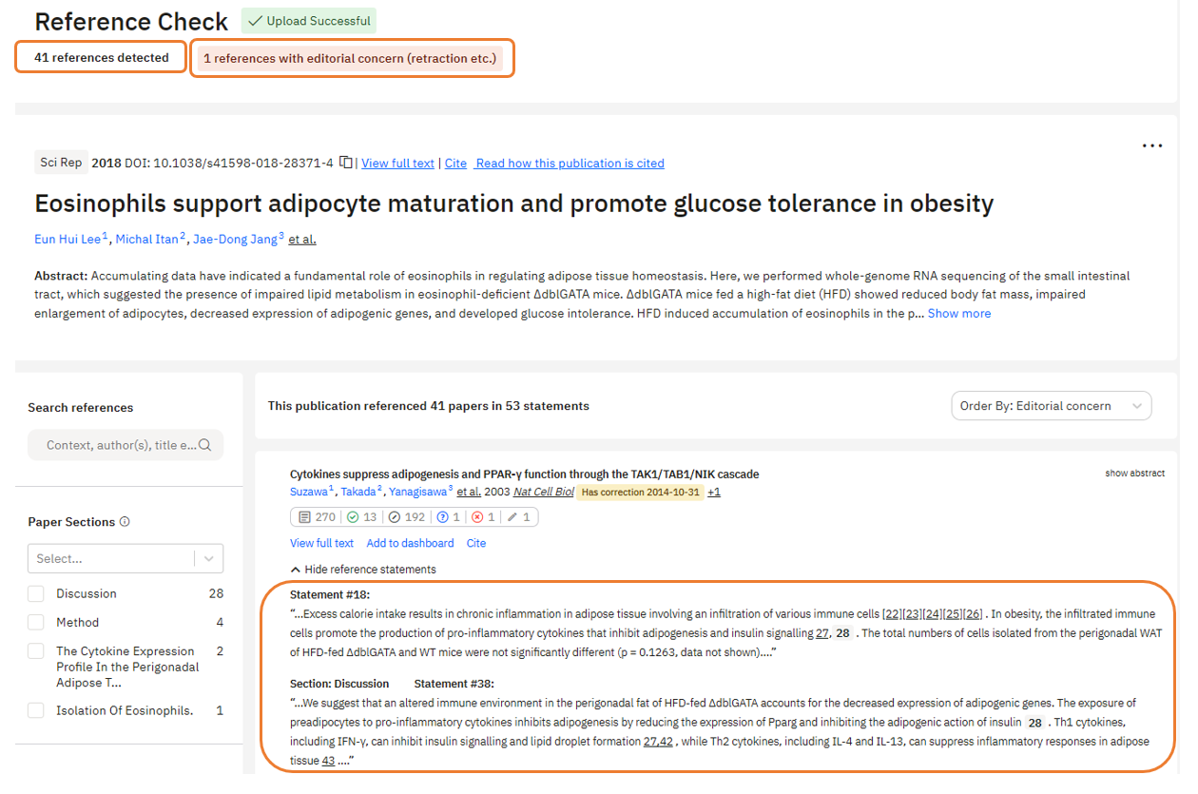
1 reference is found with editorial concern
Number of references
Example of Reference Check
You can find the text extracted from the uploaded paper and also show where it makes a citation to each reference.
Notes:
Here is an example of a paper. After uploading the paper, 41 references are detected and 1 reference is found with editorial concern.
For each citation statement, you can find the text extracted from the uploaded paper and also show where it makes a citation to each reference.

Slide 37
05
Scite Tables

Slide 38
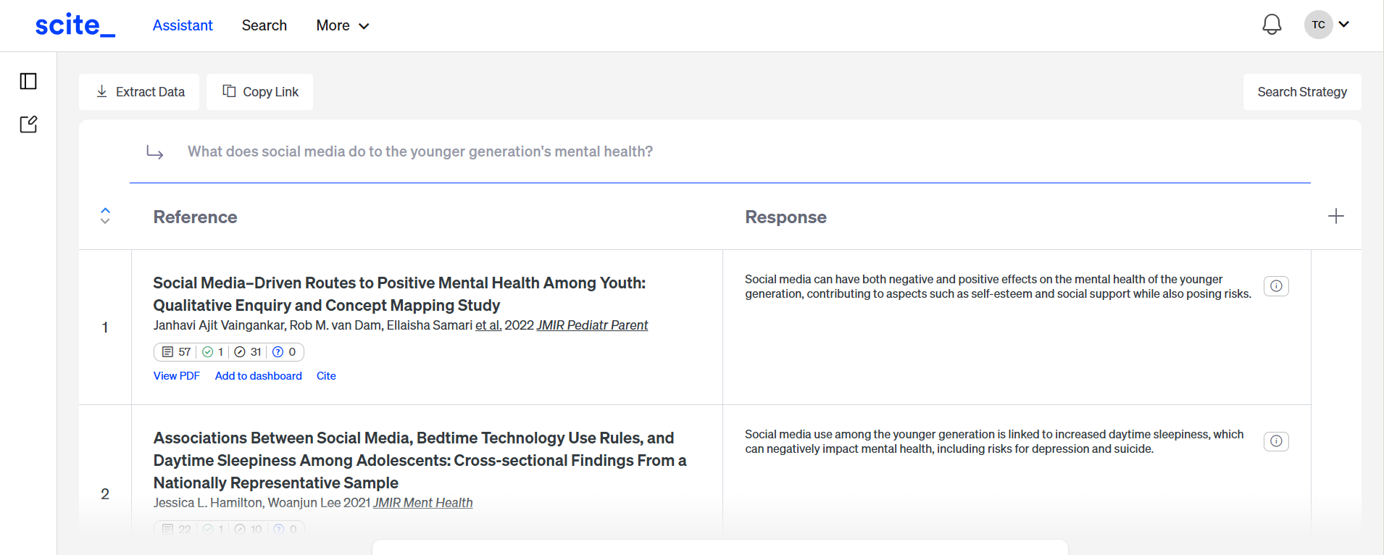
Scite Tables
Click “Search Strategy” to edit your search keywords and strategy
Scite pulls relevant information from various papers, summarizing their findings directly in the 'Response' column.
You can extract data base on your needs
You may add more columns to ask Scite to pull relevant information

Slide 39
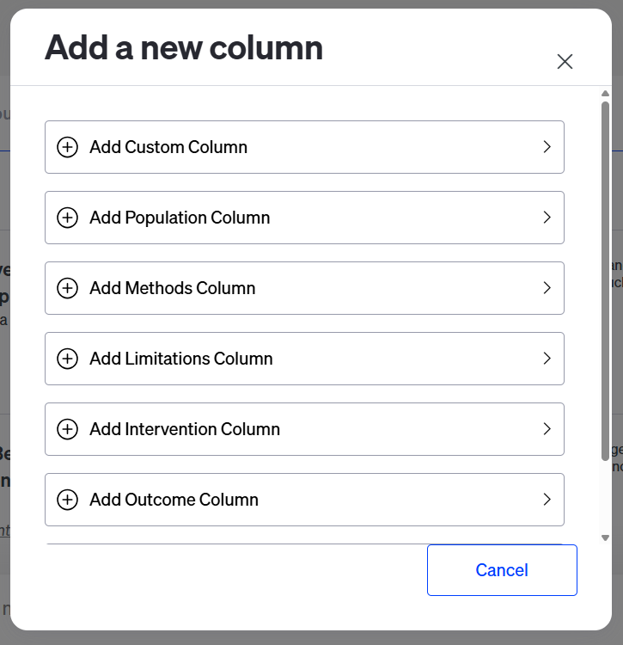
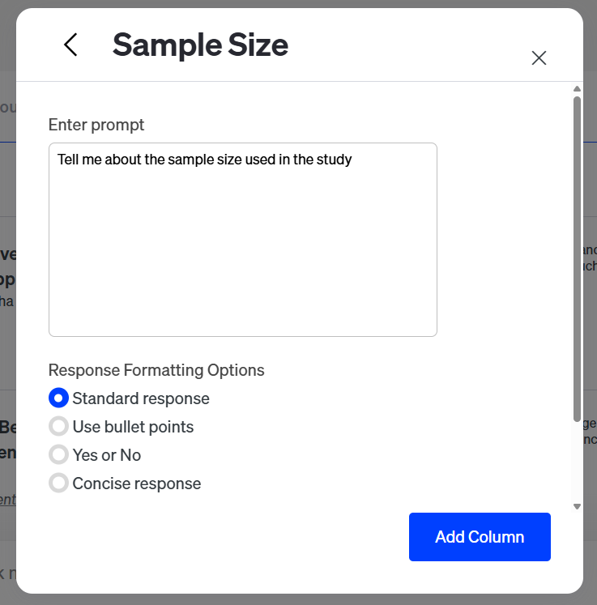
Scite Tables – Add a new column
Add a custom column to ask Scite to pull relevant data according to your instruction prompt
You may add a new column to your result table. However, you have to log in to your own account to use this function

Slide 40
06
Acknowledge Use of AI-Generated Content

Slide 41
No matter which type of AI tools you are using, you need to follow the instructor‘s guidance on where to place this acknowledgement, including a declaration of use that explains what technologies.
Generative AI Statement: You need to mention that you used generative AI.
Specify the Tool: Tell which specific AI tool you used.
Description of Information Generation: Explain how the AI generated information.
Identify Prompts: Mention the prompts or instructions given to the AI.
Explain Output's Role: Describe how the output from the AI was used in your work.

Slide 42
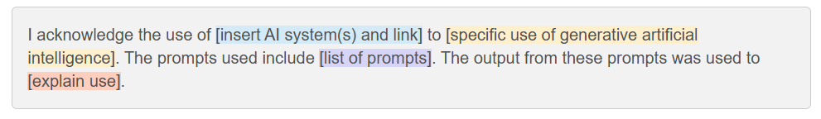
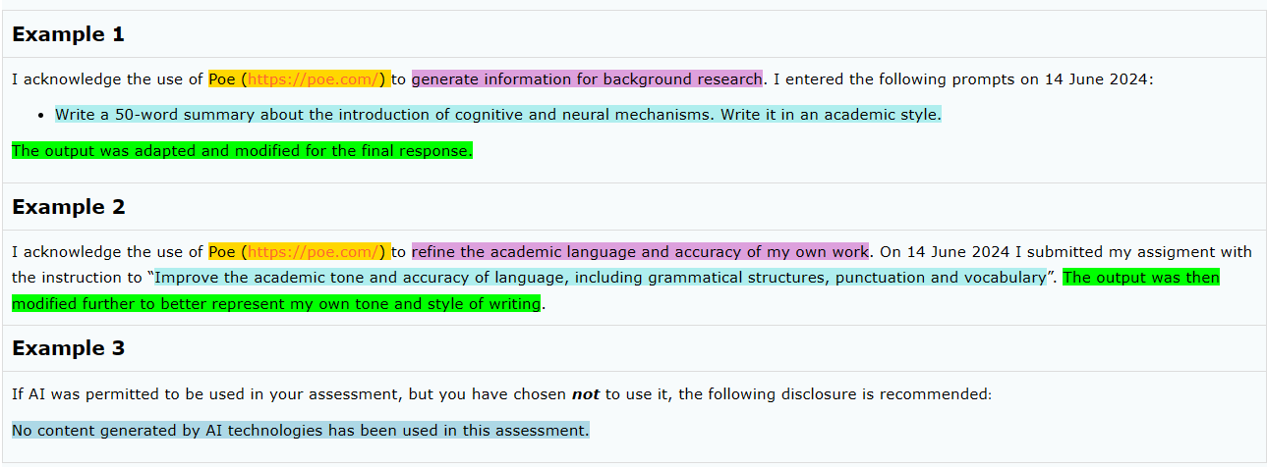
Acknowledge the Use of AI
Source: "Acknowledging the use of generative artificial intelligence" from Monash University

Slide 43
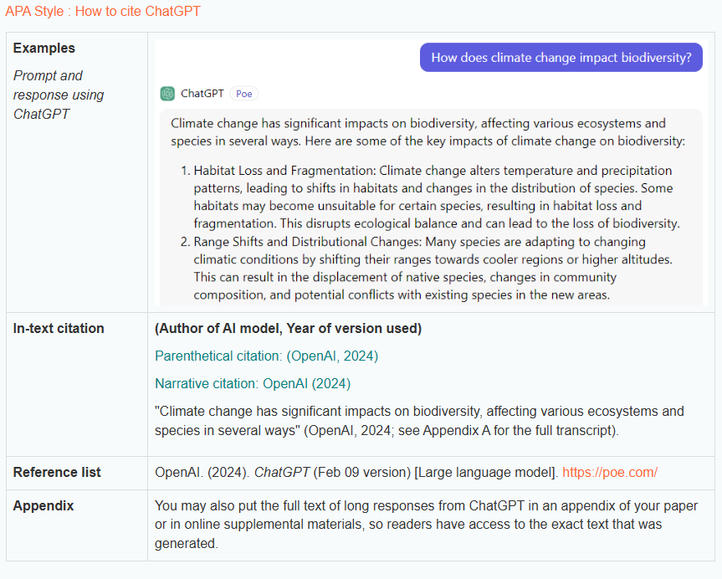
Cite AI-generated content
Cite AI content in APA style
Examples of other citing styles can be found at subject guide at
Cite AI-Generated Content
More tips:
Please be advised that the use of generative artificial intelligence carries risks due to the uploading of personal and private data.
Remember to check if generative artificial intelligence can be used in your assessments.
Notes:
In specific situations, it may be necessary to not only declare but also cite and reference material produced by AI as you would with any other source in your assessment.

Slide 44
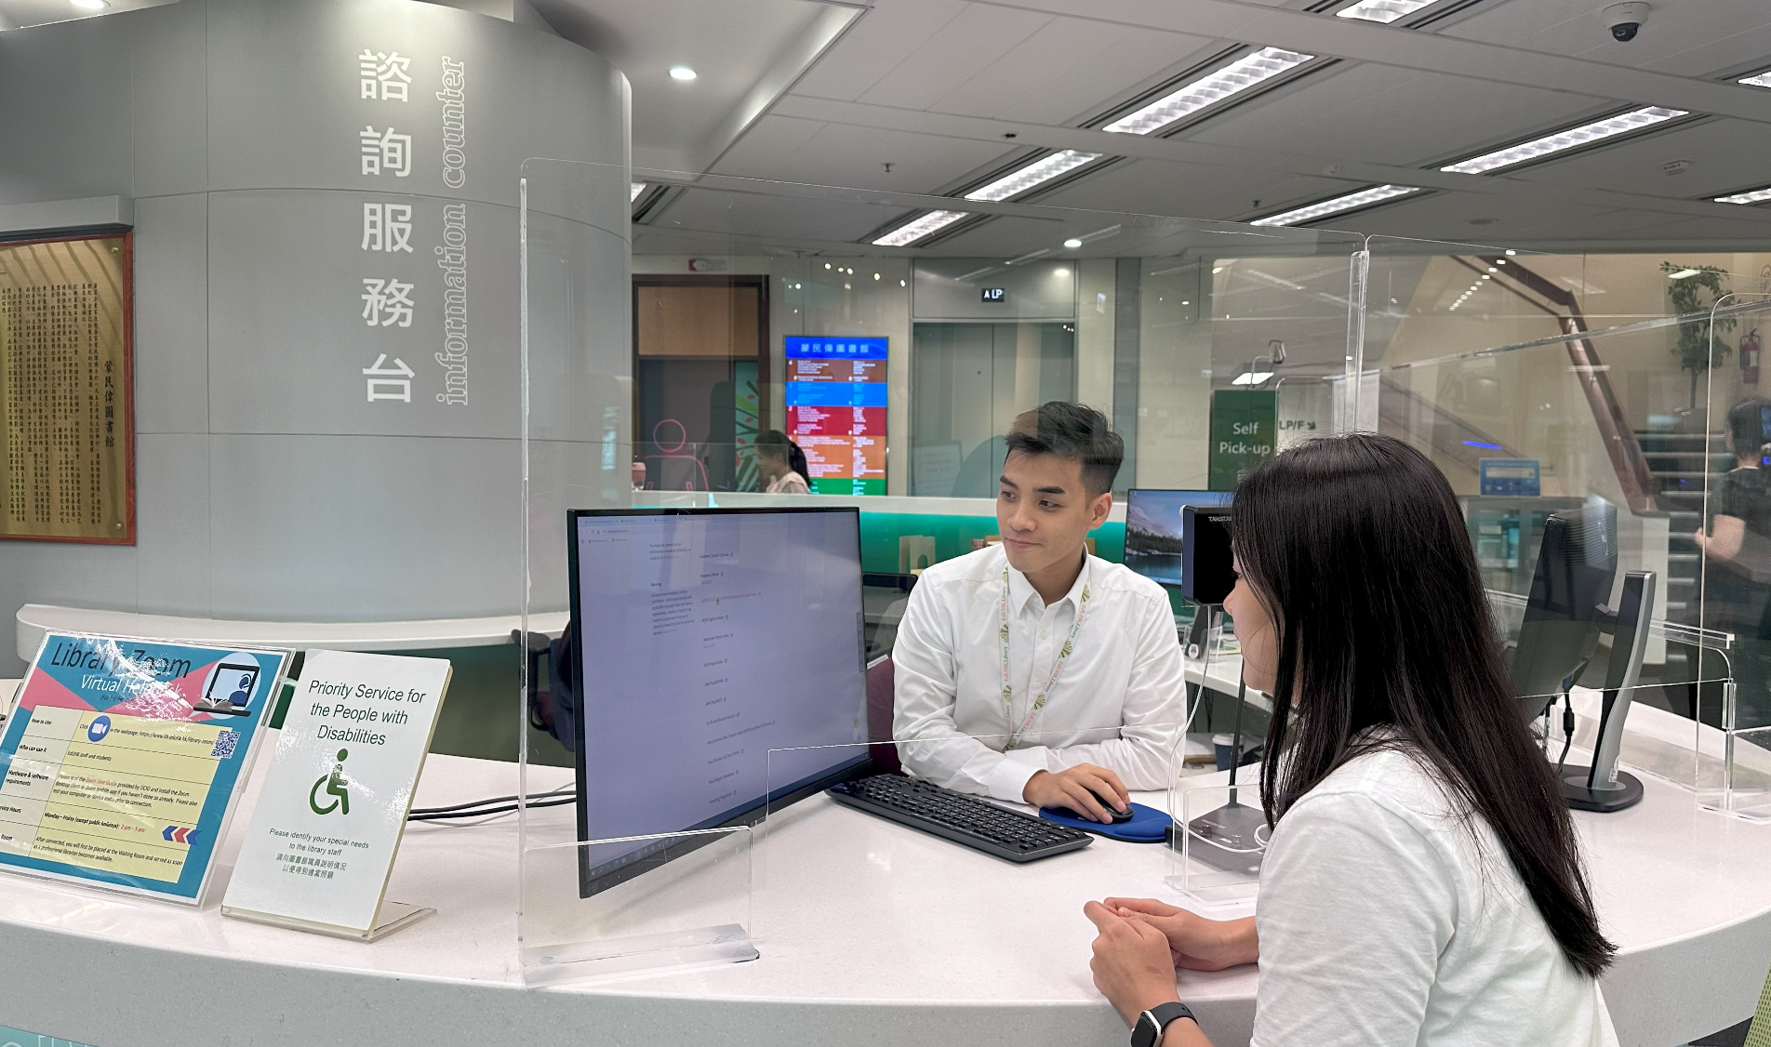






QUESTIONS?
Ask your Librarian @
Service Counter
2948 6653
libinfo@eduhk.hk
9514 9655 (Mon-Fri, 9am-5pm)
https://app.lib.eduhk.hk/zoom

