Slide 1


Boost Your Citations and Reach: The Power of Open Access Publishing
Notes:
1043

Slide 2
Foreword
00
Notes:
https://link.springer.com/chapter/10.1007/978-981-95-2961-2_13

Slide 3
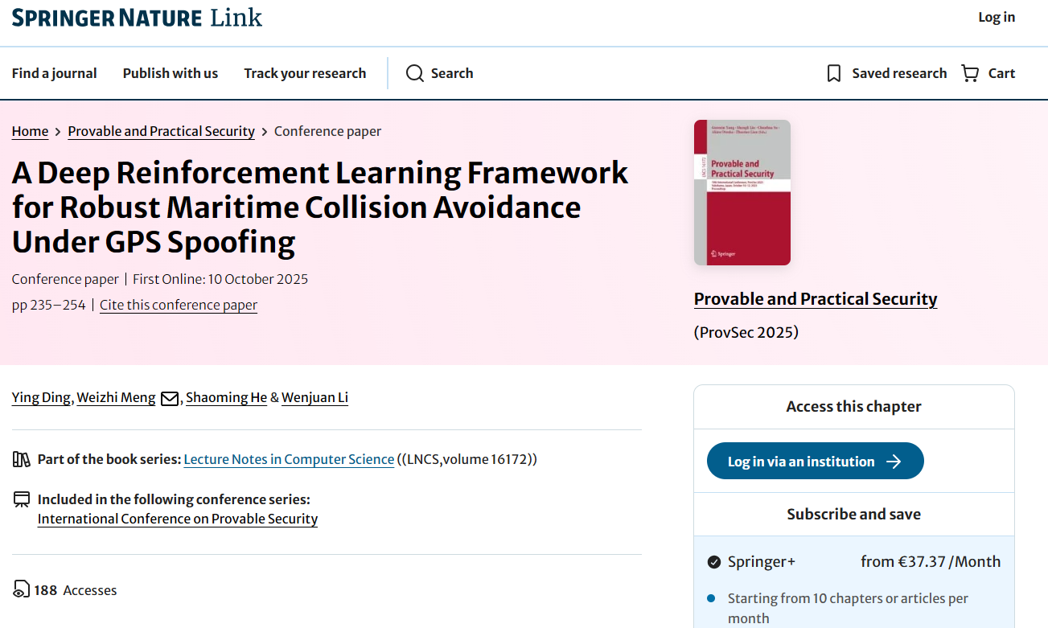
EDUHK Repository: https://repository.eduhk.hk/en/publications/a-deep-reinforcement-learning-framework-for-robust-maritime-colli/
Notes:
https://link.springer.com/chapter/10.1007/978-981-95-2961-2_13
https://repository.eduhk.hk/en/publications/a-deep-reinforcement-learning-framework-for-robust-maritime-colli/

Slide 4
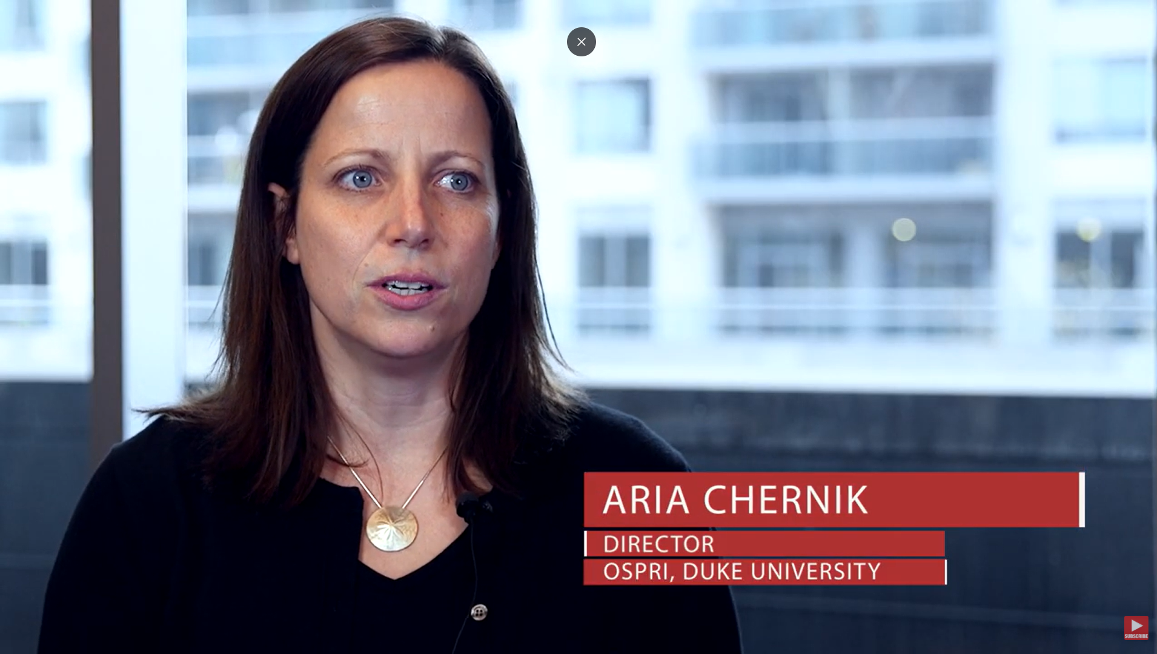
Paywall: The Business of Scholarship (Full Movie) CC BY 4.0
Notes:
https://amara.org/en/videos/nTk5qVME6PP7/zh-tw/2346514/ 1:59 10:40 43:25

Slide 5
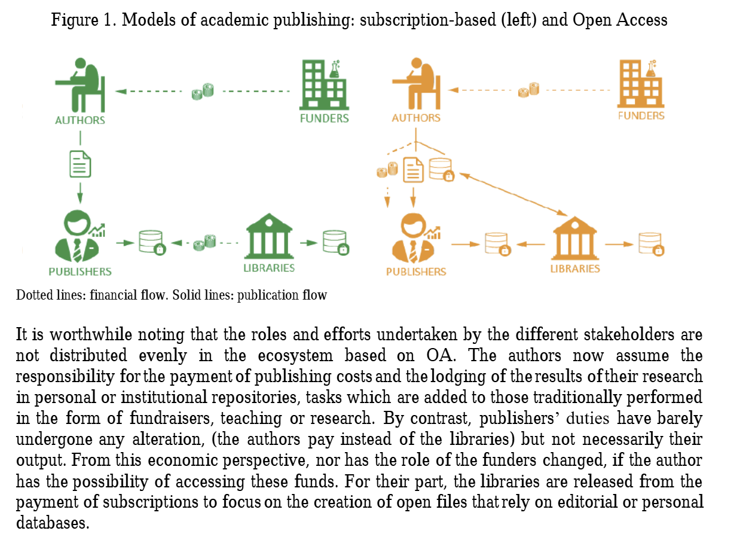
Forewords
Notes:
https://amara.org/en/videos/nTk5qVME6PP7/zh-tw/2346514/

Slide 6
Introduction to Open Access Publishing
01
Open Access can make research publications available online to read for free, so that anyone can use it without fee. Users are also allowed to create and distribute derivative works based on the original work, as long as proper attribution is given to the authors. Open Access is a significant part of making information and resources more freely available to everyone, in order to encourage creativity and innovation.

Slide 7
Bethesda Statement
The Bethesda Statement (2003) defines open access, where "The author(s) and copyright holder(s) grant(s) to all users a free, irrevocable, worldwide, perpetual right of access to, and a license to copy, use, distribute, transmit and display the work publicly and to make and distribute derivative works, in any digital medium for any responsible purpose, subject to proper attribution of authorship as well as the right to make small numbers of printed copies for their personal use".

Slide 8
What is Open Access?
Free and Immediate Access
Reuse Rights with Attribution
Barrier Removal
OA ensures scholarly research is available online without cost or delay, allowing users to read, download, copy, distribute, print, search, or link to full texts.
Users can utilize the material for any lawful purpose, provided proper credit is given, often under Creative Commons licenses that specify terms of reuse.
Eliminates financial (paywalls) and permission (copyright restrictions) obstacles, promoting inclusivity and innovation in research.

Slide 9
Benefits of Open Access
02

Slide 10
50% - 300%
OA articles receive 50% to 300% more citations

Slide 11
Benefits of Open Access
Increased Visibility
Citation Impact
Open Access (OA) journals are freely available.
Facilitates distribution across diverse regions.
Indexed by major academic databases and search engines.
Attracts a broader audience globally.
Enhances interdisciplinary reach (Ganesh et al., 2022).
OA articles receive 50% to 300% more citations (Suber, 2005).
Greater accessibility leads to increased citations.
Cited more rapidly and frequently in the first year (Lai, 2009).
Enhanced visibility upon release (Gargouri et al., 2010).
Amplifies impact beyond niche research communities.

Slide 12
Practical Guide of Open access publishing
03

Slide 13
Step-by-Step OA Workflow
Find OA Publishing Opportunities
Prepare manuscript → Follow journal style; include data appendix
Select journal → Use checklist above
Submit → Confirm self-archiving policy before signing After acceptance → Keep Accepted Manuscript
Deposit → In IR + subject repo (at acceptance or publication)
Promote → ORCID, social media, institutional profile(Asadi et al., 2019; Johnson & Elsborg, 2024)

Slide 14
Journal Selection Quick Checklist
Criteria | Action
Scope & quality | Matches your research; check editorial board (Asadi et al., 2019)
Indexing | In Scopus, Web of Science, or field-specific databases (Kalusopa et al., 2020)
OA model | Gold, Green, or Hybrid? Allowed version for deposit? (Ellison et al., 2019)
Self-archiving | Check embargo & version (use SHERPA/RoMEO) (Kirkman & Haddow, 2021)
APCs & waivers | Cost? Student/low-income waiver? Institutional fund? (Khoo, 2021; Bashir et al., 2021)
License | Prefer CC BY for max reuse (Yelamanchi et al., 2021)

Slide 15
Important Concept
04

Slide 16
Types of Open Access
OA encompasses various models, each with distinct mechanisms for achieving accessibility. The following table summarizes key types:
Type | Description | Funding Model | Examples/Notes
Gold OA | Articles are published in fully OA journals, immediately accessible upon publication. | Often funded by APCs paid by authors or institutions. | Pure gold involves no subscription fees; revenues projected to grow from $2.1 billion in 2024 to $3.2 billion by 2028.
Green OA | Authors self-archive versions (preprints or postprints) in repositories, parallel to traditional publishing. | No direct costs; relies on institutional or personal repositories. | Effective for citation boosts without fees; preprints enhance early dissemination.
Hybrid OA | Subscription-based journals offer OA options for individual articles. | APCs for OA articles; journal remains paywalled otherwise. | Common in transitional models but criticized for "double-dipping" (charging twice).
Diamond/Platinum OA | Fully OA with no fees for authors or readers; often community-supported. | Institutional, grant, or society funding. | Promotes equity; stable but marginal in overall output (around 47% OA articles in 2024).
Bronze OA | Articles made free on publisher sites without explicit OA licenses. | No formal model; temporary or ad-hoc. | Lacks reuse rights, limiting long-term benefits.

Slide 17
Transformative Agreement?
A new model for scholarly publishing
Aims to shift from subscription to open access
Involves negotiations between libraries and publishers
Focuses on making research freely accessible
Transformative Agreements@EdUHK
https://libguides.eduhk.hk/TransformativeAgreement

Slide 18
Creative Commons
What is Creative Commons?
Non-profit organization founded in 2001
Provides free, standardized copyright licenses
Enables sharing and use of creative works
Alternative to traditional 'all rights reserved' copyright
Global movement supporting open access to knowledge
https://creativecommons.org/get-cc-savvy/get-a-cc-license/ https://creativecommons.org/share-your-work/cclicenses/
Notes:
How freely the article can be reused

Slide 19
Important Tools and Platform
05

Slide 20
Important Tools and Platform
Journal Citation Rport
Directory of Open Access Journals (DOAJ)
Journal Citation Reports (JCR) is an authoritative and transparent resource published annually by Clarivate that provides data and metrics to evaluate academic journals.
DOAJ is an online directory that indexes open access peer-review journals.
Open Library of Humanities (OLH)
Open Books Hong Kong,
OLH is an open access publisher for humanities and social science. There is no article processing charges (APCs)
an innovative open access endeavor aimed at promoting worldwide knowledge exchange and bibliodiversity.

Slide 21

Evaluation form

Slide 22


OTHER INFORMATION
Follow Us
Instagram
小紅書 ( Rednote)

Slide 23
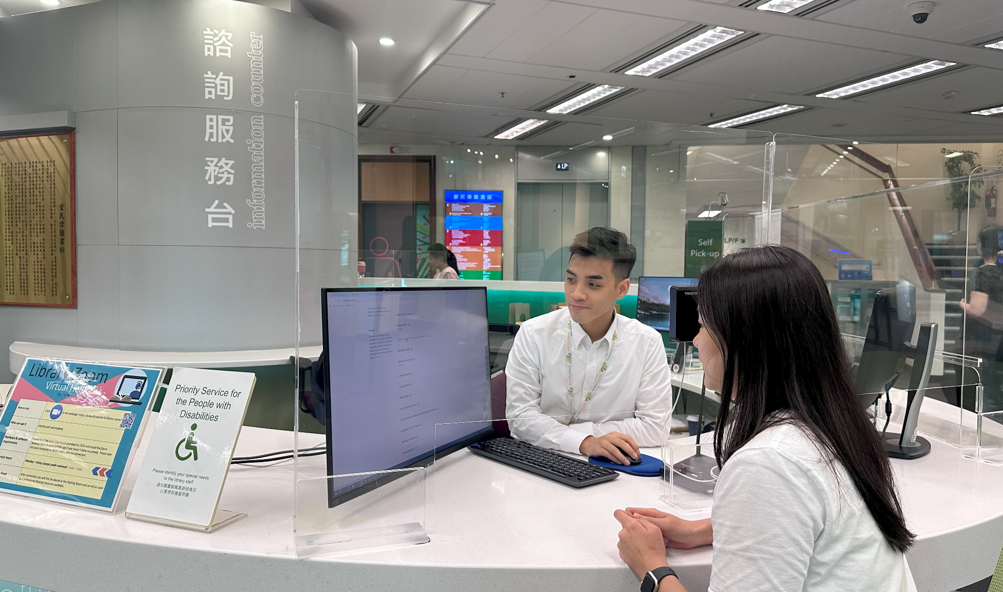






QUESTIONS?
Ask your Librarian @
Information Counter
2948 6653
libinfo@eduhk.hk
9514 9655 (Mon-Fri, 9am-5pm)
https://app.lib.eduhk.hk/zoom

