Slide 1
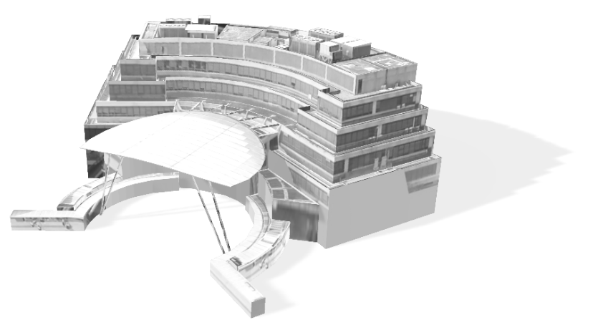


LIBRARY
ORIENTATION
2026/2027

Slide 2
CONTENTS
Our
Libraries
Other Information
Our
Libraries
Facilities and Booking System
Facilities and Booking System
Borrowing Privileges
Borrowing Privileges
iSearch
Inter-campus Delivery
Inter-campus Delivery
Joint University Librarians Advisory Committee (JULAC) Cards
Joint University Librarians Advisory Committee (JULAC) Cards
Electronic Resources
Electronic Resources

Slide 3
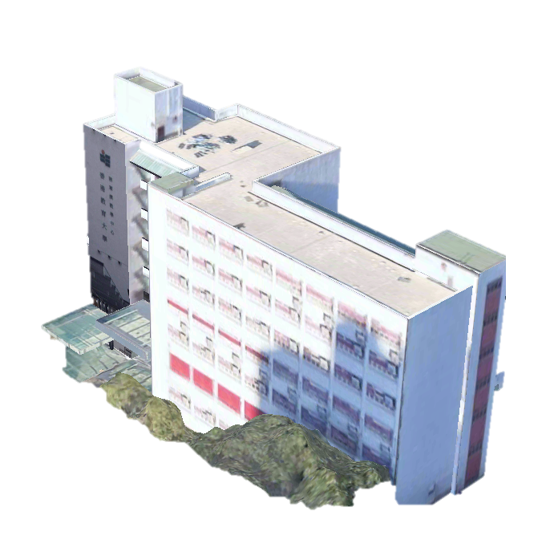

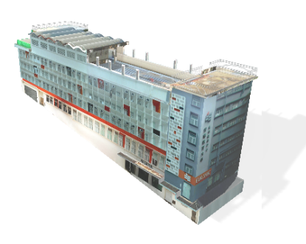
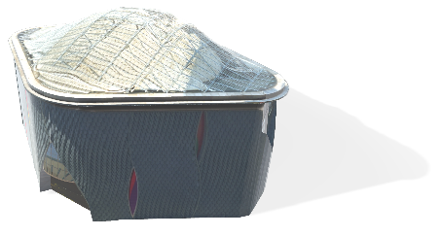
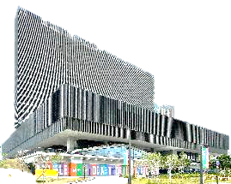
OUR LIBRARIES
Tseung Kwan O Study Centre Library (TKOSC)
將軍澳教學中心圖書館
1 King Yin Lane, Tseung Kwan O, N.T.
North Point Study Centre (NPSC)
北角教學中心
19 Cheung Hong Street, North Point, Hong Kong Island
Self Pick-up Station and Book Return only
West Kowloon Study Centre (Austin Road)
西九龍教學中心（柯士甸道）
Ground Floor, Xiqu Centre, West Kowloon Cultural District
Book Pick-up and Return only
Mong Man Wai Library (MMW)
West Kowloon Study Centre (Museum Drive)
蒙民偉圖書館
西九龍教學中心 (博物館道)
10 Lo Ping Road, Tai Po, N.T.
16/F, M+ Building, No.38 Museum Drive, West Kowloon Cultural District, Kowloon
Book Pick-up and Return only

Slide 4
OUR LIBRARIES
Mong Man Wai Library (MMW)
蒙民偉圖書館
6
>900K
>360
Floors
Physical collections
E-databases
>1800
>500
Seats
Public PCs and notebooks

Slide 5
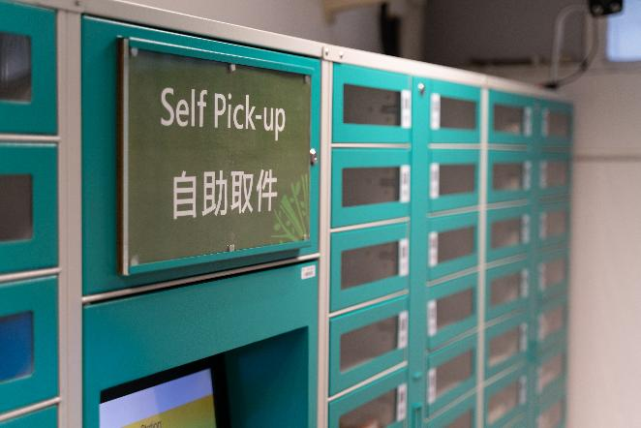
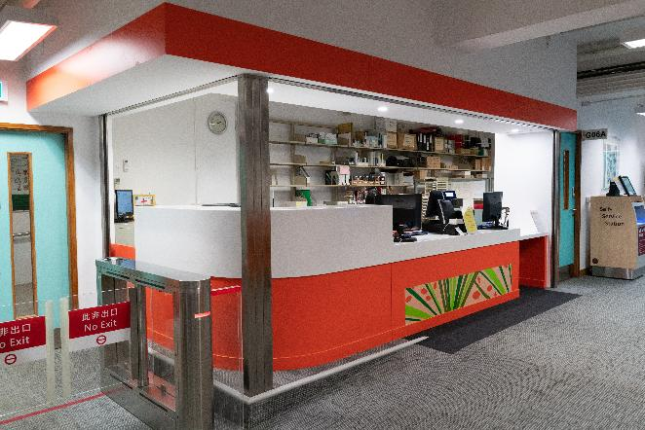
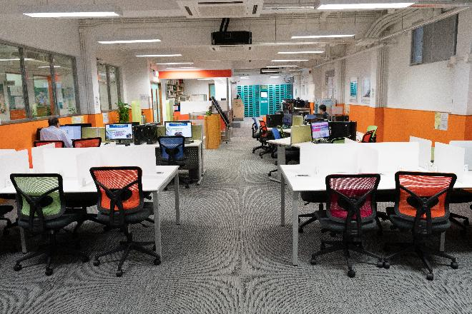
OUR LIBRARIES
OVERVIEWS
Tseung Kwan O Study Centre Library
The Tseung Kwan O Study Centre Library (TKOSC Library) is located on the ground floor of the EdUHK Tseung Kwan O Study Centre.
It serves primarily as a resource centre for students enrolled in programmes at the Tseung Kwan O Study Centre.
In addition, students and staff of TKOSC also enjoy access to the resources, facilities, and services of the MMW Library on Tai Po Campus.
將軍澳教學中心圖書館
No. 1, King Yin Lane, Tseung Kwan O, New Territories
Tel : 2190 8521
新界將軍澳敬賢里1號

Slide 6
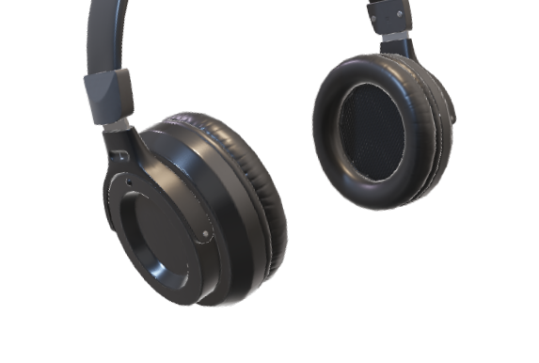

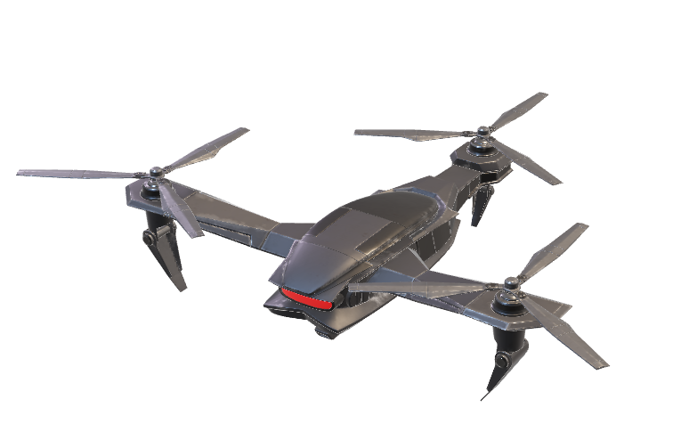
FACILITIES
The EdUHK Library provides various facilities including 24-hour study areas, group discussion rooms, media/VR studios, and STEM/Makerspace rooms. Users can access self-service options for borrowing, printing, and item returns, with accessible features such as barrier-free access and wheelchair-friendly equipment.

Slide 7
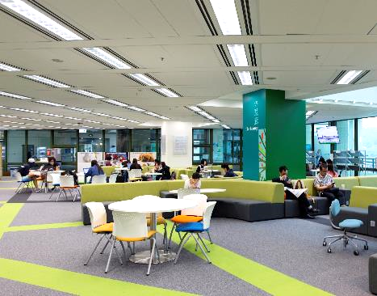
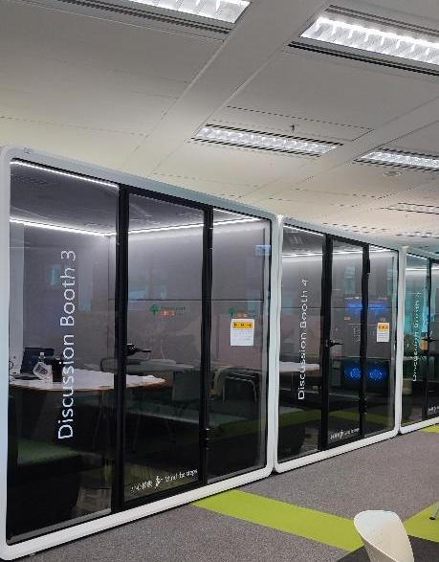
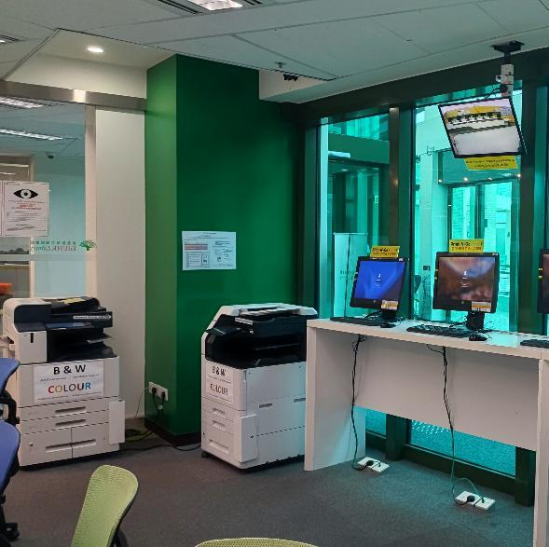
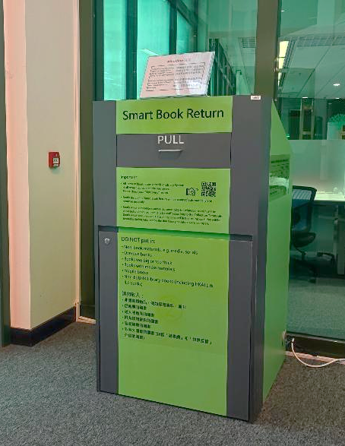
FACILITIES
G/F Ground Floor
Open 24 hours
The Lounge
Discussion Booths
Print-N-Go Stations
Smart Book Return
Perfect place for chatting and relaxation
5 on G/F
OCIO Print Quota System
Set up at MMW Library foyer

Slide 8

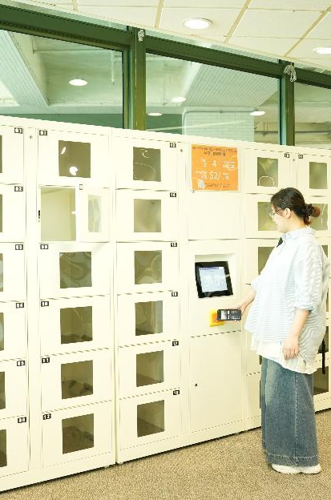
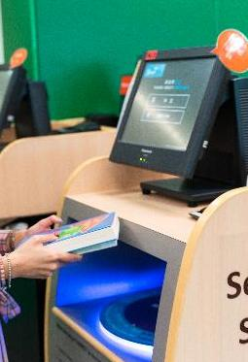
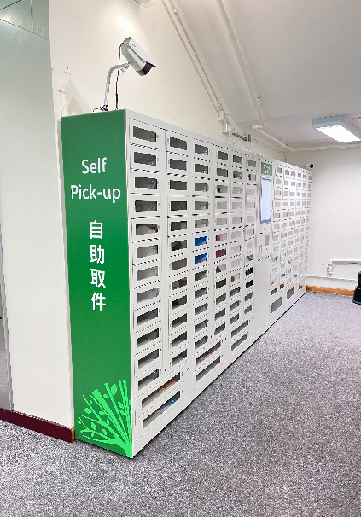
FACILITIES
G/F Ground Floor
Open 24 hours
Reserve Collection
Short-Term
Self-Service Lockers
Self-Service Stations
Self Pick-up Station
Reading materials for specific programmes and modules
RFID self-service

Slide 9
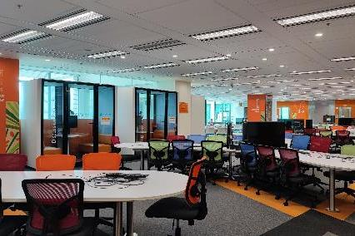
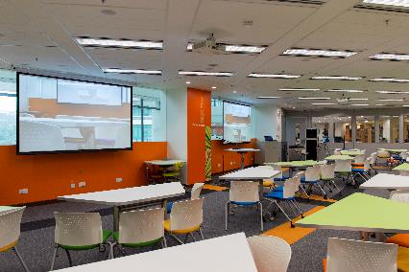
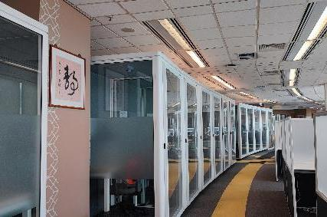
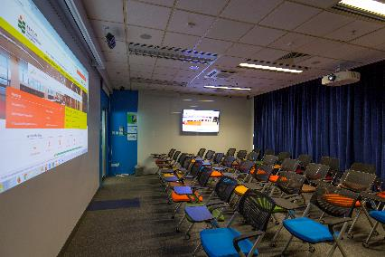
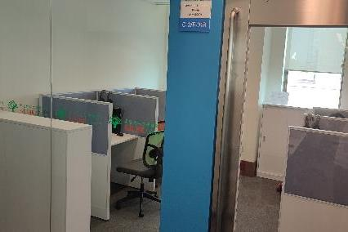
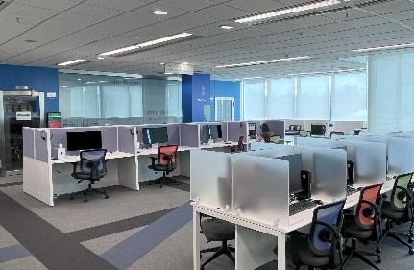
FACILITIES
1/F - 4/F
Discussion Zone (1/F)
Flexi Zone (1/F)
Research Commons (4/F)
5 Group Discussion Rooms
23 Group Discussion Tables
4 Discussion Booths
4 Study Booths
Two sets of 4K projectors and PCs
Two sets of Handheld Wireless Microphones
54 individual Study Booths
32 Study Carrels
Mini Theatre (3/F)
Language Learning Room (3/F)
Media Production Lab (3/F)
40 seats for classes
4 workstations
24 Media Production Stations

Slide 10
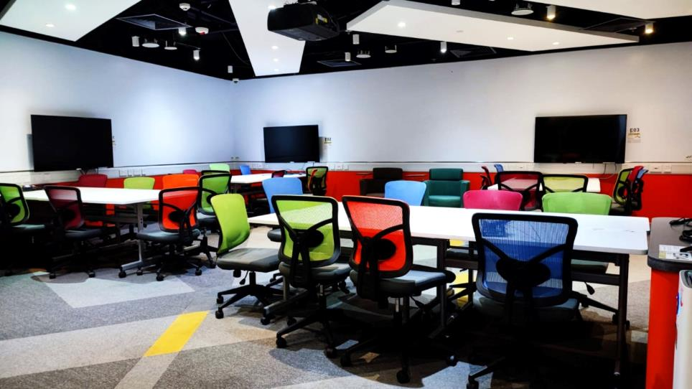
FACILITIES
EI Hub
LP/F – Open 24 Hours
Located on LP/F of MMW Library, EI Hub provides a co-working space for students who are carrying out projects or starting their own businesses. EI Hub opens 24 hours and is available for advance online booking by EdUHK students.

Slide 11
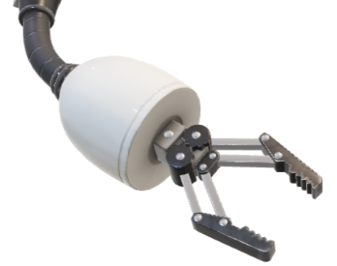


HIGHLIGHTS
FUTURE CLASSROOMS
Jointly developed by EdUHK units and experts, eight Future Classrooms were built in Mong Man Wai Library between 2018 and 2021. Designed for evolving pedagogy and IT trends, they offer students and staff innovative teaching and learning experiences with cutting-edge technologies.

Slide 12
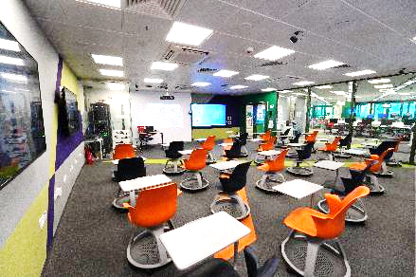
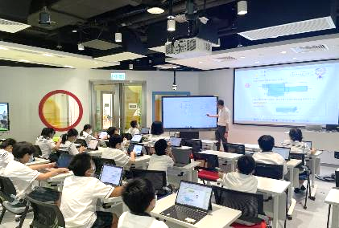
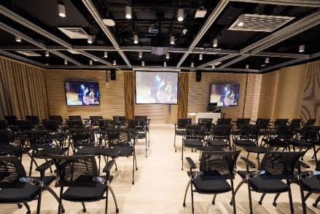
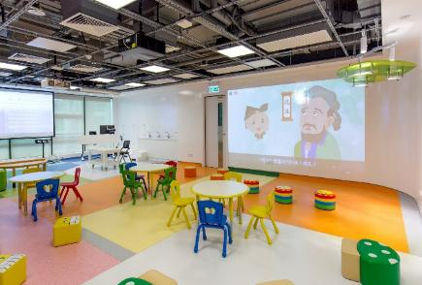
FACILITIES
Future Classrooms
Creative Lab (G/F)
Future Primary & Secondary Classroom (1/F)
Creative Arts Room (1/F)
Future Early Childhood & Primary Classroom (1/F)
VR-AR Media Equipment and Software
Video-conferencing and Recording Equipment, etc.
Designed for students at senior primary to junior secondary levels
Moveable and flappable 4K interactive touch-screen displays, etc.
Specially designed for creative arts
Professional audio-visual facilities for performance and recording
Moveable partition boards for zoning and artworks display, etc.
Designed for school children at kindergarten to junior primary levels with custom-made furniture for young children
Different lighting effects, 4K projectors, opaque projectors, projection screen and projection wall, etc.

Slide 13
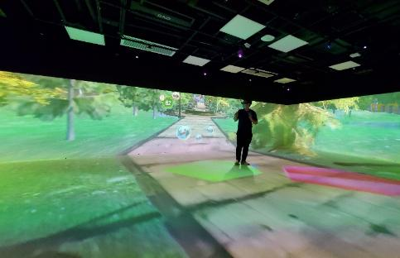
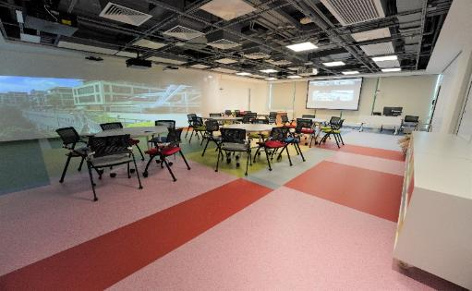
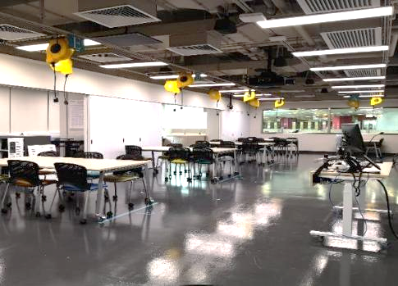
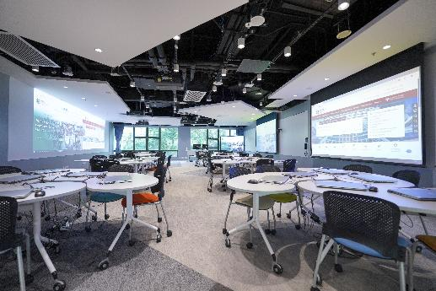
FACILITIES
Future Classrooms
Extended Reality Room (2/F)
Special Education Room (1/F)
One of the largest VR CAVEs in Hong Kong supporting 360-degree interactive 4-side and floor projection as well as surround sound system
Includes a VR Experience Area with VR treadmill and extra wide gaming station
Specially designed for students with special education needs
Induction loop system for hearing aids
32:9 extra-wide video projection wall for visual stimulations, etc.
e-Learning Studio (2/F)
STEM Room (2/F)
Designed for classes by Library and other academic units
48 notebook computers
PTZ cameras and ceiling mic arrays for 2-way video communications and online/hybrid teaching, etc.
Designed for STEM and Makerspace classes
One 4K projector & Two 4K 86” interactive LCD panels, etc.

Slide 14
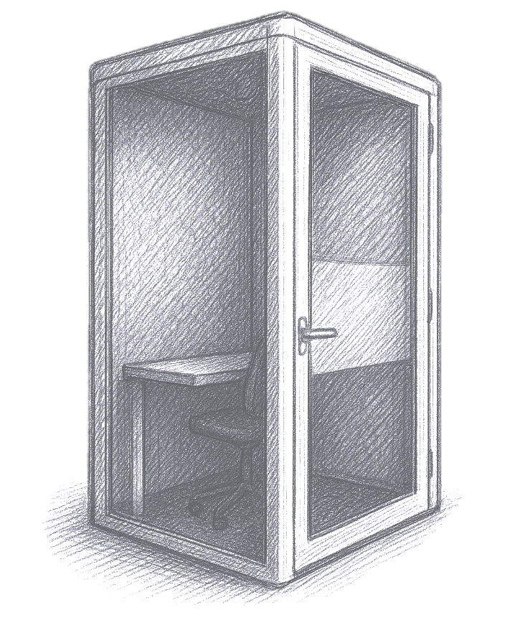
HOW
CAN
YOU BOOK?
This is the study booth on the 4th floor

Slide 15

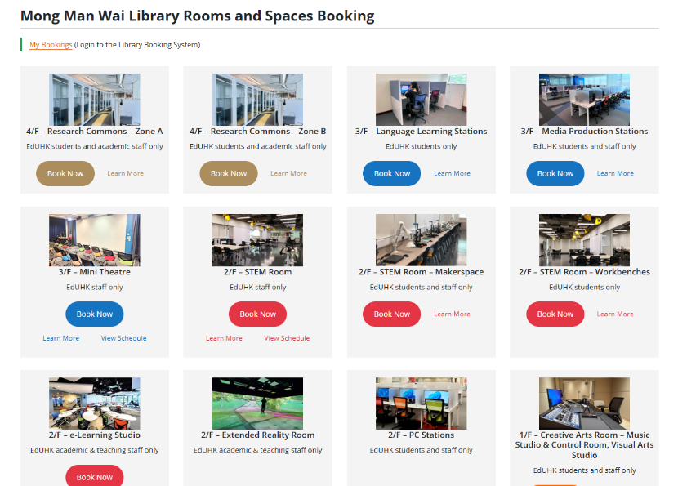
Booking System

Slide 16
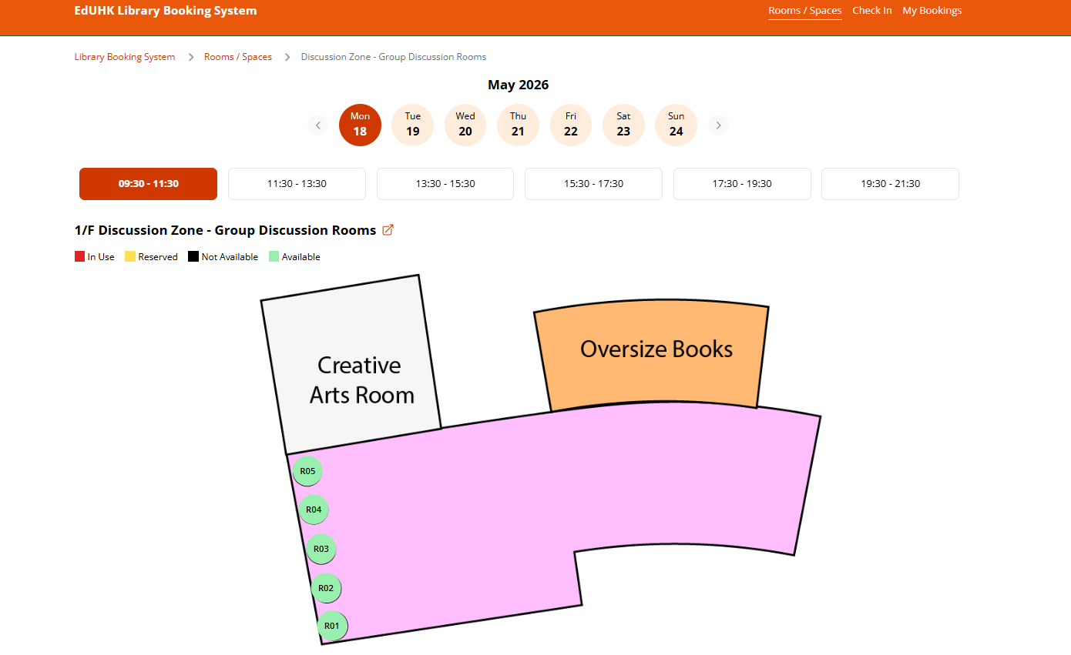
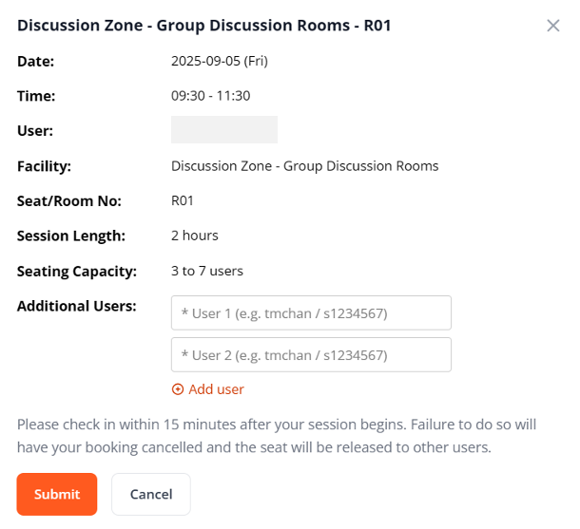
Login the Booking System and select the desired facilities and time slots

Slide 17
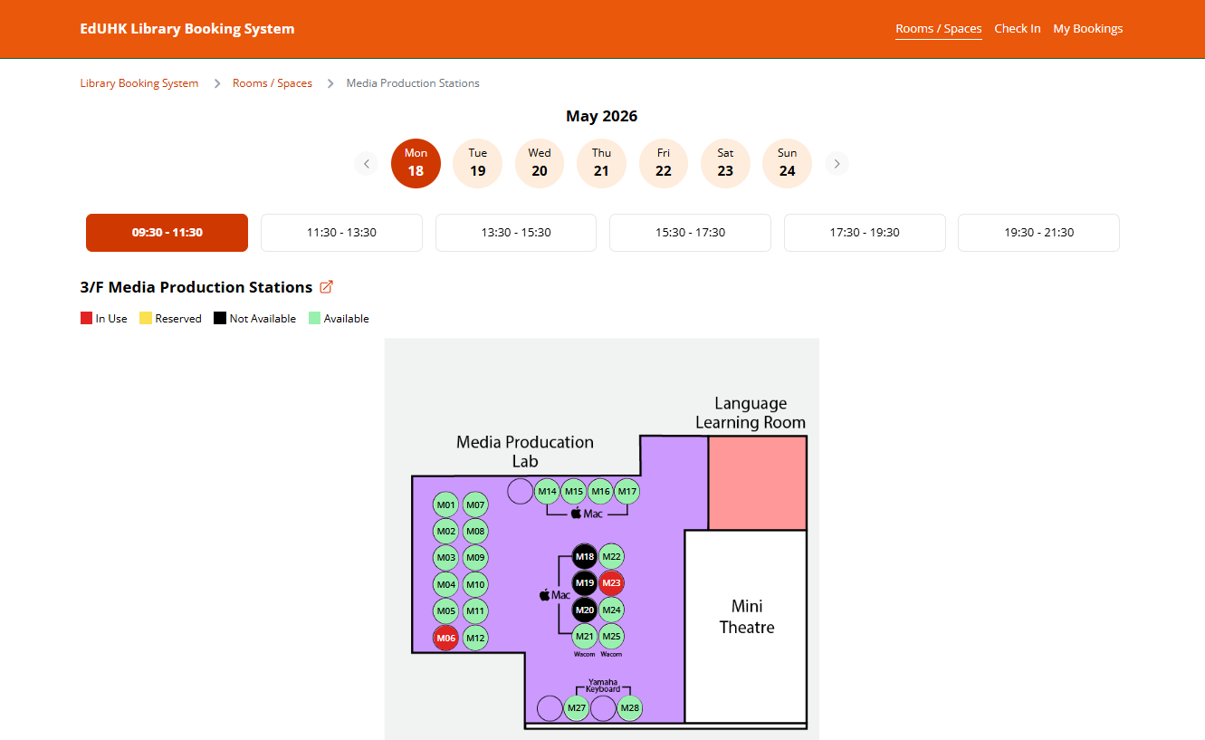
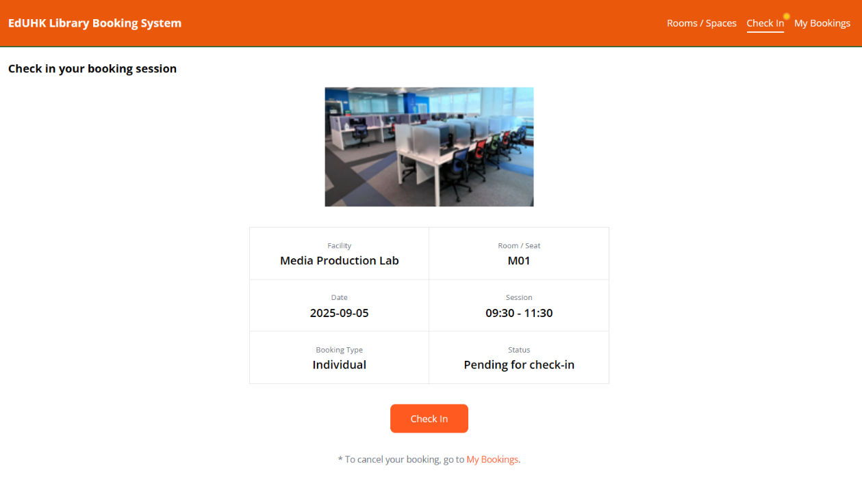
Check in within 15 minutes after the start of each booking session

Slide 18

BORROWING PRIVILEGES

Slide 19
Borrowing Privileges
Please select your status:
Postgraduate Degrees (Master’s & Doctoral Degrees)
Bachelor Degrees
Diploma
Postgraduate Diploma
Professional Development Programmes

Slide 20
BORROWING PRIVILEGES
Postgraduate Degrees
Loan Quota:
80
Circulation Books:
Media & e-book reader:
Teaching Resources, School Textbooks & EIH Collection:
Reserve Collection :
90
14
14
7
items
days
days
days
days
or Library Use Only
(for any combinations)
Hold Quota: 20 items
The initial loan periods of 14-day, 30-day and 90-day loan items will be reduced to 7 days, 15 days and 30 days respectively if the items have been held by other users when the items are being checked out.
Notes:
如要更改頁面內容，請先點擊頁面，將已選取的透明方塊移走以進行修改，修改完成後再把方塊移回原位。

Slide 21
BORROWING PRIVILEGES
Bachelor Degrees, Elder Academy, Higher Diploma, Postgraduate Diploma, Professional Development Programmes
Loan Quota:
50
Circulation Books:
Media & e-book reader:
Teaching Resources, School Textbooks & EIH Collection:
Reserve Collection :
30
14
14
7
items
days
days
days
days
(for any combinations)
Hold Quota: 20 items
or Library Use Only
The initial loan periods of 14-day, 30-day and 90-day loan items will be reduced to 7 days, 15 days and 30 days respectively if the items have been held by other users when the items are being checked out.
21
Notes:
如要更改頁面內容，請先點擊頁面，將已選取的透明方塊移走以進行修改，修改完成後再把方塊移回原位。

Slide 22
BORROWING PRIVILEGES
Hong Kong Academic Library Link (HKALL)
香港高校圖書聯網
Postgraduate Degrees
Borrow 15 books from other UGC libraries via HKALL for 30 days
HKALL loans are included in EdUHK Library loan quota
Request books with “available” status only
Pick up books at MMW Library, Tseung Kwan O Study Centre Library or North Point Study Centre
Notify by email when the item is ready
Collect books within 5 days of notification
Renew loans up to 90 days, unless a hold or recall is placed by the lending library
Notes:
如要更改頁面內容，請先點擊頁面，將已選取的透明方塊移走以進行修改，修改完成後再把方塊移回原位。
New add: All loans may be renewed up to 90 days unless a hold or recall has been placed by a local user of the lending library

Slide 23
BORROWING PRIVILEGES
Hong Kong Academic Library Link (HKALL)
香港高校圖書聯網
Bachelor Degrees,
Higher Diploma,
Postgraduate Diploma,
Professional Development Programmes
Borrow 15 books from other UGC libraries via HKALL for 15 days
HKALL loans are included in EdUHK Library loan quota
Request books with “available” status only
Pick up books at MMW Library, Tseung Kwan O Study Centre Library or North Point Study Centre
Notify by email when the item is ready
Collect books within 5 days of notification
Renew loans up to 45 days, unless a hold or recall is placed by the lending library
Notes:
如要更改頁面內容，請先點擊頁面，將已選取的透明方塊移走以進行修改，修改完成後再把方塊移回原位。
New add: All loans may be renewed up to 45 days unless a hold or recall has been placed by a local user of the lending library

Slide 24

BORROWING PRIVILEGES
Inter-library Loan and Document Delivery Service
You can request books, book chapters, or journal articles that are not available in EdUHK Library from other libraries worldwide.
You will be notified by email to download the requested electronic items from MyLibrary. There is a maximum download limit of 5 times. PDFs that have expired cannot be retrieved.
If request options are not available, eligible users* may submit a request via a “Request Form” for the requested items.
* Please refer to: https://www.lib.eduhk.hk/access-borrowing/interlibrary-loan

Slide 25
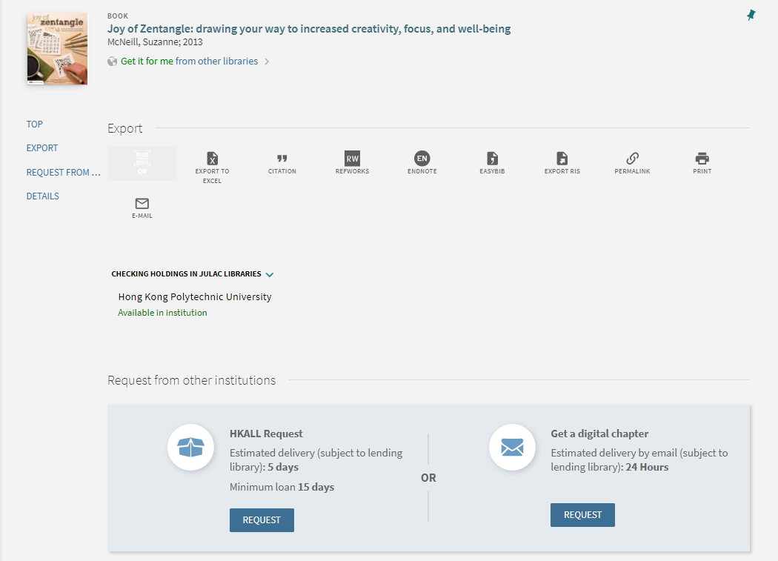
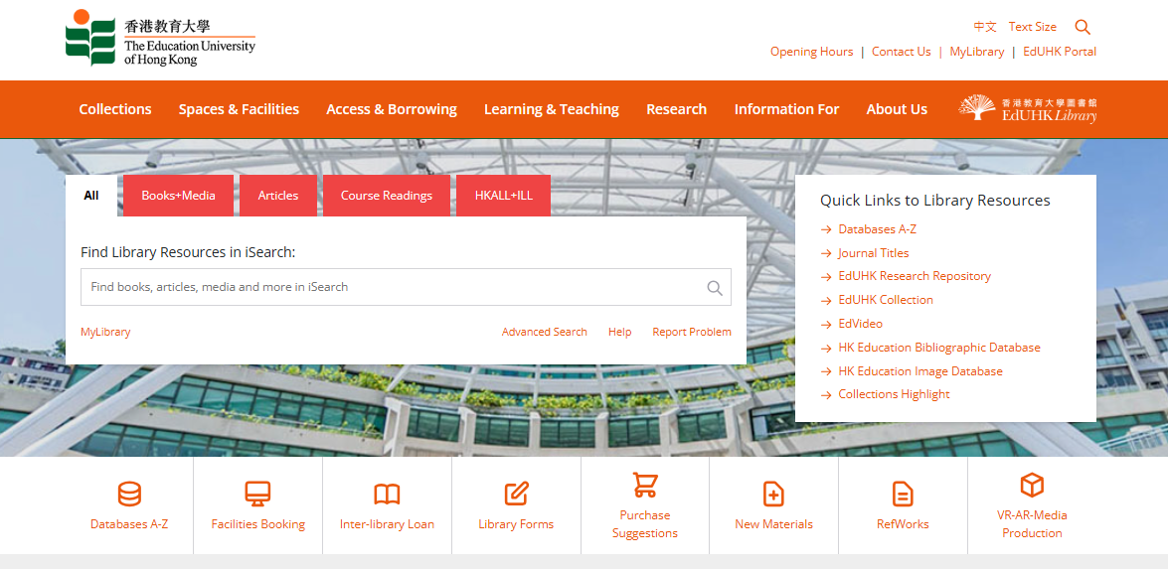
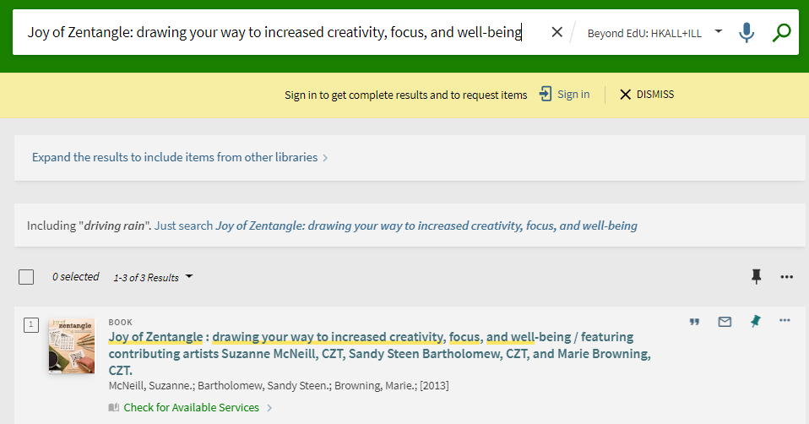
How to Request HKALL, ILL & DDS
Step 1: Sign in
Use DDS service to get a digital copy of one chapter
Use HKALL service to get a physical copy from other 7 UGC university libraries
Step 2: Check for Available Services

Slide 26
Borrowing Privileges
Overdue Fines
逾期罰款
Overdue fines are calculated according to the loan period of items
14-day, 7-day,
3-day and 1-day loans
HKALL items
30-day and 90-day loans
3-hour loans
$1
$2
$2
$2
/day
/hour
/day
/day
When an overdue fine reaches the Maximum Fine*, all borrowing privileges of the borrower will be suspended until payment is made.
*Please refer to: https://www.lib.eduhk.hk/about/policies-regulations/regulations#4.7
Notes:
New add: HKALL items

Slide 27
Borrowing Privileges
Renewal (EdUHK Library Items)
續借
Initial Loan Period | Maximum Loan Period after Renewals
14 days | 56 days
30 days | Unlimited *
90 days | Unlimited
All loans with a loan period of 14 days or more may be renewed up to the maximum loan period specified below unless a hold or a recall has been placed.
* EdUHK Students (excluding students of self-funded non-credit bearing programmes)
Borrowers can renew their loans in person or online via the Library System anytime before the due date.
The new due date is calculated from the date of renewal.
Overdue items are not renewable.
Automatic renewal of EdUHK Library items (HKALL items excluded) three days before the due date.

Slide 28
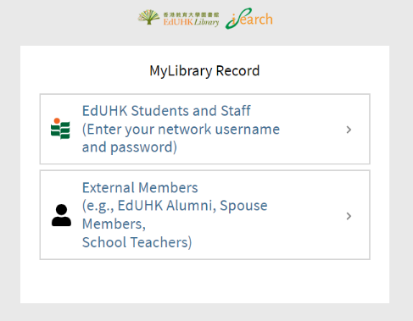
BORROWING PRIVILEGES
Sign in to MyLibrary Record to view your loan record, renew your loan items, check your loan history, view request status, save searches and search results, etc.
MyLibrary Record

Slide 29
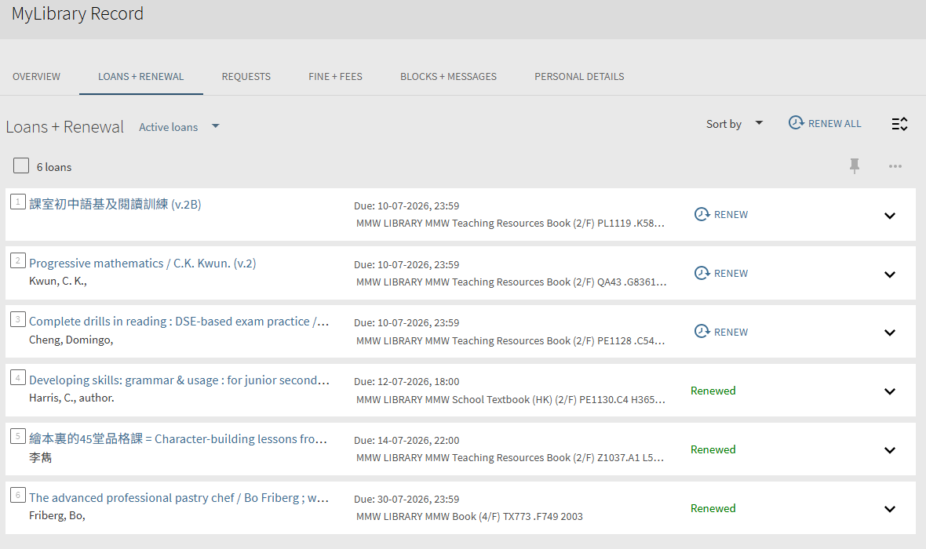
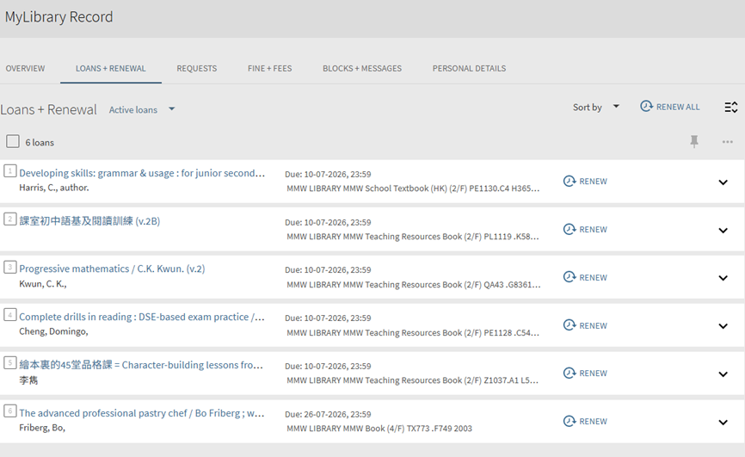
BORROWING PRIVILEGES
Loan Record and Renewal
Click to renew

Slide 30
BORROWING PRIVILEGES
Hold
Recall
預約
催還
All loaned items with a loan period of 14 days or more are subject to hold requests (original loan period will not be shortened) placed on them by another user.
Your “hold” quotas: 20 items
Email notice will be sent to you when the hold item is ready for pickup.
All loaned items with a loan period of 30 days or more are also subject to recall (original loan period will be shortened) if requested by another user.
Email will be sent to you notifying the revised due date.
HKALL items may be recalled by users of the lending library.
Late return of recalled or held items will be treated as overdue and liable to a fine.

Slide 31
BORROWING PRIVILEGES
Library Notice
All library notices will be sent to you by email
(EdUHK email account, e.g. s0765432@s.eduhk.hk)
    Due date alert notice (3 days before the due date and on the due date)
    Overdue notice
    Item recalled notice (due date shortened)
    Pickup notice
    Weekly report of loan activities

Slide 32
iSearch
/ˈaɪsɜːrtʃ/
One-stop search for multiple information sources, e.g., books, videos, journals & articles, or more
Gives you a Google-like searching experience

Slide 33
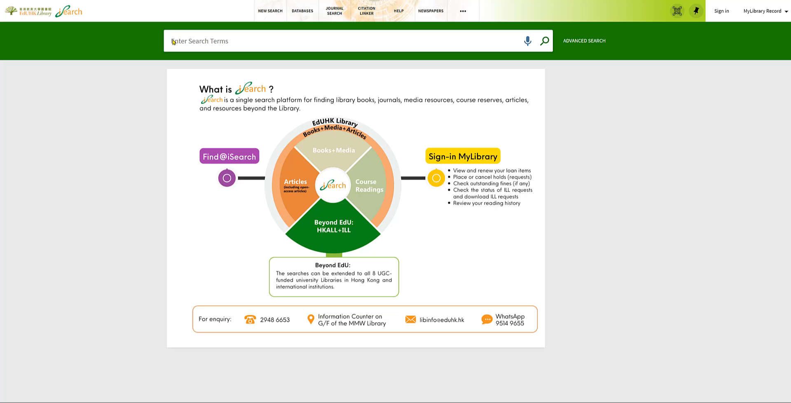

Slide 34
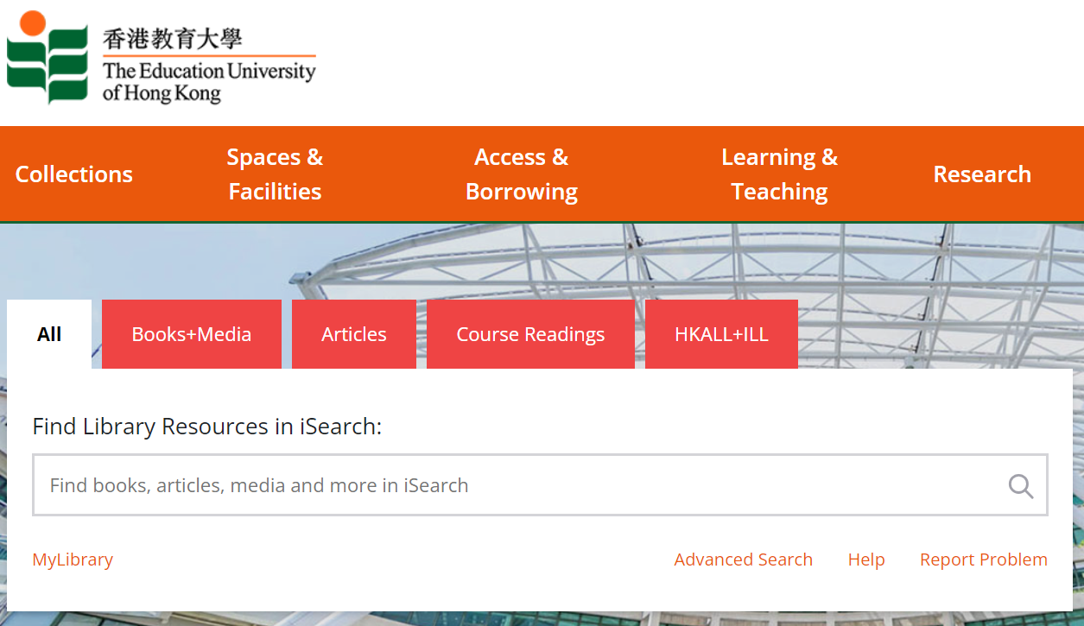
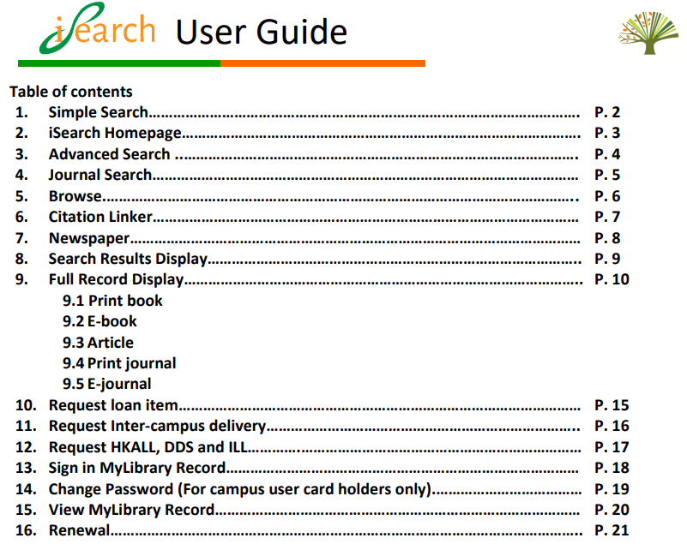
iSearch
Tips on Using iSearch
iSearch User Guide

Slide 35


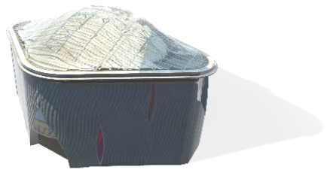
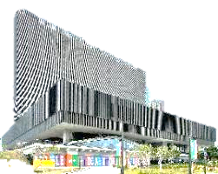
Inter-campus Delivery
校內圖書運送服務
Students and staff can request loanable materials housed in Tai Po MMW Library to be sent to the Tseung Kwan O Study Centre Library for borrowing, or vice versa. Loanable materials from above libraries can be sent to North Point Study Centre or the two West Kowloon Study Centres (Austin Road / Museum Drive) for borrowing.
Only available for loan materials can be requested for delivery. For items on loan, they can be delivered at different locations.
Items cannot be requested for delivery within the same library. Otherwise, items will be delivered to the another library automatically.

Slide 36





Inter-campus Delivery
How to Request items
Select Pickup Location
TKO book
Click Request

Slide 37







Joint University Librarians Advisory Committee (JULAC) Cards

Slide 38
Joint University Librarians Advisory Committee (JULAC) Cards
Please select your status:
Postgraduate Degrees (Master’s & Doctoral Degrees)
UGC-funded PGDE Programmes
Undergraduate Degree Programmes (UGC-funded)
Professional Development Programmes
Diploma
Not applicable

Slide 39
Joint University Librarians Advisory Committee (JULAC) Cards
UGC-Funded Postgraduate Diploma (PGDE) and Postgraduate Degree students are eligible to apply for JULAC Cards
Visit and borrow items of other 7 UGC libraries
Borrowing privileges may vary among libraries
Admission to some libraries may be restricted during “black-out” periods of peak seasons
Application can be made online at https://www.lib.eduhk.hk/access-borrowing/julac-library-cards
* Postgraduate Degrees (Master’s & Doctoral Degrees) / UGC-funded PGDE Programmes
Notes:
如要更改頁面內容，請先點擊頁面，將已選取的透明方塊移走以進行修改，修改完成後再把方塊移回原位。

Slide 40




JULAC Cards
Book Return Service
You can return books borrowed with your JULAC card at MMW Library or Tseung Kwan O Study Centre Library
No overdue items
Must return books in person with your JULAC card at the Circulation Counter
At least 3 working days before the due date
* Postgraduate Degrees (Master’s & Doctoral Degrees) / UGC-funded PGDE Programmes
Notes:
如要更改頁面內容，請先點擊頁面，將已選取的透明方塊移走以進行修改，修改完成後再把方塊移回原位。

Slide 41
Joint University Librarians Advisory Committee (JULAC) Cards
UGC-funded Undergraduate Degree students are eligible to apply for JULAC Library Reader Cards
Visit and use the collections of other UGC libraries in-house
Annual registration fee $50 charged by each host library (1 Aug - 31 Jul)
Admission to some libraries may be restricted during “black-out” periods of peak seasons
Application can be made online at https://www.lib.eduhk.hk/access-borrowing/julac-library-cards
* UGC-funded Undergraduate Degree Programmes
Notes:
如要更改頁面內容，請先點擊頁面，將已選取的透明方塊移走以進行修改，修改完成後再把方塊移回原位。

Slide 42

Electronic Resources
The Library has a rich collection of electronic resources and research tools

Slide 43



Electronic Resources
E-Databases & E-Books Collections
Refine the databases by Subject or Resource Type

Slide 44
Electronic Resources
Recommended E-Databases
More than
Academic Search Ultimate
ERIC
Factiva
ProQuest Databases
Scopus
Social Sciences Citation Index
ACI 學術引用文獻資料庫
CNKI 中國知網
中國學位論文全文數據庫
漢籍全文資料庫
… and more
360
e-databases
Join our workshops to discover how the databases can help your research

Slide 45
Electronic Resources
Upcoming Workshops
Activities
Exploring iSearch: Find Everything You Need
AI for Grade A: Boosting Your Grade with AI tools and Library Databases
RefWorks Training: Manage Your References Effortlessly
How to Avoid Plagiarism and Properly Cite Sources
Finding Hong Kong History
Scite: Smart AI Tool For Your Research
Boost Your Citations and Reach: The Power of Open Access Publishing
Searching Strategies and Tools for Academic Research
How to Find Dissertations and Theses
Boost Your Research Impact: Understand and Use Journal Metrics
Unlock Chinese Academic Resources: Using Chinese Databases (中港台電子中文數據庫)
Running Out of Research Ideas? Use Citation Databases to Spark Your Topic
How to Find Reliable News Sources for Research
Learning RefWorks – the Web-based Bibliographic Management Tool
雷射切割及雕刻初體驗
More……
活动列表
探索 iSearch：找到你需要的一切
AI 助您拿 A：有效使用 AI 工具和图书馆数据库提升成绩
RefWorks 培训：轻松管理你的参考文献
如何避免抄袭并正确引用来源
寻找香港历史
Scite: 智能 AI 研究工具
提升引用率与影响力：开放获取出版的力量
学术研究的搜索策略与工具
如何查找论文与学位论文
提升研究影响力：理解并使用期刊指标
解锁中文学术资源：使用中港台电子中文数据库
没有研究灵感？使用引文数据库激发你的选题
如何查找可靠的新闻来源用于研究
学习 RefWorks —— 基于网页的参考文献管理工具
激光切割与雕刻初体验
还有更多………

Slide 46

Electronic Resources
EdUHK Research Repository
The EdUHK Research Repository collects, manages, preserves and showcases the research output of EdUHK staff in one digital location. The Research Repository also provides access to an electronic copy of the material when available.

Slide 47

Electronic Resources
EdVideo (Local TV Programmes)
Video-on-demand service which features education related and current affairs programmes from TVB, former ATV, former ETV, ViuTV and EdUHK teaching resources

Slide 48

Electronic Resources
Remote Access to E-Resources
Remote access to library electronic resources is available via Non-EdUHK network
Use your EdUHK Network Username and Password for authentication purpose
遠程登錄圖書館電子資源

Slide 49
OTHER
INFORMATION

Slide 50


Other Information
Supports students in developing essential information and research skills
Provides hands-on training on different library resources
Library Workshops

Slide 51





OTHER INFORMATION
Library Mobile Apps
EdU LibMap
EdU Library
Smart Learning
https://edulib.me/map
https://edulib.me/app
https://edulib.me/smart-learning-app

Slide 52






OTHER INFORMATION
Mobile Borrowing Service
First mobile application among all local university libraries
Allows EdUHK Library users to borrow library books instantly by themselves anywhere inside the Library
Not all library materials can be borrowed by mobile phones, please check them out at Circulation Counter if needed
Remember to scan EdUHK Library Barcode (starting with 31995…) instead of ISBN Barcode

Slide 53

Other Information
Library SMS Alert Service
圖書館短訊提示服務
SMS Alert service (https://sms.lib.eduhk.hk/) is available to all EdUHK staff and students for free
Register your HK phone number before using this service
Receive SMS alert when a borrowed item is due within 3 days, overdue, recalled or ready to pick up

Slide 54



Other Information
Can be found on Library website:
https://www.lib.eduhk.hk/about/policies-regulations/regulations
Library Regulations

Slide 55


OTHER INFORMATION
Library Handbook & Library VR Tour

Slide 56



OTHER INFORMATION
Download This PowerPoint

Slide 57







QUESTIONS?
Ask your Librarian @
Enquiries Counter
2948 6653
libinfo@eduhk.hk
9514 9655 (Mon-Fri, 9am-5pm)
https://app.lib.eduhk.hk/zoom

Slide 58


OTHER INFORMATION
Follow Us
Instagram
小紅書 ( Rednote)

